Slide 1
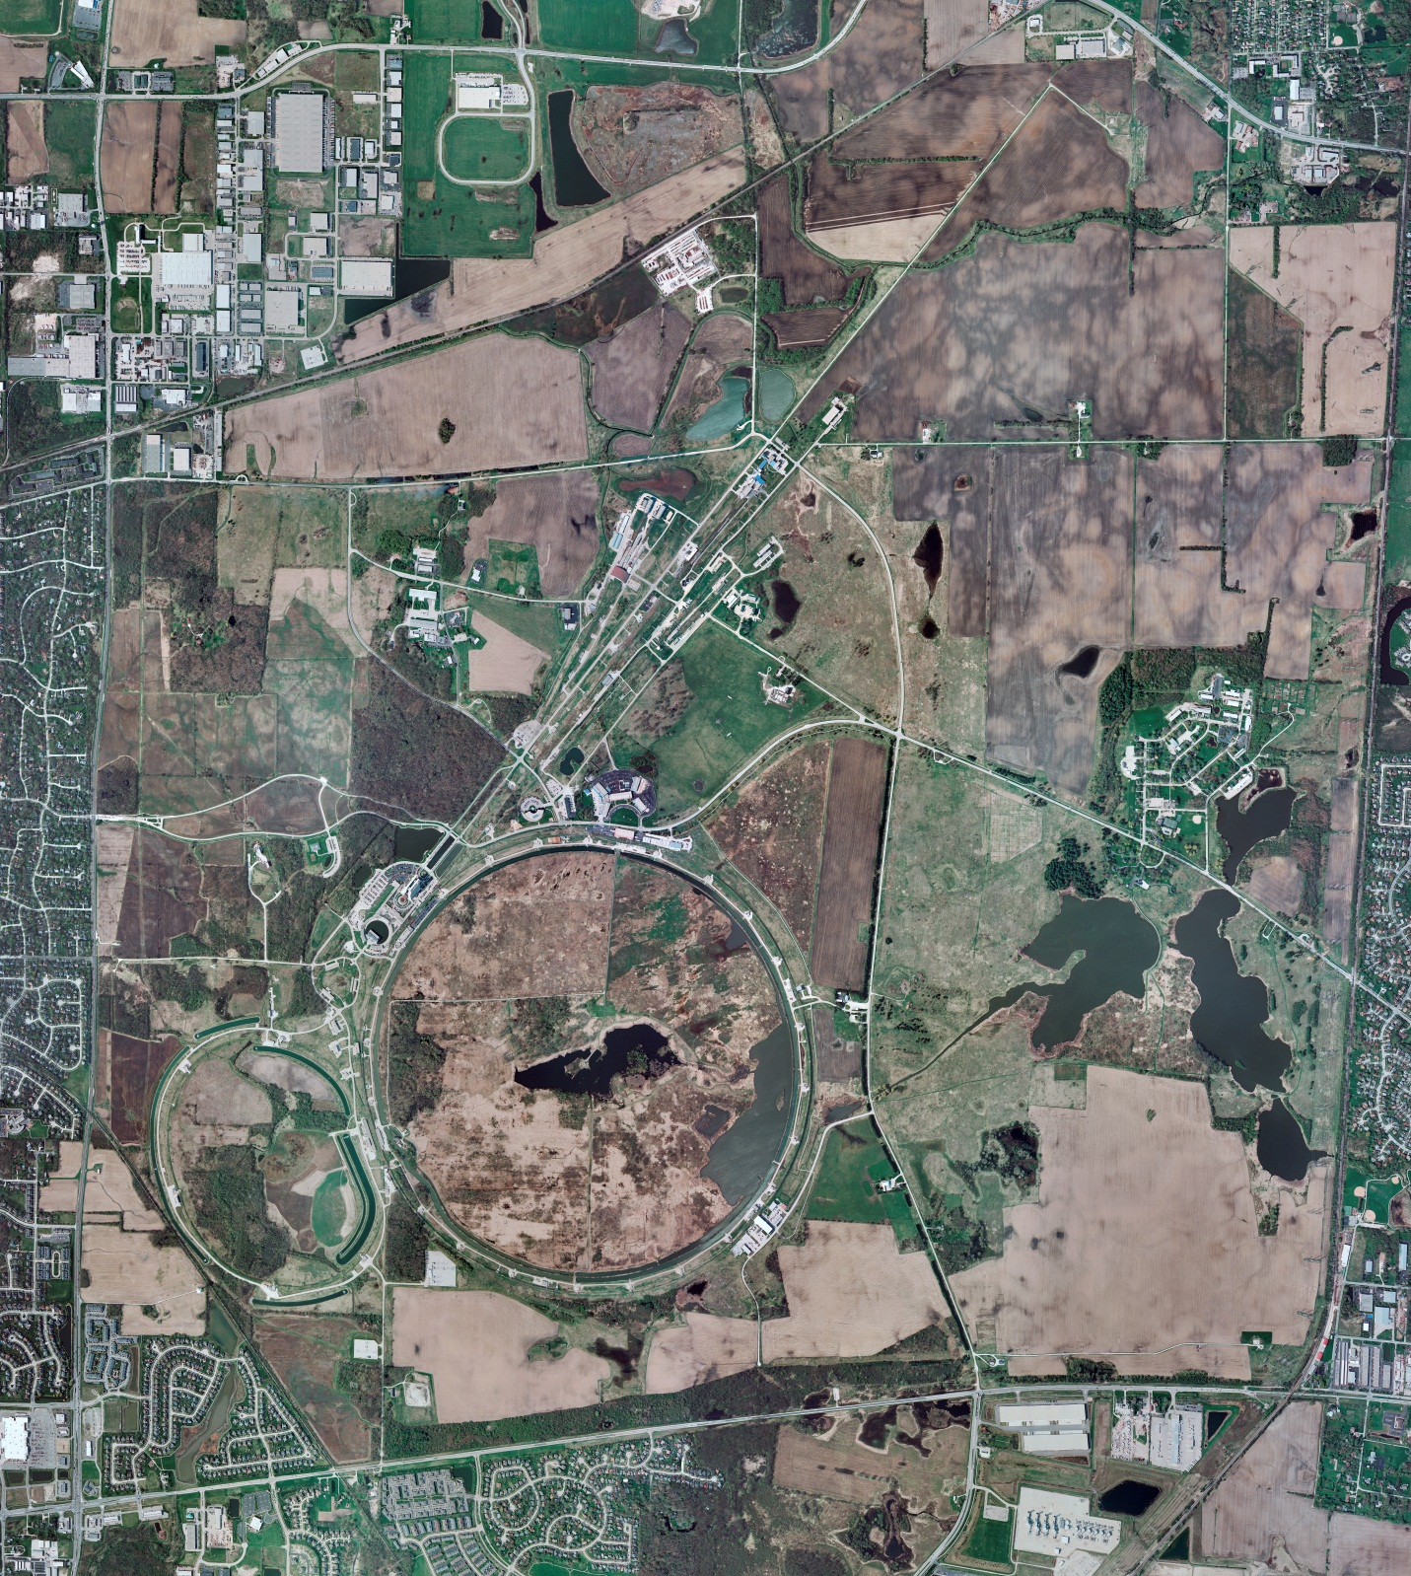
Helium Cryogenics
Status 9/4/2020 J.Makara
CMTF: SCP cryo system is cold and operating fine though lacking much excess capacity
CMTS: 3.9 GHz CM3 controlled cooldown in progress
PIP2IT: HWR cold at 2 K but needs recovering frm CMTS cooldown effect
SSR1 cold at 2 K, recovered
MCTF: cryo system at room temperature (RT), shut down and isolated
MDB/HTS: at RT
MDB/STC: at RT
MDB Magnet: at RT
NML/FAST: Cryo system at LN2 mode with startup activities in progress; Frick and Mycom comprs online to Fridges at LN2 mode;
CC1/CC2/CM: CM controlled cooldown in progress; CC1/2 at RT
IB1: system cold and operating fine
HAB: BA compr and Fridge operating fine at 5 K
STF: TSUN10/DHB controlled cooldown to 5 K almost finished
Muon Campus: A0 comprs (3) online with MC-1 g-2 cryogenic system at 5 K running fine
MISC: monitoring LN2 deliveries by vendor and they are doing well

