Slide 1
The US-CMS Tier-1 (Sort of an FNAL Science DMZ…)
Phil DeMar
Summer 2011 JointTechs meeting
July 14, 2011

Slide 2
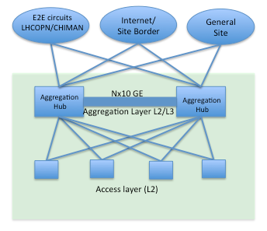
US-CMS Tier-1 - Architectural View
General
Site Access
Controls
“Trusted(*)”
Access
Controls
No Access
Controls
(*) Known traffic from well-managed systems at trusted sites, based on source/dest pairs

Slide 3
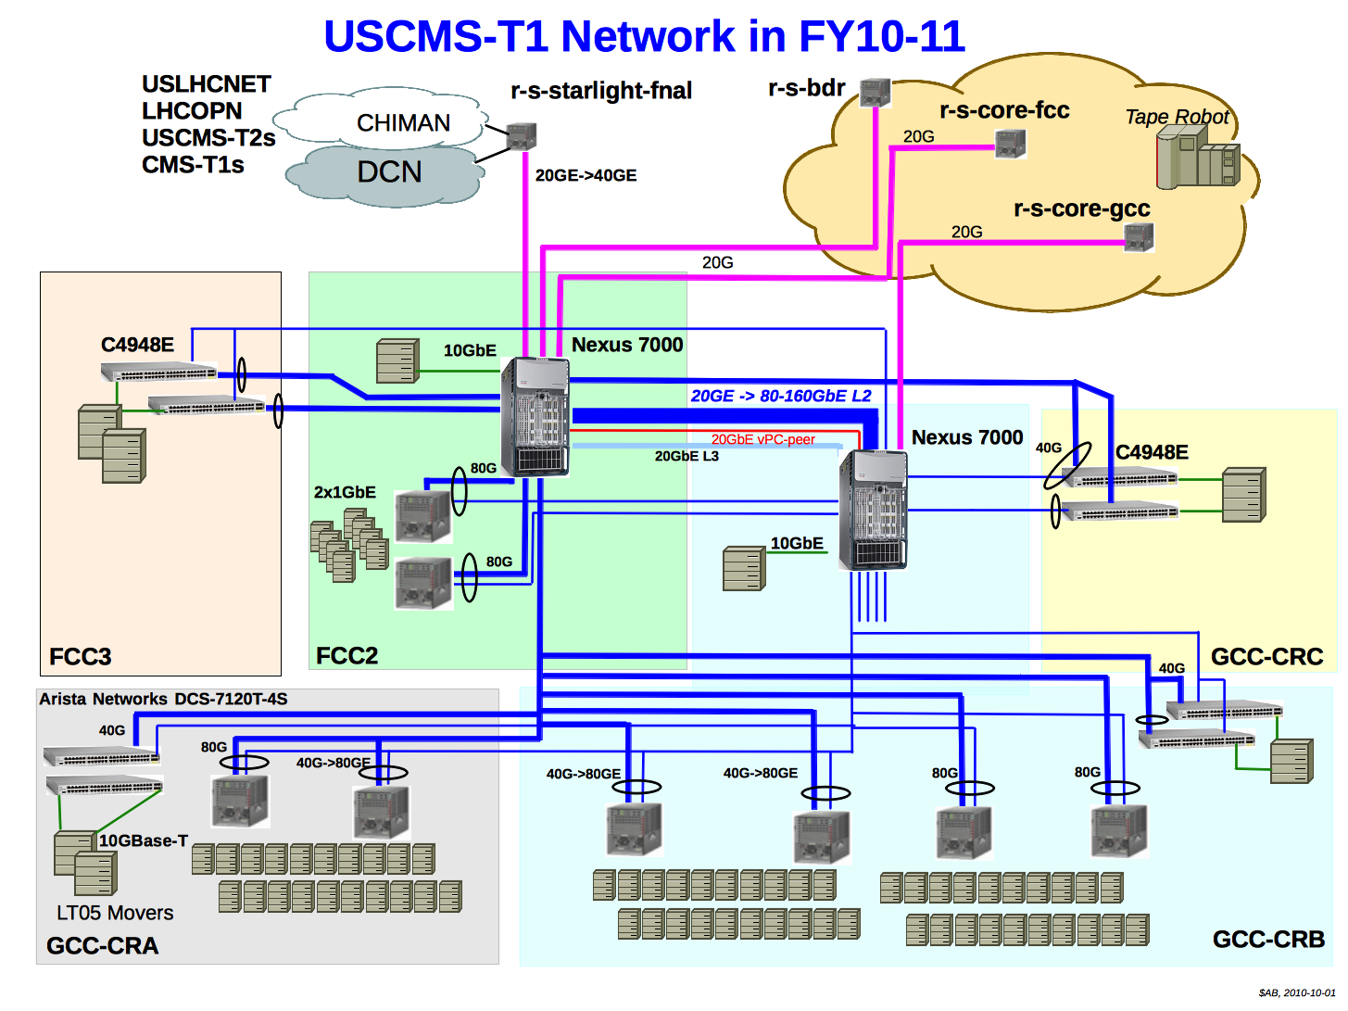
Policy Routing
Inbound
outbound

Slide 4
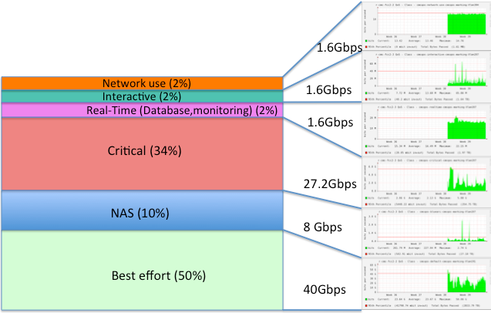
QoS within the US-CMS Tier-1
WAN traffic
here

