Slide 1
ESCC Meeting Opening Comments
Phil DeMar
Summer 2011 JointTechs meeting
July 14, 2011

Slide 2
Logistics & Stuff (I)
Agenda:
https://indico.fnal.gov/conferenceTimeTable.py?confId=4534#all
‘50’ Registrants
Meeting places:
Today & Tomorrow: Board of Regents room; Butrovich Building
Make sure you have a parking permit…
Evening focus session: The Pub, inside the Wood Center
Sustenance:
The normal lunch & mid-morning / mid-afternoon breaks
Breakfast beverages on Thursday (auditorium lobby)

Slide 3
Effort Contributions for this Meeting
ESCC provides co-chairs for JT planning
JT proposal submissions are up
Targeted topic area Co-Chairs for just completed JT:
Susan Hicks (ORNL) Advanced Infrastructures
Michael Sinatra (ESnet) IPv6
Brian Tierney (ESnet) Emerging Technologies
(General areas of continuing interest)
Paul Martinez (INL) Mobility
Joe Metzger (ESnet) Performance/Monitoring
Looking for:
Winter 2012 JT co-chairs….
Suggestions on targeted topic areas

Slide 4
Evening focus session(s)
This meeting:
- Site monitoring tools & how they could be better integrated with PerfSONAR
- Looking for closer synergy between Lab network & HPC needs and ASCR SBIR program
7:00pm-8:30pm in The Pub
Free food; free food; not-so-free beer…
Next meeting:
Suggestions are welcome

Slide 5
It’s Back! The ESCC Satisfaction Survey…
Repeat previous years’ ESCC-level surveys
Two parts:
ESnet / Site network-level interactions
Higher-level services & perspectives
Site identification w/ survey ratings anonymity
Similar process as previous years
Use SurveyMonkey to conduct the survey
Target distribution ~August 1, with 10 days to respond

Slide 6
Last Year’s Survey – ESnet / Site Network-level Interactions
Rate your satisfaction with ESnet support for your site connectivity
Rate your satisfaction with the technical and engineering interaction between your site and the ESnet staff
Rate your satisfaction with ESnet troubleshooting and performance analysis support
Rate your overall satisfaction with the quality of ESnet services provided to your site

Slide 7
Last Year’s Survey – Higher-Level Services & Perspectives (I)
Rate your satisfaction with how well current ESnet network services meet the needs of your site’s users, collaborators, and staff (higher level)
Rate your satisfaction with how well current higher-level ESnet services meet the needs of your site’s users, staff, and collaborators:
DNS Services
ESnet Collaborative Services (audio/video conferencing)
DOEGrid Certificate Services

Slide 8
Last Year’s Survey – Higher-Level Services & Perspectives (II)
Rate ESnet processes & responsiveness in anticipating and satisfying your site’s projected wide-area network needs.
Rate how well ESnet network services complement your site's cyber security activities.
Note: ESnet does not provide site-level security services.
Rate your satisfaction with the current model (Site Coordinators; semi-annual ESCC meetings, etc.) for site interaction with ESnet.

Slide 9
ReadyTalk Quarterly Reports
ESCC Coordinators receive quarterly summaries of ReadyTalk usage for their site
Asked to review local usage
I requested some changes to the report:
Add in number of callers in each call
In Top20 spreadsheet, add a top 20 users list in terms of total minutes, with the total number of call sessions by that user as a secondary field.
Question: what else would be useful to aid your review?

Slide 10
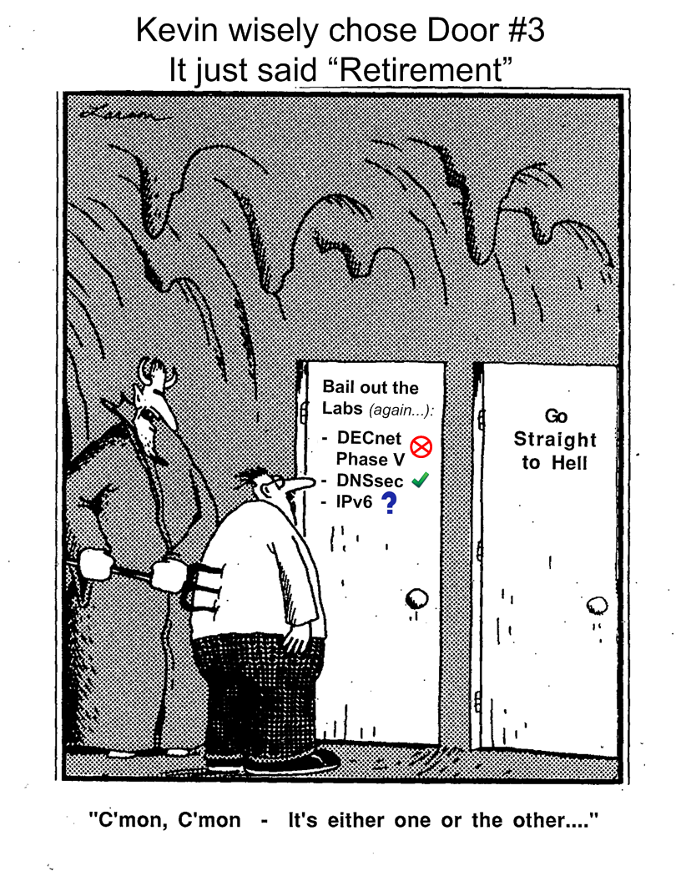
There’s a matted Far Side cartoon to sign for Kevin Oberman

