Slide 1
ESnet
Research and Advanced Development
Inder Monga

Slide 2


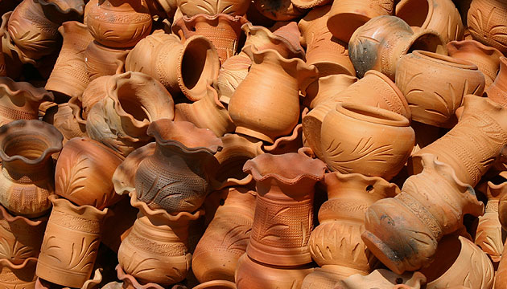

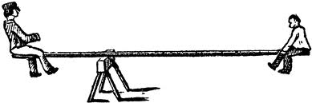
Balance
Challenge new frontiers
Create lasting value
Fail often, and learn
Solve real community problems

Slide 3
Projects
Exploration
Energy-efficient Networks
RDMA
Openflow
Research
ARCHSTONE
eCenter
Research and Development
OSCARS
perfSONAR

Slide 4
                Energy-efficient Networks
                “You Can't Manage What You Don't Measure”

Slide 5
Strategic Significance
Communication through networks is a fundamental part of modern daily life
  Number of connected devices exploding exponentially
    Wired, mobile, “Internet of things”, entertainment, smart-grid/ADR, etc.
  Networks support services that are critical to modern society
  Network traffic and energy consumption is slated to grow
    Traffic growing > normal hardware & spectral efficiency curves
ICT including networks are expected to play a critical role
in reducing global GHG emissions
  Buildings, Transport, Smart-Grid, ADR etc.
Energy efficiency research for networks
is still very nascent
  Theoretical models can be significantly
  improved with real live data
Prelim. theoretical research indicates
big gains are possible
  Greentouch claims 1000x
  Rod Tucker (CEET) claims > 1000x based on modeling
  studies
North America
Doubling every 2 years
  40% per year
  30x in 10 years
  1000x in 20 years
Mix of services is important from energy perspective:
  Mobile less efficient than fiber optics
Total Backbone
Internet Video
P2P
Wireless Data
Data from: RHK, McKinsey-JPMorgan, AT&T, MINTS, Arbor, ALU, and
Bell Labs Analysis: Linear regression on log(traffic growth rate) versus log(time) with Bayesian learning to compute uncertainty
Wireless Voice
Opportunity to scale up significantly the use of computer networking without impacting GHG emissions

Slide 6
Technical Approach
Live Measurements
  Build the tools to collect and visualize live network energy consumption
  Correlate it with network traffic information
  Build tools to analyze the data on a per network service, per network layer basis
  Make the data OPEN! Create industry-impact
Characterization
  Analyze the energy consumption patterns
  Develop correlations between traffic, network layers/functions (switching, routing, optical) and energy consumption
  Collect information from various lab testing scenarios to help characterization and supplement live network information
End-to-End understanding of the energy consumption will lead to architectural insights with impact on network energy-efficiency

Slide 7
Technical Approach
(continued)
Network Energy Consumption Model
  Leverage measurements and network equipment understanding to create a mathematical model for network energy consumption
  Leverage the modeling to predict more accurately the energy consumption of various application scenarios
    Data-intensive Science, Cloud Computing
    Solutions like Follow-the-moon model, Data to compute/computation to data movement etc.
Advocacy and change
  Potential to greatly impact understanding and behavior of the service providers, network equipment vendors, building IT consumption, Cloud providers and standard bodies.
    SC11 workshop on Data Centers and Networks
    Greentouch membership

Slide 8
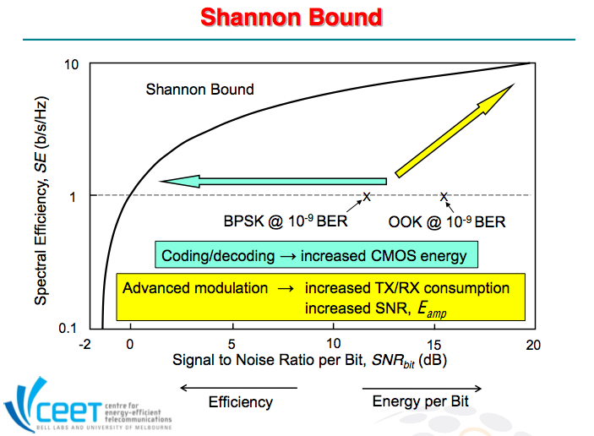
Courtesy Rod Tucker

Slide 9
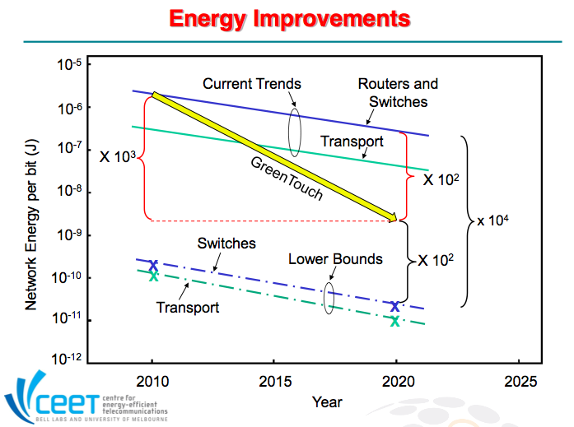
Courtesy Rod Tucker

Slide 10
RDMA over Converged Ethernet (RoCE)
“exploring new data movement protocols”

Slide 11
Remote Direct Memory Access (RDMA)
RDMA: Direct memory access from the memory of one computer into that of another without involving either one's operating system.
Advantages:
  Bypasses the CPU
  Low latency
  Out of band synchronization
  Zero copy (with hardware support)
Initially designed for HPC (i.e. LAN).
Not integrated in mainstream software stacks (but supported in Linux, Solaris, Windows and OSX as 3rd party package)
Applications must be modified to support RDMA
new API, not socket-based

Slide 12
RDMA and Wide Area Networks
Motivation:
Leverage existing LAN technologies
Shared memory model (classic in HPC )
Needed for cases where data is too large to be transferred
  remote access needed
Issues, limitations:
May not behave well on WAN (latency, packet loss, packet ordering)
  No attempt to be “fair”
May require specific network QoS – assumes no packet loss with no reordering
Requires specific Linux kernels

Slide 13
iWARP: RDMA over TCP
IETF standard for RDMA over TCP
Benefits: offloads TCP onto the network controller (TOE) – needed for zero-copy receive. (Chelsio, Intel controllers)
Supports NFS, SDP, SRP and iSCSI.
Available in Linux with Open Fabric Alliance (OFED) module
  http://www.openfabrics.org/
Works well in LAN environments
Shows poor performance on WAN
  e.g.: same/slightly worse than TCP

Slide 14
RoCE: RDMA over Converged Ethernet
Operates at Layer 2: avoids TCP all together
  Available in Linux with OFED: http://www.openfabrics.org/
Supports all Infiniband protocols: SDP, SRP, MPI, MPI-IO
Requires hardware support (Mellanox)
No TCP = no sophisticated congestion protocol.
Very sensitive to packet loss and packet reordering

Slide 15
OSCARS/Openflow:
Creating an end-to-end flexible network paradigm

Slide 16
Next Generation End-to-End Network Virtualization
One Single Network Resource Pool
One Single Virtual Network Abstraction
End-to-End Network Virtualization Plane
OpenFlow
Domains
OpenFlow
Domains
OSCAR Virtualized Circuits
OpenFlow
Domains
OpenFlow
Domains
Notes:
その仮想スイッチ上に論理的な面ＶＴＮを用意します。
この面に、必要なスイッチポートやサーバやロードバランサなどを
マッピングすることで仮想テナントを構築し、
これを複数構築することでマルチテナント環境を実現します。
サーバを追加して仮想テナントネットワークにマッピングする際、
コントローラから最適なフローテーブルが各スイッチに登録されるため
個々のスイッチに設定変更など行う必要はありません。
従ってマルチテナントネットワークの運用がこれまでより少ないコストで実現できます。

Slide 17


Current Status
1st step towards E2E Virtualization
Virtual
Network
Virtual
Network
Virtual
Network
3
1
2
NEC P-Flow
Virtualization
IDC/NSI
Service Plane
NEC P-Flow
Virtualization
OpenFlow
Controller
OSCAR
Controller
OpenFlow
Controller
ESNET
Internet2
Dynamic/Programmable
Forwarding Table
Dynamic/Programmable
Virtual Wide-area Circuits
Dynamic/Programmable
Forwarding Table
Notes:
従来のネットワークは、コア、アグリゲーション、アクセスのような階層構造の
ネットワークをVLANで縦に分割するような構成となっています。
機器の増設時はスイッチへのVLANの設定や
サーバを接続するポートなどを意識する必要があり、
設計変更には作業には時間がかかりました。
プログラマブルフローでは、複数のスイッチを１つの仮想スイッチとし、
その仮想スイッチ上に論理的な面ＶＴＮを用意します。
この面に、必要なスイッチポートやサーバやロードバランサなどを
マッピングすることで仮想テナントを構築し、
これを複数構築することでマルチテナント環境を実現します。
サーバを追加して仮想テナントネットワークにマッピングする際、
コントローラから最適なフローテーブルが各スイッチに登録されるため
個々のスイッチに設定変更など行う必要はありません。
従ってマルチテナントネットワークの運用がこれまでより少ないコストで実現できます。

Slide 18
Demonstrating end-to-end RDMA flows
PFC Controller
OSCARSController
WS-notification
Single
NIC
RoCE flow
0x8915 (ethertype)
OSCARS/IDC Domain
RDMA
Sink
RDMA
Source
Openflow Domain
All IP Traffic
Internet/IP
Domain
No modification in
End-application or
host

Slide 19
ARCHSTONE: DOE-funded proposal
“Advance Resource Computation for Hybrid Service and TOpology Networks”

Slide 20
Requirements for Flexible Network Services
Network architectures and services - Increasing Complexity
  Growing need to consider many more dimensions (or constraints) for control and provision of network resources
  User services becoming more complex and varied - virtual organization specific resource control, on-demand creation of network topologies across multiple layers, extended user-to-network "conversations"
Essentials for multi-layer network control
  Next-generation networks tend to be architected as a heterogeneous “multi-layer, multi-technology” construct
  Multiple types of services simultaneously over common infrastructures
  Need to hide network details from users, i.e., “services virtualized”
Where are we now?
  Initial renditions of user requested service provision paradigms have been realized in DOE ESnet SDN, Internet2 DCN, and others.
  Challenging issues unresolved: rich service interface definition, dynamic topology computation, multi-layer control etc.

Slide 21
Service Oriented MX-TCE
The core capability of the ARCHSTONE project is the Multi-X Topology Computation Element (MX-TCE)
  Handling multi-dimensional information and constraints that are typically not considered in current network PCE engines
  Computing both paths and topologies for multi-layer networks
  Designed to integrate into OSCARSv0.6 and provide basic PCE services
  Also designed to be used as advanced Topology Computation engine for other applications and purposes

Slide 22
Atomic and Composite Network Services Architecture
Network Services Interface
Network Service Plane
Composite Service (S1 = S2 + S3)
Service templates pre-composed for specific applications or customized by advanced users
Composite Service (S2 = AS1 + AS2)
Composite Service (S3 = AS3 + AS4)
Service Abstraction Increases
Service Usage Simplifies
Atomic services used as building blocks for composite services
Atomic Service (AS1)
Atomic Service (AS2)
Atomic Service (AS3)
Atomic Service (AS4)
Multi-Layer Network Data Plane

Slide 23
eCenter: DOE funded activity
“Network weather and performance service”

Slide 24
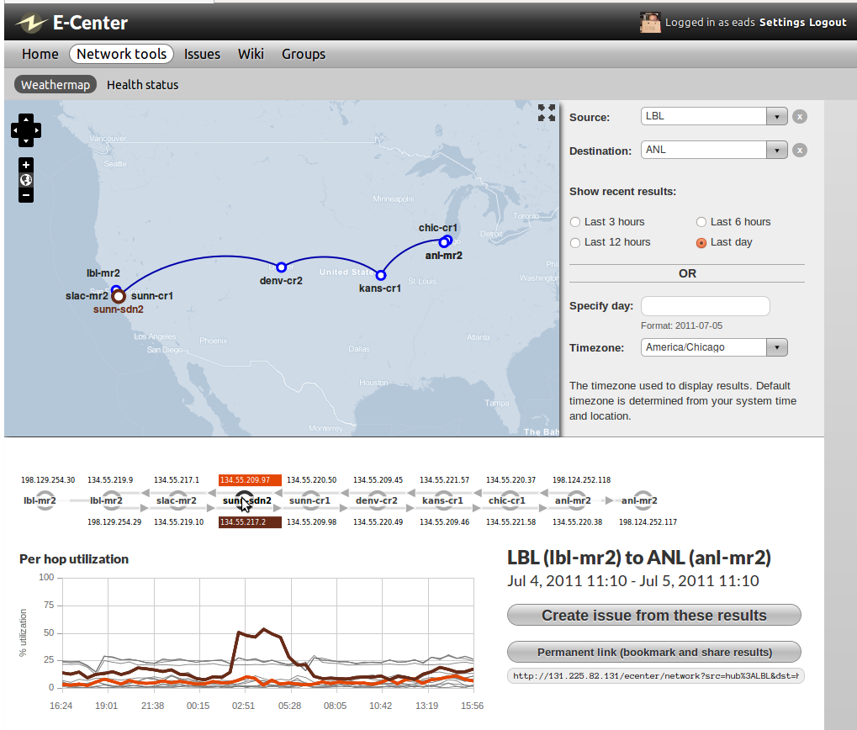
“E-Center Network Weather & Performance Service”
– P. DeMar (Fermilab); B. Tierney (ESnet);
M. Frey (Bucknell Univ.)
ASCR- Network Research Highlight
Objectives
Impact
Dramatically improve network problem diagnoses abilities
Provide end-to-end & hop-by-hop network path data extending across network domains
Create portal for end users to capture and discuss network path-related issues with experts
  Develop traffic forecasting capability for user-specified network paths
A single location for researchers to obtain detailed network path information of interest, and seek assistance with related concerns
Disjoint network path monitoring & measurement data presented in a coherent, user-understandable manner
Progress to Date
Design and initial implementation of E-Center components completed.
E-Center data collection system functional and gathering data across multiple domains
Prototype for user presentation component has been developed
New network path monitoring tool for underlying monitoring services (PerfSONAR) developed & deployed
Forecasting algorithms developed and integrated
Notes:
24

Slide 25
Summer student activity
“Risky explorations”

Slide 26
Bharat Ramaprasad (Umass Dartmouth)
Vertika Singh (CMU)
Baris Aksanli (UCSD)
Rami Shomali (CMU)
Graphical display of topology, editing capabilities, Modular design, OGF-NML based schema
Beacon openflow controller, application interaction with Openflow, bridging domains
Web interface to display energy consumption, rich metadata, research on data center/network EE (clean energy, VM motion)
Explore Oauth usability in distributed computing, explore delegation model

