Slide 1
E-Center Project
Phil DeMar, Brian Tierney, Mike Frey
Summer ESCC Meeting (Fairbanks)
July 14, 2011

Slide 2
Outline
Project Goals
Overview
Major Components
Data Collection
Data Retrieval Service
Anomalies Detection Service
Front-End
Social Features
Future Plans
7/1/11

Slide 3
Project Goals
Social Portal for the DOE Network Enterprise
Place for network users to share issues, ideas, concerns
Help set network performance expectations
User friendly tools to help users in isolating their network problems
7/1/11
Notes:
To answer questions like: What performance should I be able to get from FNAL to SLAC?

Slide 4
Overview
E-Center is Social Web portal
Support for Single Sign On federated Authentication
User Groups, Projects
A place for sharing Ideas, getting help, posting concerns
Novel approach for network data visualization
Utilization & aggregation of decentralized distributed perfSONAR-PS monitoring data
Automated & ad-hoc Anomaly Detection and network monitoring data mining/analysis
7/1/11

Slide 5
Major Components
Social Media Web Portal
UI – User Tools Components:
End To End Path Visualization
Site Centric View
Anomalies Detection UI
Data Retrieval Service
Anomalies Detection Service
Scheduled Data Collection
Automated Anomalies Analysis
MySQL DB scalable data cache

Slide 6
Data Collection
perfSONAR-PS Metadata collected and cached – nightly
From ESnet hLS – home Lookup Services
From hLSs at DOE Labs
Data collected and cached – nightly for the past 24 hours
From all DOE labs and ESnet measurement mesh:
OWAMP (delay, packet loss)
BWCTL (throughput)
PingER (RTT, packet loss)
From ESnet centralized services:
Interface Utilization, Drops, Errors
ESnet Topology
Traceroutes between ESnet PoPs and DOE lab's
7/1/11

Slide 7
Data Collection: Just Numbers
Monthly cached data for June 2011 (entries):
OWAMP 100M+
SNMP 50M
PingER 15M
Traceroute 587K
BWCTL 133K
Collecting data from 294 service endpoints, about 20500 unique measurements (metadata entries).
Nightly automated anomalies detection for BWCTL and OWAMP data - 8943 metadata entries for the past 7 days.

Slide 8
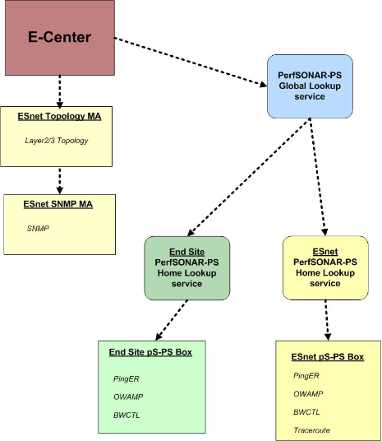
Data Collection: API
Scheduled pull of all registered pS-PS metadata from ESnet & designated sites
Scheduled pull of ESnet’s Layer2 and Layer3 topology
Caching of all metadata, ESnet topology elements
Sharded cache for pS-PS data
On-fly asynchronous dispatch to remote pS-PS services via E-Center Data API and distributed worker nodes
7/1/11

Slide 9
Technical Details
Choice of the REST Data services – simple, flexible
Data cache - MySQL DB engine – ACID transactions, scalable, supports replication and clustering for the future extension, data sharding – slicing each data set in pieces for fast retrieval
Gearman distributed Job submission manager for all backend tasks – to provide desired level of scalability
Modern Perl for the backend and services – stable, 20+ yr old language, great variety of APIs, mature web development framework, availability of the perfSONAR-PS client API
PHP, Drupal, and jQuery for the front-end – popular, well-known open-source development and contentment management tools with strong support for social functionality.
7/1/11

Slide 10
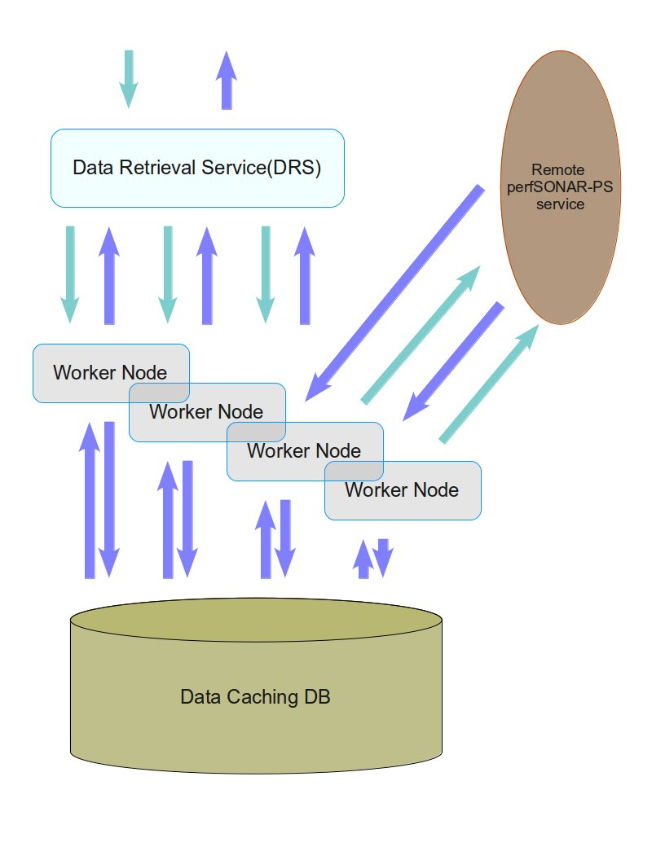
DRS: Data Retrieval Service
Scalable web service
Returns cached data or data from remote pS-PS services
End to End tomography via SNMP & Traceroute
Parameters:
Time period
Source/Destination IPs
Source/Destination HUBs
Data type
Resolution - number of aggregated data points
7/1/11

Slide 11
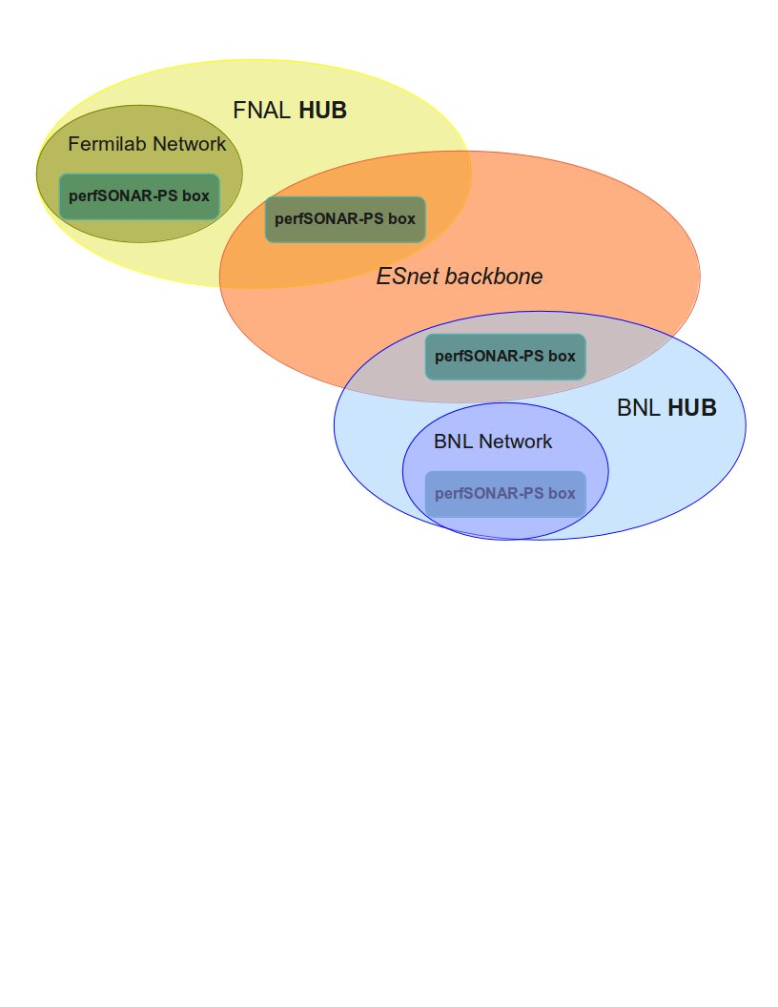
DRS: What is the HUB ?
Logical aggregation of the End-to-End pS-PS monitoring endpoints - End Site located with ESnet edge located
Allows one to see all available data for WAN network path
Every pS-PS service and as result every measurement is mapped to specific HUB upon discovery
7/1/11

Slide 12
ADS: Anomalies Detection Service
REST based web service, can be located anywhere
Designed to work with any E-Center supported data sample or may send request to the DRS for the time series dataset
Implements Static (SPD) or Adaptive Plateau Detection Algorithms (APD):
developed at Ohio Supercomputing Center (Prasad Calyam)
Protocol is documented at:
https://cdcvs.fnal.gov/redmine/projects/ecenter/wiki/Anomalies_Detection_Service(ADS)
7/1/11

Slide 13
ADS: Plateau Anomaly Detection
Enhanced mean ± standard deviation (MSD) algorithm
Plateau detector uses two salient thresholds
Sensitivity (s): specifies magnitude of plateau change that may result in anomaly
Trigger duration (td): specifies duration of anomaly event before trigger is signaled
Network health norm determined by calculating mean for set of measurements sampled recently into “summary buffer”
Number of samples in “summary buffer” is user defined, and labeled ‘summary window count’ (swc)

Slide 14
ADS: SPD and APD samples
Static Sensitivity in SPD Scheme
Dynamic Sensitivity in APD Scheme

Slide 15
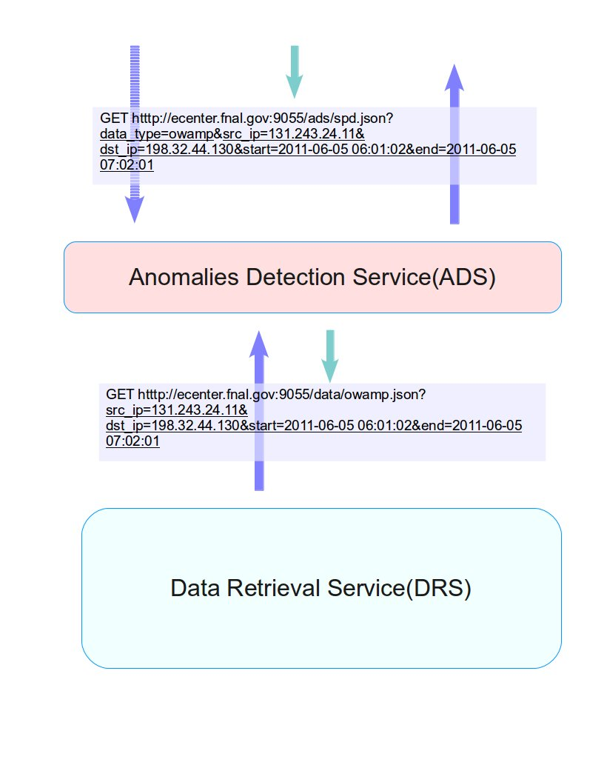
ADS: Integration with DRS
ADS = standalone web service
Can return results for supplied data sample
OR, can send request to DRS for specific data type for time period
Returns all warnings & critical anomalies found according to plateau detection parameters

Slide 16
Front-end
Powered by Drupal Content Management System
Popular and proven: Great community, stable, widely-known. Strong support for social networking features (issue tracking, blogs, knowledge base, tag cloud)
Widely adopted by government: Challenge.gov, Whitehouse.gov, Energy.gov, Recovery.gov
Key social features
Data conversations: Issue & data notification system allows conversation & collaboration across DOE networking community.
Knowledge base: A powerful WIKI with an easy editor for generating and sharing documentation.
Groups: Lightweight system for sharing conversations & documentations with a task force or working group
Activity stream: A birds' eye view of important conversations, anomalies, and knowledge base articles customized for each user
7/1/11

Slide 17
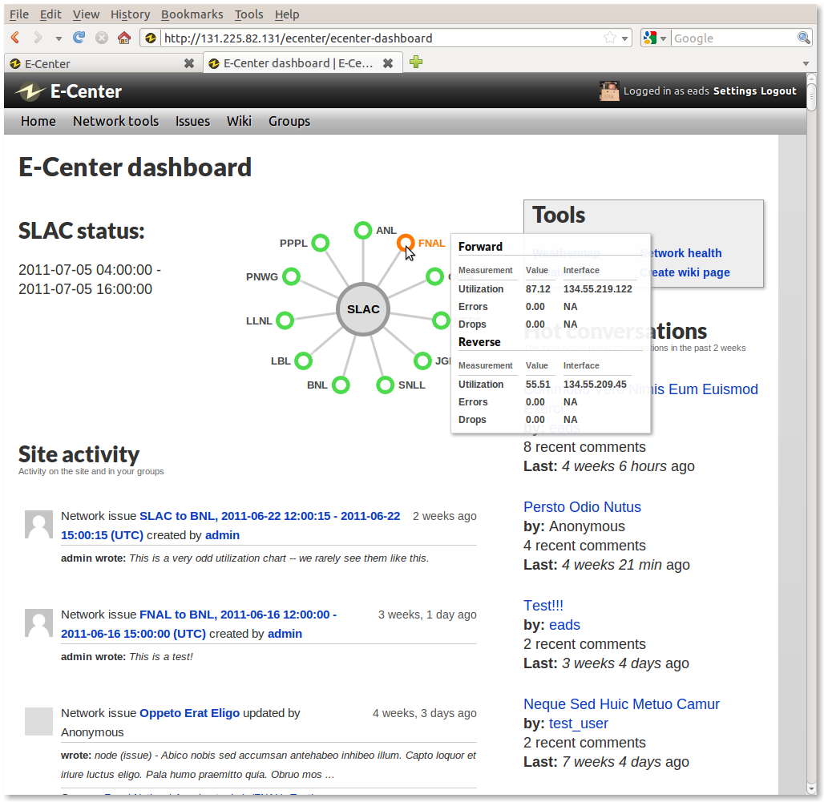
Front-end: Dashboard
Dynamic, per-user dashboard:
encourages users to interact with site and each other
user-selectable site-centric view and other data tools to give user instant snapshot of network status
site-wide activities using familiar "activity stream" interface
Activity stream includes detected anomalies, new content, comments, and more, based on user's group membership
7/1/11

Slide 18
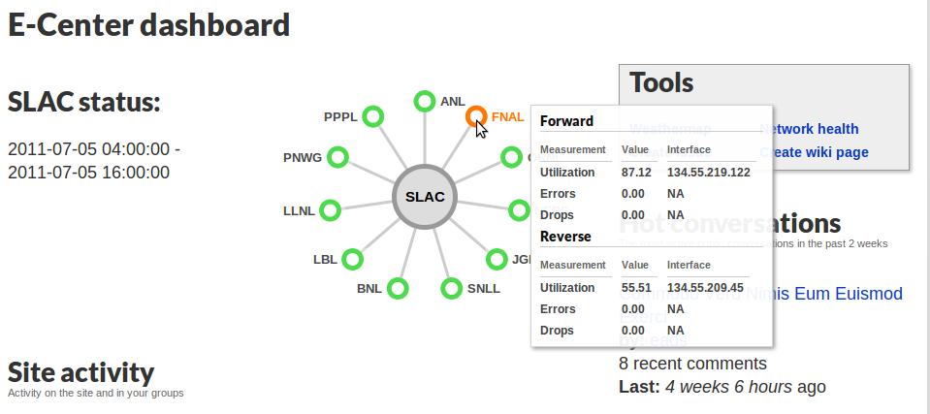
Front-end: Site-centric view
User-customizable view of connections to other DOE sites.
24-hour snapshot to find where problems exist
Cached hourly for speedy display on dashboard
7/1/11

Slide 19
Front-end: E2E UI & data visualization
7/1/11

Slide 20
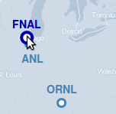
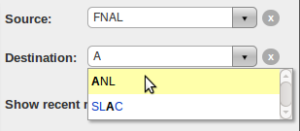
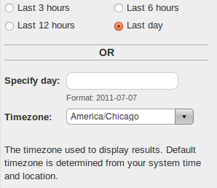
Front-End: Weathermap UI usage
Select source and destination on map
...or by typing to search or selecting from list of sites
Select date range and
timezone for query
7/1/11

Slide 21
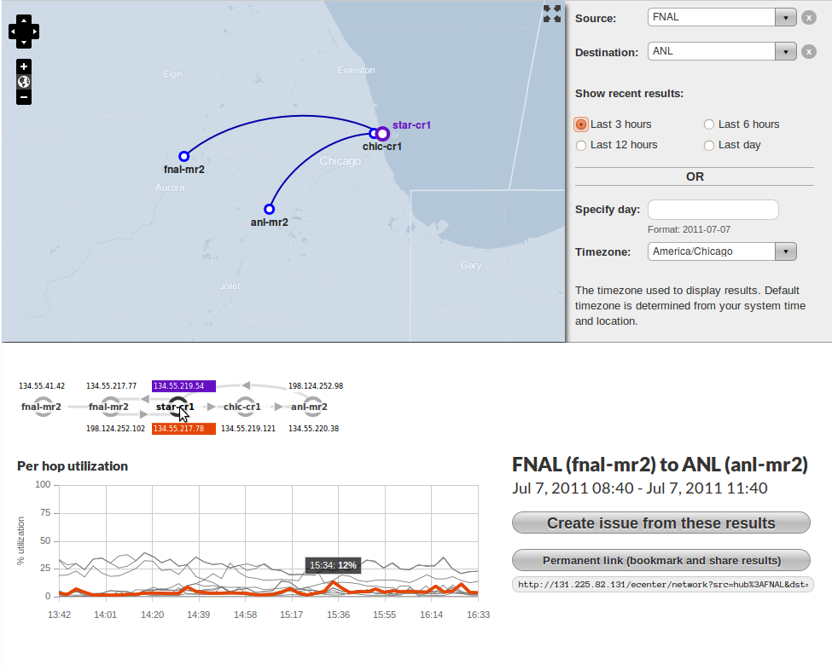
Front-end: Weathermap Results
Geographic
traceroute
Logical traceroute
Create issue
from query
Permanent link
to query
Path utilization chart
7/1/11

Slide 22
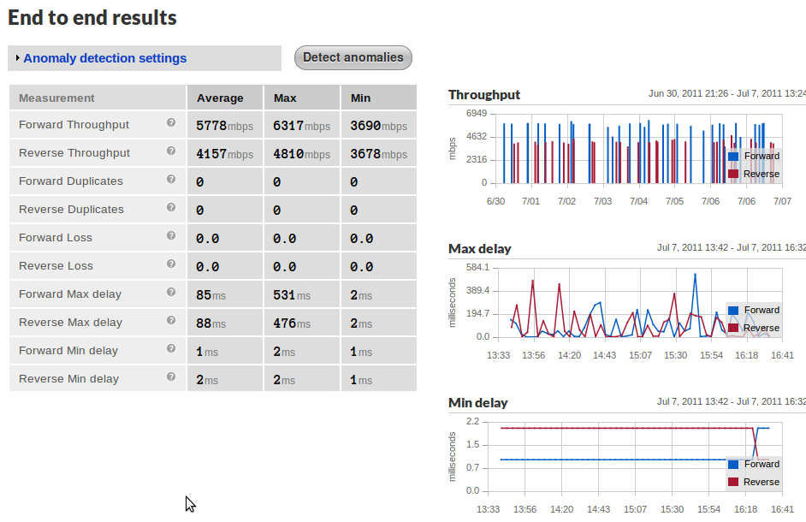
Front-end: Weathermap Results (II)
7/1/11

Slide 23
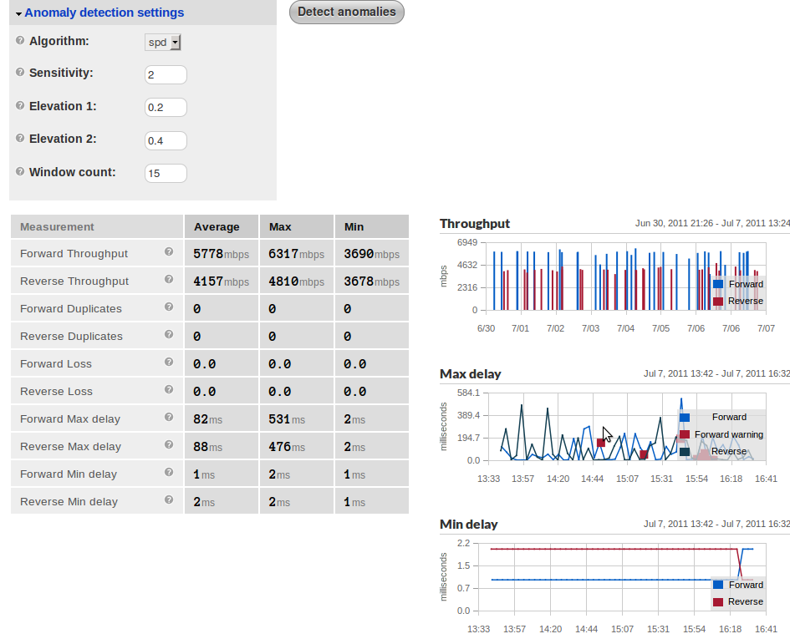
Front-end: Weathermap Results
Experimental anomaly detection
Anomalies shown on charts
7/1/11

Slide 24
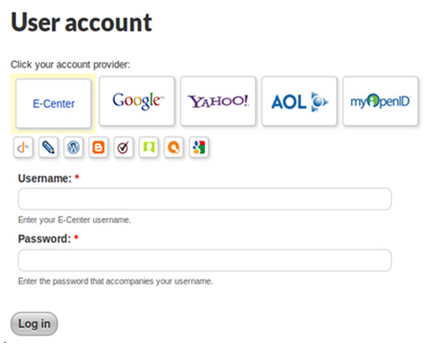
Authentication & User's Registration
Make signup/login easy AND safe
Support for deployed DOE AA systems: OpenID, Shibboleth (experimental)
Other common OpenID providers (Google, Facebook, etc.) as well
Fallback to domain-based white-lists and manual user management

Slide 25
Front-end: Easy Content Creation
WYSIWYG and Markdown modes
Embedded media support (YouTube, Vimeo)
Code/syntax highlighting
Powerful, secure, nice to use

Slide 26
Easy Content Creation (cont)

Slide 27
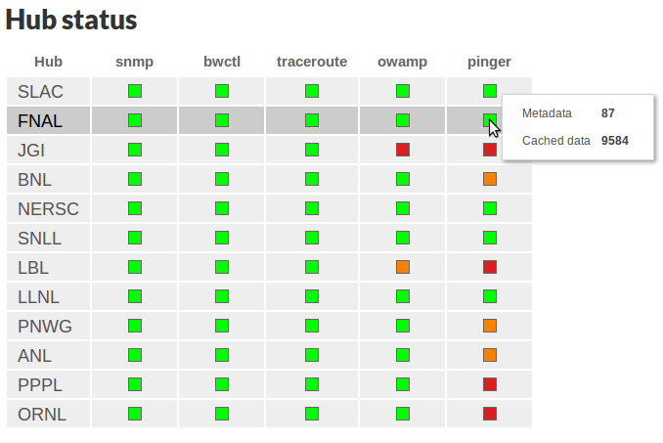
Front-end: Measurement mesh health
Shows which perfSONAR data is being collected by DRS
Helps identify/ troubleshoot problems in measurement infrastructure
7/1/11

Slide 28
Front-end: End-to-end UI & data visualization
Streamlined UI:
Reduce clicking and "knob turning" for common cases (inspired by Google instant).
Provide many views of data:
Subway map, geographical map, and end-to-end tables provide several perspectives on path data. Site-centric and measurement health status provide logical views of site status. Anomaly "feed" provides event-based view of anomalies.
Self-revealing:
Tool-tips integrated throughout UI provide users with context for interpreting results.
Highlight critical information:
Chart highlighting technology attempts to make finding and isolating abnormal results easy.
7/1/11

Slide 29
Future Plans
Support for user-provided traceroute feeds
Circuit-based network path monitoring
On-demand measurement test capabilities:
Traceroute
BWCTL
Forecasting Service
UI improvements: Provide more tools for "drilling down" into data and isolating individual charts
Alerts and updates notifications framework
Mobile device support: Smartphone (Android, iPhone) and tablet (iPad) interface
Frontend Update Drupal 7:
Move to latest & greatest Drupal technologies for long-term sustainability
7/1/11

Slide 30
Project Information
E-Center Project Site, including documents & software repository:
https://cdcvs.fnal.gov/redmine/projects/ecenter
Live Demo: https://ecenter.fnal.gov
7/1/11

Slide 31
Demo
7/1/11

