Slide 1
Biasing for EM physics
V.N.Ivanchenko
16th Geant4 Workshop
19-23 September 2011
SLAC, Stanford, CA, USA

Slide 2
Biasing for EM physics
Number of discussions were carried out recently on biasing options for EM physics
M.Verderi, M.Maire, A.Howard. F.Lei, G.Santin
ELSHIELD project funded by ESA includes extension of biasing options in the GRAS tool (see A. Howard talk)
Difference options were under discussed:
Reverse Monte Carlo
Physics based biasing
Geometry based biasing

Slide 3
3-D benchmark
Main focus to study biasing methods, first of all, Reverse Monte Carlo
Uniform flux of electrons with uniform spectrum in log scale
Cosine law angular distribution for source
Rin = 1 cm
Rout = 10 cm
Rsource = 11 cm
Al 2 mm
Ta 0.162 mm
Si detector 2 volumes
0.96x0.96x0.001; cm³
0.96x0.96x0.03 cm³
Al
Si1
Si2

Slide 4
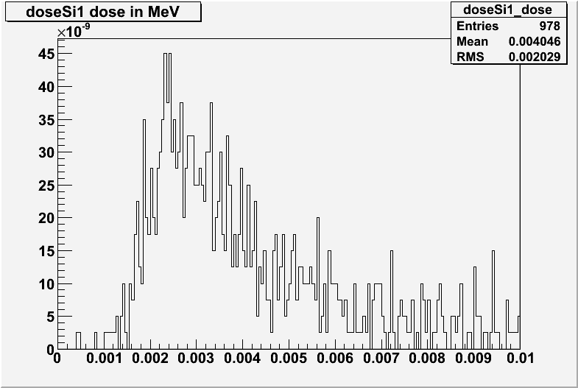
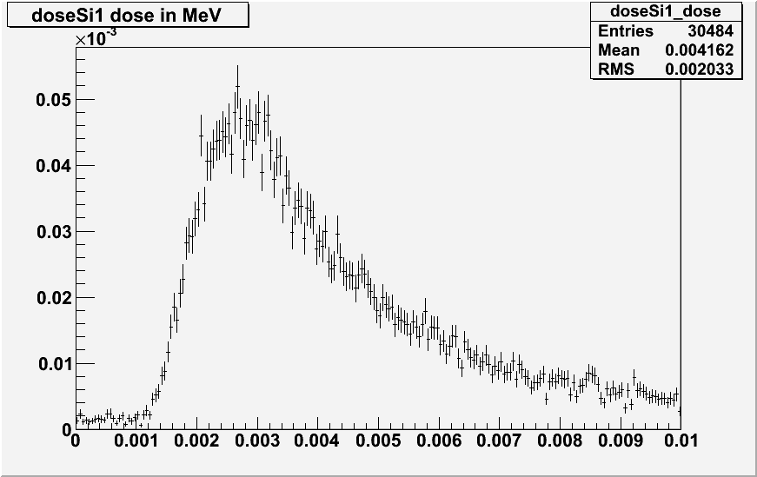
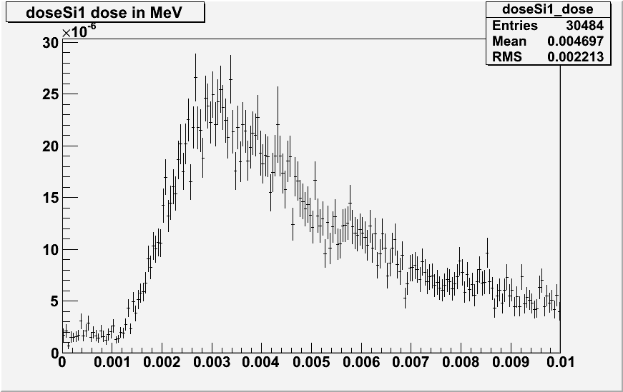
Reverse Monte Carlo in 3D benchmark for the 10 um Si layer
Forward
Reverse
1/E spectrum at 11 cm
Exponential spectrum at 1 cm
Forward simulation is very ineffective
We estimate CPU speed up 600 times
Forward
in inner sphere

Slide 5
Our experience
Reverse Monte Carlo is working!
Usage is not trivial
Each EM model has “reversed partner”
Analysis is not straightforward – completely new histograms must be added to analysis module
Natural question: can we have more easy biasing options?

Slide 6
Why not wrapper process?
Wrapper process approach was in Geant4 for long time and there are a lot of examples of implementation of user applications
Advantages:
Biasing is independent from main EM development
Default simulation is not affected
Disadvantages:
Biasing is independent from main EM development
EM group is not involved in validation and in usage of biasing options
Wrapper process implemented for one version of Geant4 may not work for other version

Slide 7
Physics based biasing options
New options are added to EM infrastructure:
Cross section biasing
Forced interaction of primary
Secondary splitting
Russian roulette for secondary
Simple UI commands activate/deactivate biasing options for any EM Physics Lists per process and G4Region

Slide 8
New UI commands
/process/em/setBiasingFactor procName factor
/process/em/setForcedInteraction procName regionName length
/process/em/setSecBiasing procName regionName factor
New class G4EmBiasingManager is added to a process selected by these commands. Main EM interfaces are practically unchanged, run time CPU penalty is minimal
These features are available with ref-08
Validation is hardly required

