Slide 1
Space requirements
Contributors: Giovanni Santin (ESA), Vladimir Ivantchenko (G4AI), Vladimir Grichine (LPI), Alex Howard (PSI), Sébastien Incerti (CENBG), Dennis Wright (SLAC), Sergio Ibarmia (INTA), Angela Rivera (INTA) Presented by: John Allison (G4AI)

Slide 2
Topics
Low energy electromagnetic physics
dose precision
biological effects
Dose and charge scoring
Ion-ion interactions
Galactic Cosmic Rays
Non-ionising energy loss
Biasing
Reverse Monte Carlo
Multi-threading
Geometrical precision

Slide 3
Low energy electromagnetic physics
Dose in complex geometries
electronic components
effect of nearby high-Z material
secondary fluorescent x-rays
Charge accumulation in complex geometries
Dose in biological tissue and effect
Geant4 DNA project
Tracking of chemical ions
Supported by ESA contract AO6041

Slide 4
Low energy electromagnetic physics
Dose in complex geometries
Electronic components
Eg. microdosimetry models in Si
Effect of nearby high-Z material
Charge accumulation in complex geometries
Secondary fluorescence
Requires unification of atomic de-excitation in EM physics
See talk by Alfonso on Thursday: parallel 7A – 14h25
Modelling of complex geometries
Eg. upgrade of ISS DESIRE model (in progress ESA AO6041)

Slide 5
Low energy electromagnetic physics
Modelling biological effects of space radiation in Geant4 (ESA AO6041 & French ANR Geant4-DNA fundings)
Inclusion of accurate physical processes for biological targets such as liquid water and DNA
For dominant species first: e-, p, He, C, N, O, Fe….
Modelling of direct DNA damages
Inclusion of radiochemistry processes for the production and interactions of oxydative radical species
Modelling of non-direct DNA damages (dominant)
See talk by Mathieu on Thursday: parallel 7A – 14h25
Geometrical modelling of biological targets
DNA content, nuclei, tissues, organs
Bacteriae, multi-cellular organisms
Possible inclusion of simple biological repair models
Requirements similar to radio/hadron-therapy

Slide 6
Charge accumulation in complex geometries
Form tetrahedral mesh
parallel world
Score charge (and dose)
enhancement of Geant4 scoring
Solve Poisson’s equation and Ohm’s Law
SPIS open source solver
tricky boundary conditions
get electric potential
Supported by ESA contract AO6049

Slide 7
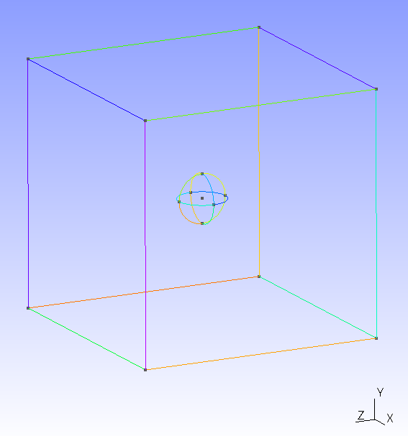
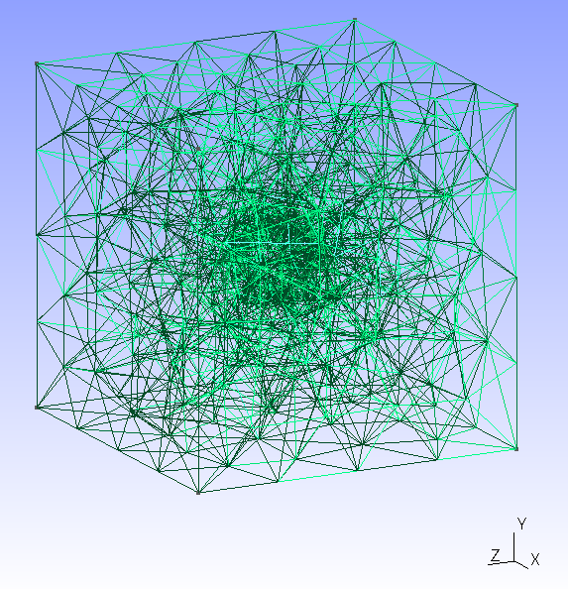
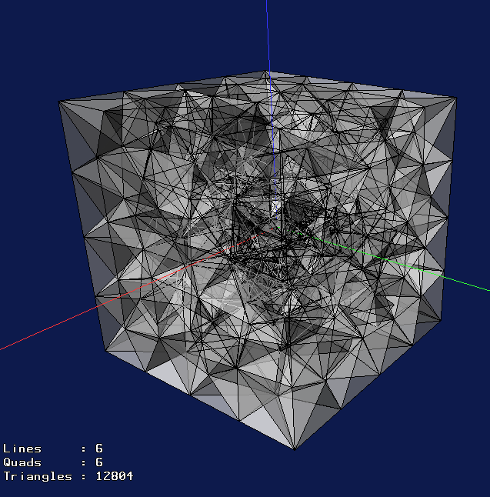
WP 2330 – GRAS Charging Analysis Module
EXAMPLES & DEMO
Example
Box 10x10x10 mm with an spherical hole inside
.msh File
$MeshFormat
2 0 8
$EndMeshFormat
$Nodes
696
1 2 0 0
2 -2 0 0
3 0 2 0
4 0 -2 0
5 0 0 2
…
$EndNodes
$Elements
4058
1 15 2 59 1 12 15
2 59 2 23 15 2 59
3 34 15 2 59
4 45 15 2 59
5 56 15 2 59
6 67 15 2 59
[…]
Original volume
(as seen in GMSH tool)
Meshed volume
(only tetrahedra. 3200 volumes)
/gras/geometry/type gmsh
/gdml/file/ test.mesh
Geant4 World
(VRML view)

Slide 8
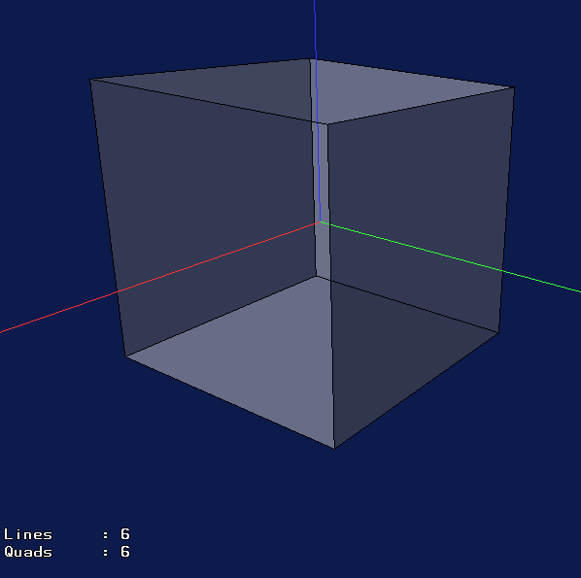
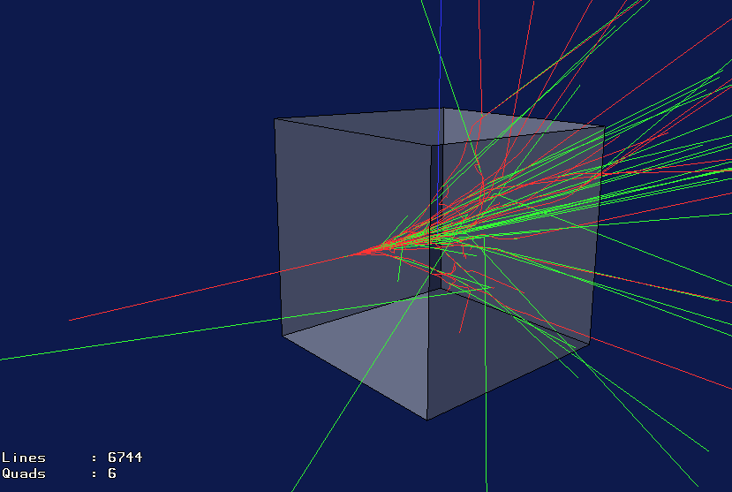
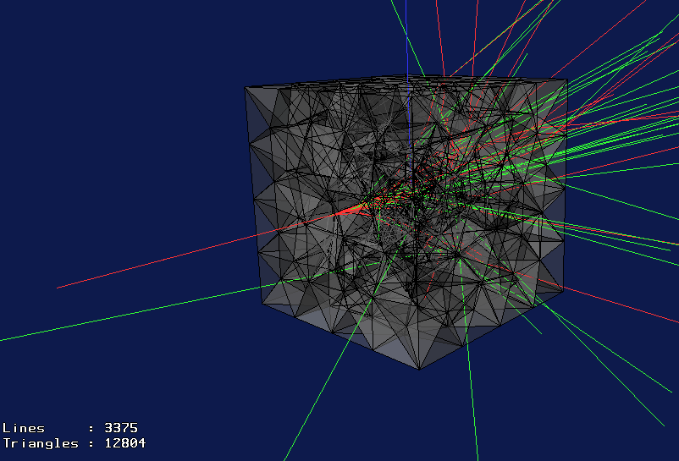
WP 2330 – GRAS Charging Analysis Module
EXAMPLES & DEMO
/gras/geometry/type gdml
/gdml/file/ test_geom.gdml
Mass world
Aluminium solid box 10x10x10 mm
/gras/physics/setCuts 0.01 mm
/gras/physics/addPhysics em_lowenergy
/gps/position 25 0 0 mm
/gps/direction -1 0 0
/gps/particle e-
/gps/energy 20.00 MeV
/run/beamOn 20
Mesh
Box 10x10x10 mm with an spherical hole inside
Geant4 geometry
(Only mass world visible)
Mesh
(only tetrahedra.
3200 volumes)
/gras/analysis/mesh/addModule MyMesh
/gras/analysis/mesh/MyMesh/geometryType gmsh
/gras/analysis/mesh/MyMesh/geometryFile test.msh

Slide 9
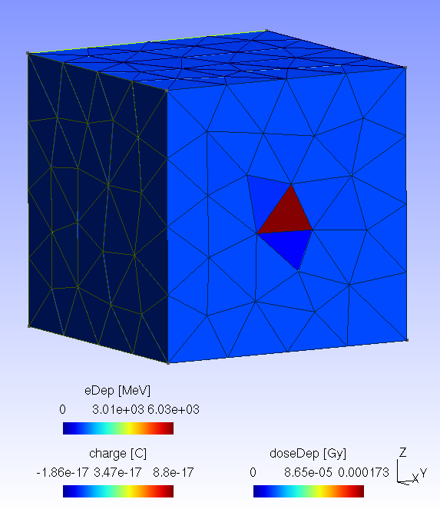
WP 2330 – GRAS Charging Analysis Module
EXAMPLES & DEMO
/gras/geometry/type gdml
/gdml/file/ test_geom.gdml
/gras/analysis/mesh/addModule MyMesh
/gras/analysis/mesh/MyMesh/geometryType gmsh
/gras/analysis/mesh/MyMesh/geometryFile test.msh
/gras/physics/setCuts 0.01 mm
/gras/physics/addPhysics em_lowenergy
/gps/position 25 0 0 mm
/gps/direction -1 0 0
/gps/particle e-
/gps/energy 20.00 MeV
/score/open MyMesh
/score/quantity/cellCharge charge C
/score/quantity/doseDeposit doseDep Gy
/score/quantity/energyDeposit eDep MeV
/score/verbose 0
/score/close
Results
Dose, Charge and Energy deposited per mesh cell
Gmsh formatted
Visualized with GMSH Linux tool
/run/beamOn 10000

Slide 10
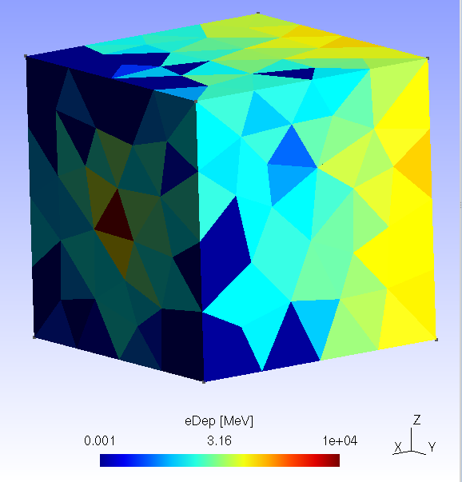
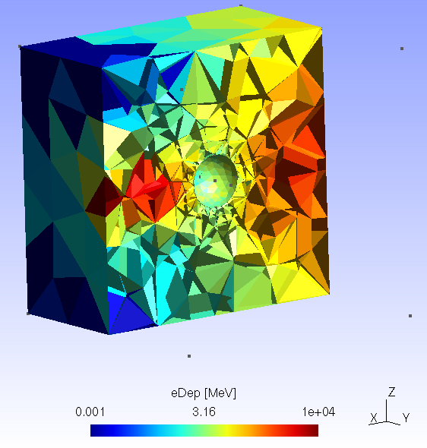
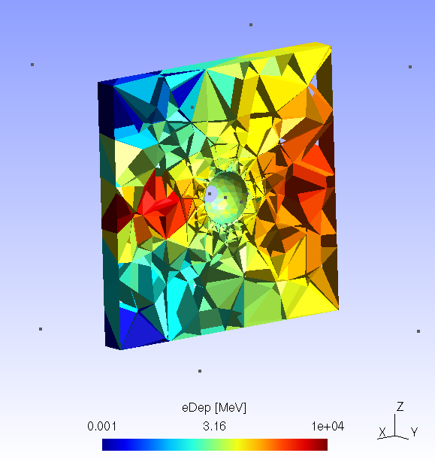
WP 2330 – GRAS Charging Analysis Module
EXAMPLES & DEMO
Deposited Energy
Visulaization with GMSH post-processing tool

Slide 11
WP 2330 – GRAS Charging Analysis Module
SUMMARY
GRAS-SPIS Charging Interface
New GMSH “.msh” file reader classes for Geant4 and GRAS
New generic G4ScoringUserGeomFile to score quantities in arbitrary geometry volumes user-defined (GDML, GMSH, C++)
New GRASMeshAnalysisModule
Loads GMSH, GDML files as parallel scorers
Outputs analysis results in a SPIS-GMSH compliant format
WP status
First beta version of all developments available.
GRAS new classes and modifications already comitted to trunk
Geant4 modified classes (Scoring) should be reviewed and proposed for next G4 release
If ESA approves, GRAS SUM will be updated and a new GRAS tag created.
Notes:
11

Slide 12
Ion-ion physics
Galactic Cosmic Rays
mostly protons (90%) and alphas (9%)
1% heavier ions (very little above Fe) but significant ionising effect, including fragments
peak near 1 GeV/u, significant out to 100 GeV/u
significant biological hazard in space habitats
Known deficiencies
deficiencies in some models even with known data
big gaps in our knowledge of ion-ion interactions
new data needed
please consult D.Wright and V.Ivantchenko
interface to Fortran DPMJET-II.5 is available
not ideal situation
ESA have issued an ITT
experimental work at GSI (Darmstadt)
comparison with existing simulation codes
recommendations for improvements of Geant4 models
Notes:
The absence of physics for arbitrary ion-ion interactions is still a big issue. This is needed up to roughly a TeV/u, any two nuclei, not just light on heavy. We use LAQGSM from Los Alamos for this. I am not sure that QMD, even RQMD, is the answer, either. That's for wiser persons than I, but frankly, I'm skeptical. We find that the binary collision model is pretty good, but the Fortran CEM03 is better, and we use it, e.g., for the CREME web site. We prefer models in this order: CEM03, binary cascade, Bertini cascade.
Dennis: We don't have a native C++ ion-ion code that goes up to a TeV/u. It would be a major project to develop (or translate) one, and unlikely unless we also get a mandate from HEP. As the Vanderbilt guys say, QMD or even RQMD is not close to going that high. The best we can offer at present is DPMJET II.5, but that is an interface to Fortran code. It would satisfy their energy needs, however.

Slide 13
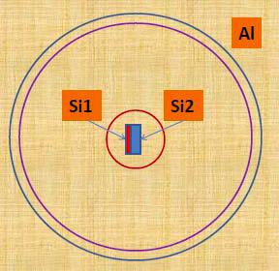
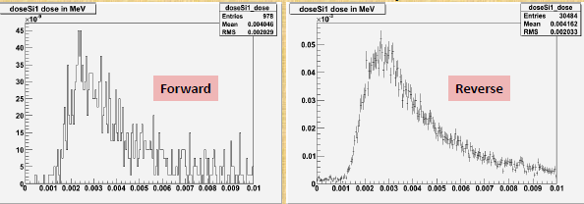
Biasing
Reverse Monte Carlo
improvement: x600 typical
only standard electromagnetic processes
supported by ESA contract
Notes:
3.- Non-ionising dose. In the space domain, a big concern is the degradation of micro-electronics (semiconductors) by non-ionising interactions. In fact, for example, for some opto-electronics components NIEL processes are the dominant degradation mechanisms. By default NIEL is not calculated for common physics lists and as far as I know, G4IonCoulombScatteringModel must be used to do it. However, it is is still not clear for the space community what steps should be followed to include NIEL calculations and what are the limits of G4IonCoulombScatteringModel in terms of valid range of energies, particle species or target materials. Only testem7 example makes use of this process. A list of recommendations or good practices about how to include bulk damage dose calculations would be very beneficial.

Slide 14
Geometrical precision
Space applications encompass
galaxy: 10²⁰ m
solar system: 10¹² m
Earth system: 10⁸ m
spacecraft: 10⁰ m
components: 10⁻⁶ m
biology: 10⁻⁹ m
Best practice?
Adjusting tolerances?
Surface tolerance can be adjusted: worldExtent*10⁻¹¹
But radial and angular tolerances cannot be adjusted
Changing base CLHEP unit?

Slide 15
Summary
Issues are recognised and are being addressed

