Slide 1
Testing and Packaging Geant4 with CTest and CPack
Geant4 Collaboration Meeting 2011, SLAC
P. Mato/CERN

Slide 2
Motivation
Facilitate testing and packaging using the tools (CTest and CPack) developed by Kitware and distributed as part of CMake.
No need to reinvent the wheel
Perfect integration to CMake build system
Testing is absolutely essential for any “agile” software development activity
All Geant4 functionality should be thoroughly tested
Developers should participate to testing activity
Adding, running, surveying tests should be extremely easy and effortless

Slide 3
Adopting Kitware Process?

Slide 4
Building the Examples and Tests

Slide 5
Use Cases
End User
Examples and/or tests are build against the installation area of Geant4.This is done by configuring a user build area pointing to a source area and pointing Geant4_DIR to the G4 installation area. The installation area can be anywhere: official read-only installation, user installation area, etc.
Developer
Examples and/or tests are build against a build area of Geant4 managed by the developer. This is done by configuring a user build area pointing to a source area and pointing Geant4_DIR to the build area of a previously built G4. It is the developer responsibility to remember to re-issue a build of G4 every time a change is done in the original G4 source tree.
Tester/Developer
Examples and/or tests are build together and as part of the Geant4 build. This is done by connecting the example/test into the global CMake tree (add_subdirectory). There is only a single build area. Dependencies are fully checked by CMake and any change will trigger a re-build of the dependent parts.

Slide 6
Building Examples and Tests
Added one CMakeLists.txt file in each test or example
Written as a top-level project CMakeLists.txt file
Using directly the standard CMake commands to increase portability
Added two new ‘options’
GEANT4_BUILD_EXAMPLES: Build the examples of the project
GEANT4_ENABLE_TESTING: Enable and define all the tests of the project

Slide 7
Example CMakeLists.txt (N01)
cmake_minimum_required(VERSION 2.6 FATAL_ERROR)
project(N01)
find_package(Geant4 REQUIRED)
include(${Geant4_USE_FILE})
include_directories(${CMAKE_CURRENT_SOURCE_DIR}/include
${Geant4_INCLUDE_DIR})
file(GLOB sources ${CMAKE_CURRENT_SOURCE_DIR}/src/*.cc)
add_executable(exampleN01 EXCLUDE_FROM_ALL
exampleN01.cc ${sources})
target_link_libraries(exampleN01 ${Geant4_LIBRARIES})
Standalone CMake project
Locate Geant4 and use it
Define executable
Add dependent libraries

Slide 8
Building N01
End-User case:
Using libraries from installation of Geant4
Will only build the example
Developer/tester case:
Using own built G4 libraries
Will build all the required libraries by exampleN01
$ mkdir <buildarea>; cd <buildarea>
$ cmake -DGeant4_DIR=<G4inst>/lib/Geant4-9.5.0 <G4src>/examples/novice/N04
$ make exampleN01
$ mkdir <buildarea>; cd <buildarea>
$ cmake -DGEANT4_BUILD_EXAMPLES=ON <G4src>
$ make exampleN01[/fast]

Slide 9
Defining and Running Tests

Slide 10
Defining Tests
With CTest/CMake tests are defined using the add_test(...) command
Developed a high-level function GEANT4_ADD_TEST(…) to encapsulate the Geant4 policies and an specialized command wrapper for the tests
Test programs themselves can also be built as part of the test (BUILD option)
# function GEANT4_ADD_TEST( <name> COMMAND cmd [arg1... ]
# [PRECMD cmd [arg1...]] [POSTCMD cmd [arg1...]]
# [OUTPUT outfile] [ERROR errfile]
# [ENVIRONMENT var1=val1 var2=val2 ...]
# [DEPENDS test1 ...]
# [TIMEOUT seconds]
# [DEBUG]
# [SOURCE_DIR dir] [BINARY_DIR dir]
# [BUILD target] )

Slide 11
Defining Tests: Tests
cmake_minimum_required(VERSION 2.6 FATAL_ERROR)
project(test21)
find_package(Geant4 REQUIRED)
include(${Geant4_USE_FILE})
GEANT4_EXECUTABLE(test21 test21.cc src/*.cc)
GEANT4_EXECUTABLE(test21_geninput test21_hadronic_exerciser.cc)
#---Test definitions---------------------------------------------
GEANT4_ADD_TEST(test21_geninput COMMAND test21_geninput
OUTPUT test21.in
BUILD test21_geninput )
GEANT4_ADD_TEST(test21 COMMAND test21 test21.in
BUILD test21
ENVIRONMENT ${GEANT4_TEST_ENVIRONMENT}
DEPENDS test21_geninput)
Used a macro to simplify writing

Slide 12
Defining Tests: Examples
Tests are also defined for each example
GEANT4_ADD_TEST() specified outside the CMakeLists.txt of the example (tests/CMakeLists.txt)
Full paths are required instead of relative ones
GEANT4_ADD_TEST(example-nov-n01
COMMAND ${CMAKE_BINARY_DIR}/examples/novice/N01/exampleN01
${CMAKE_SOURCE_DIR}/examples/novice/N01/exampleN01.in
SOURCE_DIR ${CMAKE_SOURCE_DIR}/examples/novice/N01
BINARY_DIR ${CMAKE_BINARY_DIR}/examples/novice/N01
BUILD exampleN01)

Slide 13
Running Tests
The ctest executable is provided and distributed as part of CMake
Many options available to select what tests to run, configuration, verbosity, etc.
Used by developers and the continuous integration testing
mato% ctest -R test10
Test project /Users/mato/Development/G4/make
Start 90: test10
1/2 Test #90: test10 ........................... Passed 15.32 sec
Start 91: test10-largeN
2/2 Test #91: test10-largeN .................... Passed 70.76 sec
100% tests passed, 0 tests failed out of 2
Total Test time (real) = 86.34 sec

Slide 14
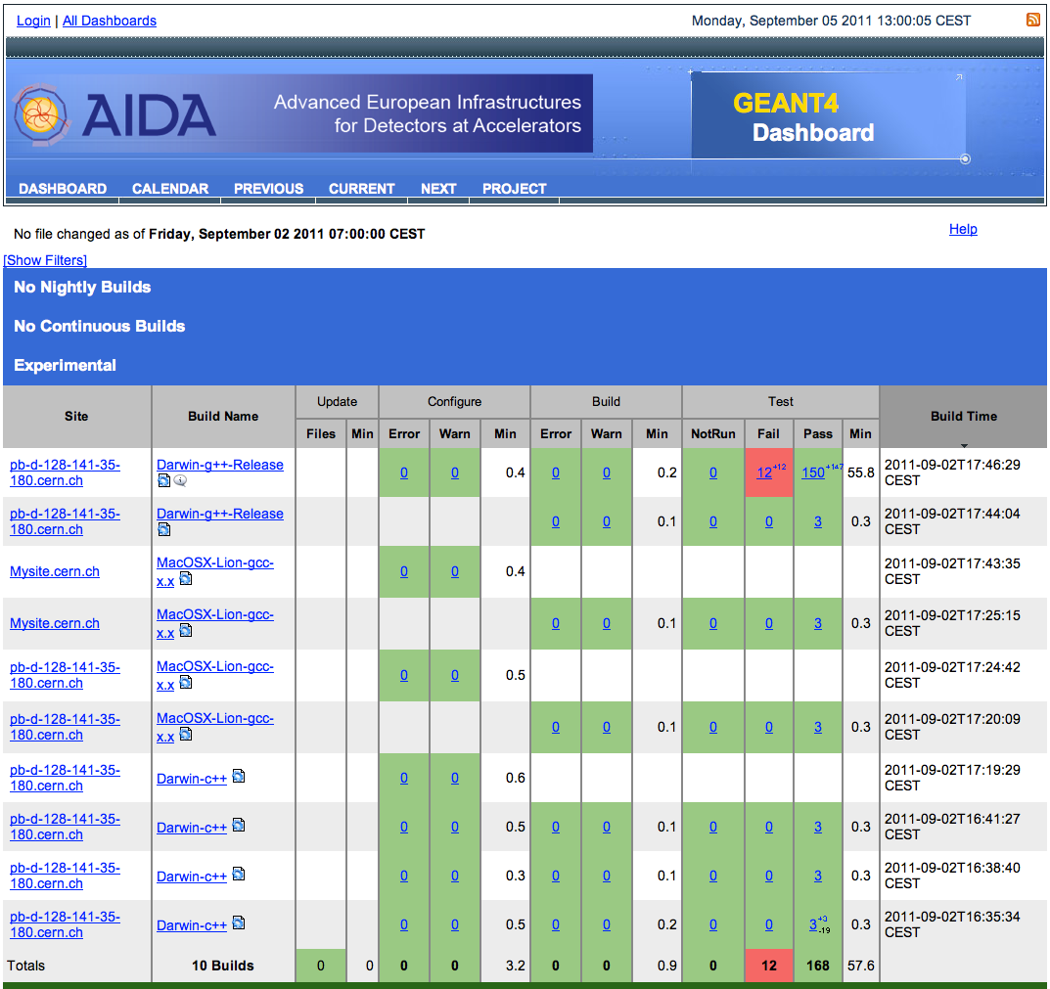
Uploading test results to CDash
The results of running a Nightly or Continuous integration tests as well as developer initiated (Experimental) test runs can be very easily uploaded to CDash
Customizable views with different level of details
Command wrapper output
E-mail notification
Currently squatting the Desy service for testing
https://aidasoft.desy.de/CDash/index.php?project=Geant4
% ctest –j –D Experimental

Slide 15
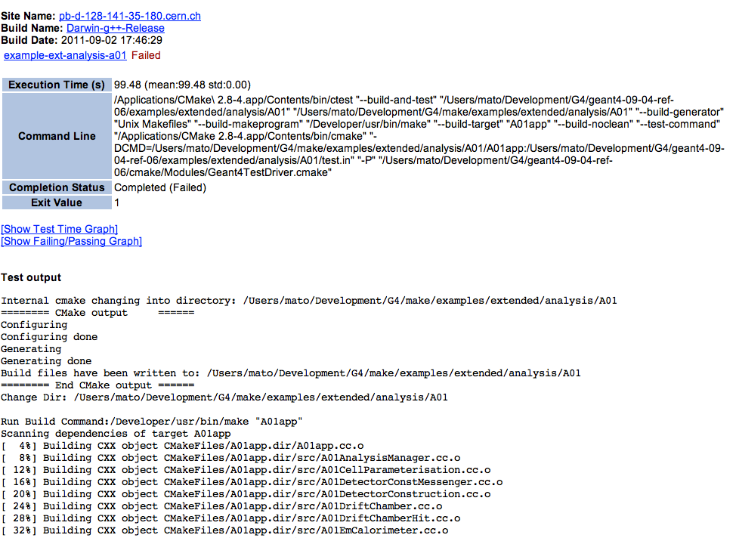
CDash Dashboard

Slide 16
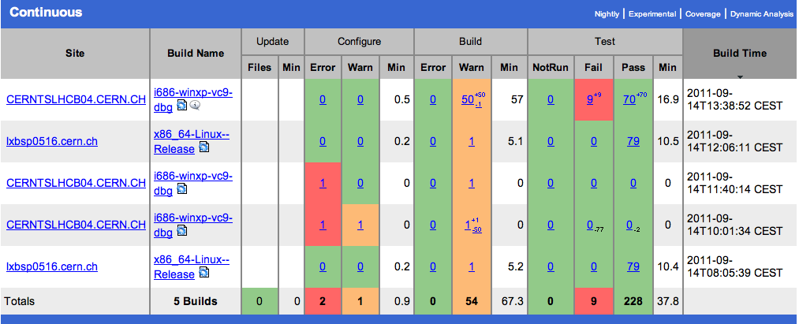
Continuous Integration Testing
A pilot ‘continuous’ integration and testing has been setup (few times/day)

Slide 17
Testing Status and Next Steps
162 tests defined and working
It includes building most of the tests
‘Benchmark’ tests are still missing
Still few tests fails on Windows
Committed to SVN all the CMakeLists.txt files for the examples
Setup experimentally a ‘nightly’ tests using CDash
Can it be a replacement for QMTest/LCGNightlies?
Feedback is welcome
Documentation
Need to write documentation

Slide 18
Packaging

Slide 19
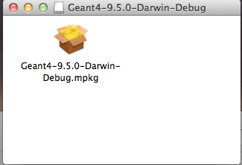
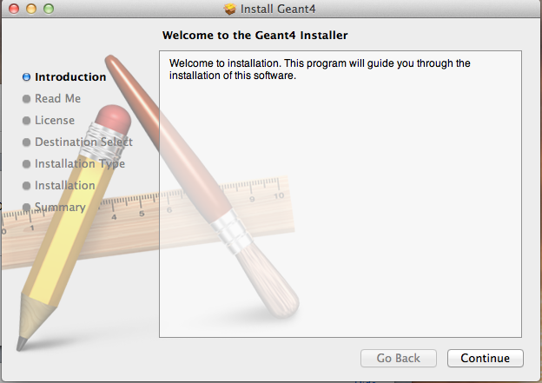
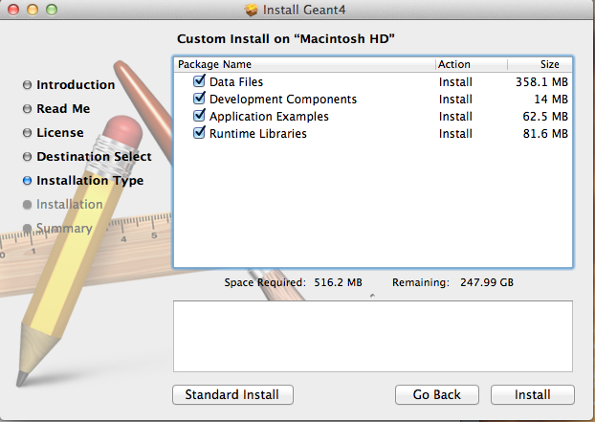
Packaging with CPack
CPack (bundled with CMake) is able to create professional platform specific installed
GZ and Self extract TGZ (STGZ), NullSoft Scriptable Install System (NSIS), OSX PackageMaker, RPM, Deb
For Geant4:
Binary and Source installers (TGZ, NSIS, PackageMaker)
User can select what components to install

Slide 20
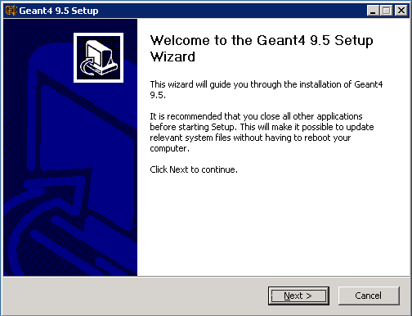
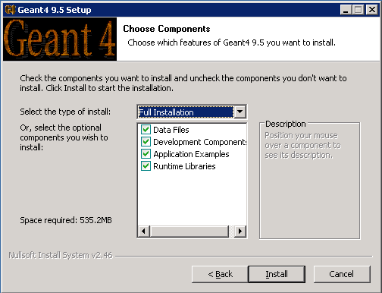
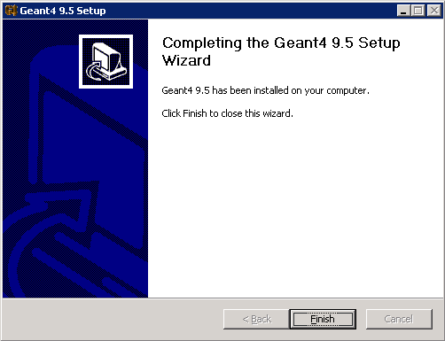
Building the Installers
To create the installers you need to enable a couple of CMake options to include the examples & data:
GEANT4_INSTALL_DATA
GEANT4_INSTALL_EXAMPLES
Make the 'package' target for the binary distribution and 'package_source' for the sources

Slide 21
Conclusions
Provided the definition, building and running of tests using CMake/CTest/CDash tools
The main goal has been to make it easy for developers to define, run, automate and monitor tests
Feedback is required at this moment in time
CDash could offer a competitive replacement to the LCG nightlies
CPack is a nice utility to provide ‘professional’ packaging with very little effort
It is time for all developers to move to CMake

