Slide 1
The new Geant4 Requirements Tracking system
Koichi Murakami
KEK/CRC

Slide 2
Introduction
Current Situation
An old Bugzilla-based system in Geant4 HP (User Support)
It does not work!
Requirements from TF are managed with a local PPT file.
New requirement tracking system is necessary.
open system: visibility, clarity, and responsibility
should avoid chaos…
Each requirement should be well evaluated before listed-up.
The scope of this talk
Introduce the new system features
How to operate the system collaboration-widely will be discussed in a Friday session.

Slide 3
Back again to A Tool
There are many kinds of tracking system…,
Bugzilla, Savannah, Trac, …
JIRA is used for the new system.
"JIRA provides issue tracking and project tracking for software development teams to improve code quality and the speed of development."
A web-based tracking system
Wiki-like documentation
Flexible access control
Workflow
Support for Agile development
Open source license is applied.
CERN software team also uses JIRA.
already have experience!

Slide 4
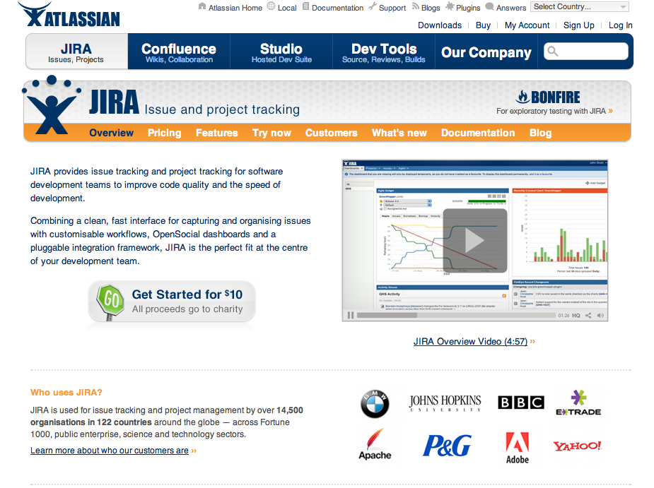

Slide 5
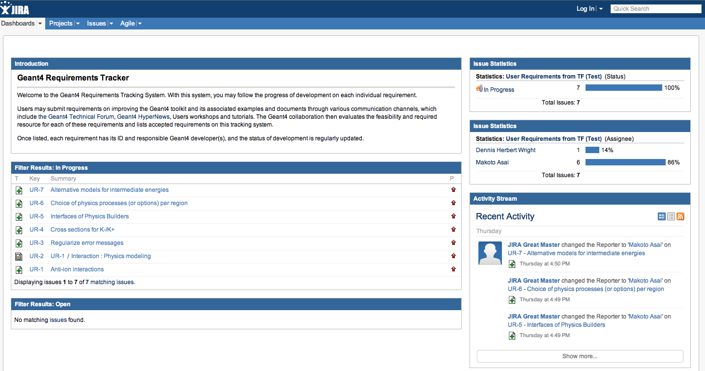
New System
A prototype of the new system is ready on
http://jira-geant4.kek.jp/
Some requirements are input for test.
Some users are created for test.

Slide 6
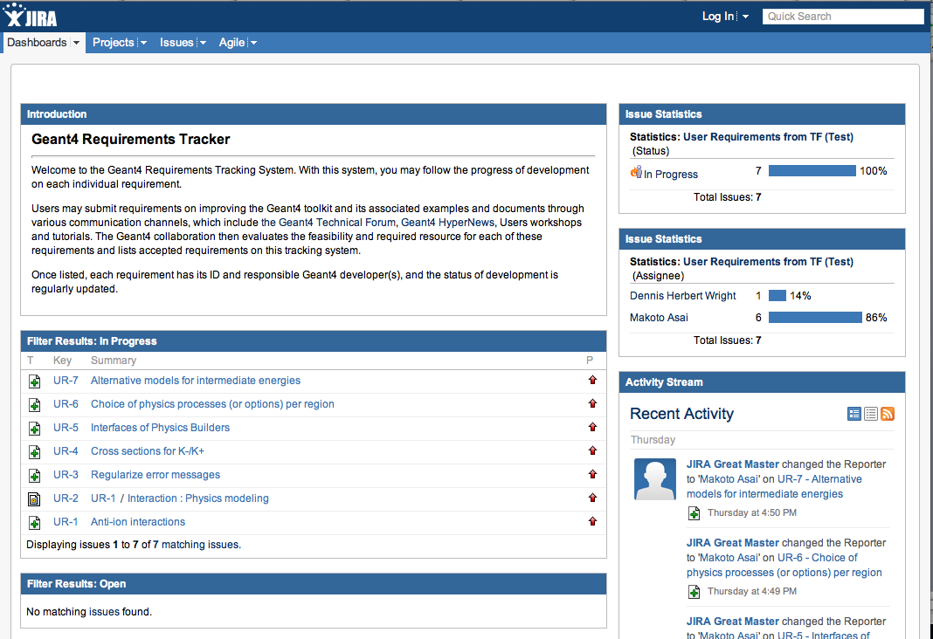
Login from here
Issues Stats.
List of In-Progress Issues
Recent Activity
List of Open Issues

Slide 7
User Management
operated in private mode.
no anonymous sign-up, admin creates user accounts.
avoid divergence
login dashboard is suppressed
Users are limited to Geant4 developers,
category coordinators, basically
responsibility of updating the progress of tasks
Permissions
Only limited persons can create new requirements
Makoto, Marc, Gabriele
Pre-evaluation for each requirement
Category coordinators can edit task status.

Slide 8
Status & Workflow

Slide 9
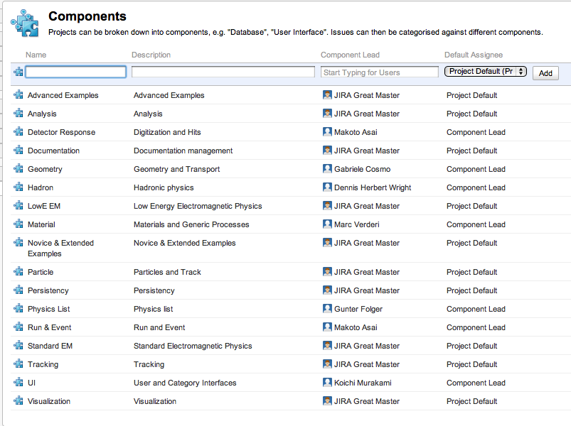
Components (Categories)

Slide 10
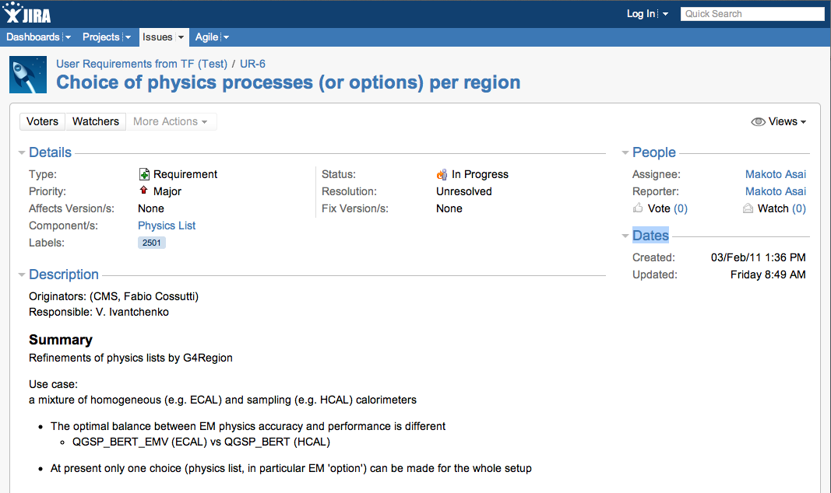
Task Description
Summary
Wiki-like Description

Slide 11
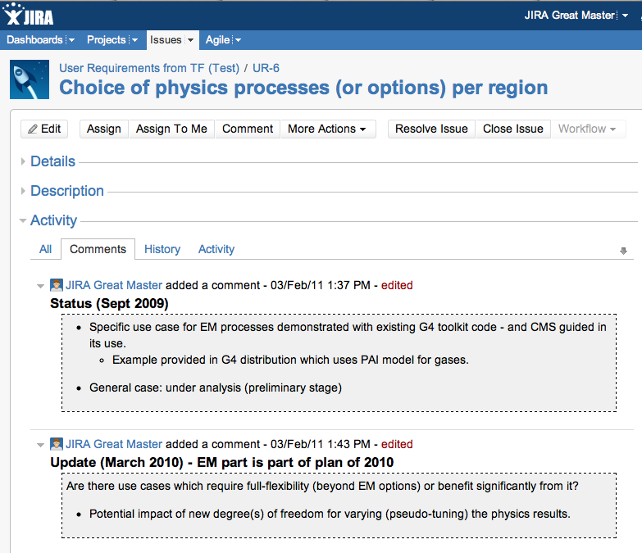
Update Documents
Add comments for new updates

Slide 12
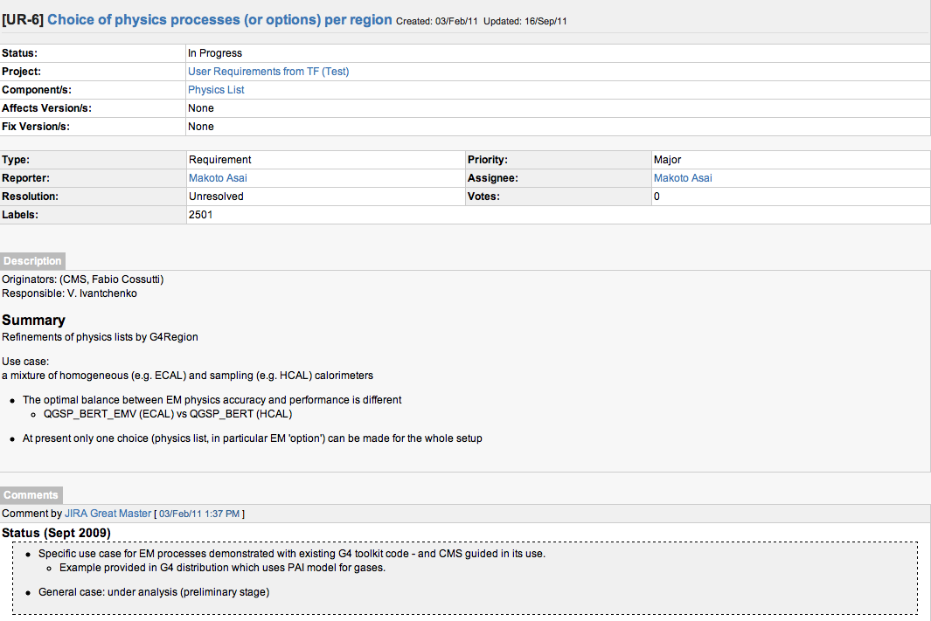
Printable Format Available

Slide 13
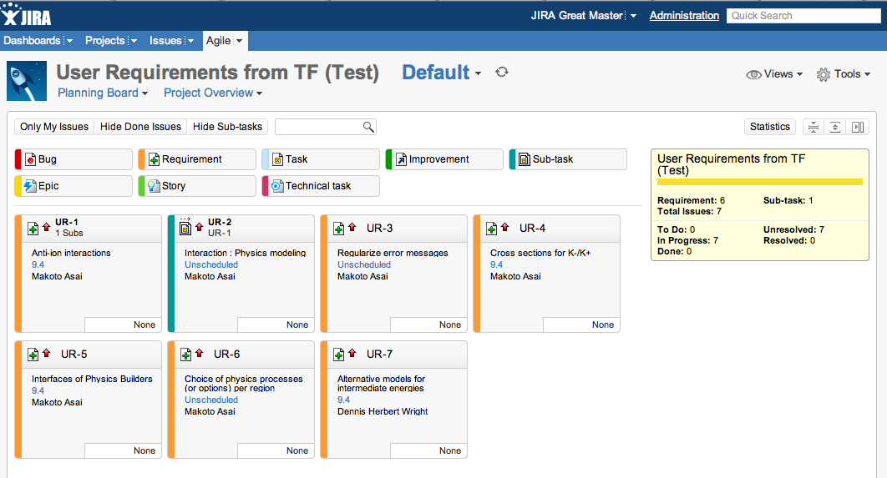
Task Board

Slide 14
One more thing

Slide 15
Announcement on G4Bugzilla
The system of G4Bugzilla will be updated on February/2012, with the replacement of the KEK computer system.
Ver. 3.2 currently (almost 3 years ago)
A plan to upgrade to ver.4
Top page layout is changed.
Look-and-feel is slightly changed.
Next-next update on Aug/2015 (for 3.5-years)
bound to KEK computer system replacement

Slide 16
Summary
JIRA for the new requirement tracking system
A web tool, instead of classical management
Open for visibility, clarity, and responsibility
Any feedback is welcome.
Now ready to fly
How to operate the system will be discussed in the workshop.

