Slide 1
MQXFA04 SG Data in Quench Tests（Up to Current Holding at 16.67 kA）
H. Pan
09/04/2020
LBNL

Slide 2
MQXFA04 SG Gauges Layout
LE
MID
RE
Shell 2
Shell 4
Shell 7
Coil Stations
Only HBM gauges are installed.
Shell gauges --- three axial locations:
Shell gauges (T & Z): on shell 2, 4, & 7
Coil gauges (T & Z): on the axial location of 3989 mm (RE) from LE.
Rod stations are located on the RE
Each station is full bridge with four individual gauges.
Only one of the strain gauges is not functional:
One of the gauge on Rod 4 is damaged during rods handling.

Slide 3
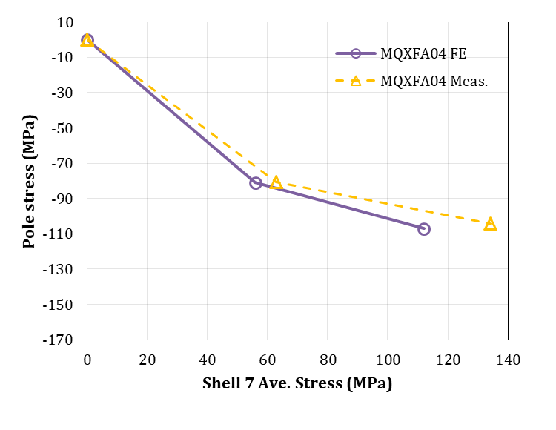
Cooldown SG Readings
The Targets set for MQXFA04
The TF plots of MQXFA04
The stresses are average stress: (MPa)
 |  | MQXFA04 (Target) | MQXFA04 (Meas.)
RT | Coil | -80 | -80.5 (-76.7 ---24 hr later)
 | Shell | 53 | 60
CD | Coil | -103 | - 97 (taking out the shift of Q3 reading)
 | Shell | 110 | - 135 (shell 7)
Measurements spread
If take out the shift of the Q3 gauge after cooldown, the coil spread is as shown in dark blue:
Proposed target window
To get reasonable TF plot, the coil data pairs with the shell 7 data.
Average Coil stress is on target, the average stress of each shell is higher than target.
 | Shell 02 | Shell 04 | Shell 7
R.T. | 60 MPa | 58 MPa | 63MPa
CD | 130 MPa | 128 MPa | 135 MPa

Slide 4
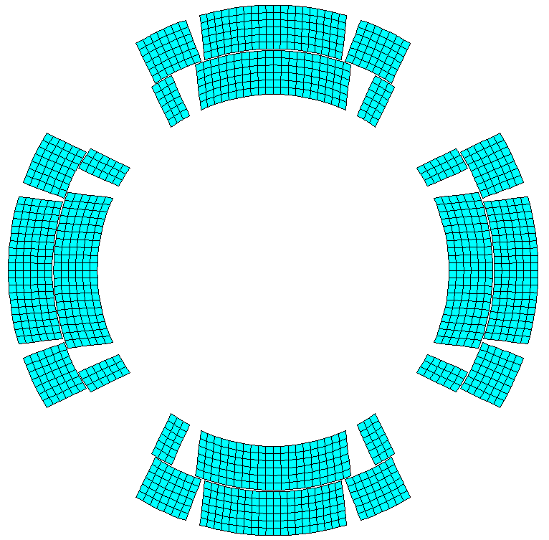
SG Readings in the Quench Tests (up to #6)
Coil 113
Coil 203
Q2
Q1
Q3
Q4
Coil 206
Coil 112

Slide 5
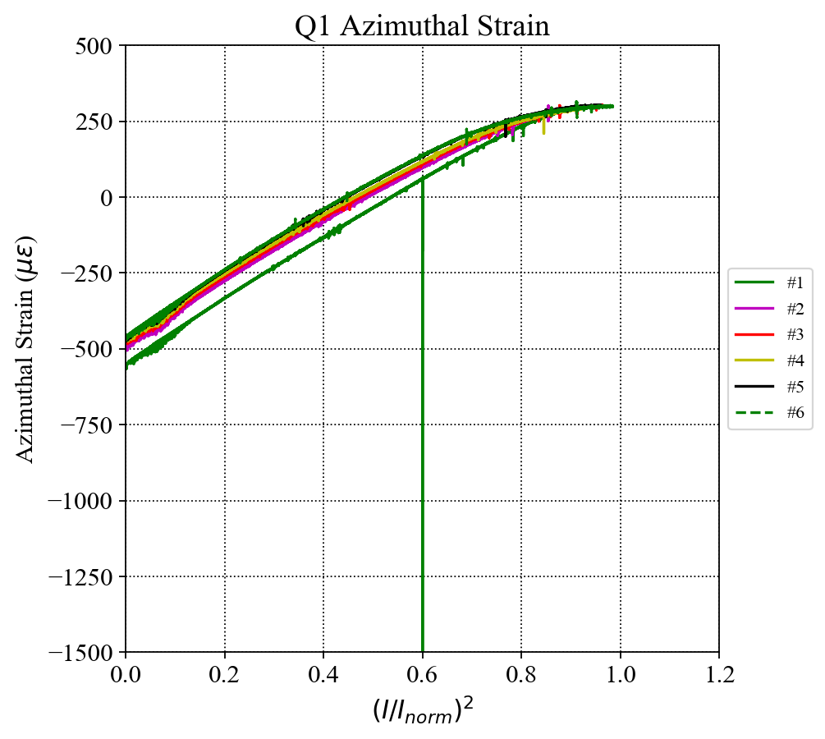
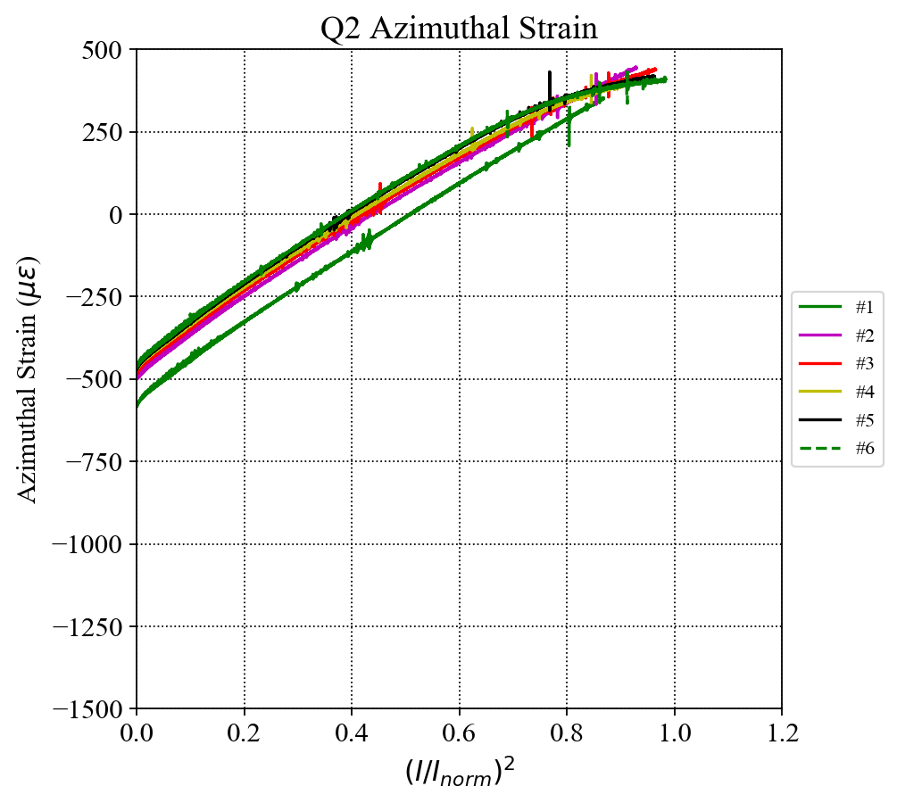
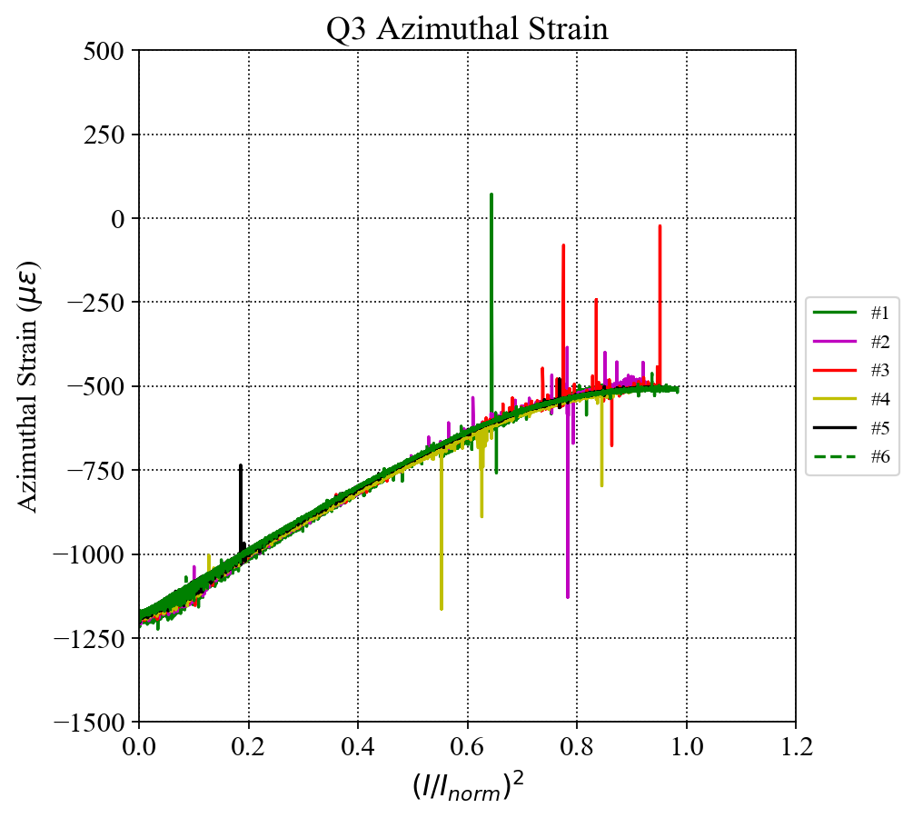
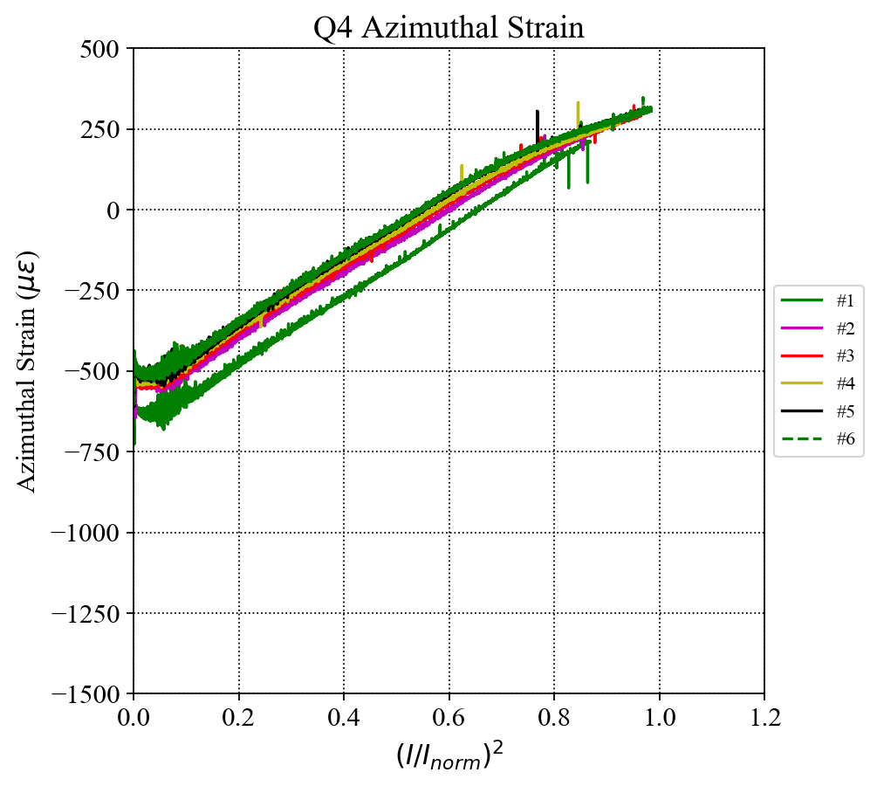
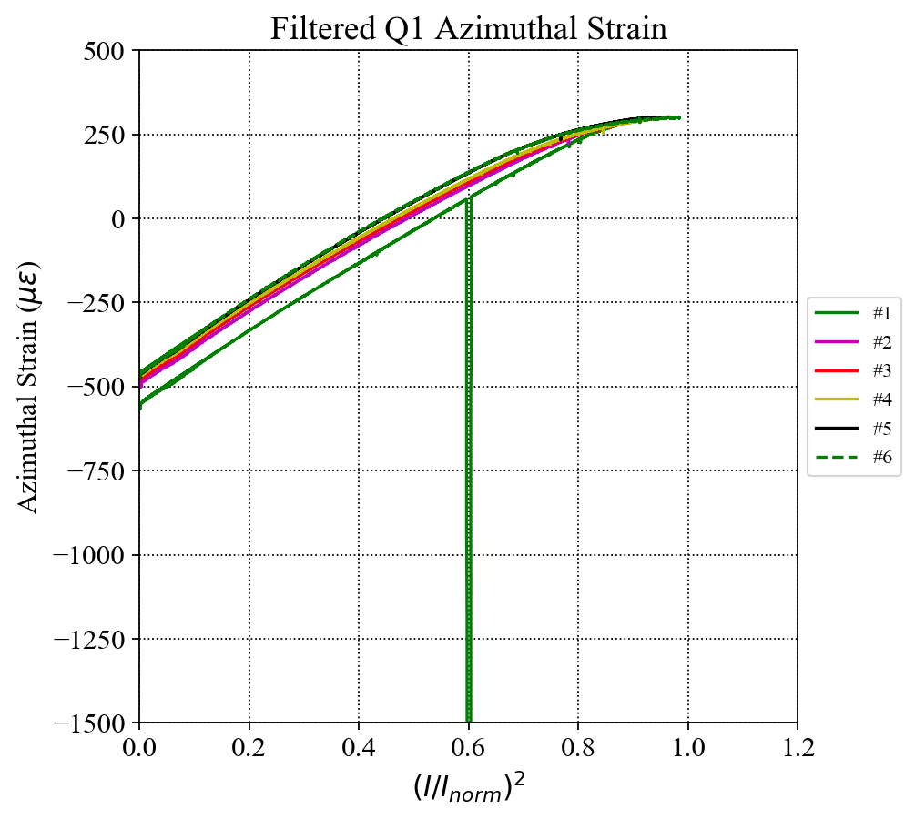
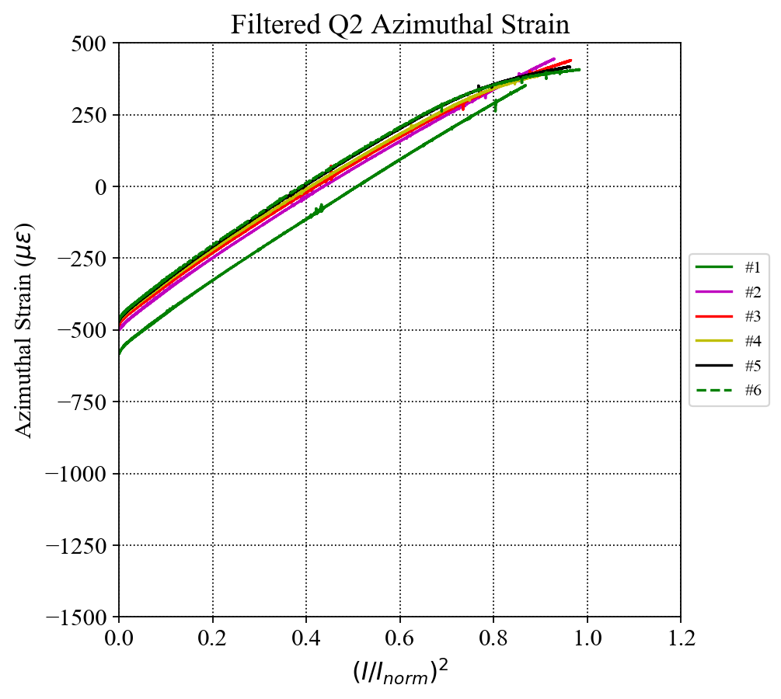
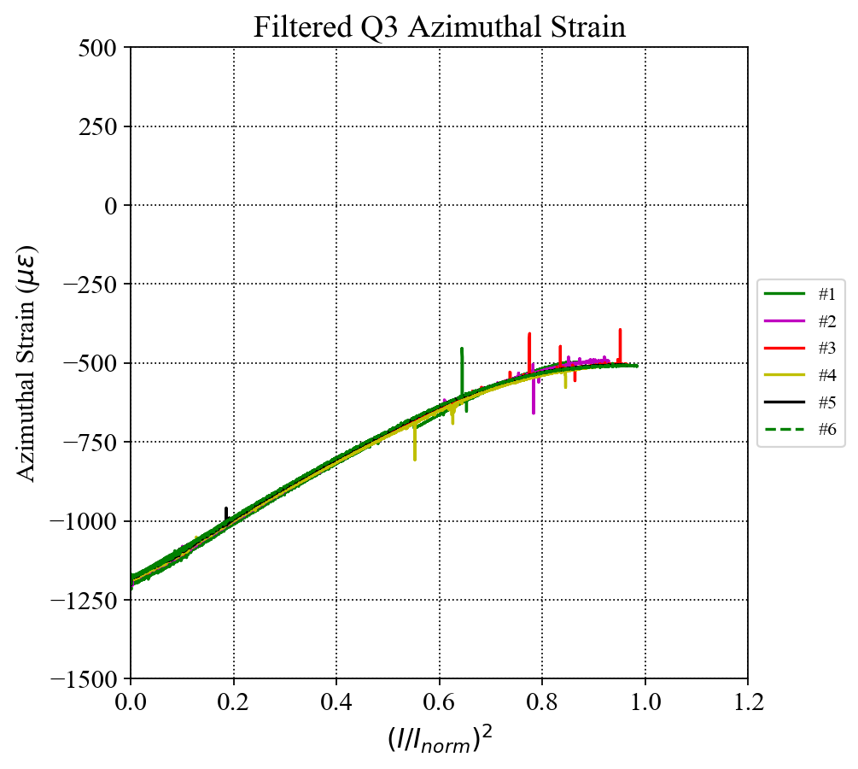
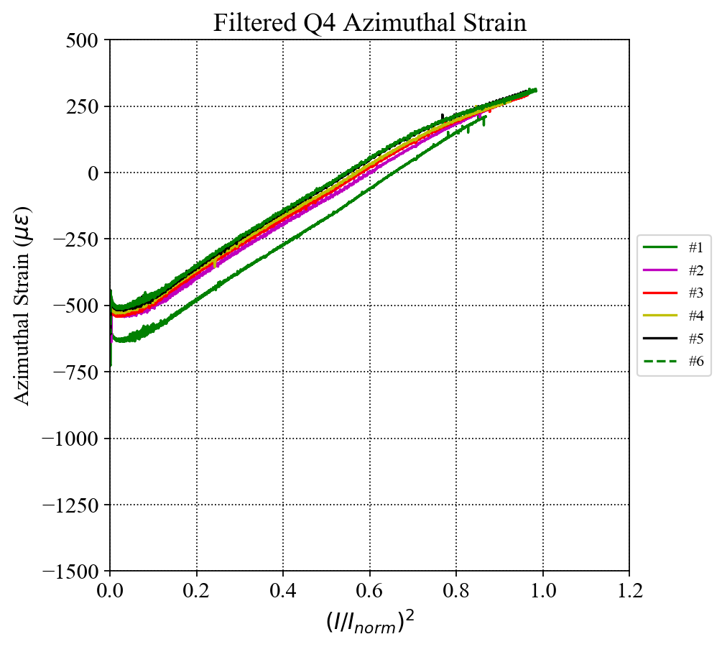
Coil Azimuthal Strain (up to Q#6)
I_{norm} = 16.47 kA
LP Filter
Cutoff frequency: 2 Hz

Slide 6
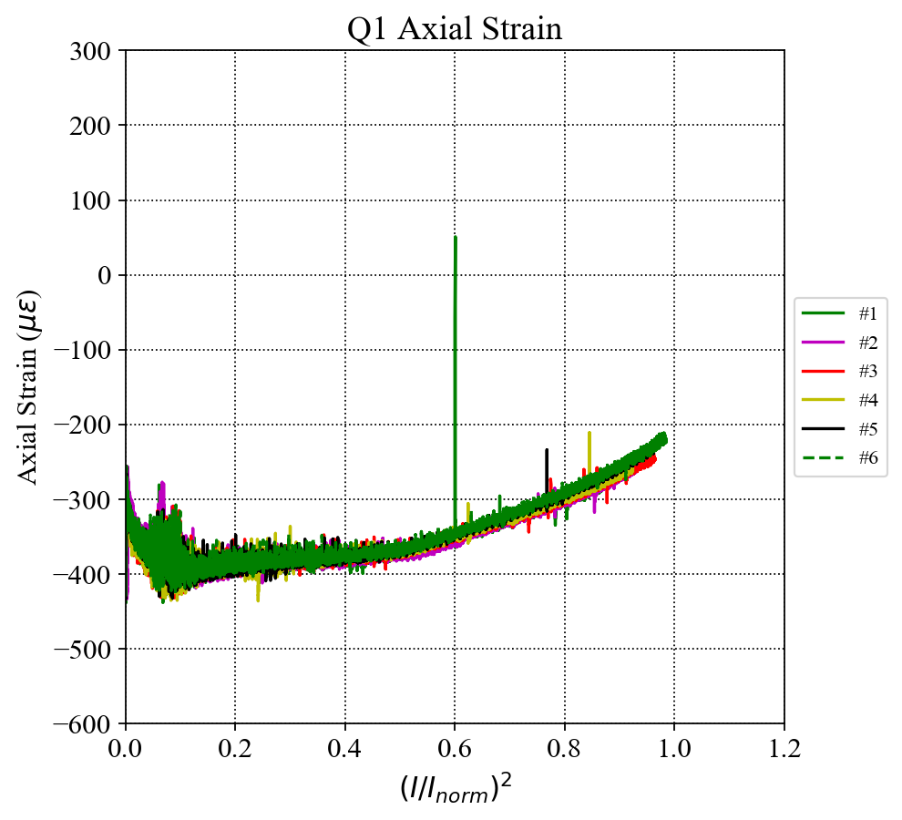
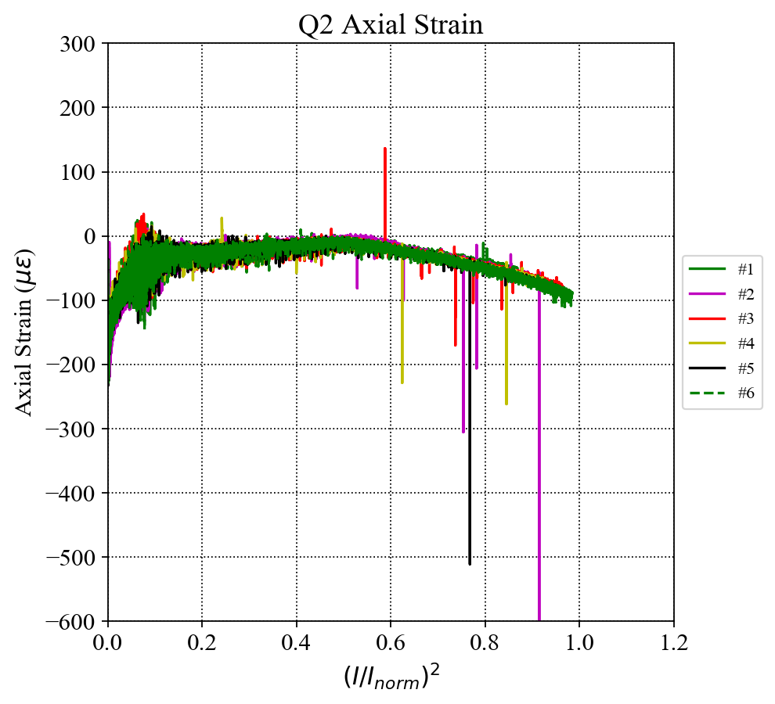
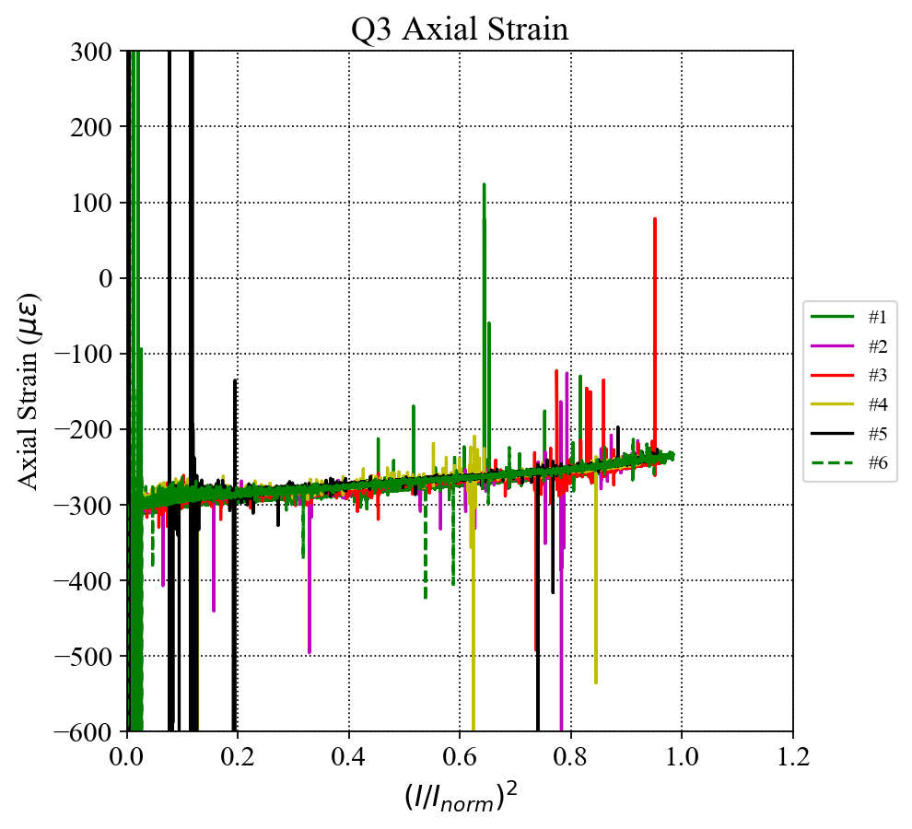
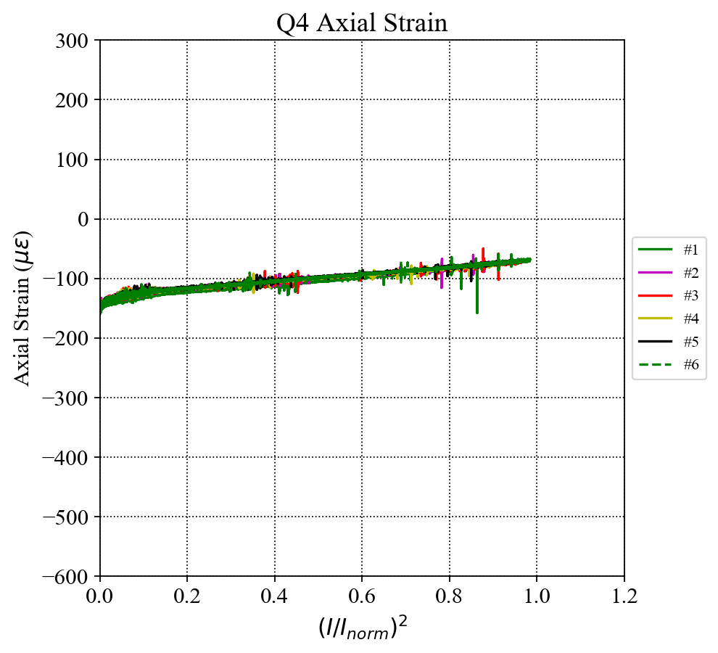
Coil Axial (up to Q#6)
I_{norm} = 16.47 kA
Noisy signals in quadrant 1, 2 and 3.
Signals of quadrant 1 and 2 are distorted by magnetic field.

Slide 7
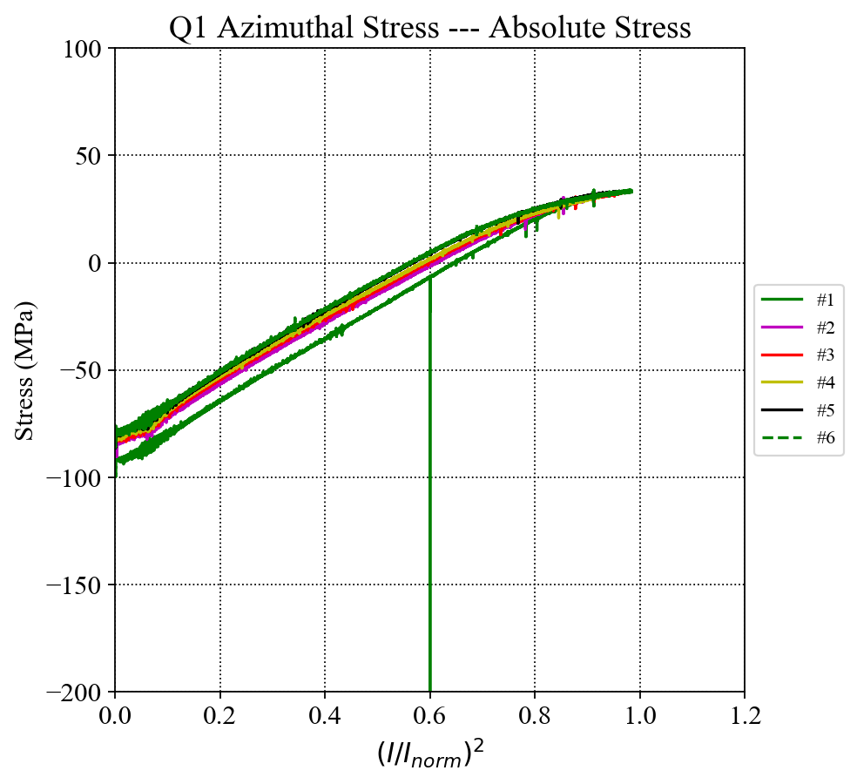
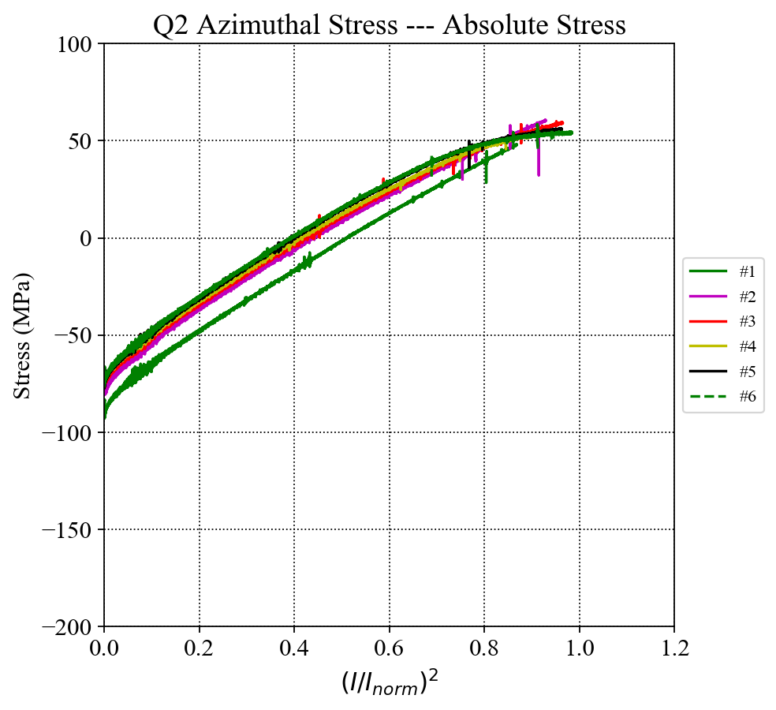
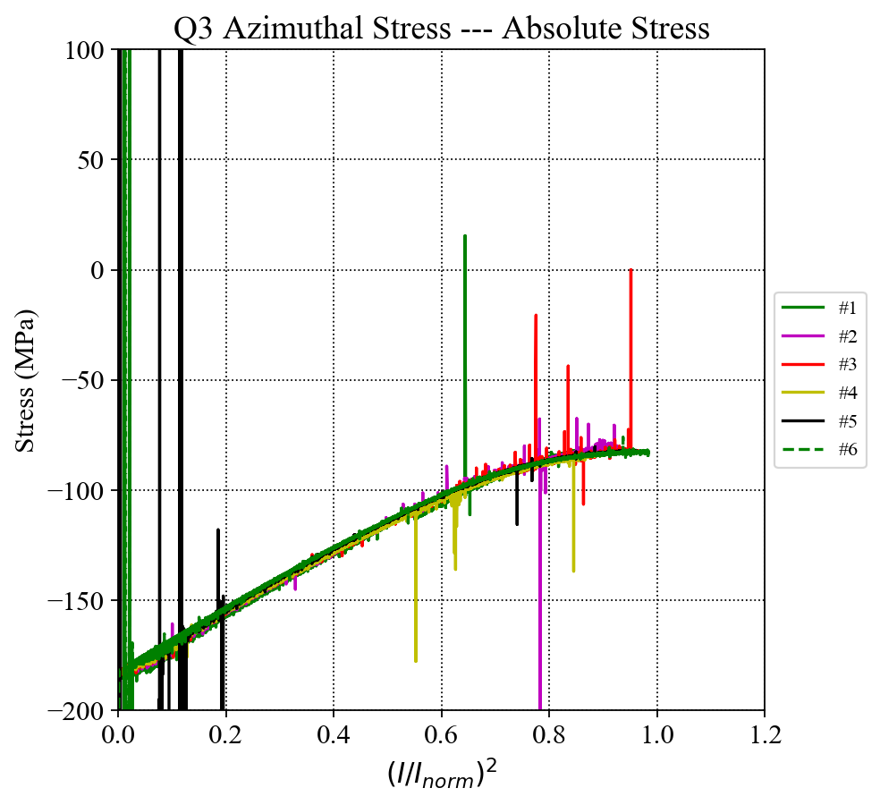
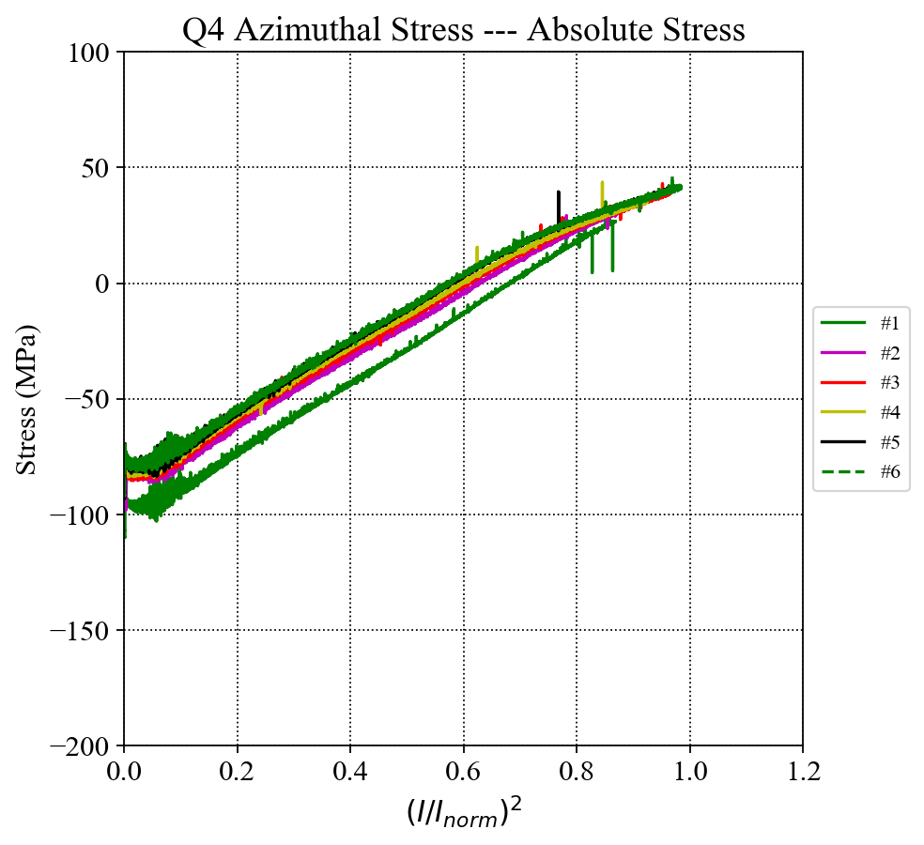
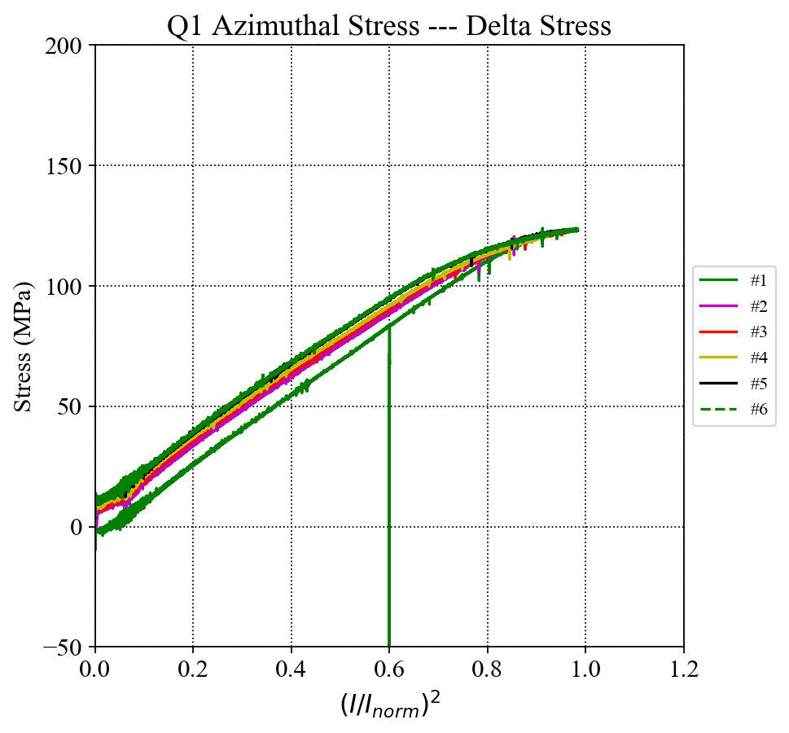
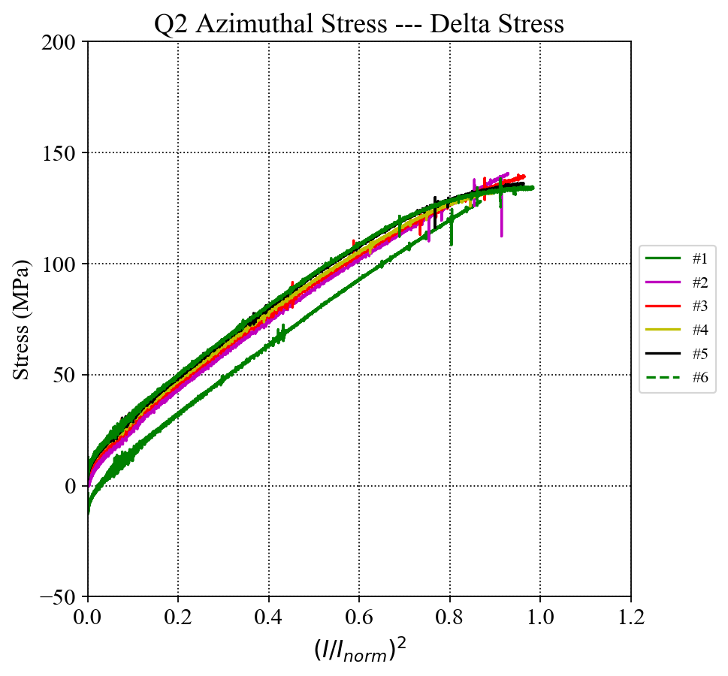
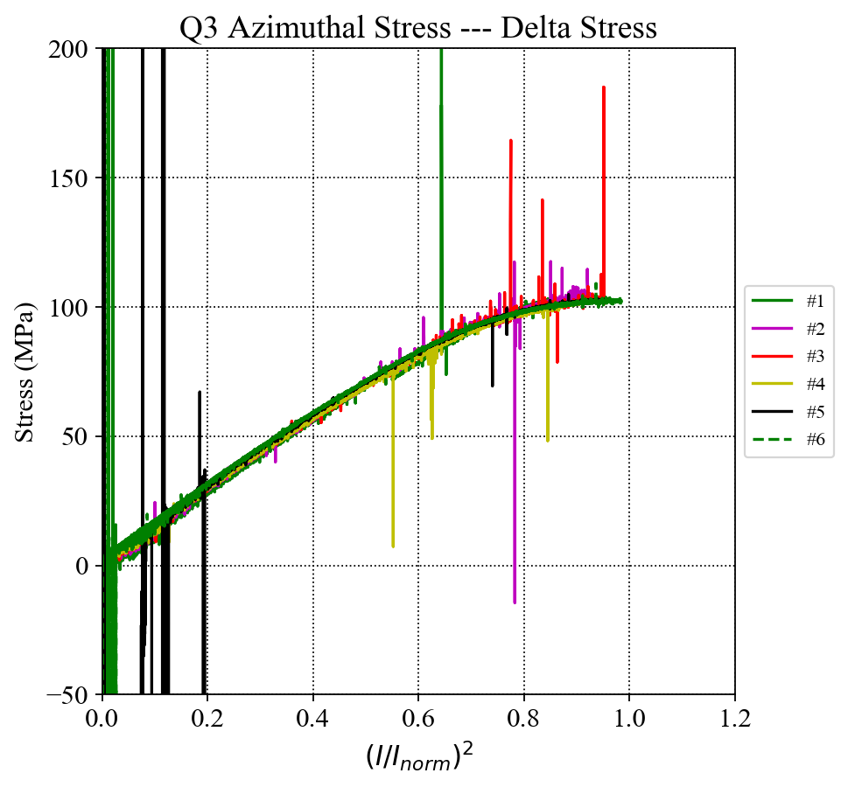
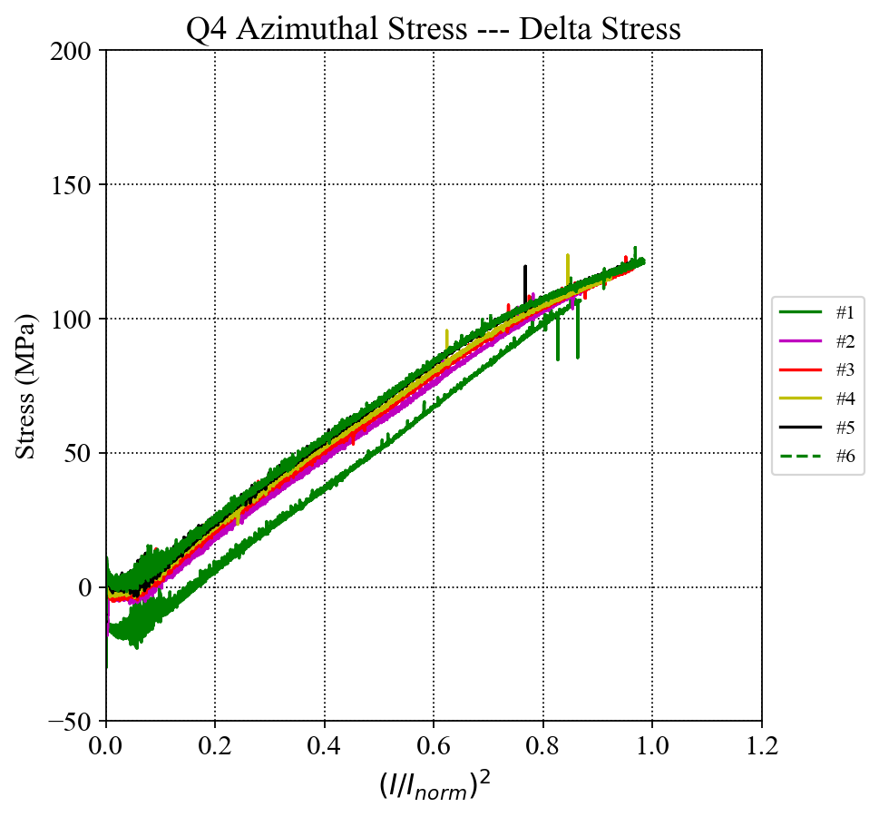
Coil Azimuthal Stress (up to Q#6)
I_{norm} = 16.47 kA
Absolute Stress:
Delta Stress:

Slide 8
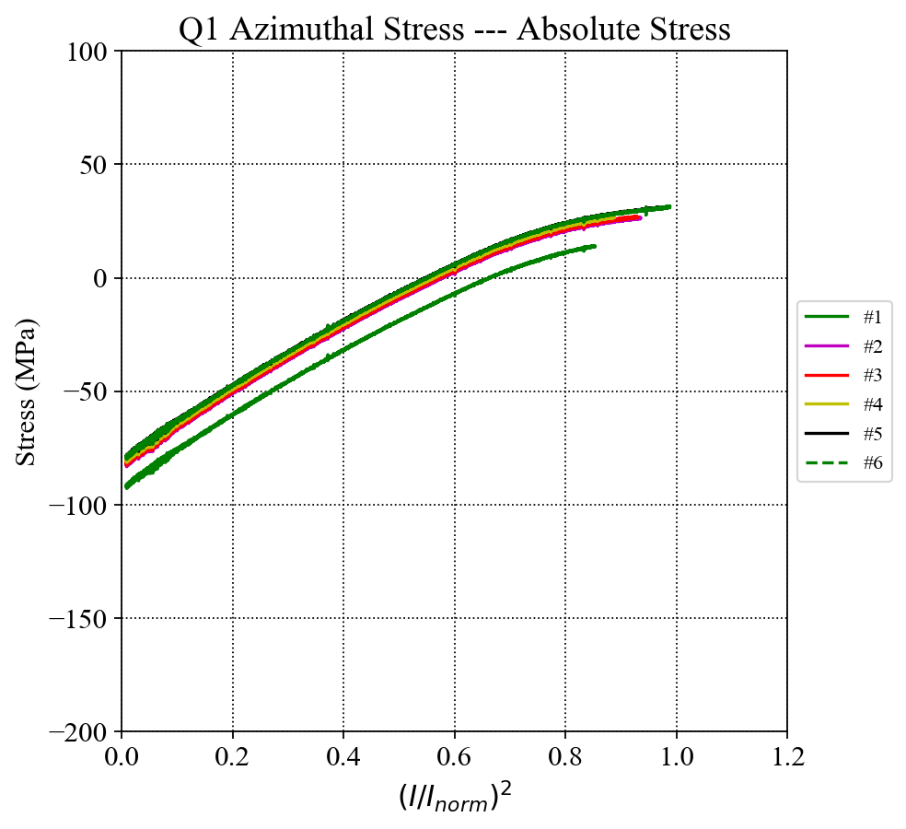
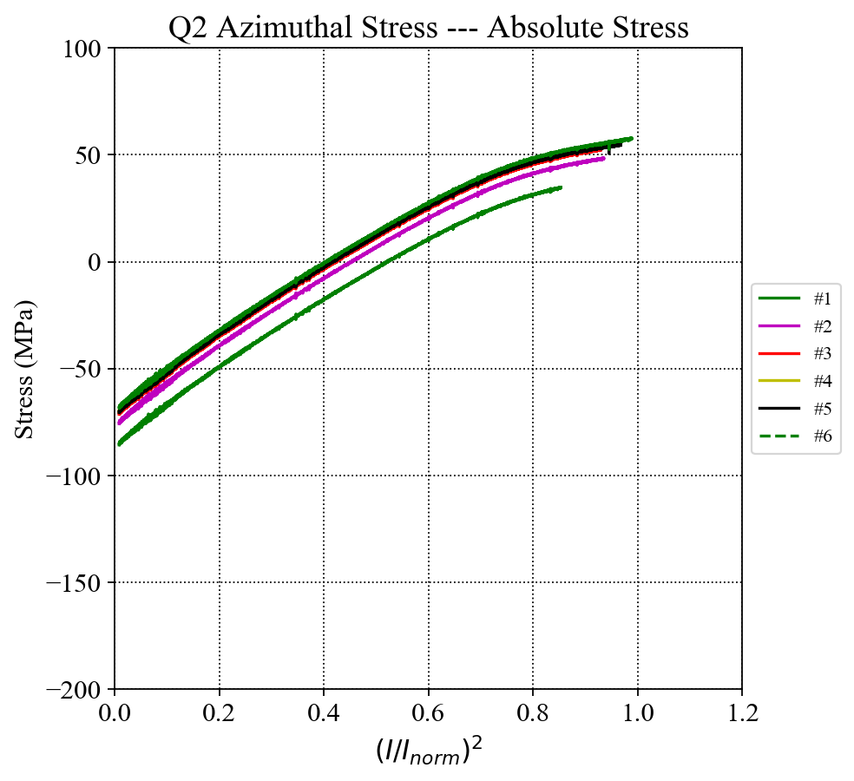
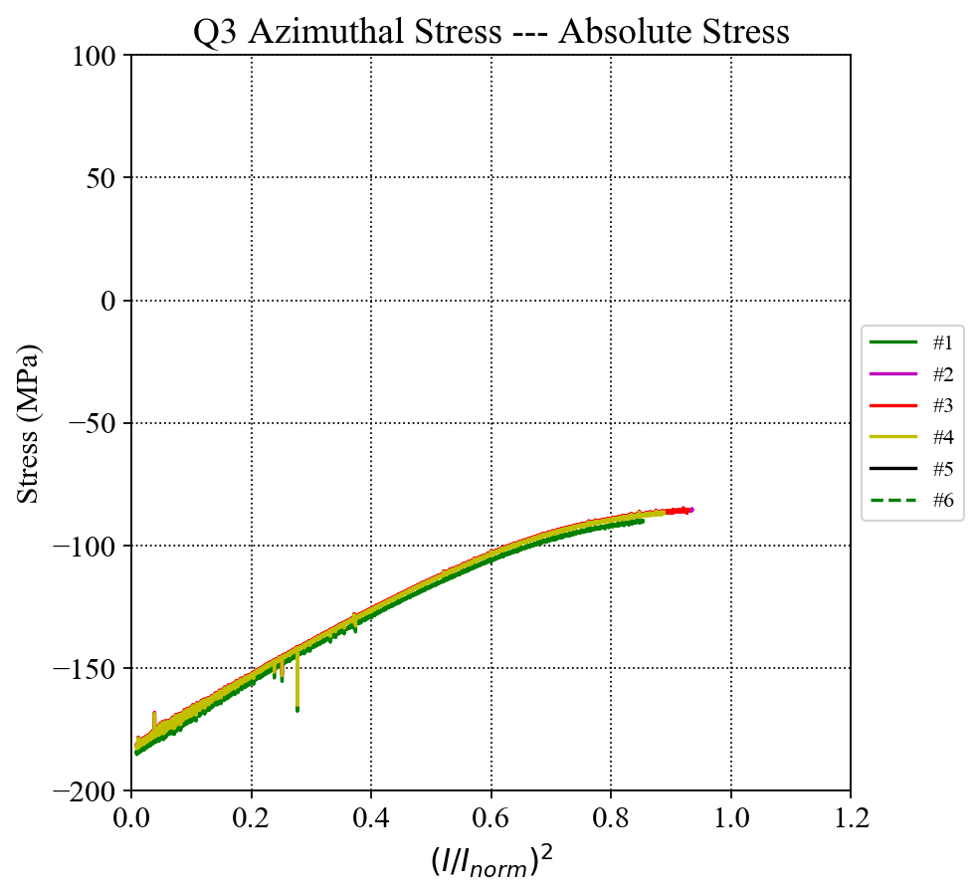
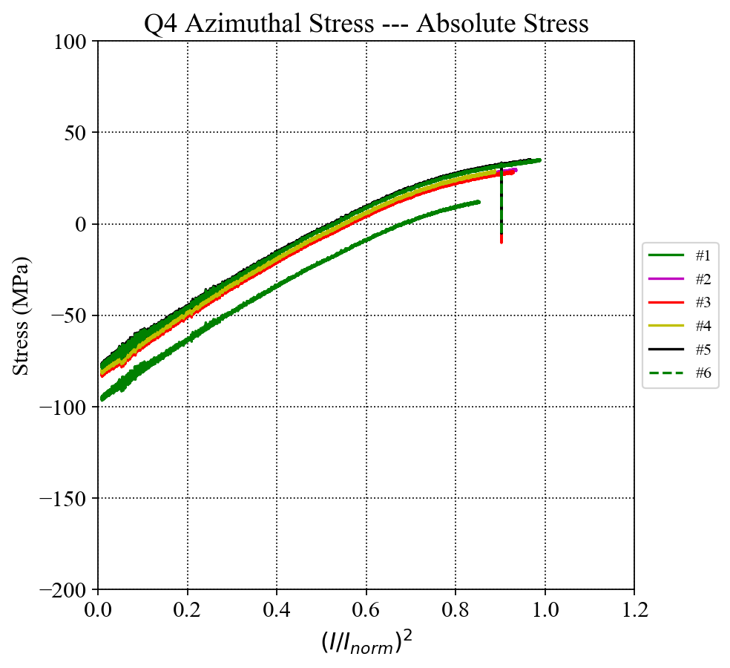
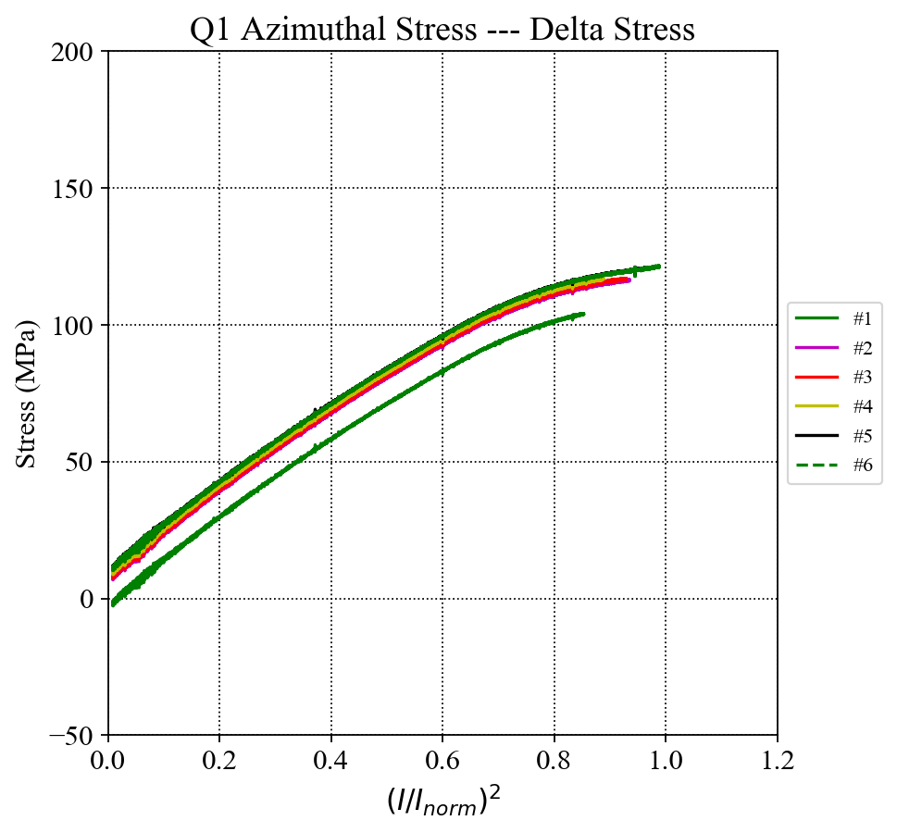
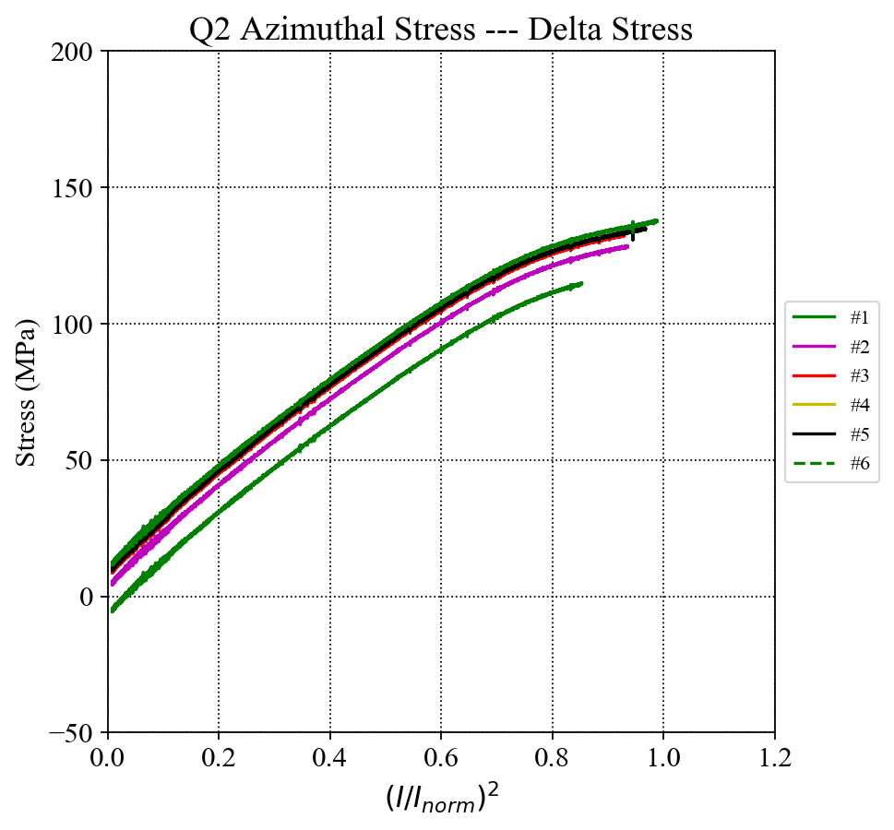
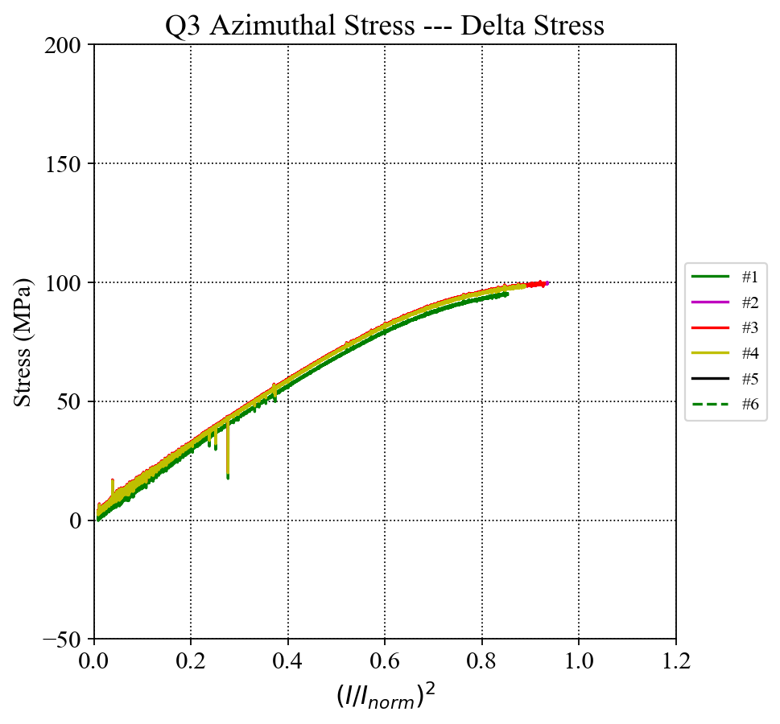
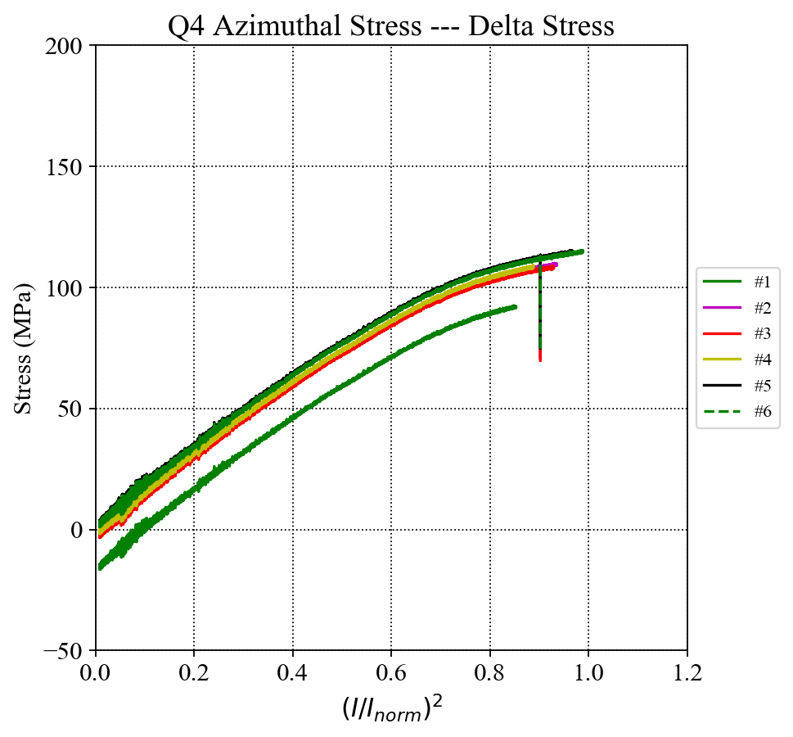
Corrected Coil Azimuthal Stress (up to Q#6)
I_{norm} = 16.47 kA
Absolute Stress:
Delta Stress:

Slide 9
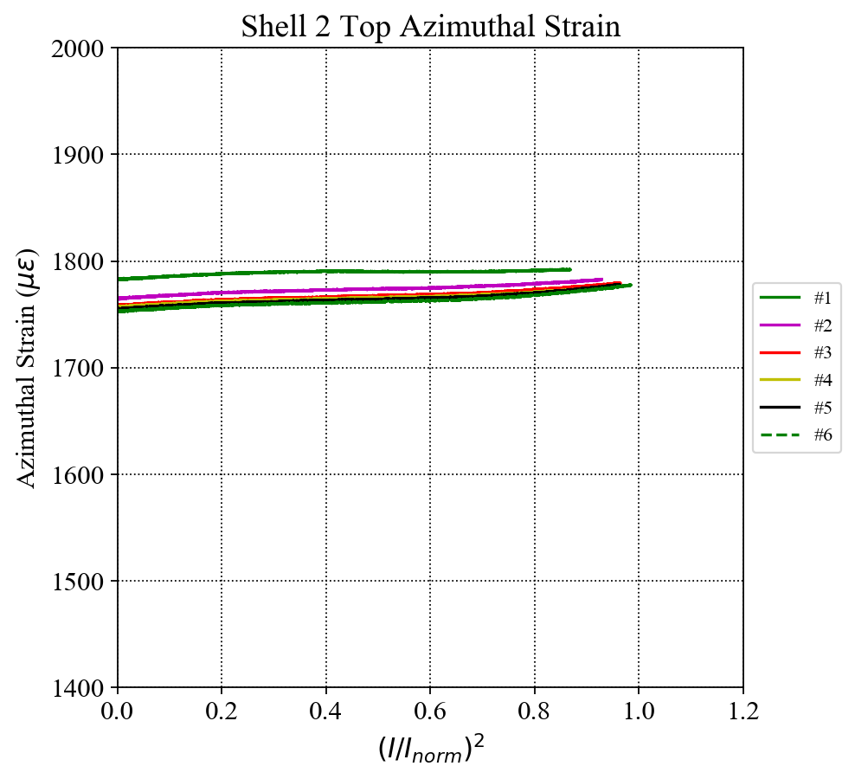
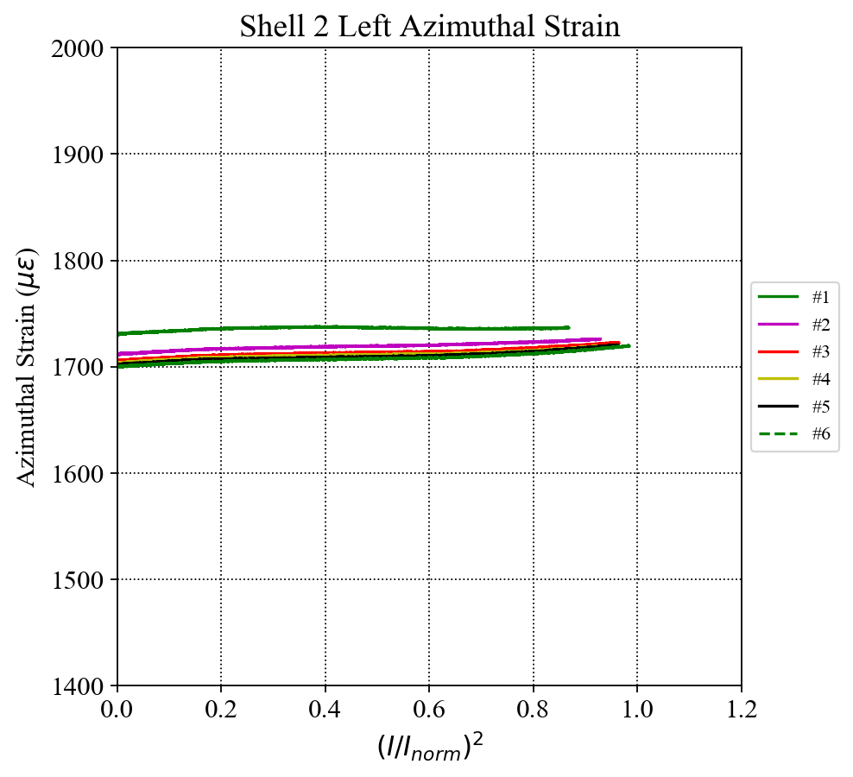
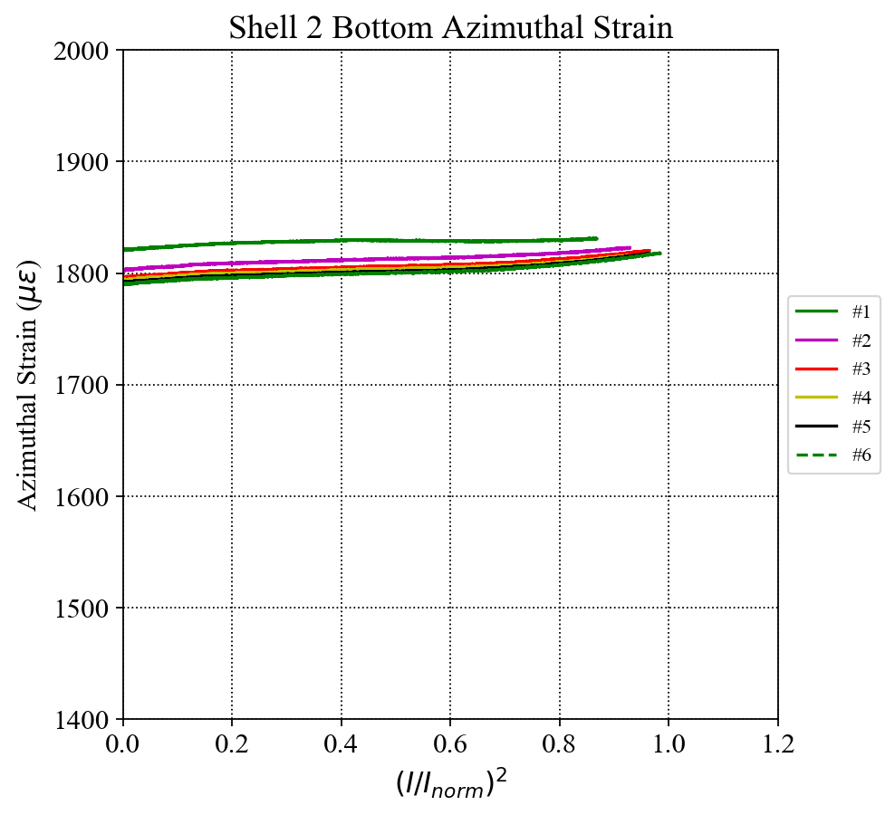
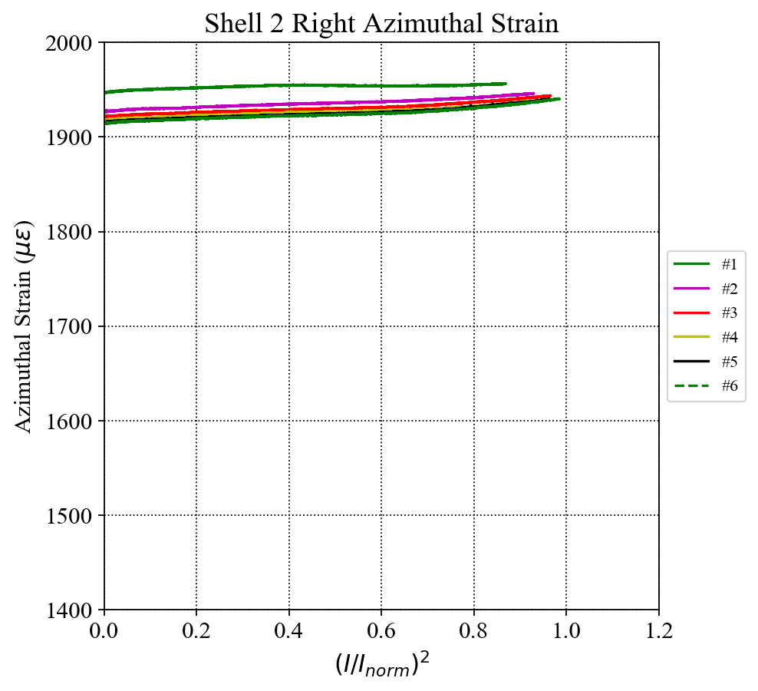
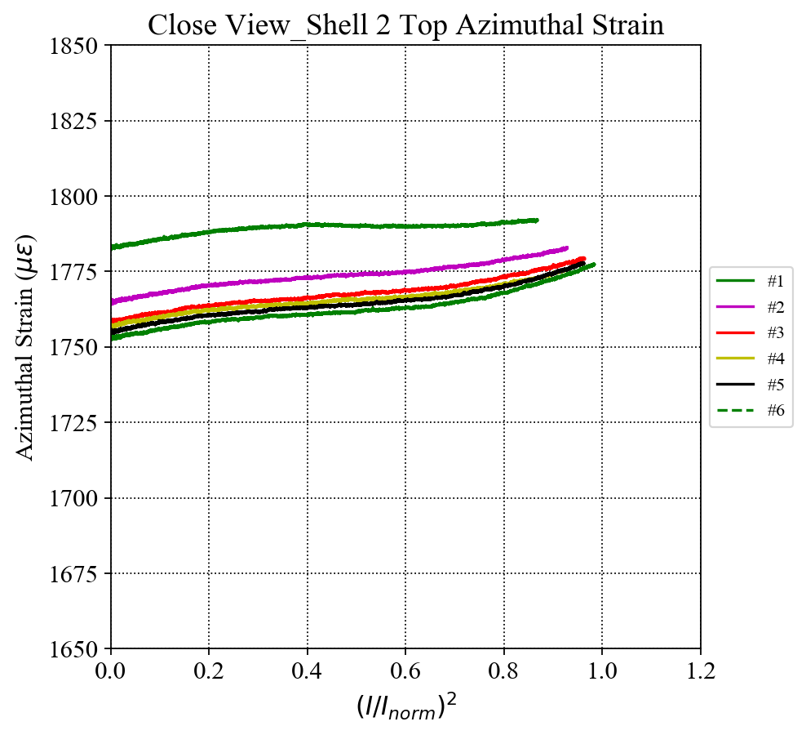
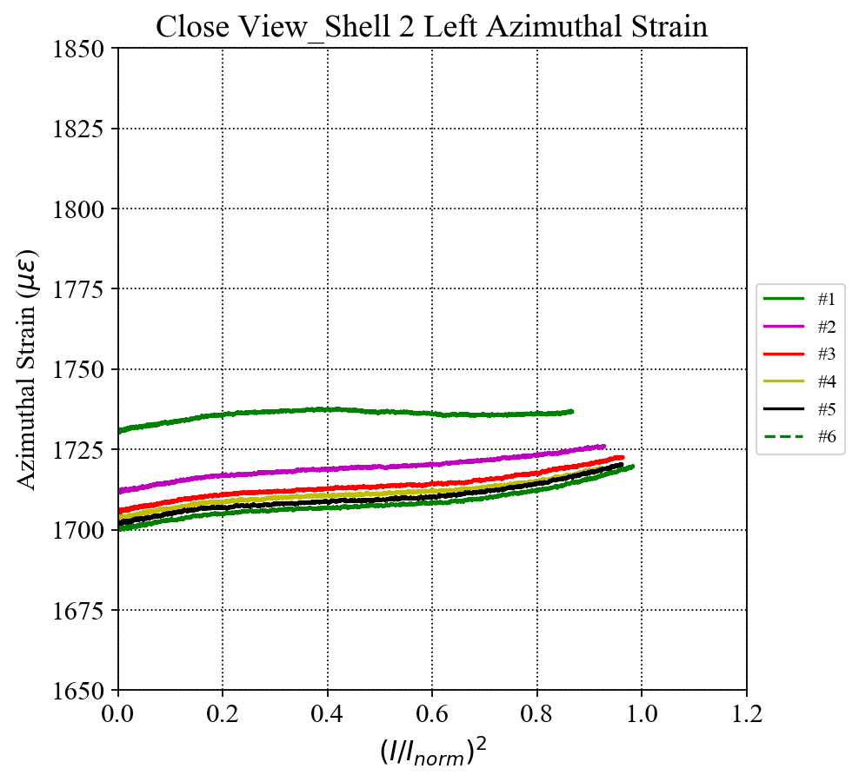
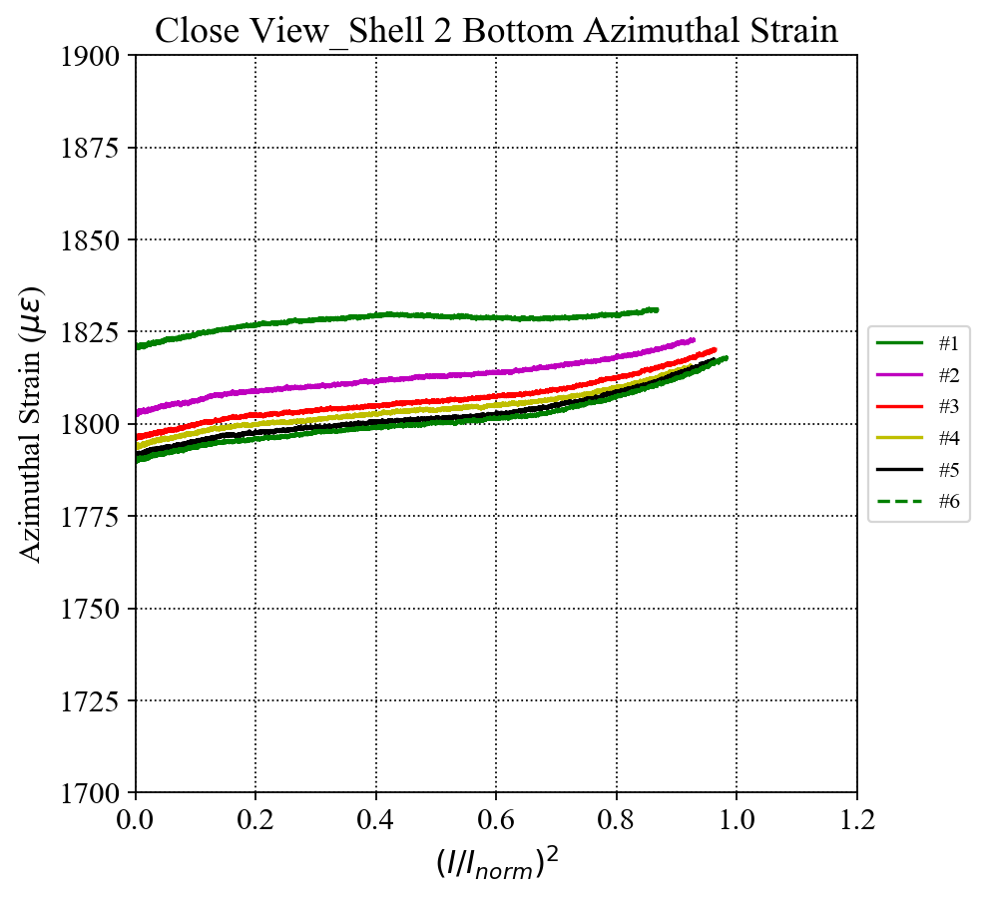
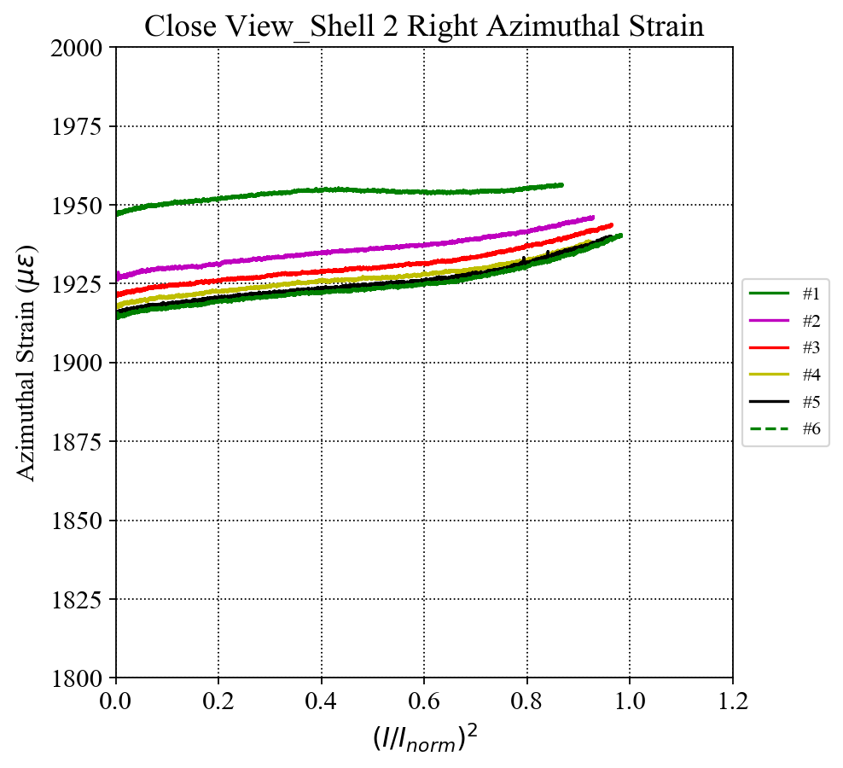
Shell 2 SG Readings (up to Q#6)
I_{norm} = 16.47 kA
Azimuthal
Close View

Slide 10
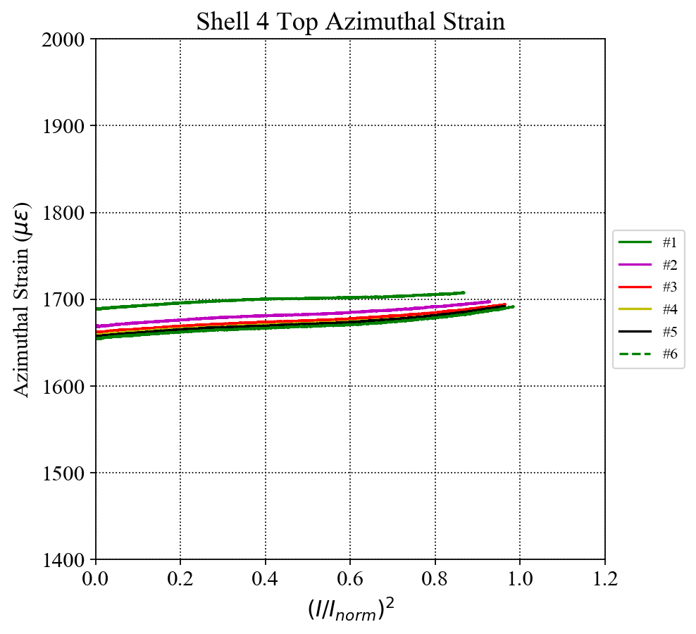
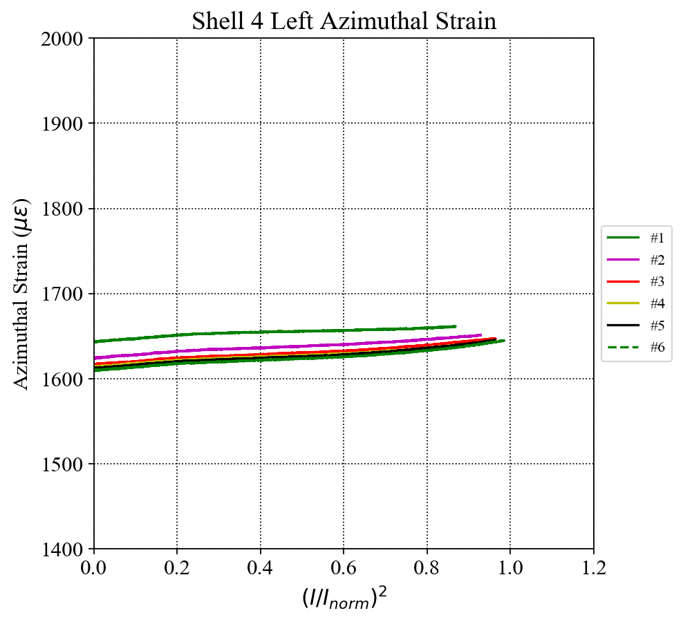
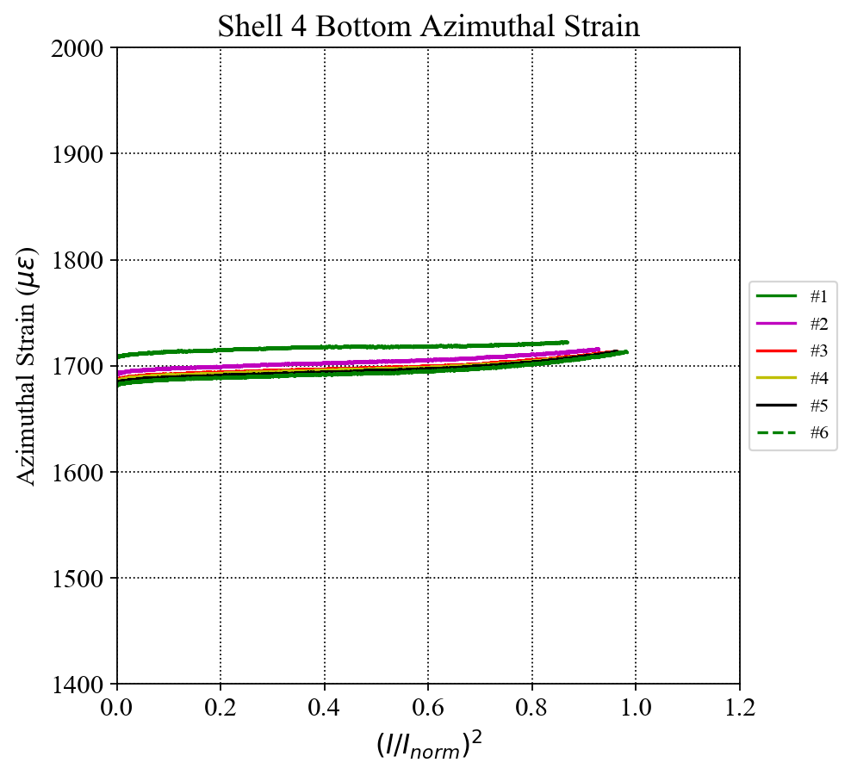
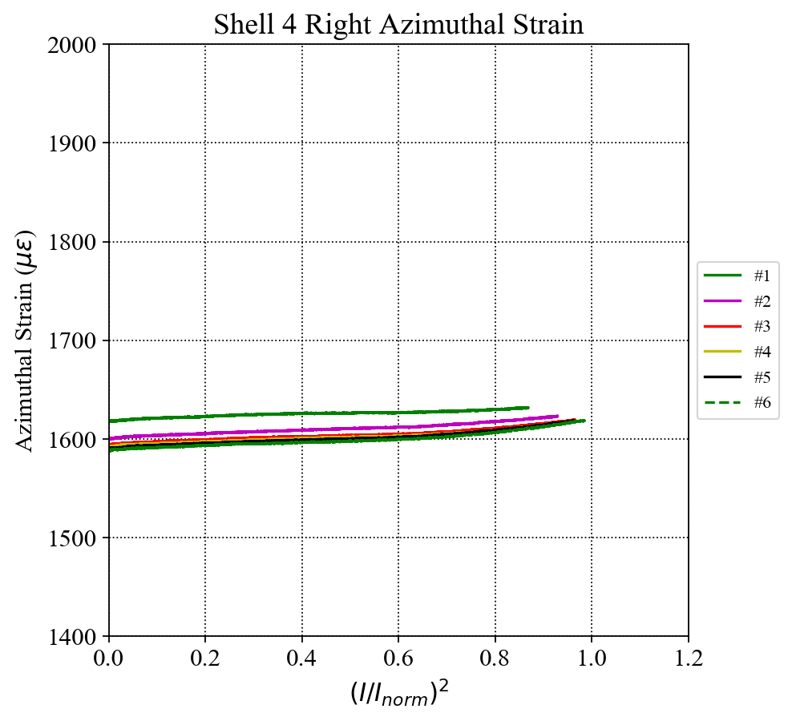
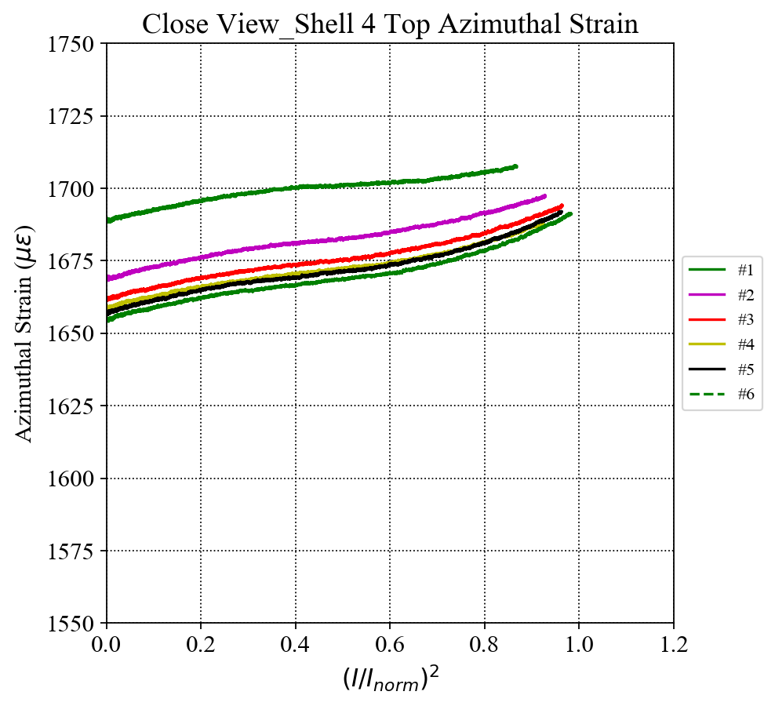
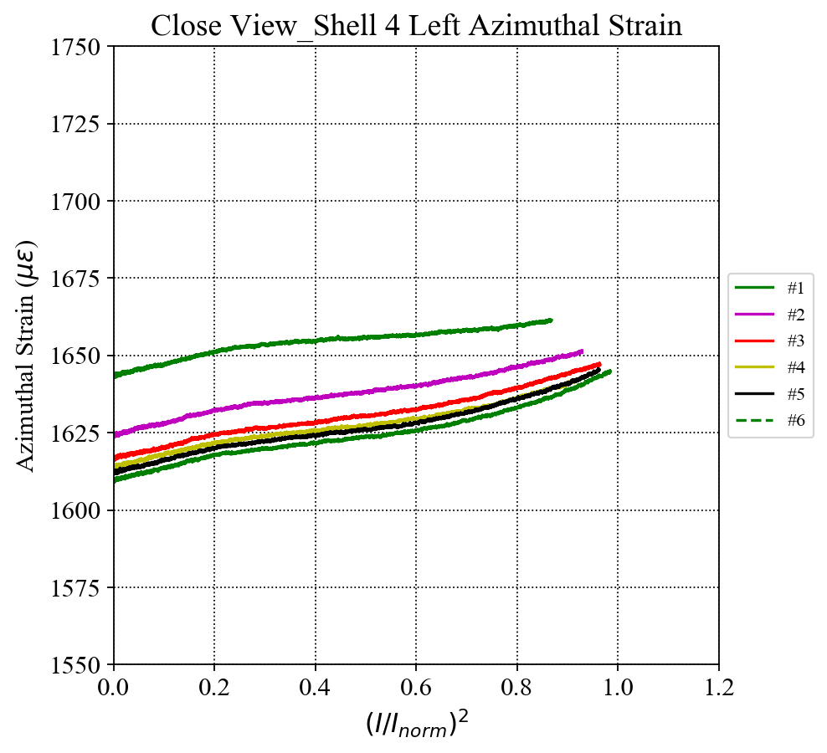
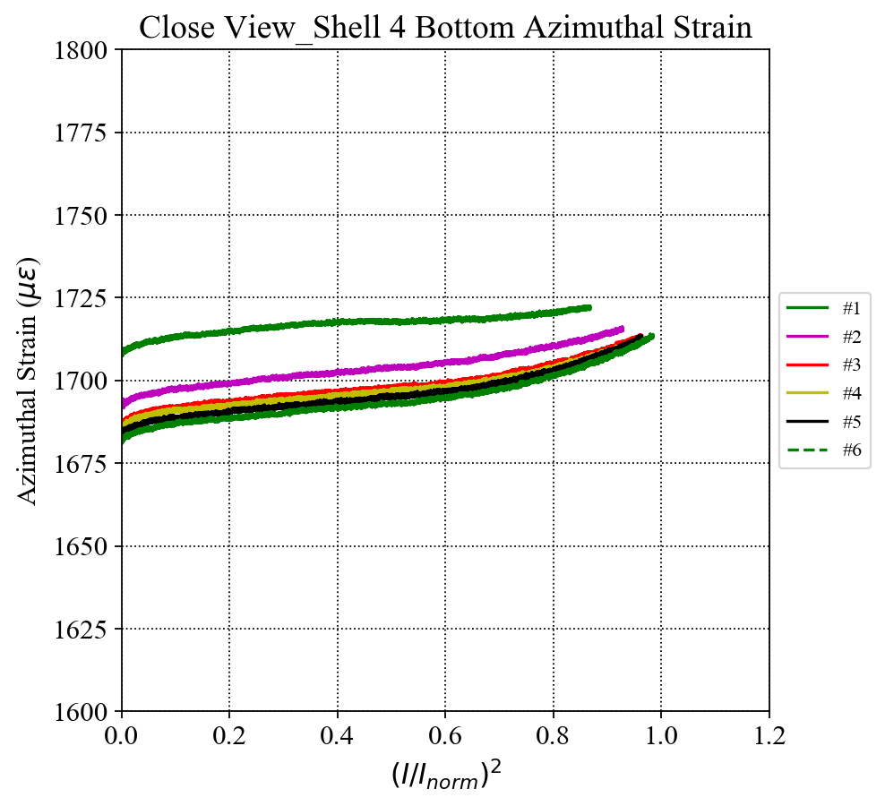
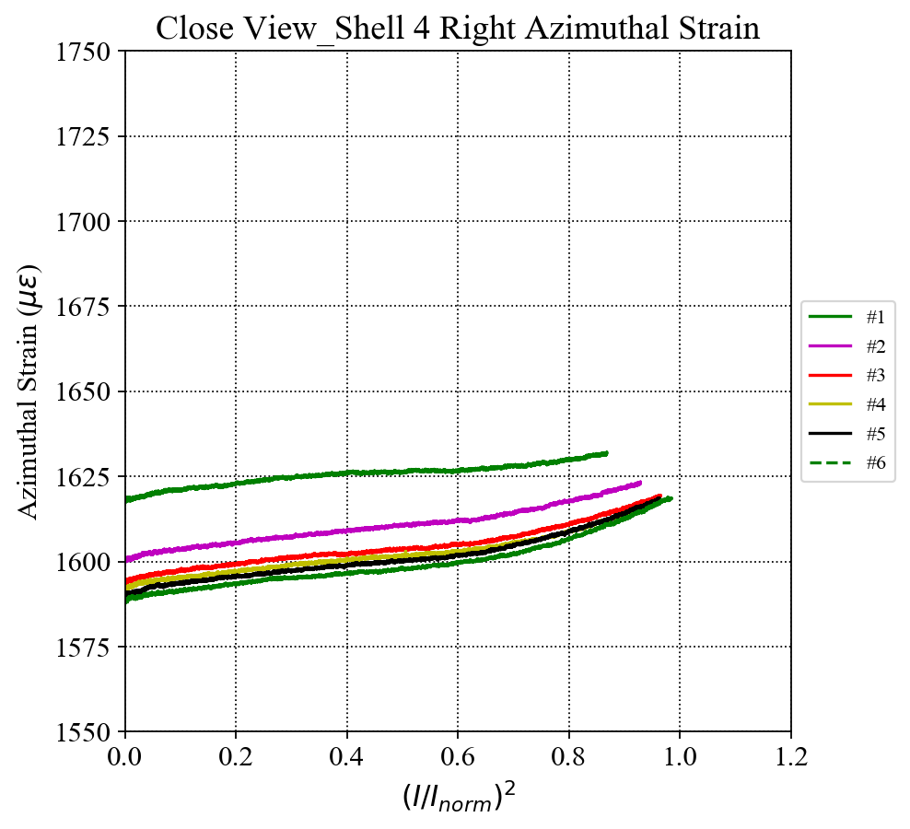
Shell 4 SG Readings (up to Q#6)
I_{norm} = 16.47 kA
Azimuthal
Close View

Slide 11
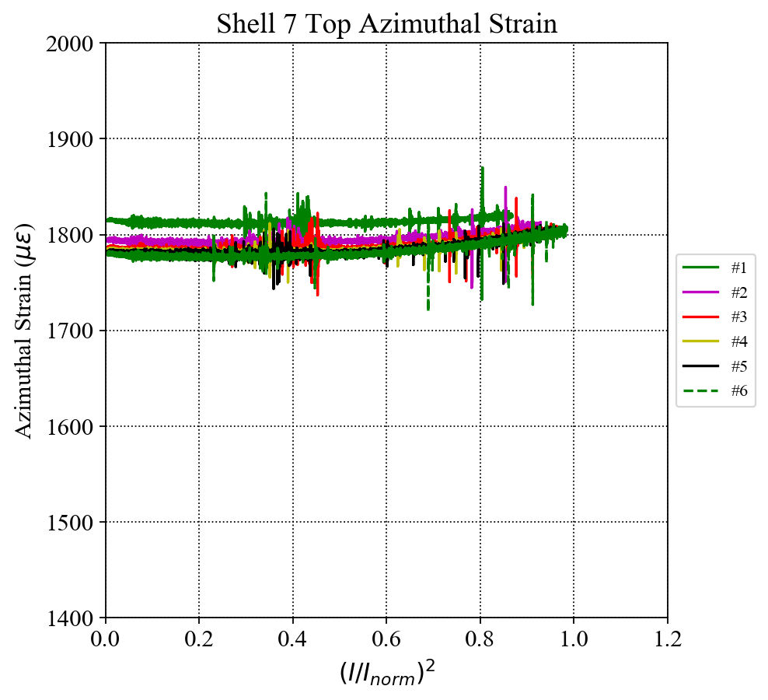
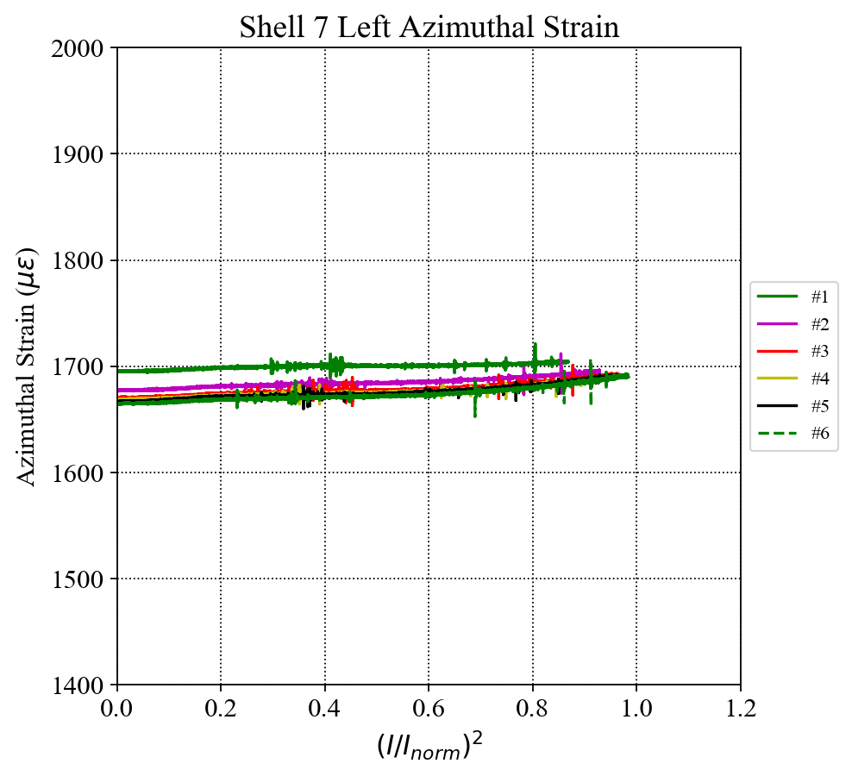
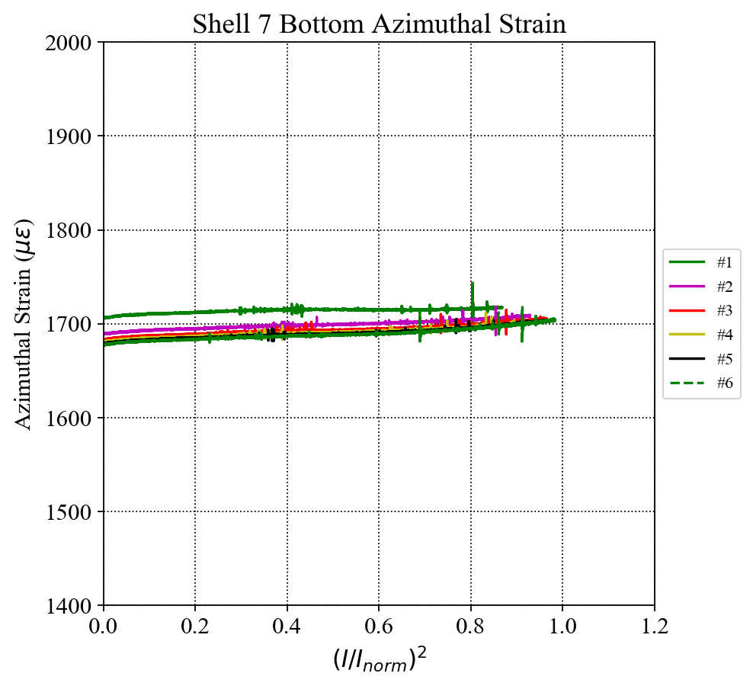
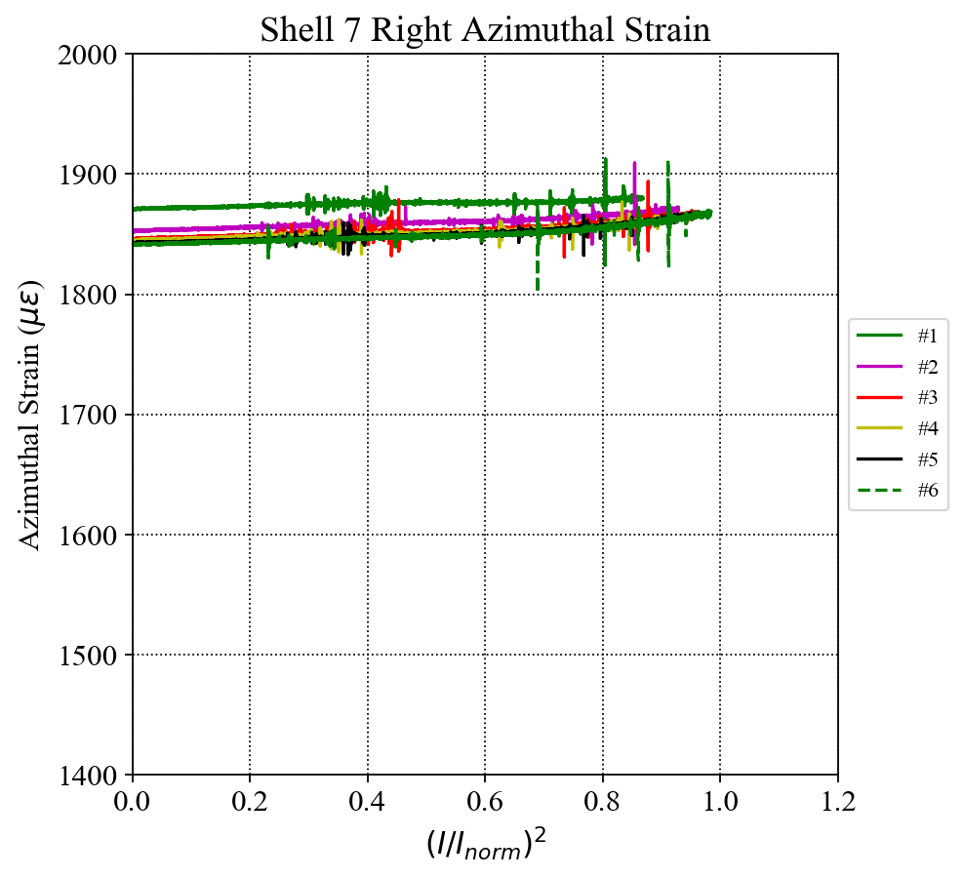
Shell 7 SG Readings (up to Q#6)
I_{norm} = 16.47 kA
Azimuthal
Close View

Slide 12
Delta Azimuthal Stress of Shells in Q#6
I_{norm} = 16.47 kA
Shell azimuthal stress with shell 7 corrected data

Slide 13
Rod Gauge Readings (up to Q#6)
Rod 2
Rod 1
Rod 3
Rod 4
I_{norm} = 16.47 kA
LE view
Full bridge configuration of each Rod’ SG station
LOST
Notes:
Show the HBM gauge plot for comparison in this slide (for convenience)

Slide 14
SG Readings in Current Holding at 16.67 kA
Coil 113
Coil 203
Q2
Q1
Q3
Q4
Coil 206
Coil 112

Slide 15
MQXFA04 Coil Strain at 16.67 kA
Coil Azimuthal strain over time
Coil Azimuthal strain over I²
Inductive distortion on strain signals due to changings of dI/dt.
The “loops” on the right plot are formed by the ramp up and ramp down cycle due to magnetic field coupling.

Slide 16
MQXFA04 Corrected Coil Strain at 16.67 kA
By averaging the ramp-up and ramp-down data, the inductive components are eliminated.
The corrected data shows above indicates that the coils behave similarly in the quenches, and there are no anomalies observed.
According to the corrected data, the preload stresses in coils can be determined from the right plot:
Coils | Preload stress (MPa)
Coil Q1 | -118
Coil Q2 | -120
Coil Q3 | -98
Coil Q4 | --107

Slide 17
Corrected Coil Stress at 16.67 kA (MQXFA Magnets)
MQXFA03
(Q3 coil gauge lost)
MQXFA04

