Slide 1
Elegant- and ACL- based trajectory tuning for FAST facility (ElegantACL)
PI Jinhao Ruan
co-PI Chip Edstrom

Slide 2
Outline
Background
Purpose of this proposal
Method
Progress so far
Proposed study

Slide 3
Background
FAST LINAC performance is critical for the stable injection of IOTA. So far with the help of 6DSIM program LINAC performance has been improved quite bit.
Two modes of operation right now
Operator mode
Mainly rely on sequencer
Routine turn on-off, very efficient, pretty reliable
Expert mode
Mainly rely on 6DSIM
Trajectory tune, beam matching, IOTA research etc…

Slide 4
Purpose of this proposal
The ultimate goal is to move the trajectory tuning from 6DSIM to sequencer-based operation.
We all know how efficient 6DSIM is doing the trajectory tuning.
However it will be difficult to integrate 6DSIM into sequencer-based application because of the interface.
Also the learning curve is steeper for operators with most day-to-day beamline tuning activities
A new, integrated approach with ElegantACL would:
Allow for ACL/Python/C++/Java wrappers to interface with elegant in different ways according to the tuning activity.
These could each be launched via sequencer or synoptic in keeping with other FAST controls applications and could be made available anywhere on the controls network.
Allow for seamless upgrades to the process based on the developing needs of the facility or hooks for studies to make use of the online model.
Allow outside collaborators develop own application because of the popularity of elegant in accelerator community

Slide 5
Initial Method
ACL language
Currently our sequencer application is developed with ACL by Chip
Very well supported by Control group
Elegant
Very popular accelerator simulation toolkit
Already installed on the CLX cluster
Currently CLX33 only, but extendable to all CLX nodes if use justifies it
Lattice file has been established by Dan
Uses similar algorithms for trajectory tuning as 6DSIM
Some work initiated by Summer student Lea C. Richtmann (2019)

Slide 6
Method-simplified flow chart
ACNET
Read
Set
Sequencer Application
(ACL based)
Operator control
Real time reading
Simulation results
FAST Lattice simulation
(Elegant based)
Fast Lattice

Slide 7
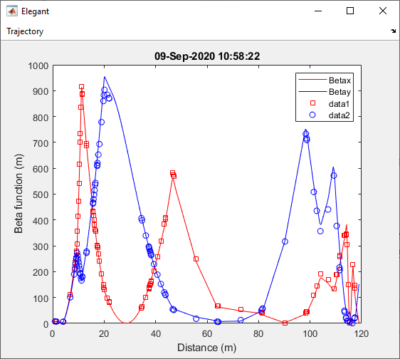
Some progress
Since 6DSIM has been proved in our real application we start with matching the result from 6DSIM with elegant.
In the plot line is elegant based result and data points is from 6DSIM.

Slide 8
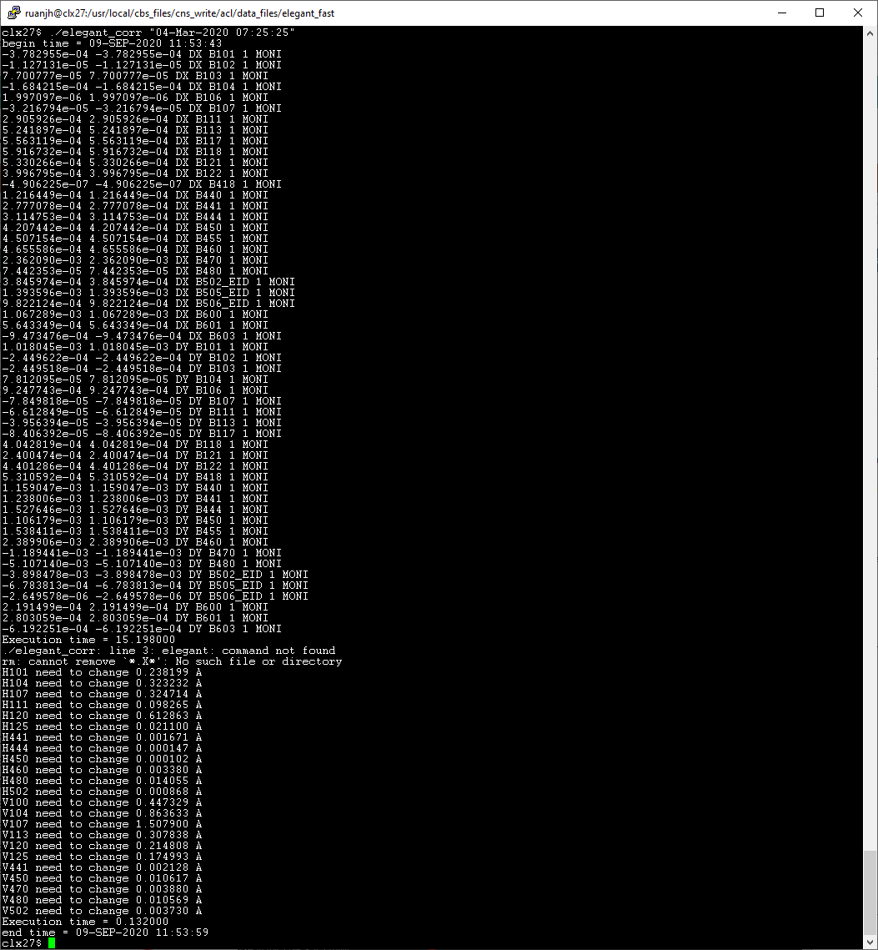
Some progress
cLx27$ ./elegant_corr "04-Mar-2020 07:25:25"
begin time = 09-SEP-2020 11:53:43
Elegant lattice file established
ACL based elegant input file written
ACL based elegant output analysis file written, i.e., once elegant simulation is done, we can use ACL to analyze the file and get the actual setting need to be sent to device
Elegant can be run on CLX33 from any node via DO_n command
Execution time = 15.462000
Execution time = 0.132000
end time = 09-SEP-2020 11:53:59

Slide 9
Proposed study-Beam condition
Beam species: electrons
Intensity: < 250 pC (minimum depends on BPM sensitivity).
Energy: 41 MeV at entrance to CM2 and ~100 MeV initially at exit of CM2
Number of bunches: 10 bunches at most
Micropulse repetition Freq. 3 MHz
Trajectory requirement: Try to use the golden trajectory establish during run 2 as our reference
BPM: Need to be functional along the line. We are hoping to use all of them but can live with if just 1 or 2 is malfunctioning

Slide 10
Proposed study-rough shift plan
Three shifts in Run 3 with at least 2 days between each shift for data analysis and code changes.
Shift 1 (2 study periods, 8 hours total) Establish the reference trajectory. Establish the real time simulation with live parameter. Calibrate BPM response vs magnet strength.
Shift 2 (1 study period, 4 hours total) Finish the final setup of the program. Preliminary study of trajectory tuning with our ACL.
Shift 3 (2 study periods, 8 hours total) integration of our ACL to sequence and real beam test. The final 4 hours of this shift will be used as backup just in case any of the planned study take longer than expected.

Slide 11
Expected results
We expect to develop a sequencer-based trajectory tuning package that will allow operators to rapidly and easily tune the beam back to a golden trajectory within reason.
The proposed trajectory tuning are designed to compensate for the magnetic errors. But there’s other operation conditions that will effect the trajectory as well, such as energy drift, thermal effects etc.
We hope that this effort will lay a good foundation for further exploration, allowing for development of tools that make use of more sophisticated codes (e.g. neural networks) to perform more rigorous error compensation and offer greater operational flexibility.
With elegant-acl being one of our available tools we are expecting to be able to help more LINAC study proposals in later runs.

