Slide 1
LBNE Water Cherenkov Detector
Jim Stewart June 2011
CF kickoff meeting

Slide 2
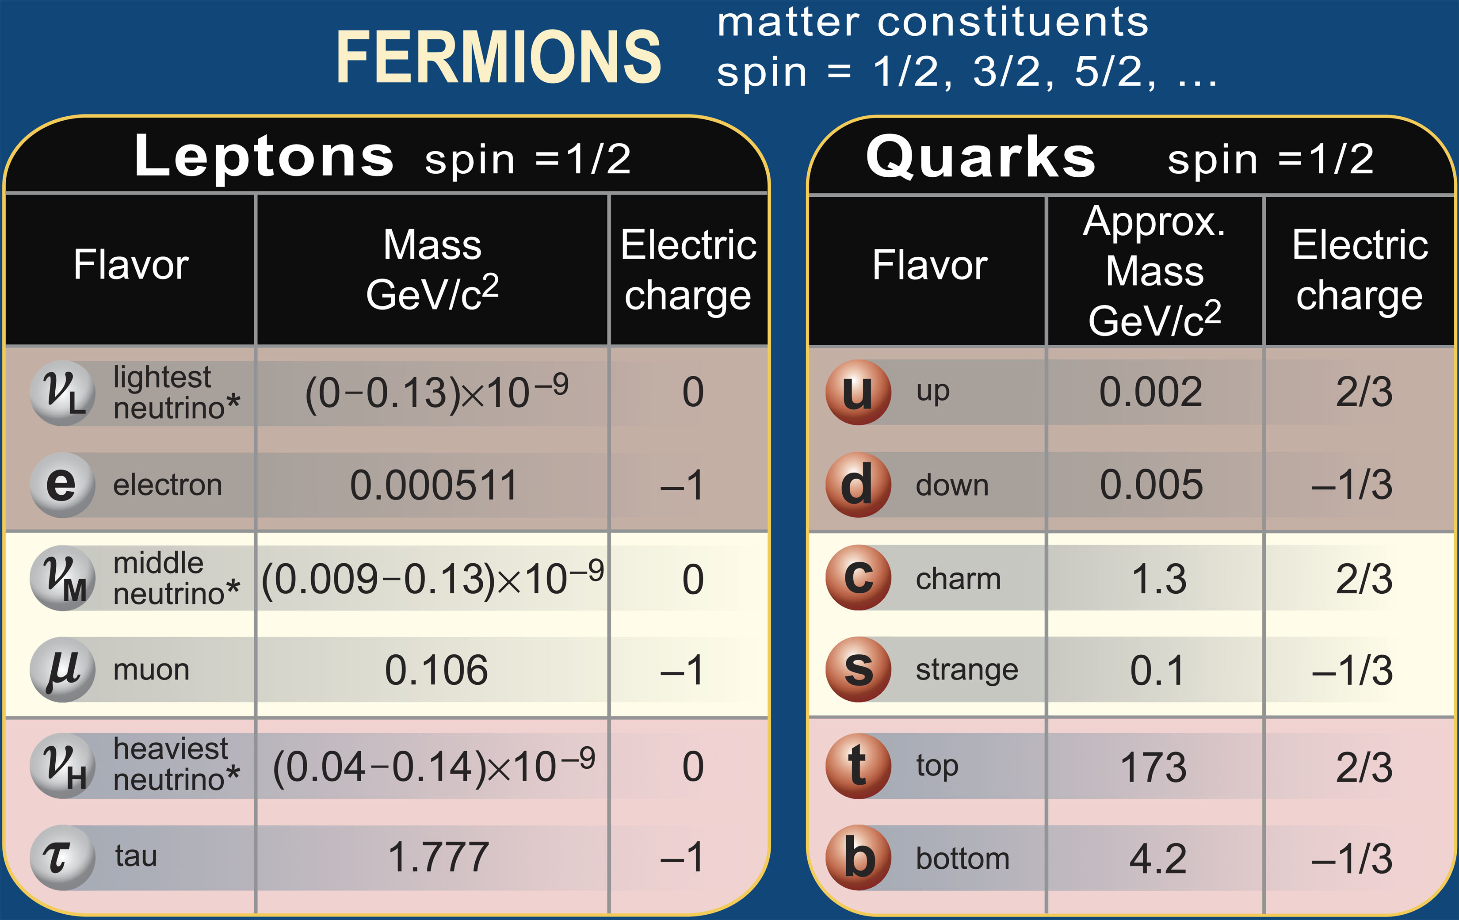
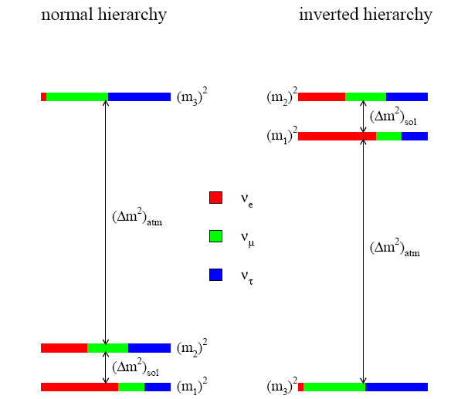
Neutrino Physics
Neutrino Basics
Three types of neutrinos.
Neutrinos interact weakly.
  Can pass through the earth easily
    Need a lot of neutrinos
    Need a big detector
Neutrinos mix
  If you make one type and it interact as another type
We now know that neutrinos have mass and that there is one small mass difference (solar) and one large mass difference (atmospheric)
We do not yet know how much ν_{e} mixes with ν_{τ}
From: hep-ph/0411274

Slide 3
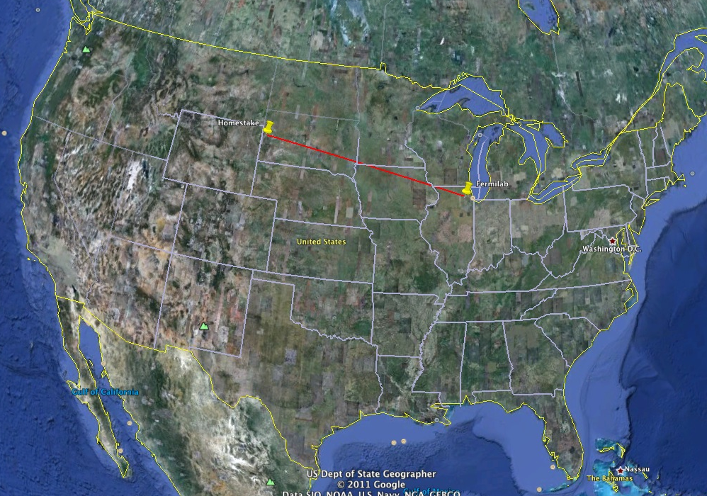
Top Level Considerations
Location
Homestake
1,300 km
FNAL
Observing neutrinos after passing through matter will resolve the Mass Hierarchy

Slide 4
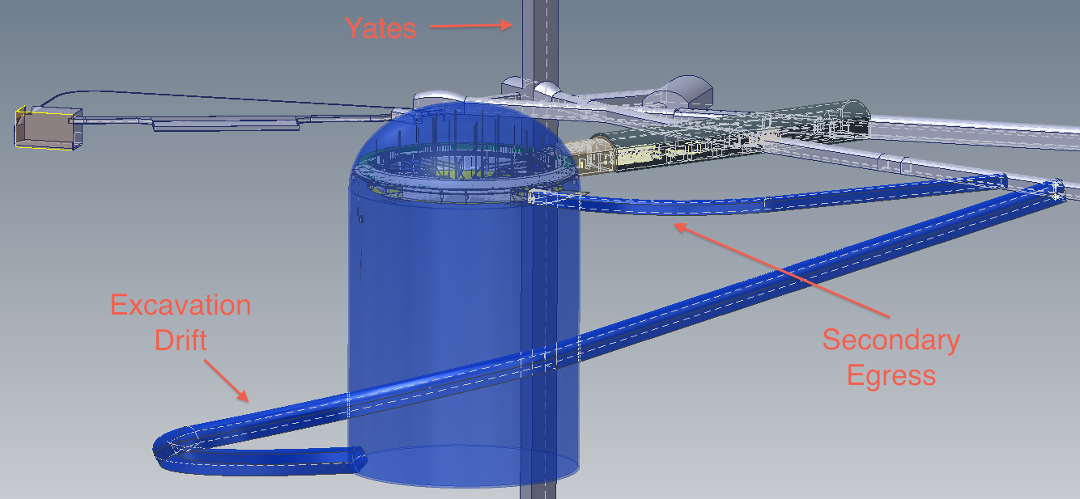
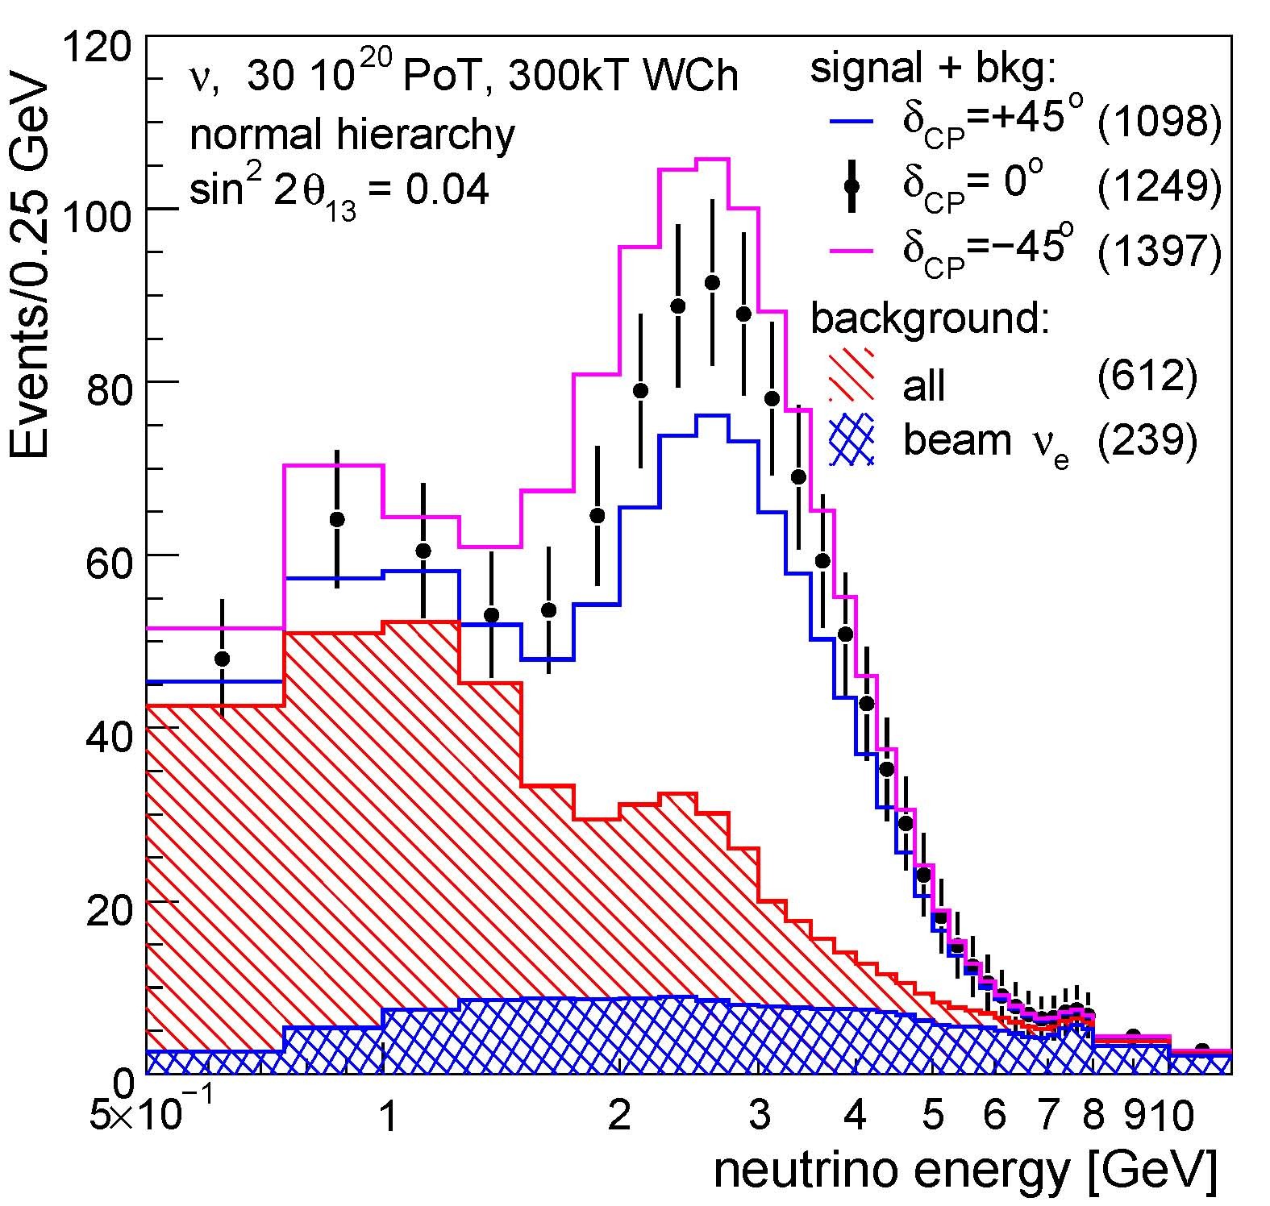
Need a big detector
Neutrinos interact weakly
A Megawatt beam at Fermilab
A 200kt water detector
Ten years of data taking
Few thousand events total
Need the biggest detector possible
Running time is proportional to detector size

Slide 5
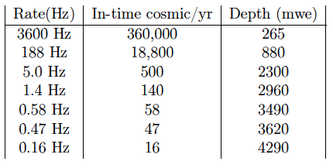
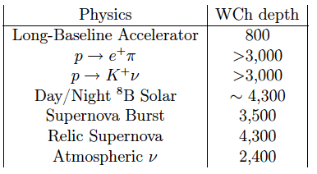
Want a Deep Detector
Expect few hundred events/year
4850
6800
7400
Rock Shields against cosmic rays
Low Background
At 4850L all physics topics are accessible

Slide 6
Fundamental Requirements
Long baseline (>1000 km to Fermilab)
High power beam (Megawatt scale)
Huge detector (>200kt Fiducial Volume)
Really Deep
Must be as cheap as possible to get the largest volume possible (Frugal construction means more physics)
Must be SAFE!!!
A large detector at the 4850L of Homestake fulfills all the fundamental requirements!

Slide 7
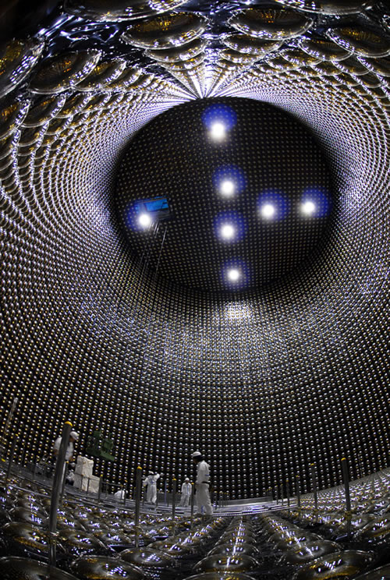
The Water Cherenkov Detector
Image of Super-Kamiokande
Large cylindrical volume
Walls floor and top lined with light sensors (PMTs)
  29,000 12” vacuum tubes
Top covered with a deck which keeps light and contaminants out
Detector is filled with ultra-pure water
  Water is the cheapest detector material known

Slide 8
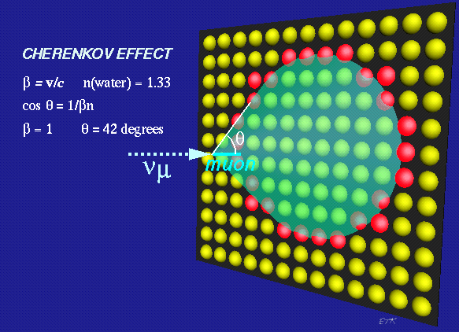
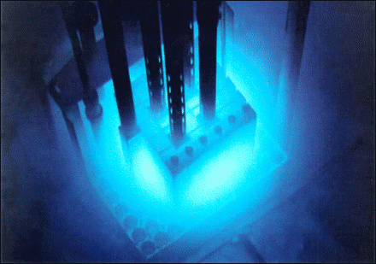
Cherenkov Light
Charged particles make rings
If a charged particle moves faster than the local speed of light in a medium it emits light
Blue Glow from pictures of nuclear reactors.
(Water transparency - BLUE)

Slide 10
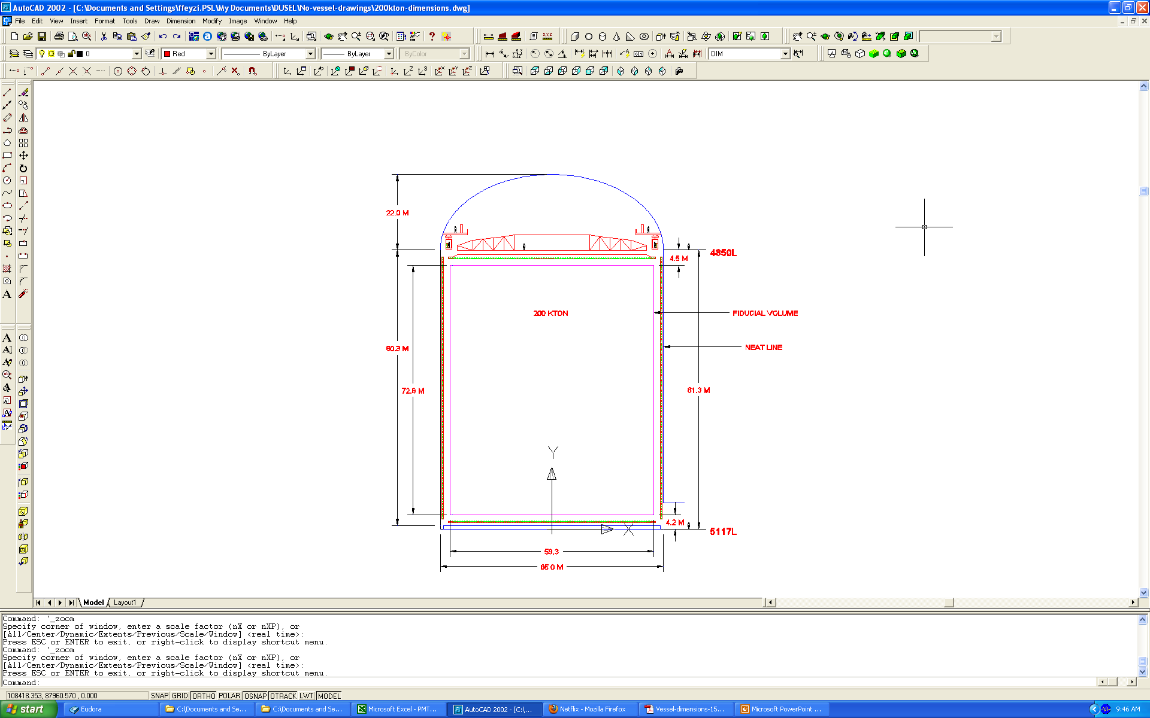
200 kton
No vessel, liner on shotcrete
12” HQE PMTs
Cavern Dimensions
  65mØ to neat line
  81.3m high
Water Volume
  65mØ and 80.1m high
  266k m³ volume
85cm from wall to PMT equator
2m from PMT equator to fiducial volume cut
Fiducial Volume
  59.3mØ 72.6m high
  200k m³ volume
Fiducial volume: Imaginary volume outside of which data is deleted in the analysis

Slide 11
200kt WCD parameters
29,000 12” PMTs line the inside of the detector
The top of the detector (called the deck) must be light and air tight
  PMTs are very sensitive to light
  Dirt contains U/Th which would be a background
The detector is filled with ultra-pure water
  Water transparency especially in the blue is critical
  Requires a large scale industrial water plant
  All wetted materials must be tested for impact on water purity
    UV stabilizer in most plastic must be avoided

Slide 12
Vessel/Liner
Several Vessel/Liner constructions have been considered
Presently costing “membrane on shotcrete” option
  Membrane on shotcrete did not get approved at last techboard presentation. The board requested the sub-group solicit information from different vendors as to cost and probable water leak rate. Requirement << 250 gal/min.
  LCAB discussed the liner in the April meeting and saw no difficulties with the membrane on shotcrete option.
  Will go back to the Tech Board before CD-1when more information on expected leak rates are available.
Fallback option is the concrete vessel option. Cost numbers for this option are scaled from the CNA cost estimate.
Liner materials must not contaminate the ultra-pure water.
  Several plastics have been tested and look good.

Slide 13
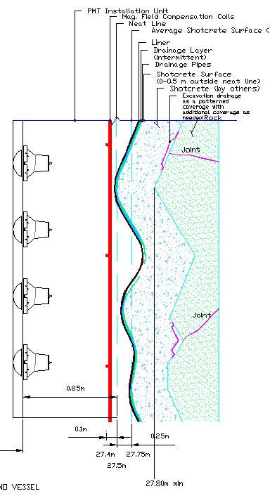
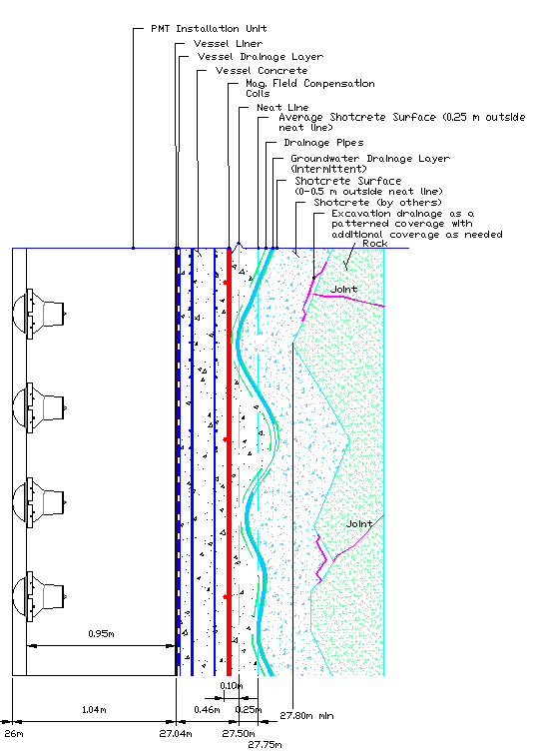

Slide 14
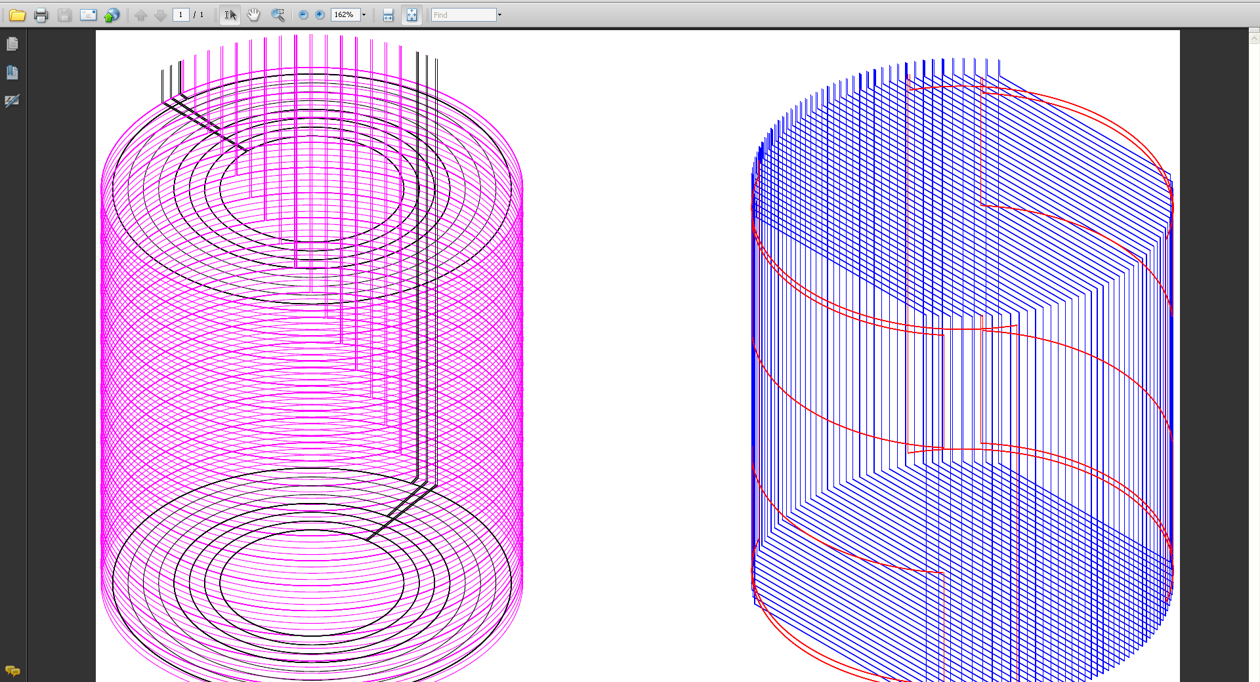
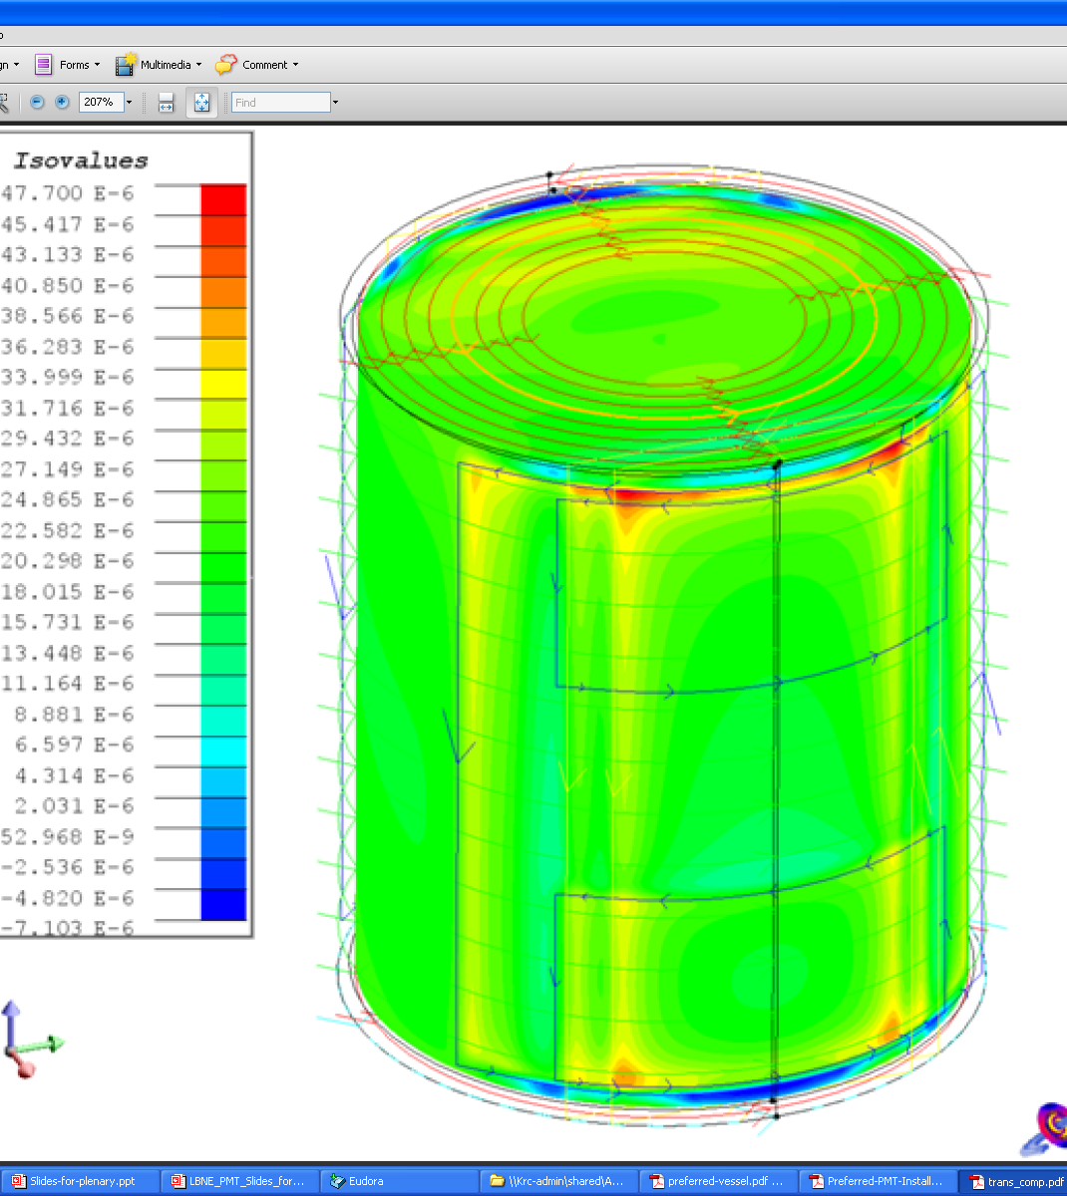
Magnetic Compensation
PMTs are affected by the earths magnetic field.
Horizontal, vertical and saddle coils simulated to cancel the earths field
Interface with cavern construction and liner installation needs understood
Shielding placed on each PMT could eliminate need for coils
  Being investigated

Slide 15
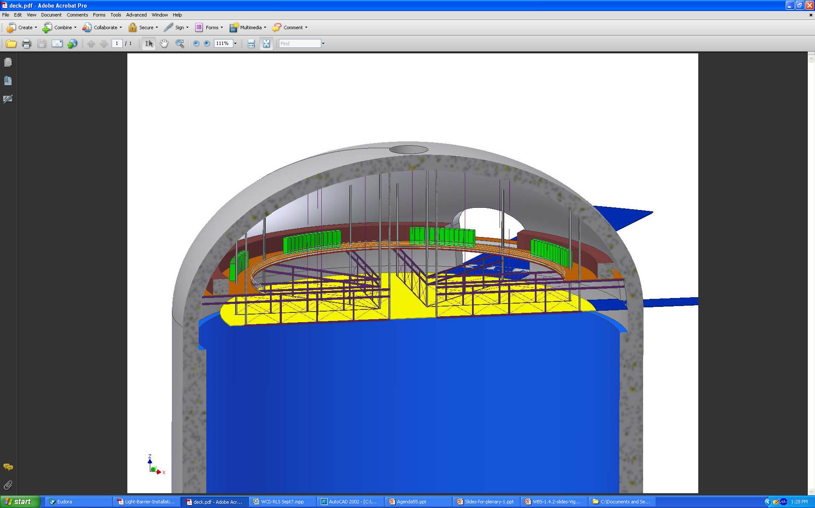
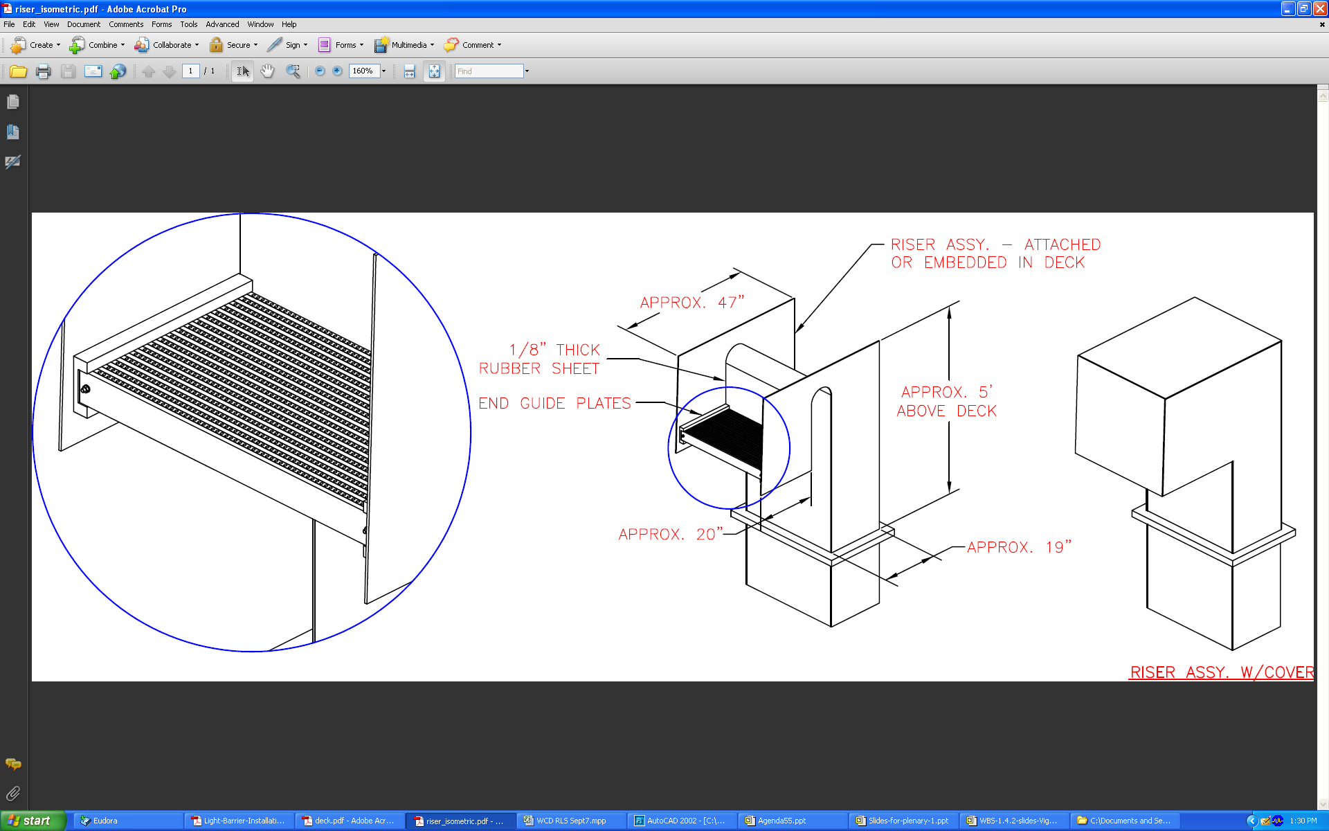
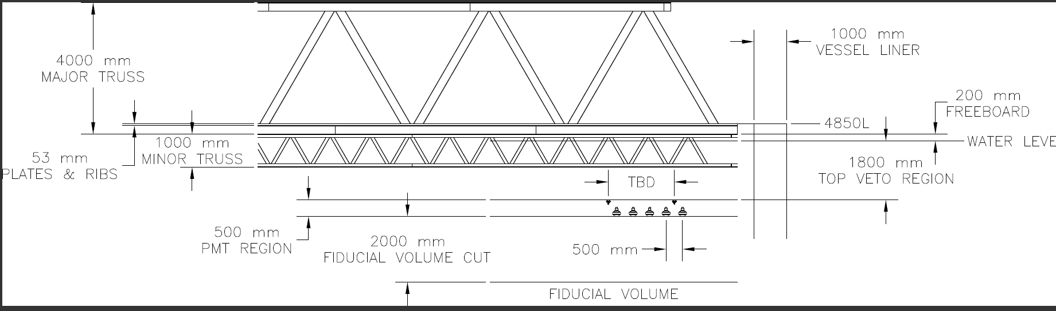
WCD Deck
A balcony runs around the perimeter of the top of the detector.
  Electronics are place on the balcony
  Electronics huts will be needed since the AC is de-scoped
Cable feedthrus (risers) conceptual design done
Top veto region defined
Interface and loads to cavern dome
Alternates being investigated

Slide 16
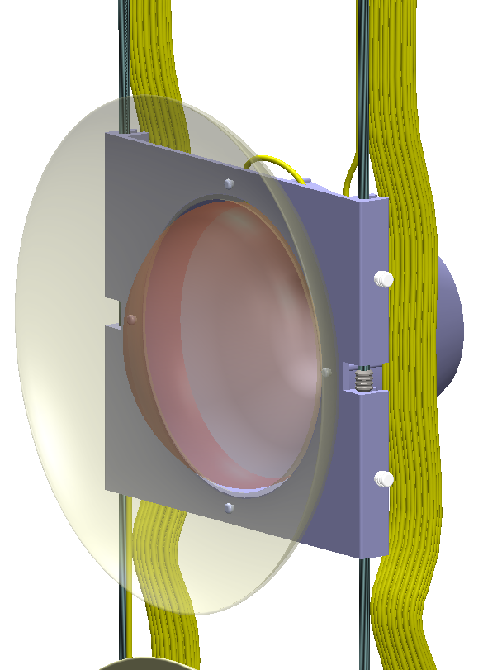
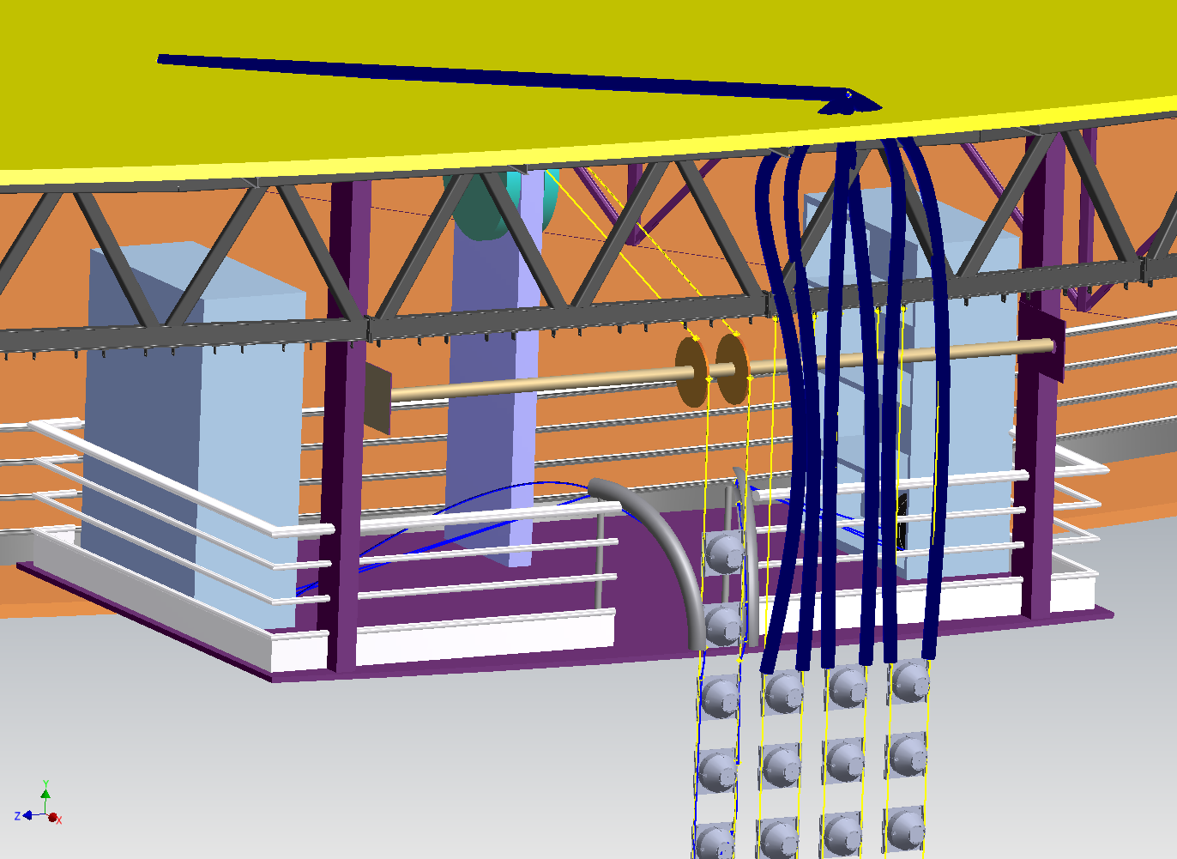
Wall PMTs suspended on stainless steel cable strings
No/few Vessel wall penetrations needed for PMT mounting
Investigating steel cables for material compatability

Slide 17
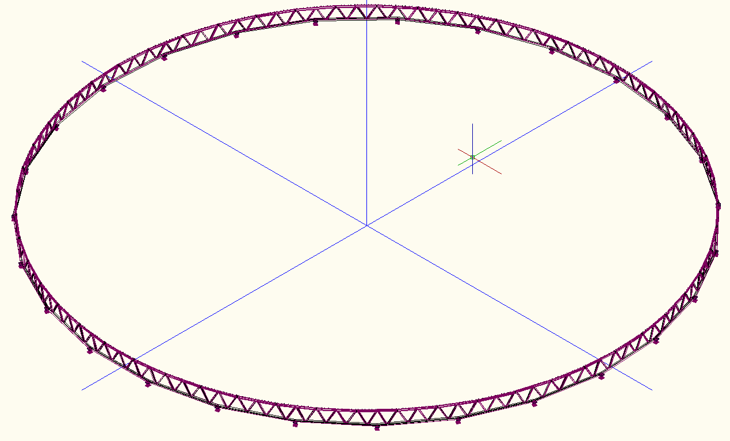
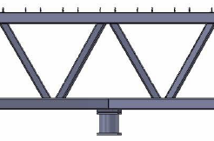
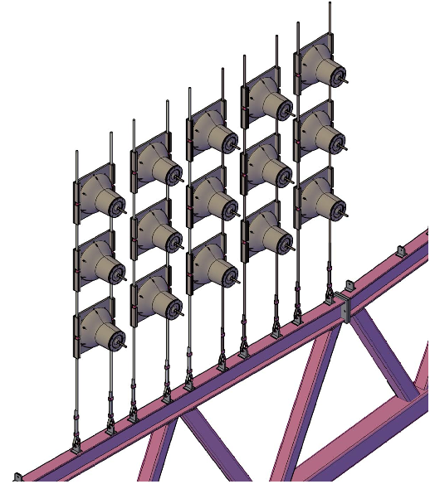
Bottom Truss Anchor
Wall PMTs anchored to floor using truss structure
Few floor liner penetrations
Deep truss to control deflections

Slide 18
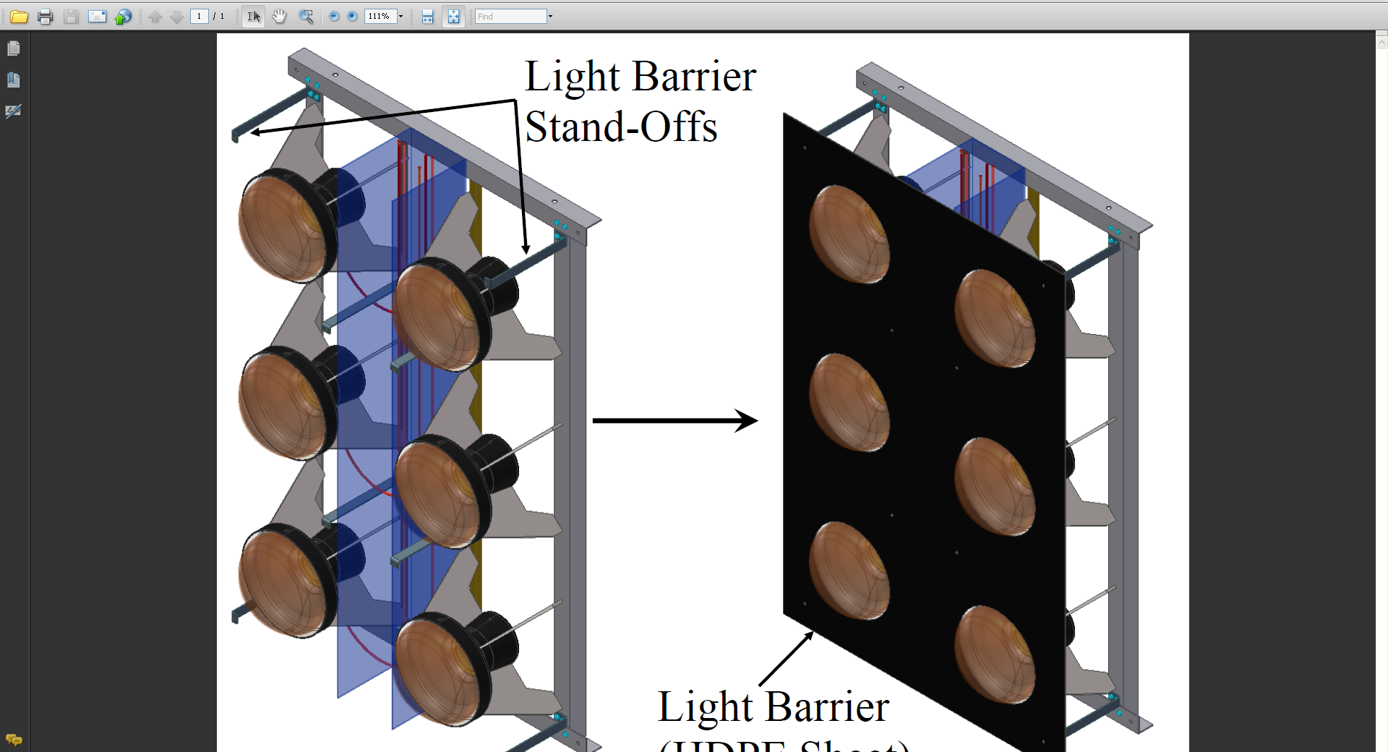
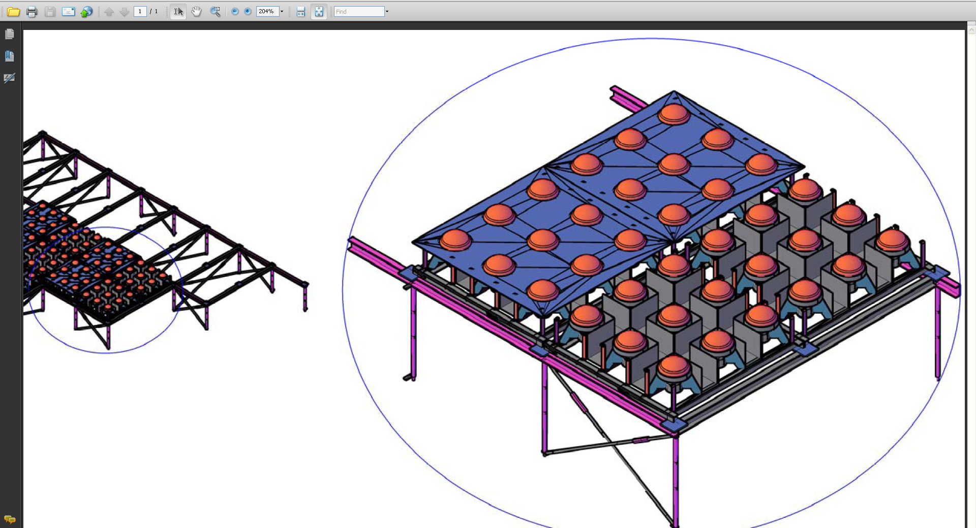
Floor and Roof PMTs
Floor and roof PMTs mounted using frames
  Design is evolving quickly

Slide 19
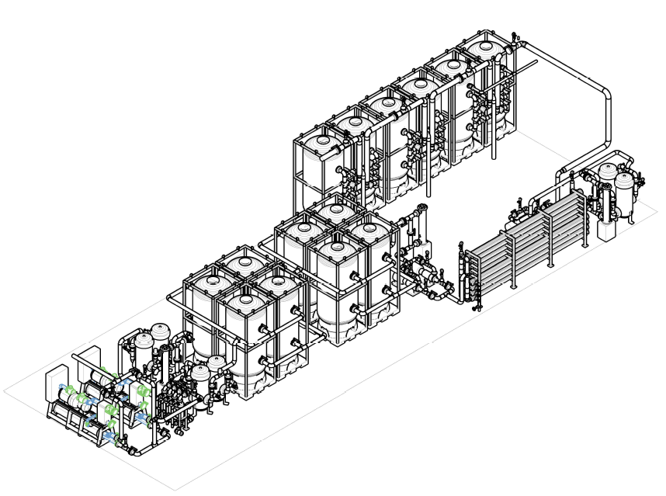
250 gal/min water fill system (water treatment plant) placed on the surface
Placed on surface as large amount of consumables are needed to fill
Will fit in motor generator room if available.
Need ~6 months to fill the detector

Slide 20
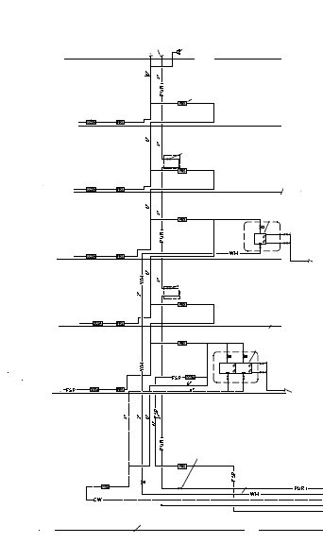
Integration of the fill pipe in CF needed
Yates Shaft
Surface
800
1700
2600
3500
4100
4850
Proposed WCD Fill Line with Pressure Reduction and optional pumping of Gd wastewater to surface
DUSEL Domestic / Fire Water Supply

Slide 21
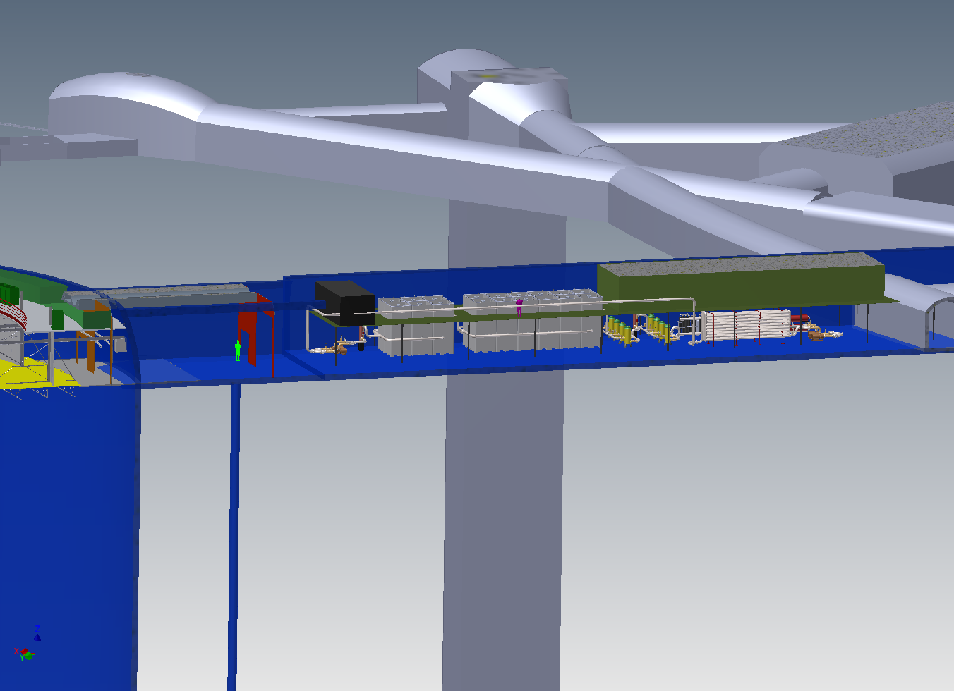
1200 gal/min water recirculation system placed near the detector

Slide 22
Key Detector Parameters for a 200kt WCD
One Detector Modules
Fiducial volumes 200kt (may scale costs to get 150kt)
The distance from the black sheet to the neat line is 85cm.
Cavern diameter design as in document 2602. The depth is determined from the PMT placement and the FV definition.
No- Vessel option (membrane on shotcrete)
Deck with tensile archetecture construction and separate balcony
A Top veto is present
Thin veto is not part of design but space is available (85cm)
PIU based on wire rope supports for the wall and frames for floor and deck
PA - A plastic shell exists but does not cover the face of the PMT
Super-K II equivalent light collection
  The Hamamatsu 12" HQE tube with potted base (QE 30% est.)
  Light collectors (either Winston cones or scintillators) increasing good light yield by 40%
A black sheet is placed in the plane of the PMTs to prevent reflections back into the detector
The electronics will be out of water with variable length cables
The water fill system is on the surface as in South Coast waters design
A 1200 gal/min recirculation system depending on detector volume
Calibration equipment such as diffuser balls/ DT generators/Sources will be used
Magnetic compensation based on coils on wall

Slide 23
Backup

Slide 24
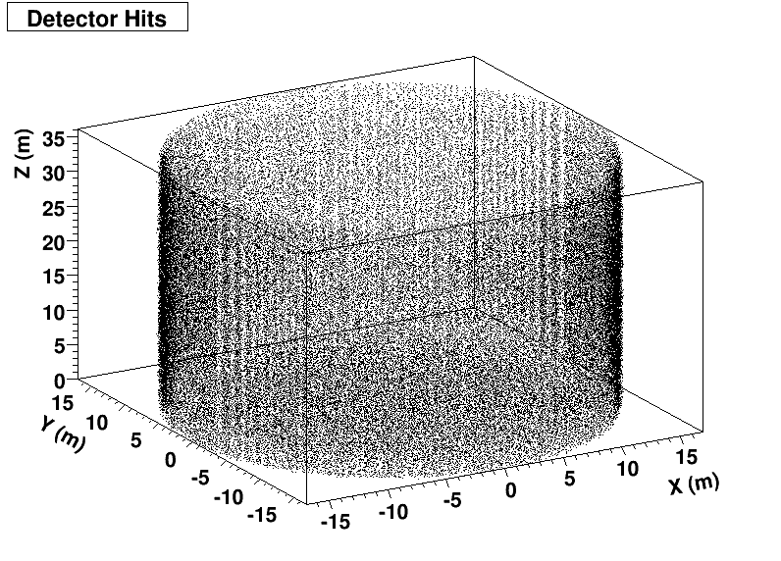
Tube Coverage
HQE tubes are blue enhanced!
Put the QE curve into the MC digitization and adjusted the coverage to match the light yield from a detector instrumented with the 20” tubes from super-K
Found needed 31k tubes for 100kt using 10” HQE tubes

Slide 25
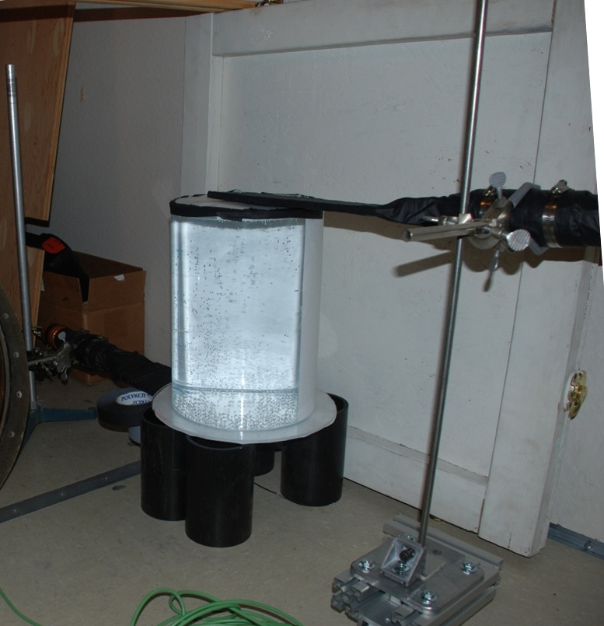
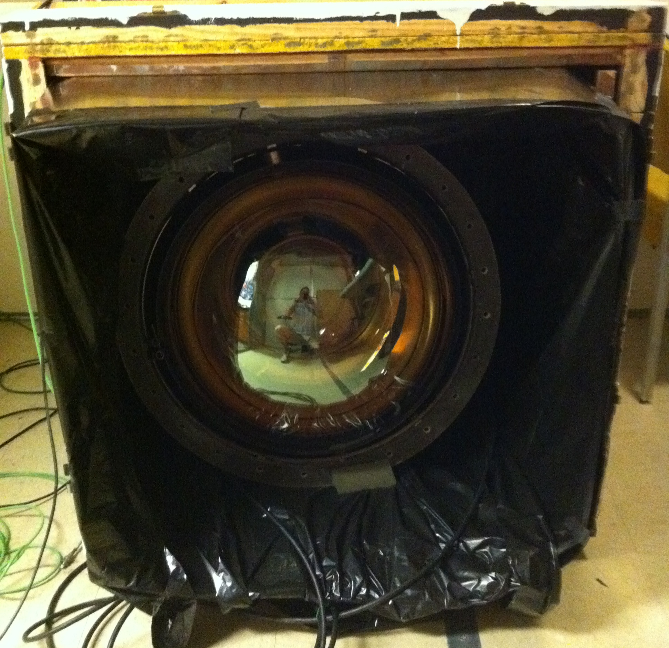
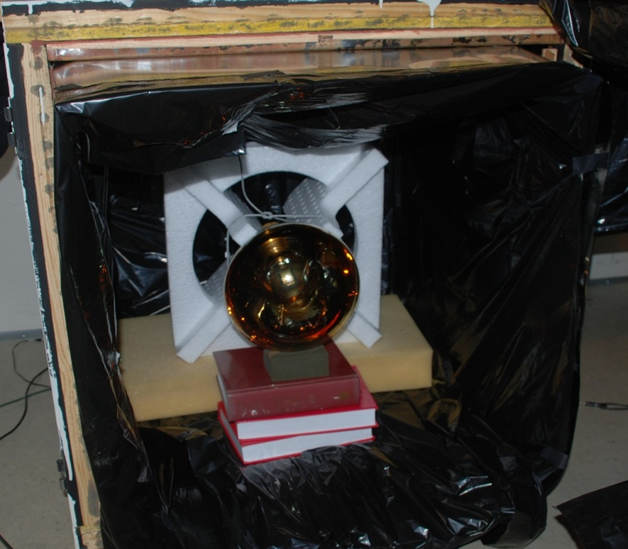
Cross checked tube equivalence in the lab
Placed a Cherenkov light source in the lab
Compared response of 10” tube to a 20”tube
Masked off a defined area on each tube and repeated.
HQE performance was as expected

Slide 26
WCD Summary Schedule
By Fiscal Year
 | FY10 | FY11 | FY12 | FY13 | FY14 | FY15 | FY16 | FY17 | FY18 | FY19 | FY20 | FY21 | FY22
Critical Decisions
Start Cavern Excavation Beneficial Occupancy
Commissioning
Design Phase Construction Phase
CD0: 1/10
CD1: 7/11
CD2: 6/13
CD3: 12/14
Large Cavern 1: 1/15
Detector 1: 12/18
Detector 2: 7/19
Detector 1: 11/21
Detector 2: 8/22
January 2010 - December 2014
December 2014 - August- 2022

Slide 27
Value Engineering cost exercises affect the Recirculation System, Sump, Waste Water, and interfaces with the Detector vessel and the DUSEL Facility
1.4.6.2 Fill System
District Water
1.4.6.4
Shaft Systems
1.4.6.3 Recirculation System
1.4.6.3 Recirculation System
Value Engineering cost exercises:
1. Reduce recirculation rate from 1200 gpm to 600 gpm
2. Relocate recirculation system to the surface and combine with the fill system
3. Use mine water to remove heat from chiller in recirculation system
1.4.6.5 Sump
1.4.6.5 Sump
4. Move all water system equipment off L5060
1.4.6.6 To Mine Waste Water Dump

Slide 28
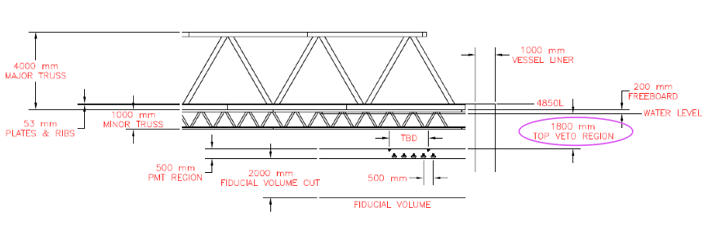
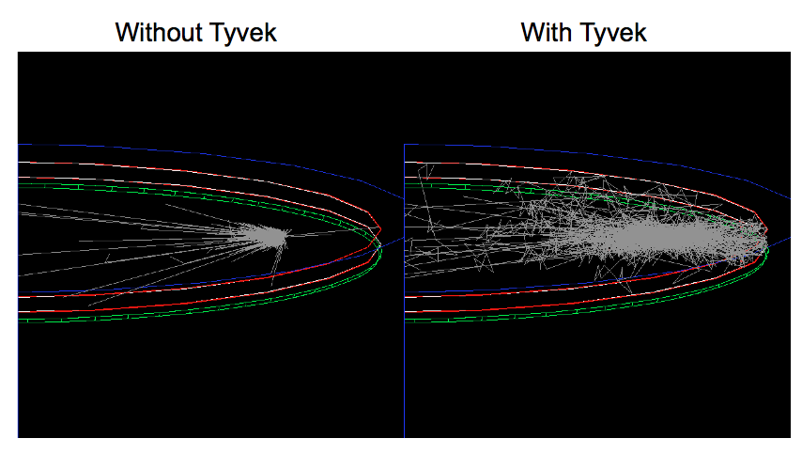
Veto design/simulation has begun
Jen Raaf
Top Veto Simulation

Slide 29
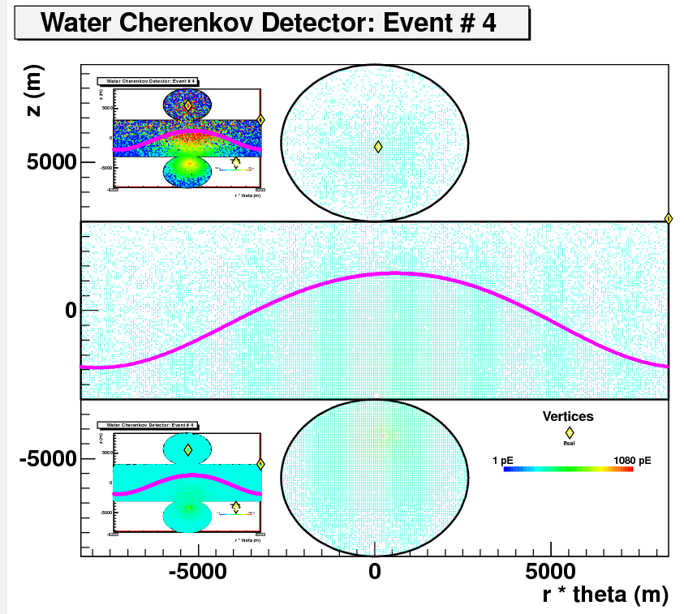
Using Cosmic-Ray Muons for Absolute Energy Calibration
Reconstruct path to predict total light
yield – use to calibrate measured light yield
J. De Jong

Slide 30
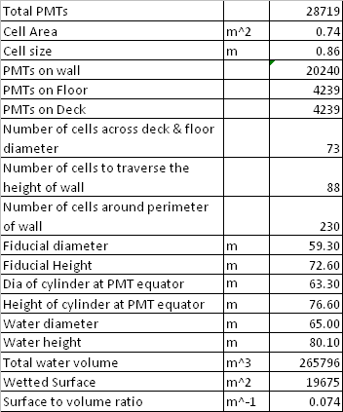
200 kton
No vessel, liner on shotcrete
12” HQE PMTs

