Slide 1
WCD Surface Scope Discussion
Review Work Scope
Utilization of Yates and Ross Shafts and Campus’
Primary Access – Yates
Main Utility Delivery Points – Yates
WRH & Secondary Access – Ross
Conflicts (Water System, Assembly/Staging, Shaft Heating)
Parts Storage – ?
Surface Control Room – Facilities ONLY
Sanford Center for Science Education
Utilities
Cyber & Security
SDSTA Operations Requirements

Slide 2
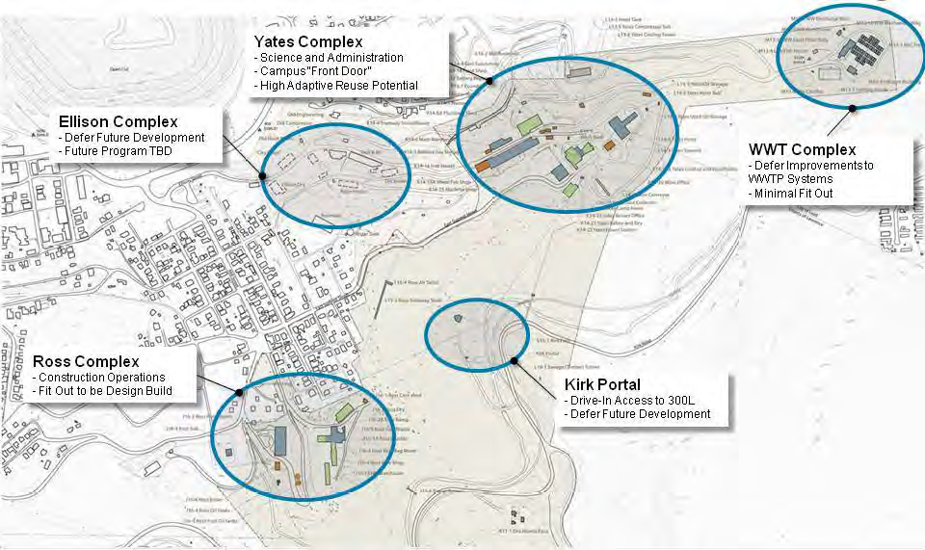
Homestake/Sanford Lab Site

Slide 3
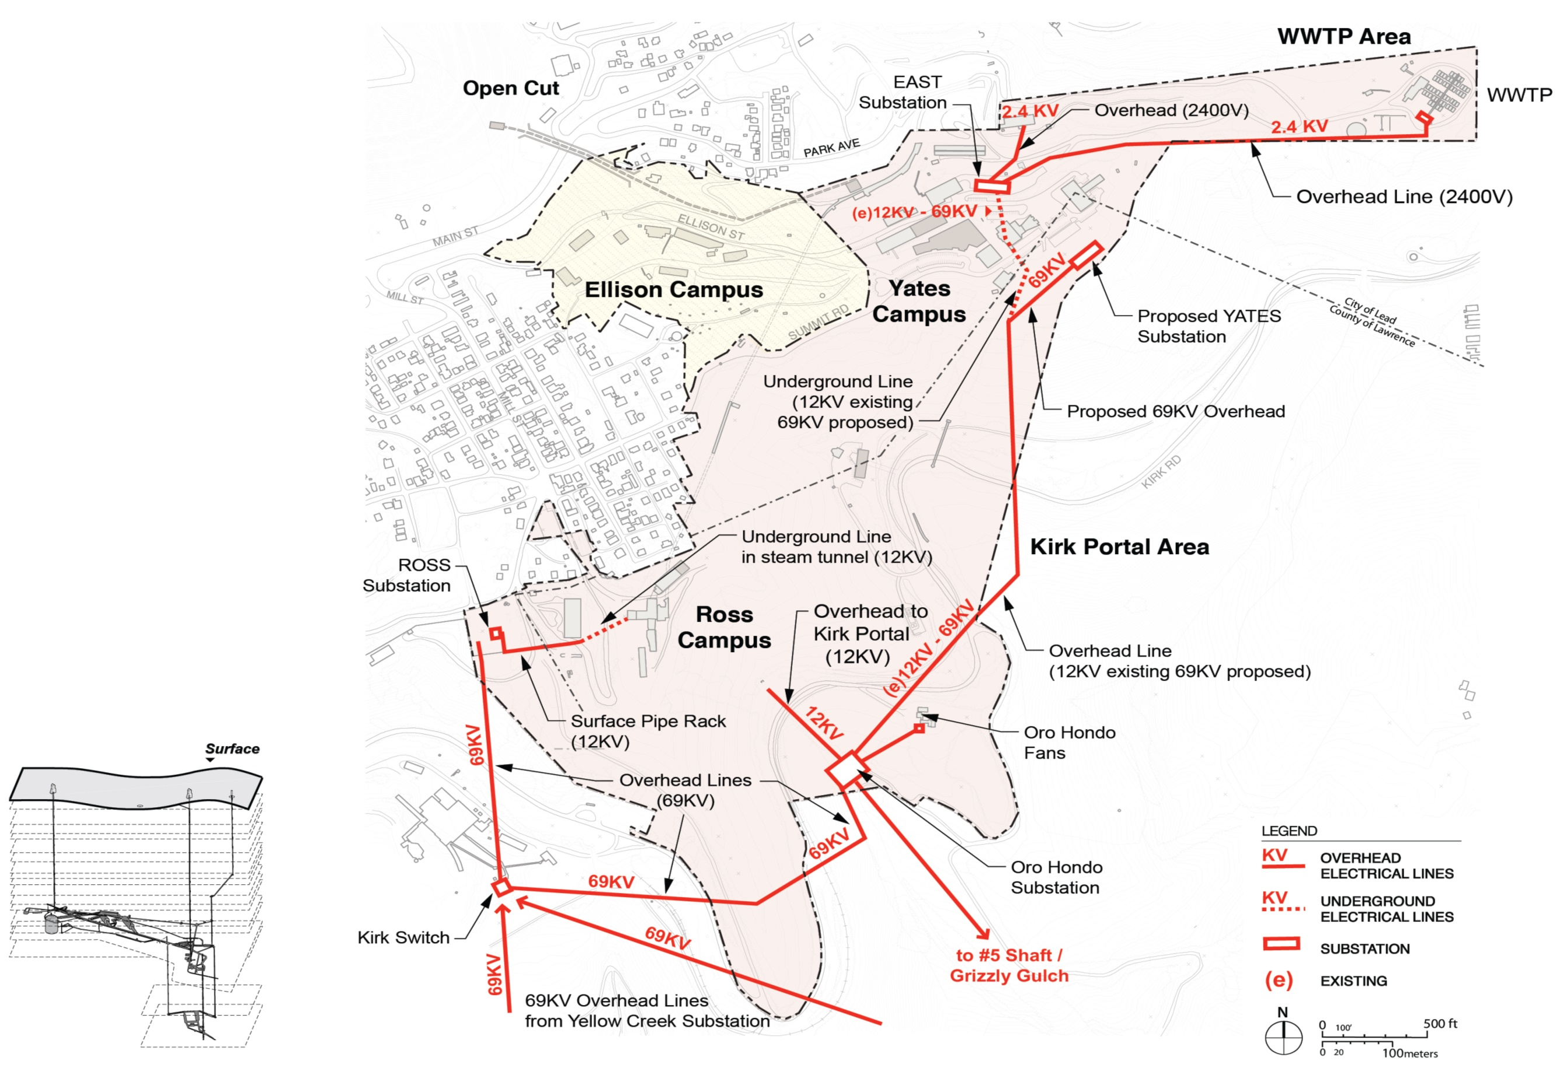
69kV Distribution

Slide 4
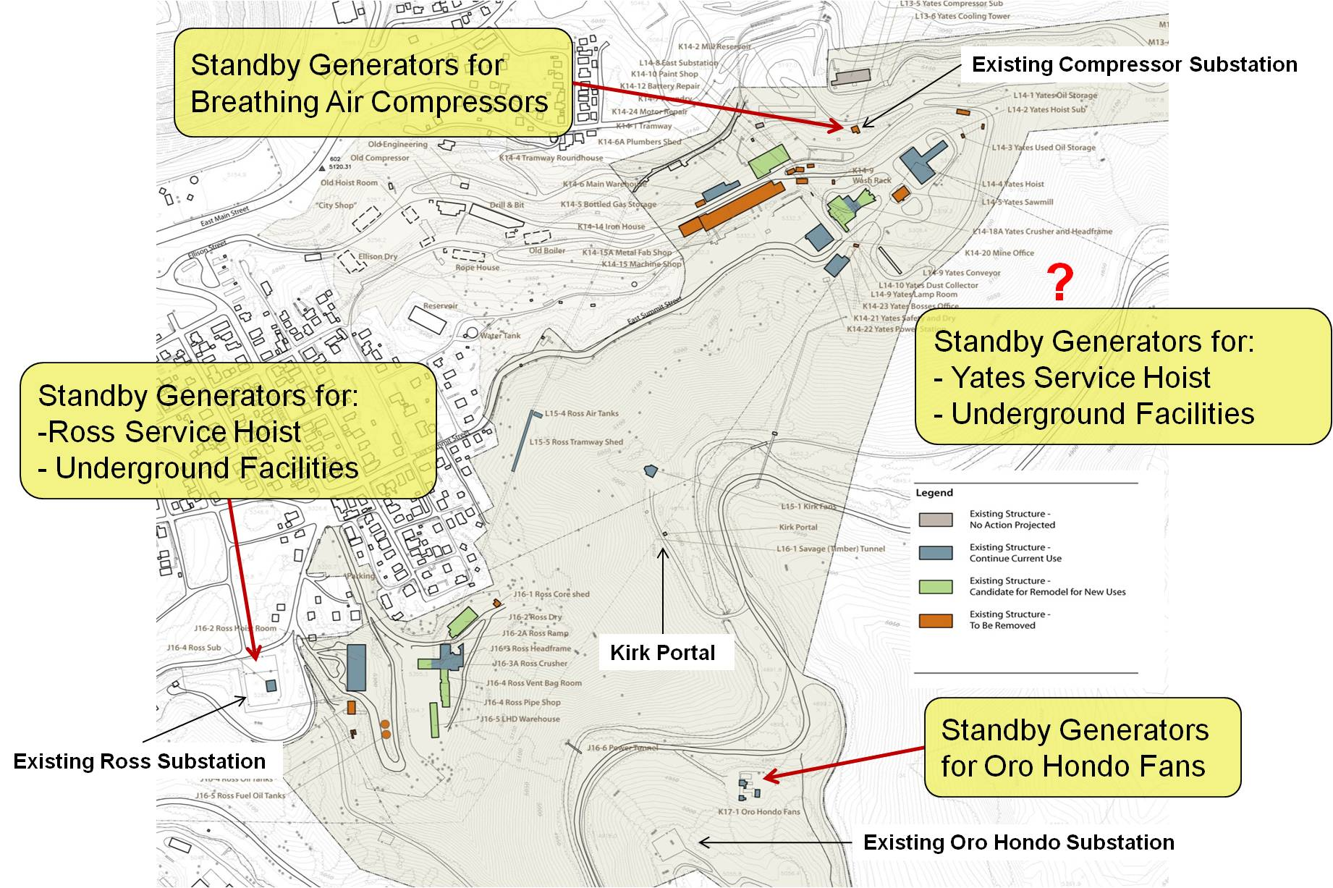
Standby Generators

Slide 5
Surface Cyberinfrastructure

Slide 6
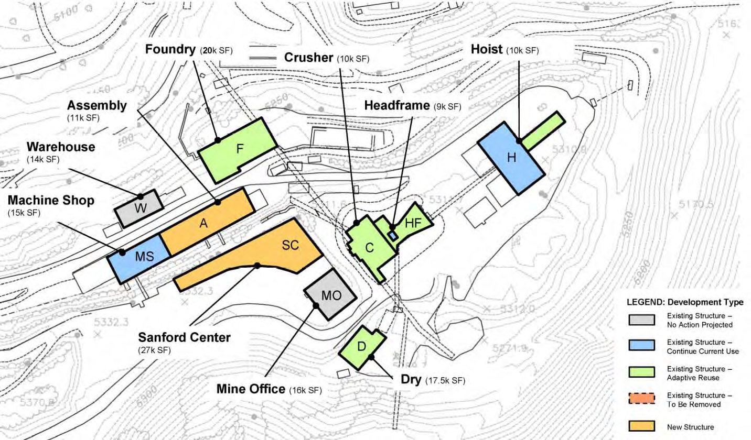
Yates Campus

Slide 7
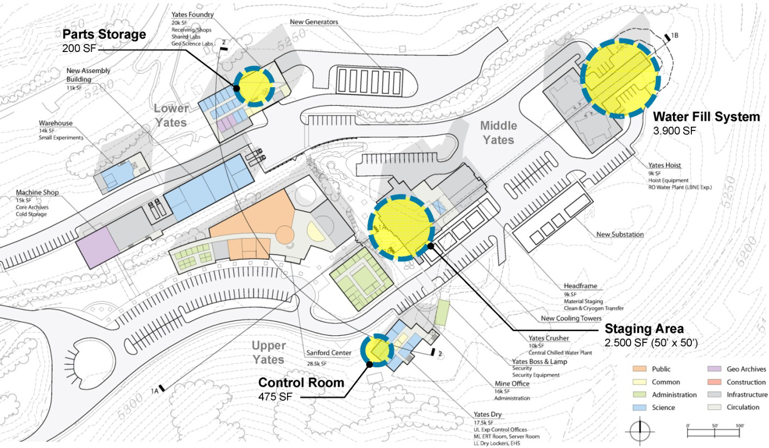
Yates Campus (LBNE CDR)

Slide 8
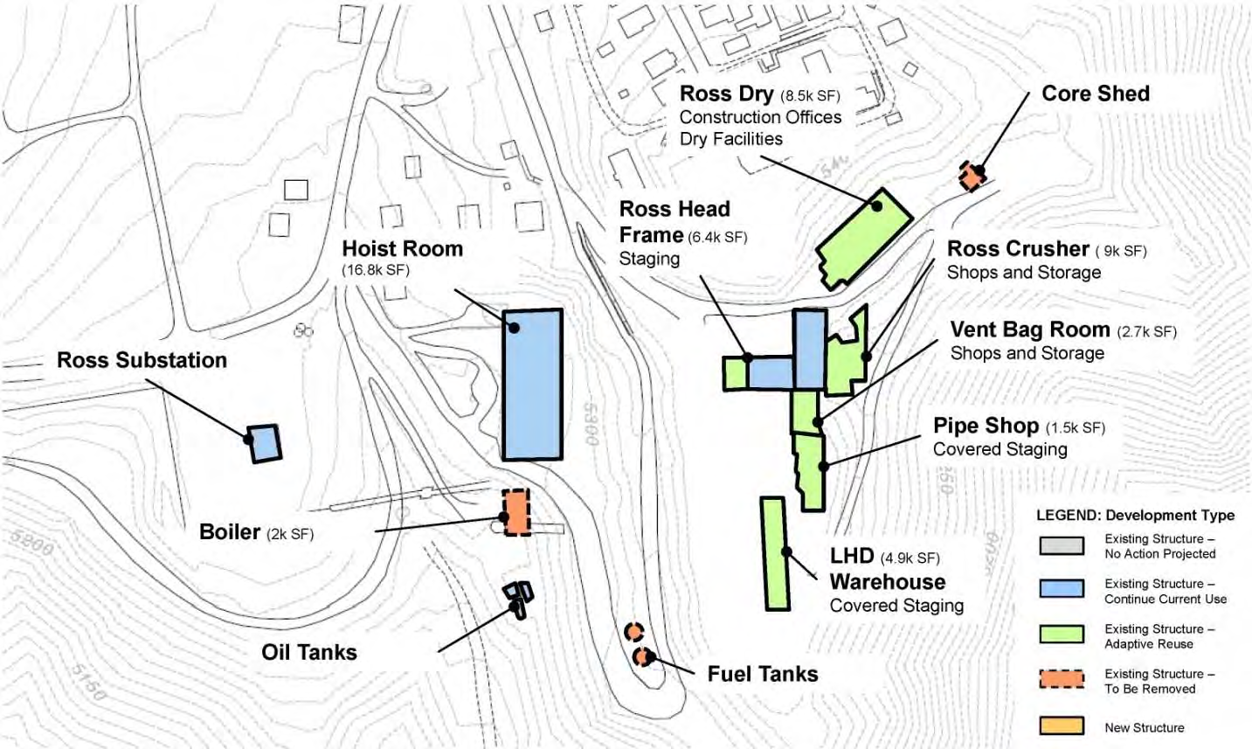
Ross Campus

Slide 9
Backups

Slide 10
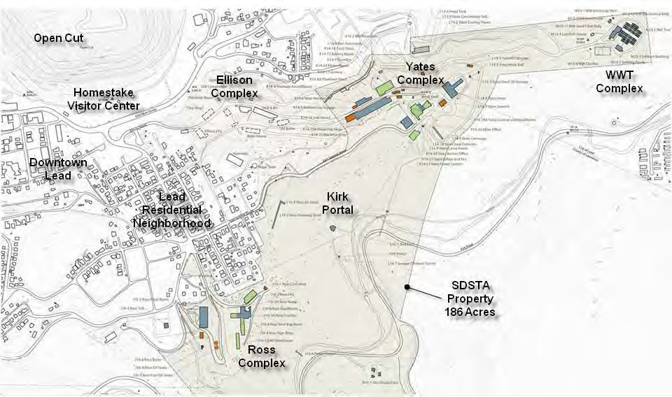
Homestake/Sanford Lab Site

Slide 11
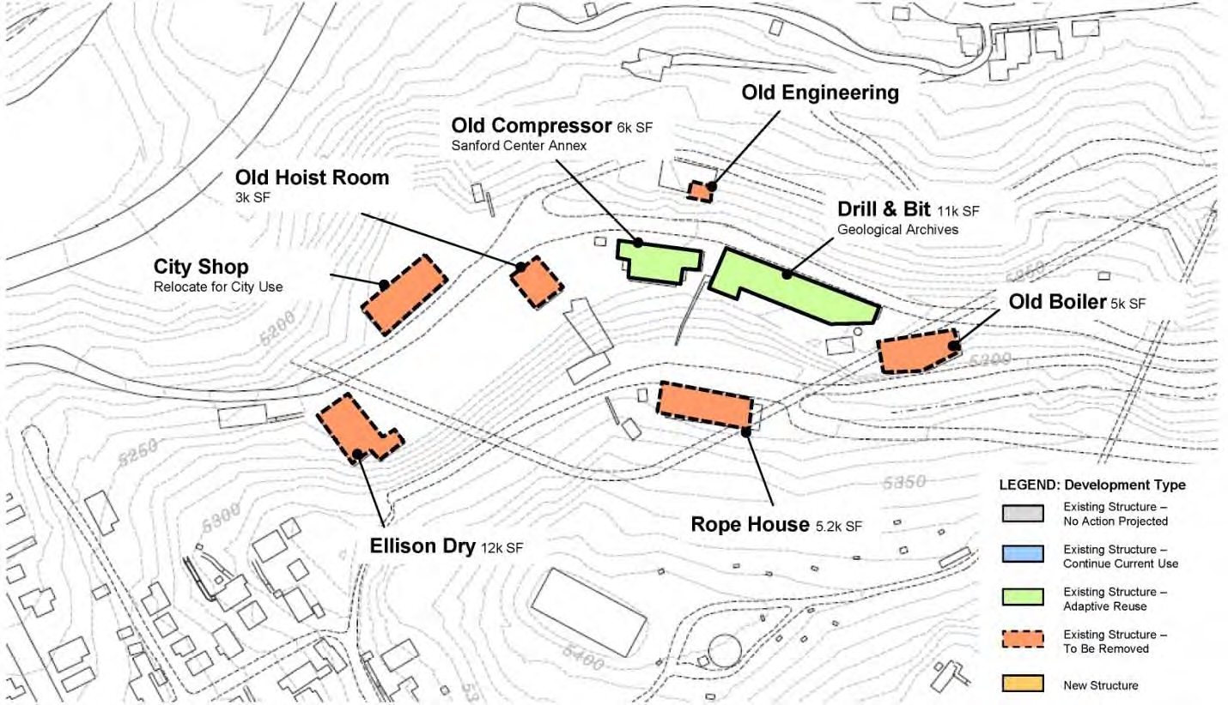
Ellison Campus

