Slide 1
LAr Detector Overview
Bruce Baller - Fermilab

Slide 2
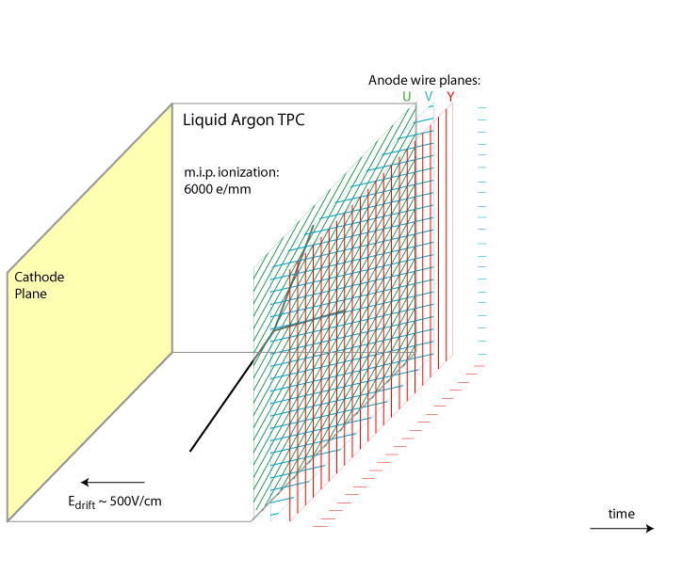
Time Projection Chamber (TPC) Operation
Liquid Argon (LAr)
Specific gravity 1.4
Boiling point 87K

Slide 3
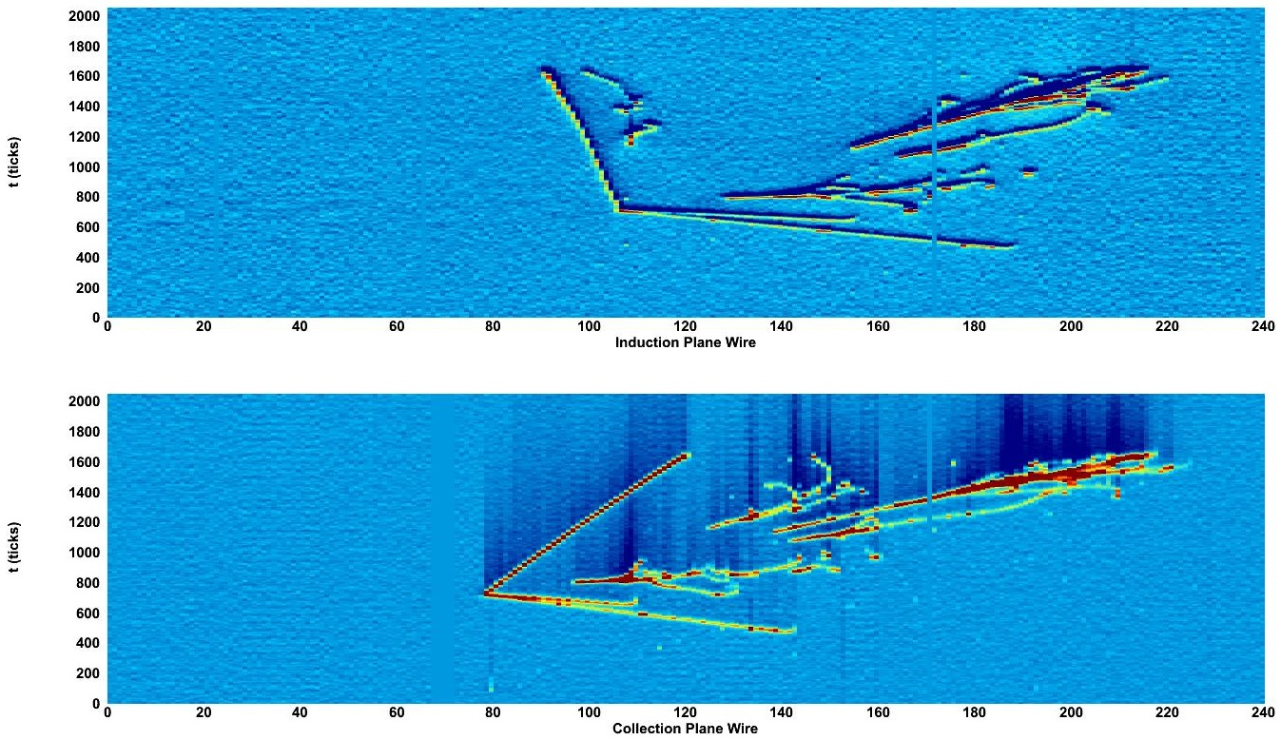
Neutrino Interaction in a Small TPC
3 μs
Induction Plane
Drift time
47 cm
90 cm
Wire Number
3 μs
Collection Plane
Drift time
Wire Number

Slide 4
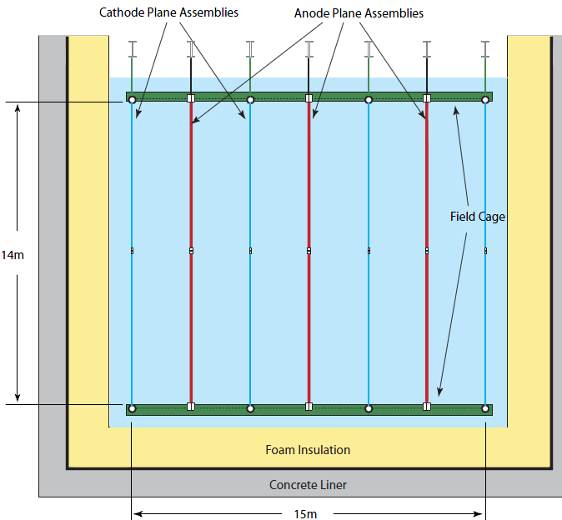
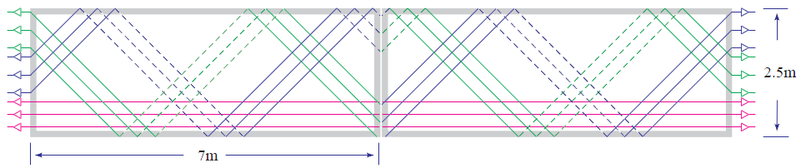
Detector Configuration
CPA
APA
APA Count
2 high x
3 wide x
18 long x
2 cryostat =
216
e
e
APA
22.4m

Slide 5
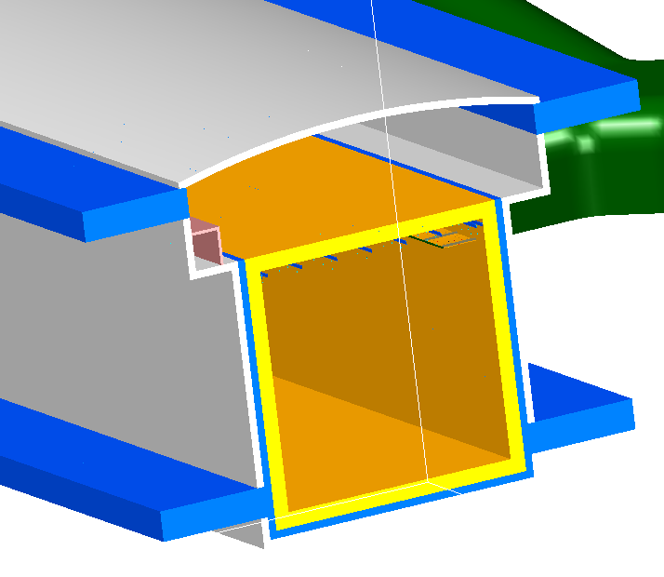
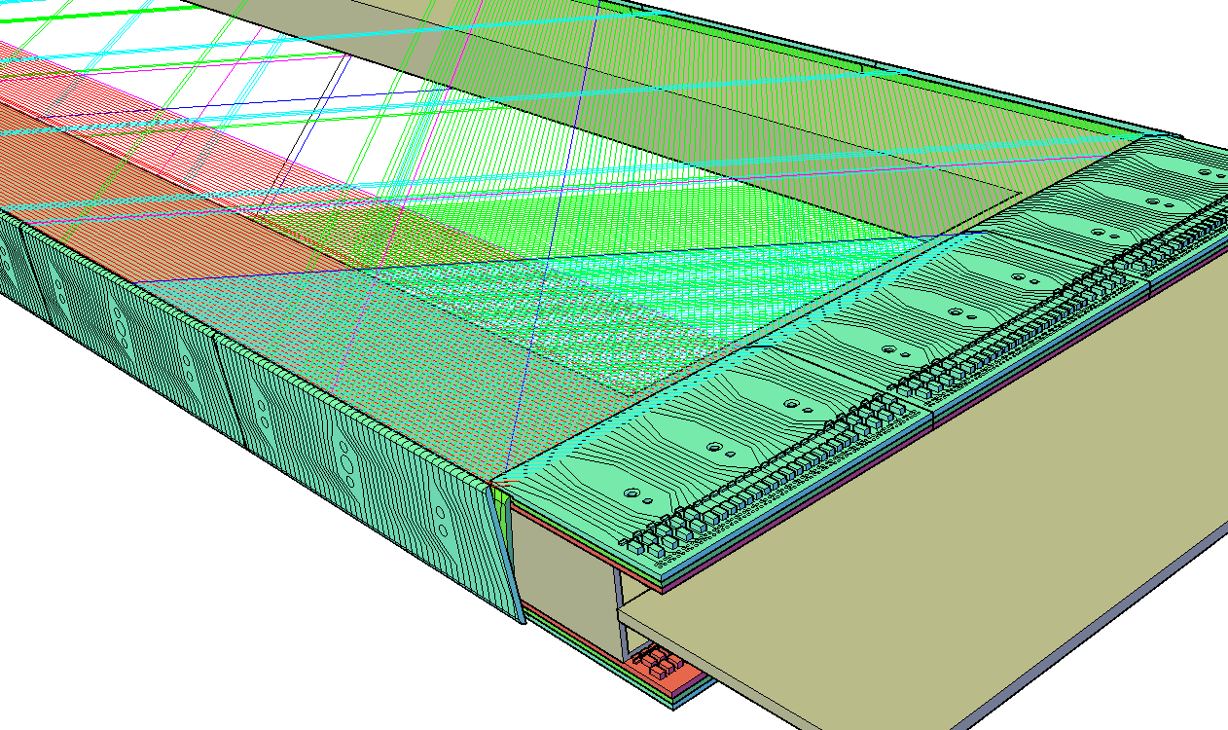
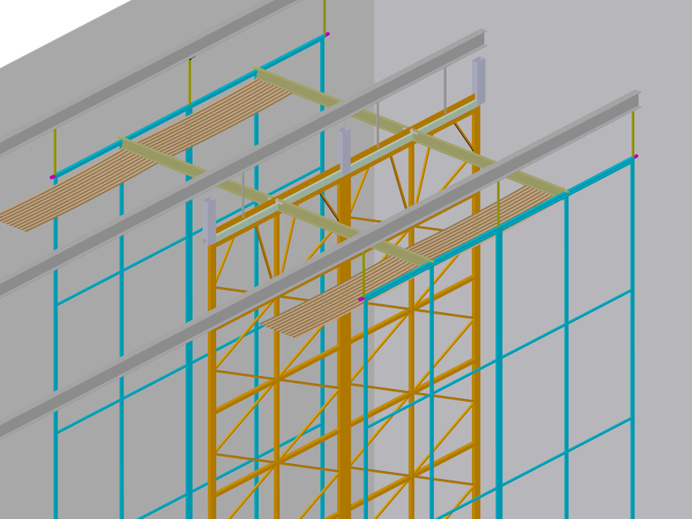
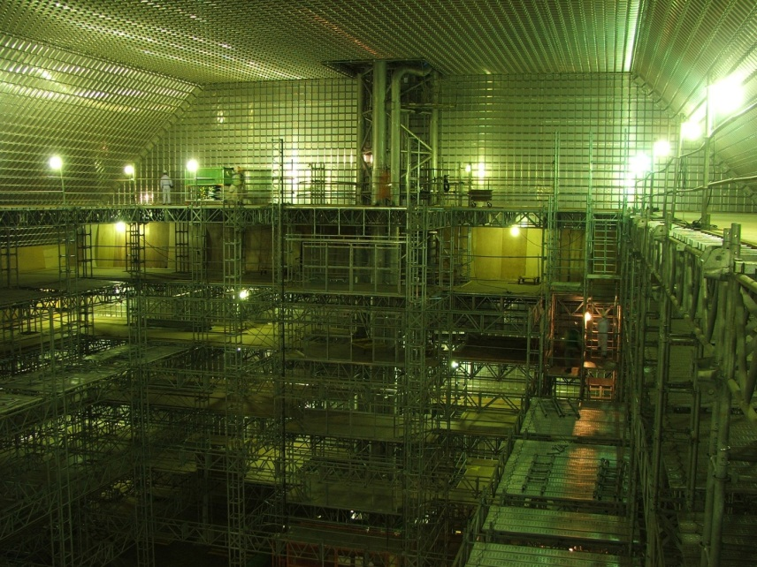
CR Veto
CR Veto
2.5m
Membrane Cryostat
Mounting Rails
7m
CR Veto
Anode
Plane
Assembly
No Crane
Field Cage
Cathode
Plane
Assembly

Slide 6
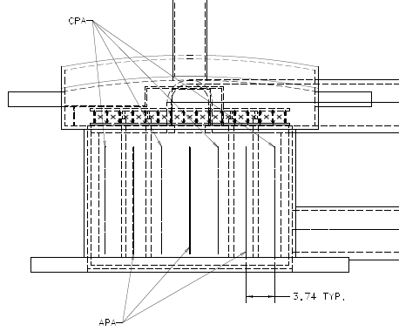
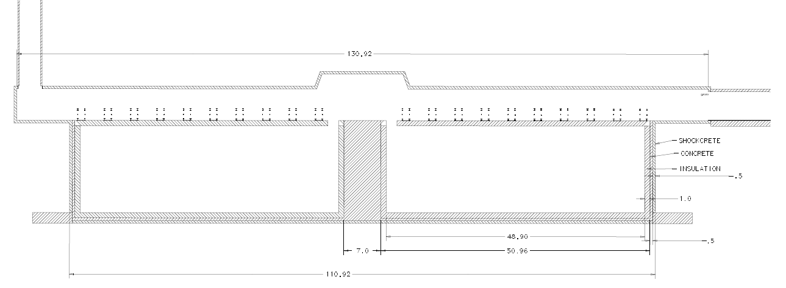
Emergency egress
Ventilation/cryo
Air exhaust
Installation hatch
Cryo piping
18 x 2 drift cells

Slide 7
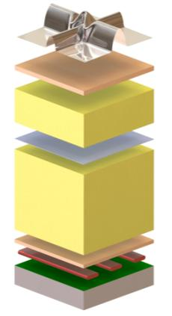
Membrane Cryostat
Detector volume
Purge, vacuum, LAr
❶ Stainless steel primary membrane
❷ Plywood board
❸ Reinforced polyurethane foam
❹ Secondary barrier
❺ Reinforced polyurethane foam
❻ Plywood board
❼ Bearing mastic
❽ Concrete covered with moisture barrier
❶
Insulation space #1
Purge, test gas, vacuum
❷
❸
❹
Insulation space #2
Purge, test gas, vacuum
❺
Concrete bathtub
Ufer ground, heating
❻
❼
❽

Slide 8
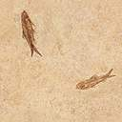
Safety of LAr Containment
Air exhaust to South Portal
Isolation bulkheads
Air from North Portal
Ross Shaft
Existing
Two egress routes
Containment
1st – SS membrane
2nd – aluminum sheet
3rd – polymeric barrier
4th – 50 cm concrete
Native rock
LAr
Foam insulation

Slide 9
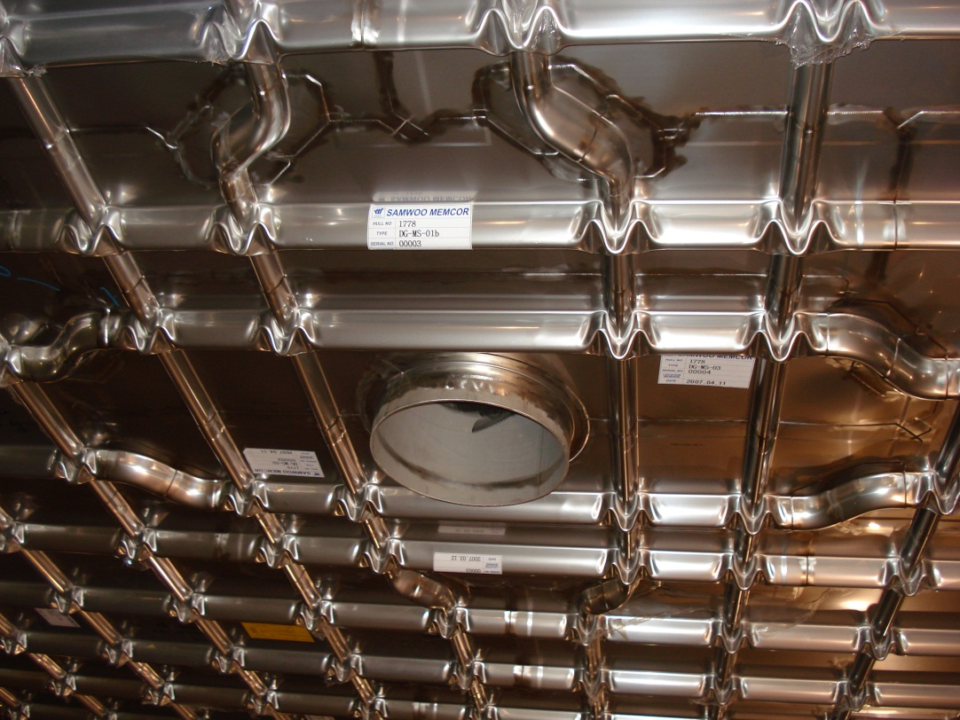
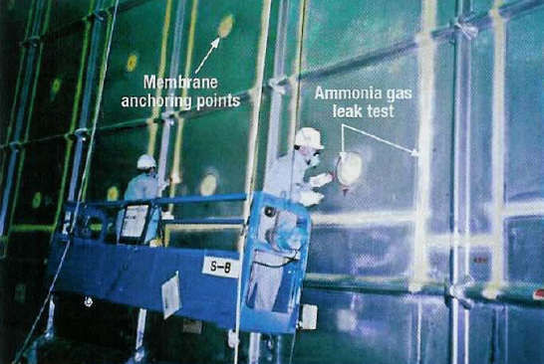
Membrane Cryostat Vendors
GTT membrane roof penetrations
1m x 3m panels
1.2mm 304 SS
IHI membrane leak checking
3m x 8m panels
2mm 304 SS

Slide 10
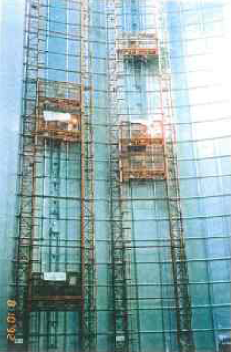

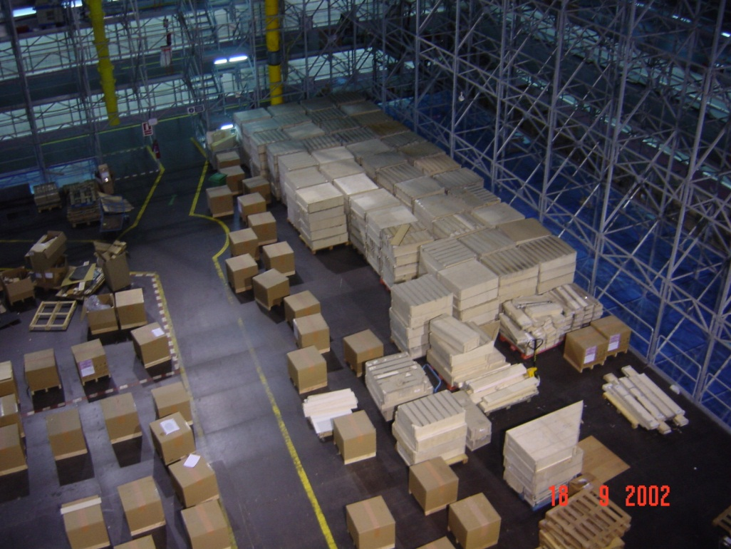
Cryostat Construction
Above ground tank
LNG Ship

Slide 11
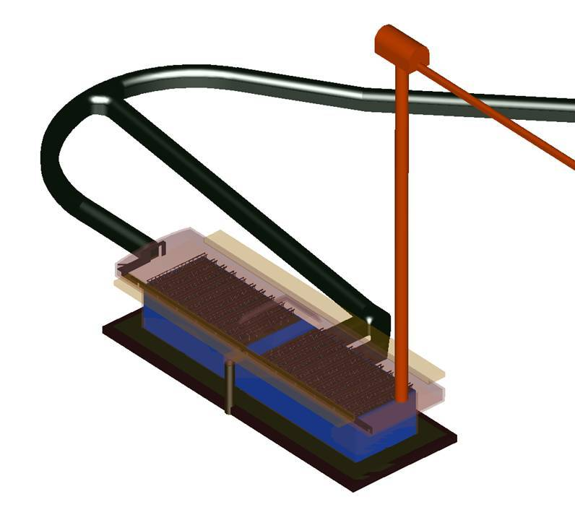
Decline Tunnel
4.5m x 5.5m
Air supply
Ventilation/cryo
Air exhaust
2ndry egress
Mucking drift
+ Cryostat construction
+ sump pump
+ lower level veto access
Cryostat 1
130m
Cryostat 2
33m

Slide 12
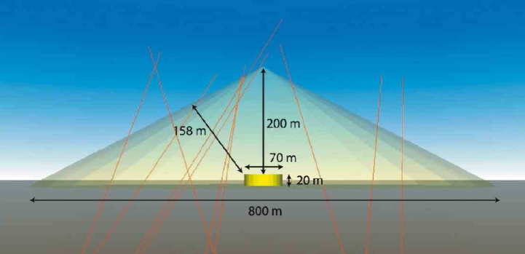
Shallow Depth – Cosmic Ray Background
European study of the effect of cosmic ray flux on physics capability
Science goal: detect the decay of protons
Cosmic Ray interactions in the rock can produce signals in the detector that mimic these signals
Rock overburden reduces cosmic ray background
Veto detects the passage of cosmic rays through the rock near the cavern (7m)

Slide 13
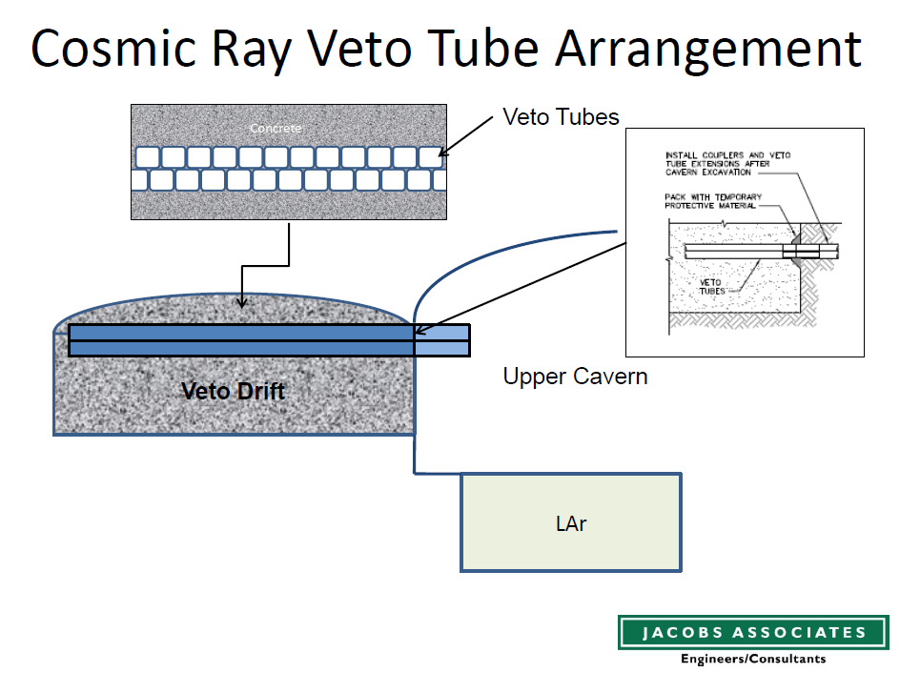
4” square
tubing
Stuff veto tube holes with your favorite high efficiency detector
Example: loop of WLS fiber inside a flexible light reflective bag containing liquid scintillator

Slide 14
Detector Module Cooling Requirement
Total ~ 40 kW
  Insulation - 28 kW
    1m foam - 5.4 kW/m2
  LAr Pumps - n x 6 kW
  Electronics – 5 kW
    Front end – 10 mW/chan
    Digital – 5 mW/chan
LN refrigerators designed for 60 kW cooling
  Heat output 140 kW
LAr40 = 2 detector modules
Detector volume
Purge, vacuum, LAr
❶ Stainless steel primary membrane
❷ Plywood board
❸ Reinforced polyurethane foam
❹ Secondary barrier
❺ Reinforced polyurethane foam
❻ Plywood board
❼ Bearing mastic
❽ Concrete covered with moisture barrier
❶
Insulation space #1
Purge, test gas, vacuum
❷
❸
❹
Insulation space #2
Purge, test gas, vacuum
❺
Concrete bathtub
Ufer ground, heating
❻
❼
❽

Slide 15
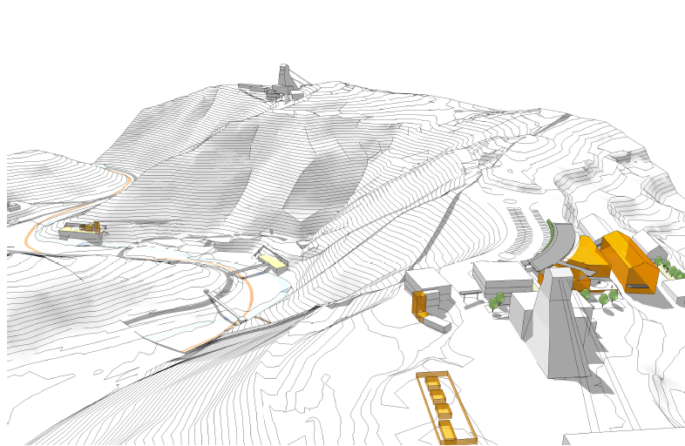
Surface Overview
Ross Headframe
Kirk Drift (existing)
At 300 level
South Portal (new)
Cryogenics building
300’ elevation
North Portal (new)
Access to cavern
Kirk Road

Slide 16
LN Refrigeration System
2 operating + 1 spare

