Slide 1
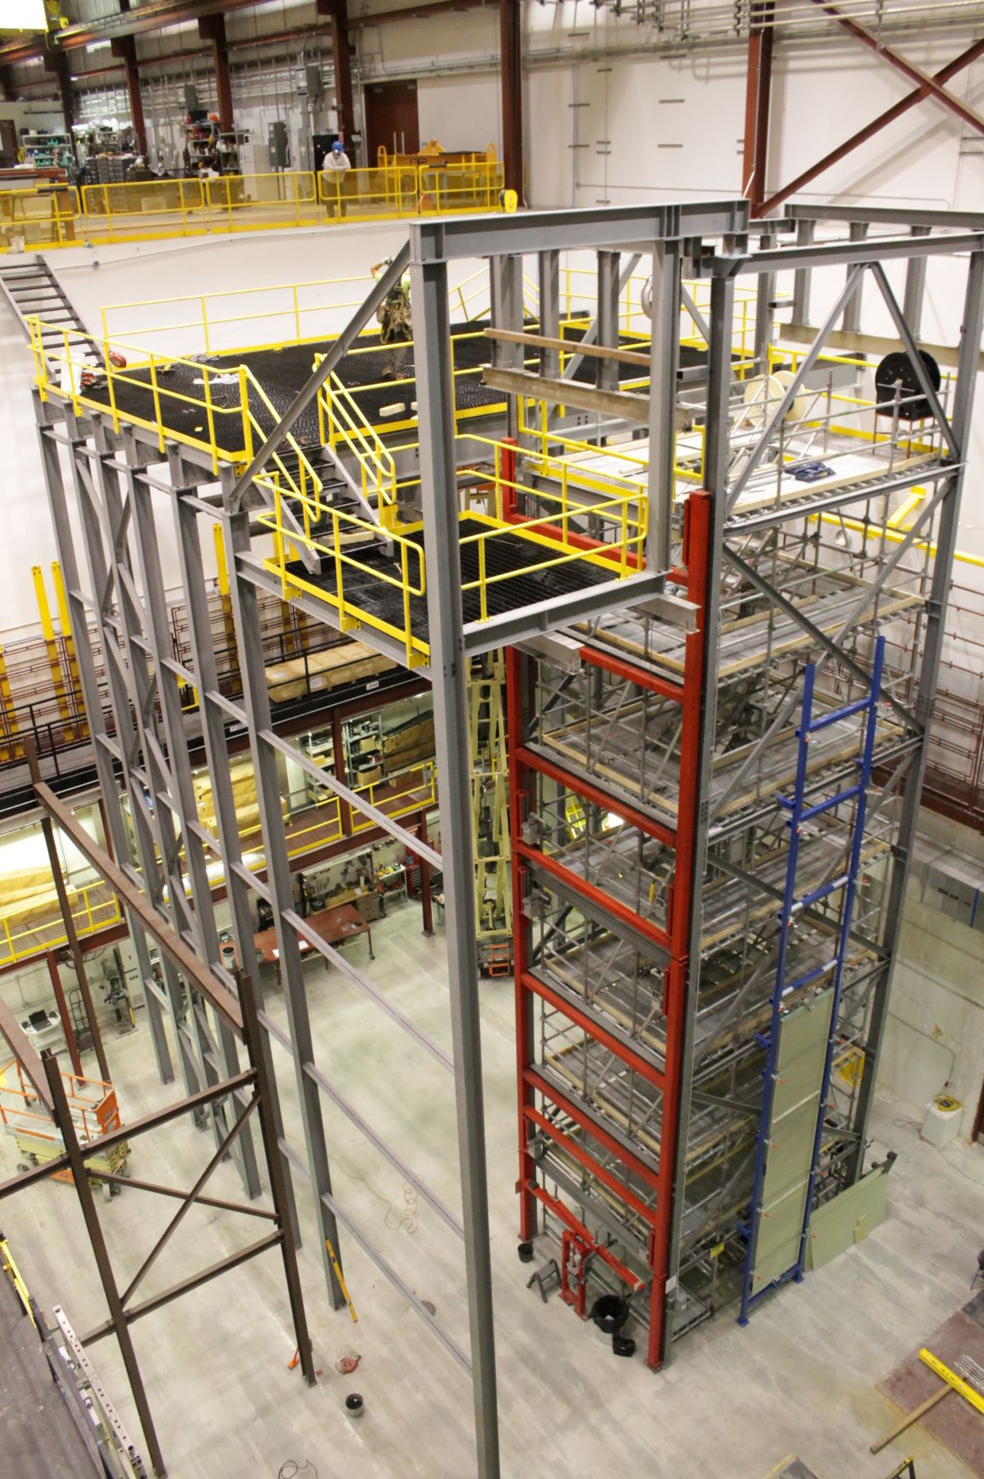
DUNE Trolley Designs
William Miller
University of Minnesota
16, September 2020
Phase 2 DSS support structure at Ash River

Slide 2
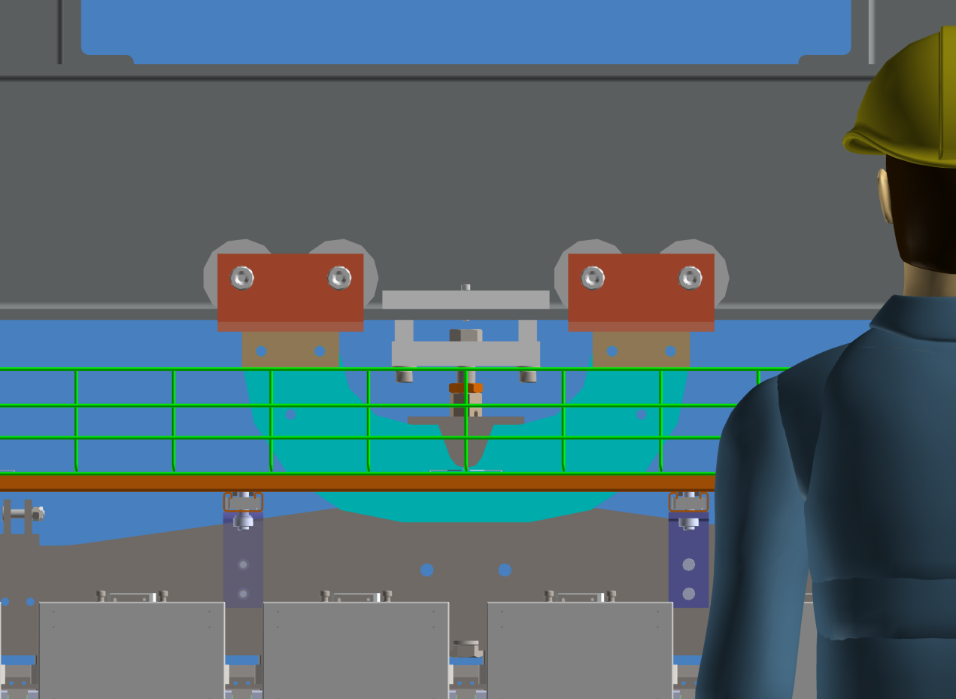
APA Trolley
Design improvements for better access and removal.
Design changes to PSL yoke
Test trolley for Ash River
Use them in ProtoDUNE?
The sequence and the number of trolleys are different from what Benoit proposed at the DSS meeting.
APA vertical cable tray trailing trolley?
APA Trolley in Ash River model

Slide 3
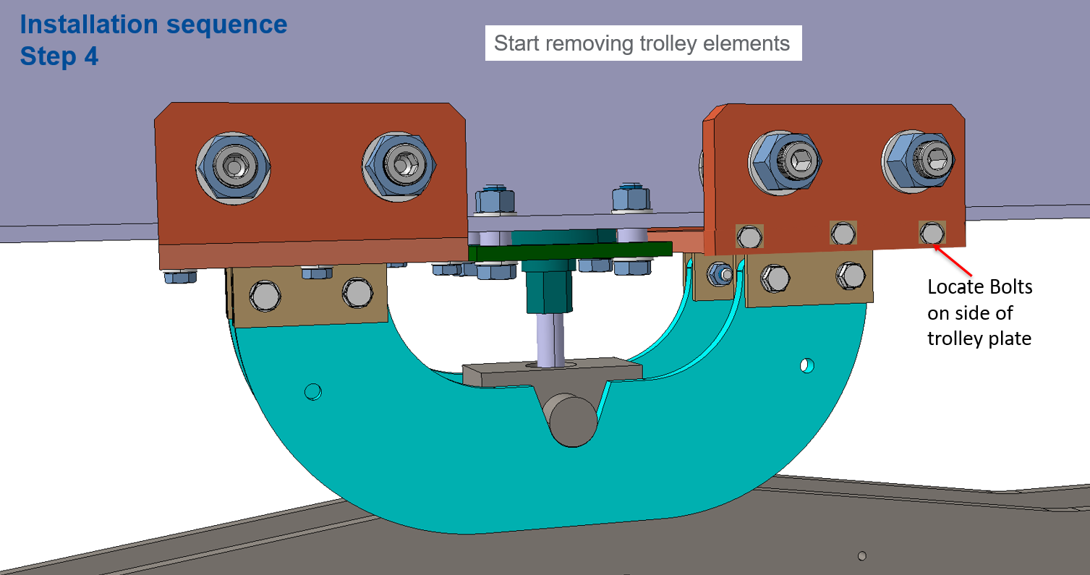
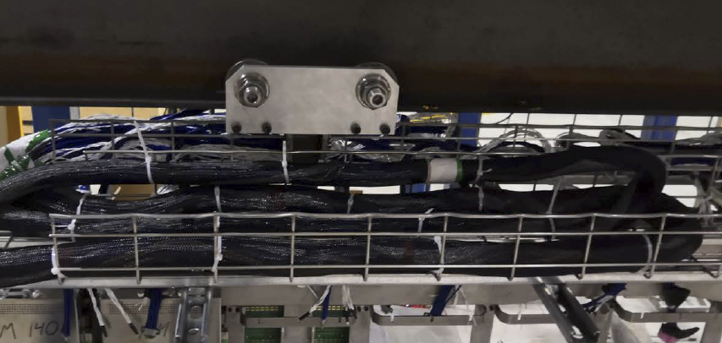
Access the trolley
Access will be difficult with bolts pointed down on trolley. It would be better to locate them on the side ONLY on the accessible side. Use a long bolt into a threaded plate on the back side. That way there is no bolt to remove.
Have a tie off hole on the back trolley plate so it can be pulled up over the top. All parts need to be on a lanyard.
Access to APA Hanger important, size of hanger bolt and tread sized to easily lift the load into position.

Slide 4
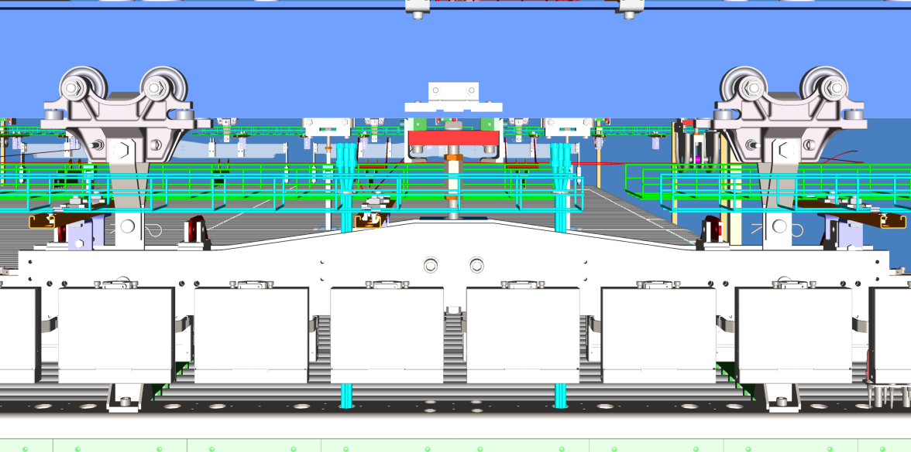
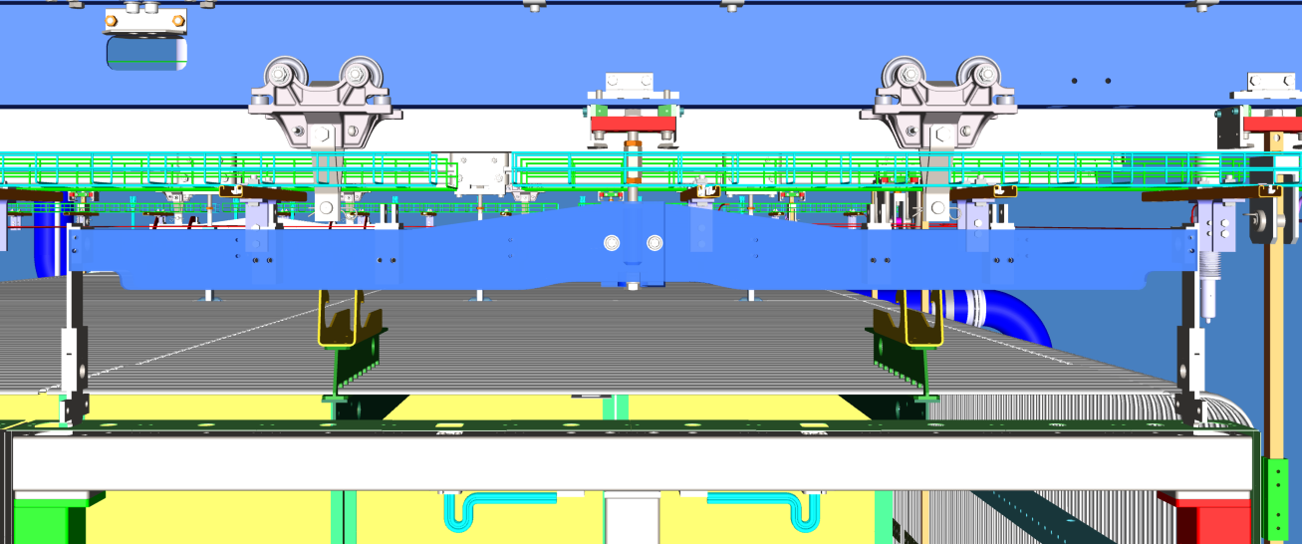
Open questions
Current Navisworks model of ProtoDUNE 2
Modifications to Yoke connection-PSL ?
ProtoDUNE 2 Trolleys
  Standard APA use new Trolley?
  Inverted APA use the old trolley design?
I am assuming that CERN engineering group will complete design and write engineering note?
If off the shelve items (trolley wheels) are used are they US certified as well as CE?
Does Ash River have the first set manufactured?
We will have to do a load test, write procedures and Hazard Analyses and get them approved by Fermilab and University of Minnesota ES&H.
Standard APA configuration
Inverted APA with new yoke and “lifter”

Slide 5
Sequence and number of trolleys
Our current installation plans uses approximately 16 trolleys:
  Up to 6 on the 3 main assembly lines plus 1 on the spare line
  Up to 3 in the Cold boxes
  In the cryostat we would have 3 new APAs entering each week and the cabling and testing process takes about week so potentially you could need 6 more trolleys
When the trolley is removed is still an open question until the cable management test at BNL are completed.
Current best estimate is
  Move the APA into position so that APA side alignment pins are engaged
  Attached APA Hanger to yoke so it remains in a stable position
  Do not remove trolleys until all the cable tests are completed and cable management is done in case there are issues.
  Remove trolleys in tethered pieces and place in scissor lift for use with the next APA

Slide 6
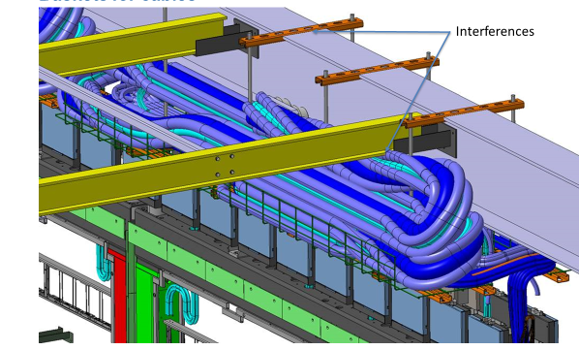
Removal of ground plane support during cabling
If the ground plane supports which are fixing the distance between the DSS beams can be removed during the cable process when this would remove some access issues
We would have to think about the installation sequence. Removing the support beams before the APA goes into position would minimize damage and clearance to the cable trays

Slide 7
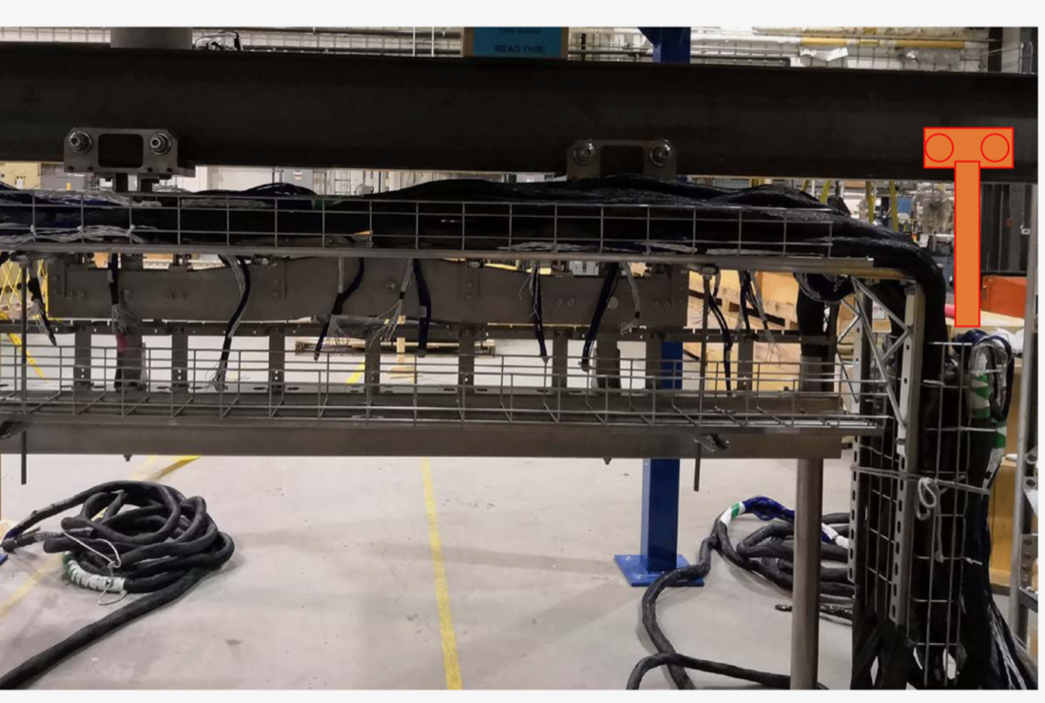
Vertical Cable Tray – Work in Progress
Without a trailing trolley to remove the off balanced cable load the APA could hang out of plane by ~10cm
It looks like we are moving in the direction of having a trailing vertical cable tray to manage the cable that goes into the feed-thru.
The load would be on a separate trolley, but it would also be secured to the APA via 10mm Rivnut?
It would be in place during the cold box test and removed as part of the cabling process in the cryostat.
Trailing Trolley to support vertical tray

Slide 8
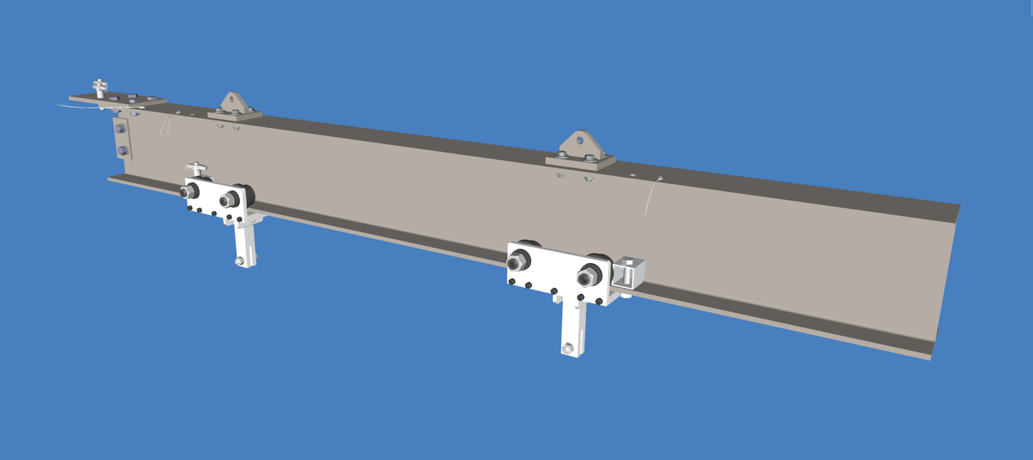
CPA/Slave Trolley
Current status of the slave trolley (identical to the CPA Trolley except no DSS mounting holes) this is the original design used on the DSS by Vic.
  It was approved for use during the Phase 1 APA doublet test completed last year.
  It is getting re-reviewed as part of the updated APA lifting fixture upgrade to allow us to move a completed APA Double to the TCO beam on the Phase 2 DSS support structure.
We have had several rounds of discussions with Argonne and Giuseppe and expect a completed and approved trolley design by the end of this week
We have two slave trolleys for the APA Double and Ash River will fabricate two CPA trolleys for the CPA for the DUNE Trial Assembly work.

Slide 9
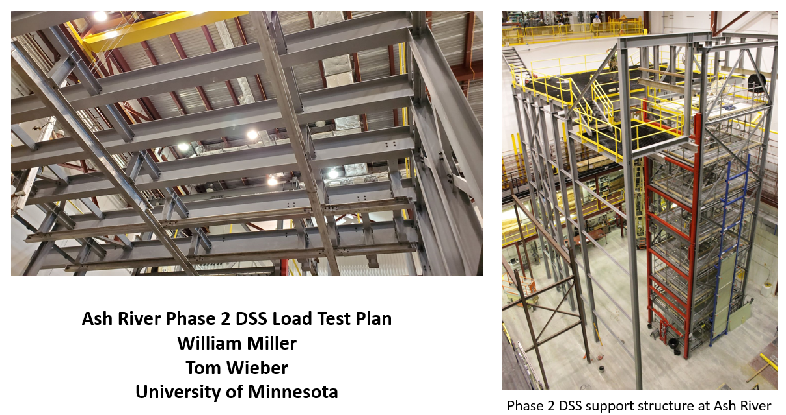
Once Engineering notes approved, DSS Load Test plan and HA approved for testing Phase 2 structure

Slide 10
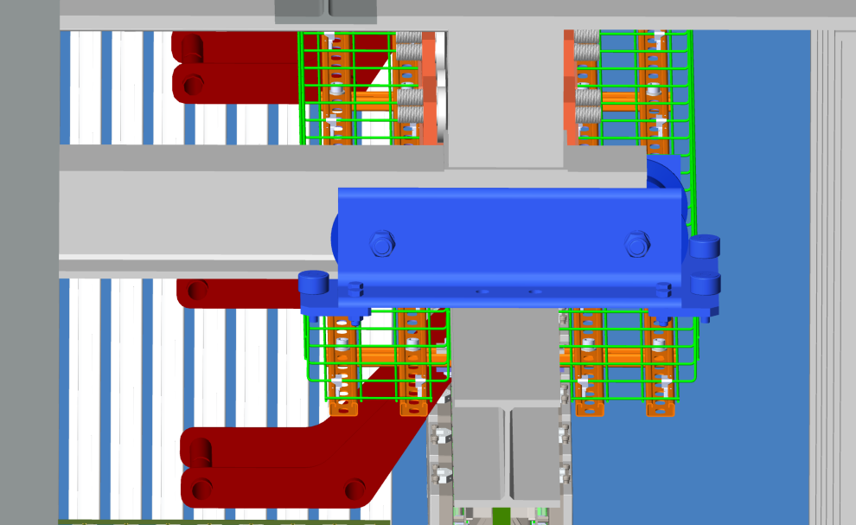
Shuttle beam trolly design problem
This is an issue that came up at Ash River. Best design practices to minimis racking from AR crane person says that the distance between the wheels and cam followers should be a minimum of 4 times the width of the beam (~24”). There is already no room for trolley design as is moving the outside DSS beam out 22mm adds to the issue

Slide 11
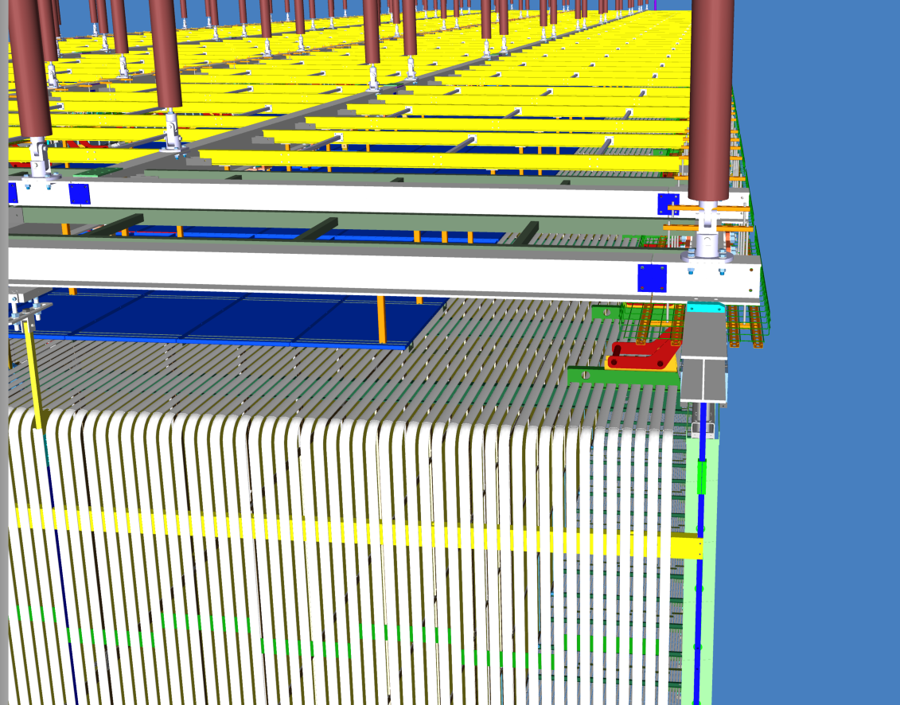
Shuttle Trolley missing in v.6 model
The issues are the same in the cryostat as it was in Ash River.
Runway beam needs to be extended as far as possible

Slide 12
Additional installation comments from change in DSS location

Slide 13
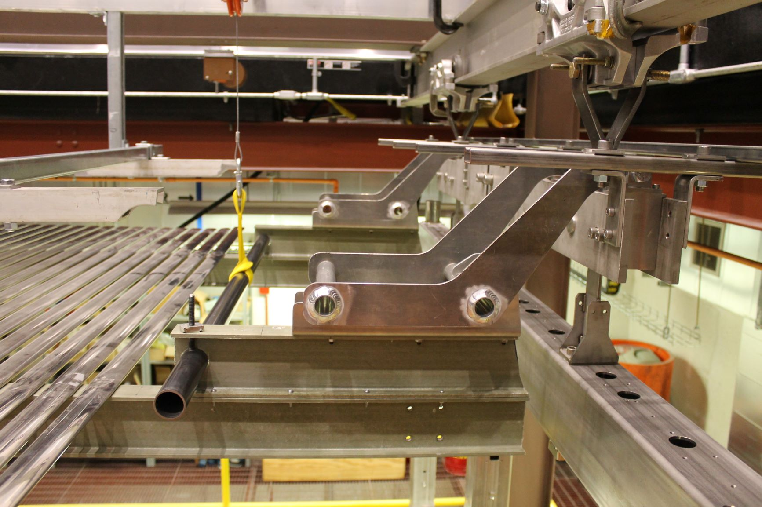
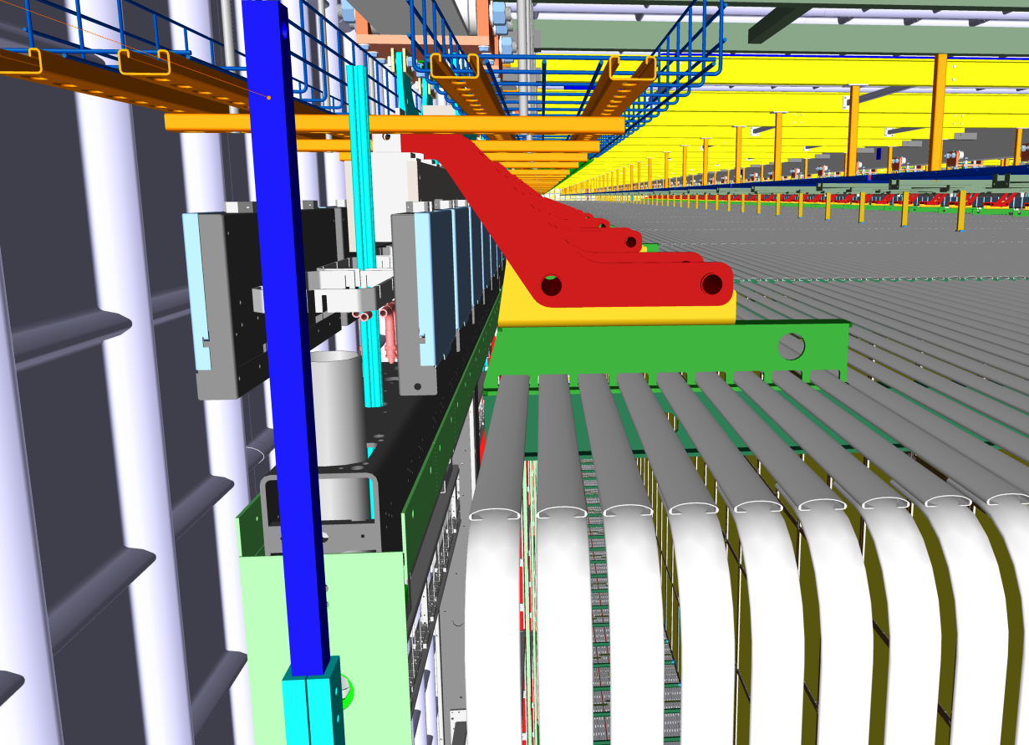
Length of Top and Bottom FC
Does the length of the top and bottom FCs and End Walls increase by the 11mm additional spacing between the DSS runway beams? I assume this changes

Slide 14
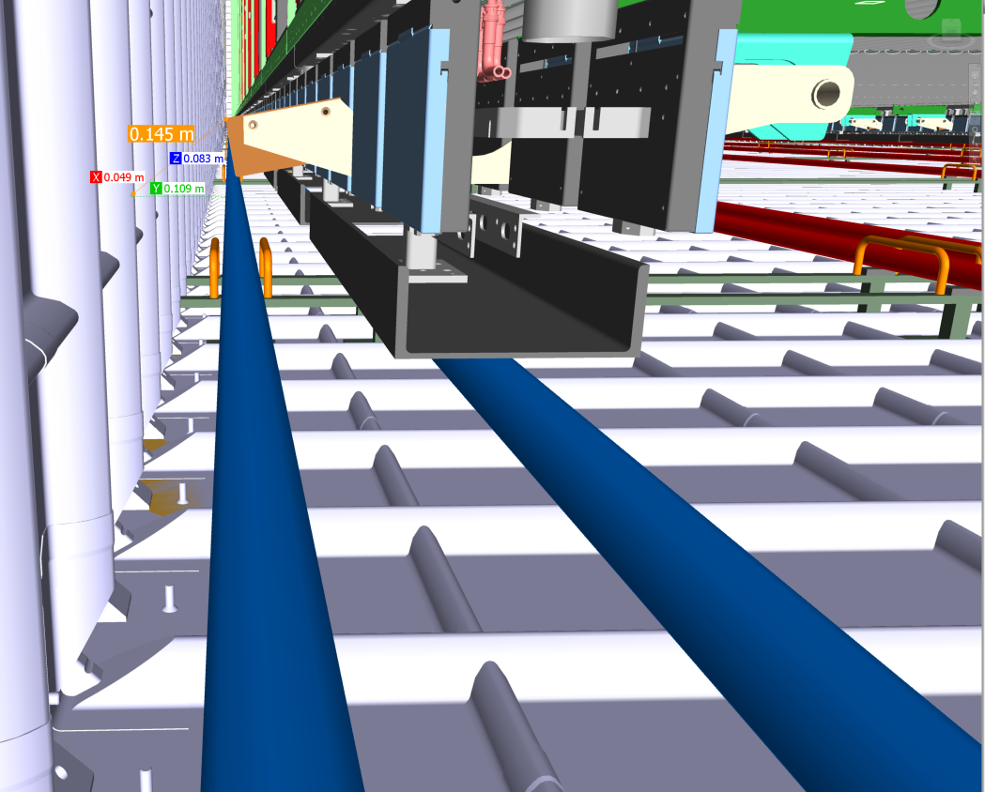
Clearance of Bottom FC latch
If the cable tray load is not balanced well at the top the bottom may be at a different position. This is particularly true during transport when the APA is “swinging free”
Ash River Test during showing potential off set
  A load test was performed to understand how much the lower APA deflects if an asymmetric load is placed on the cable trays. A 150lb load was placed on the cable tray after the APA was freed from all lower constraints. The deflection measure was 1” at the middle and 1.5” at the bottom.

Slide 15
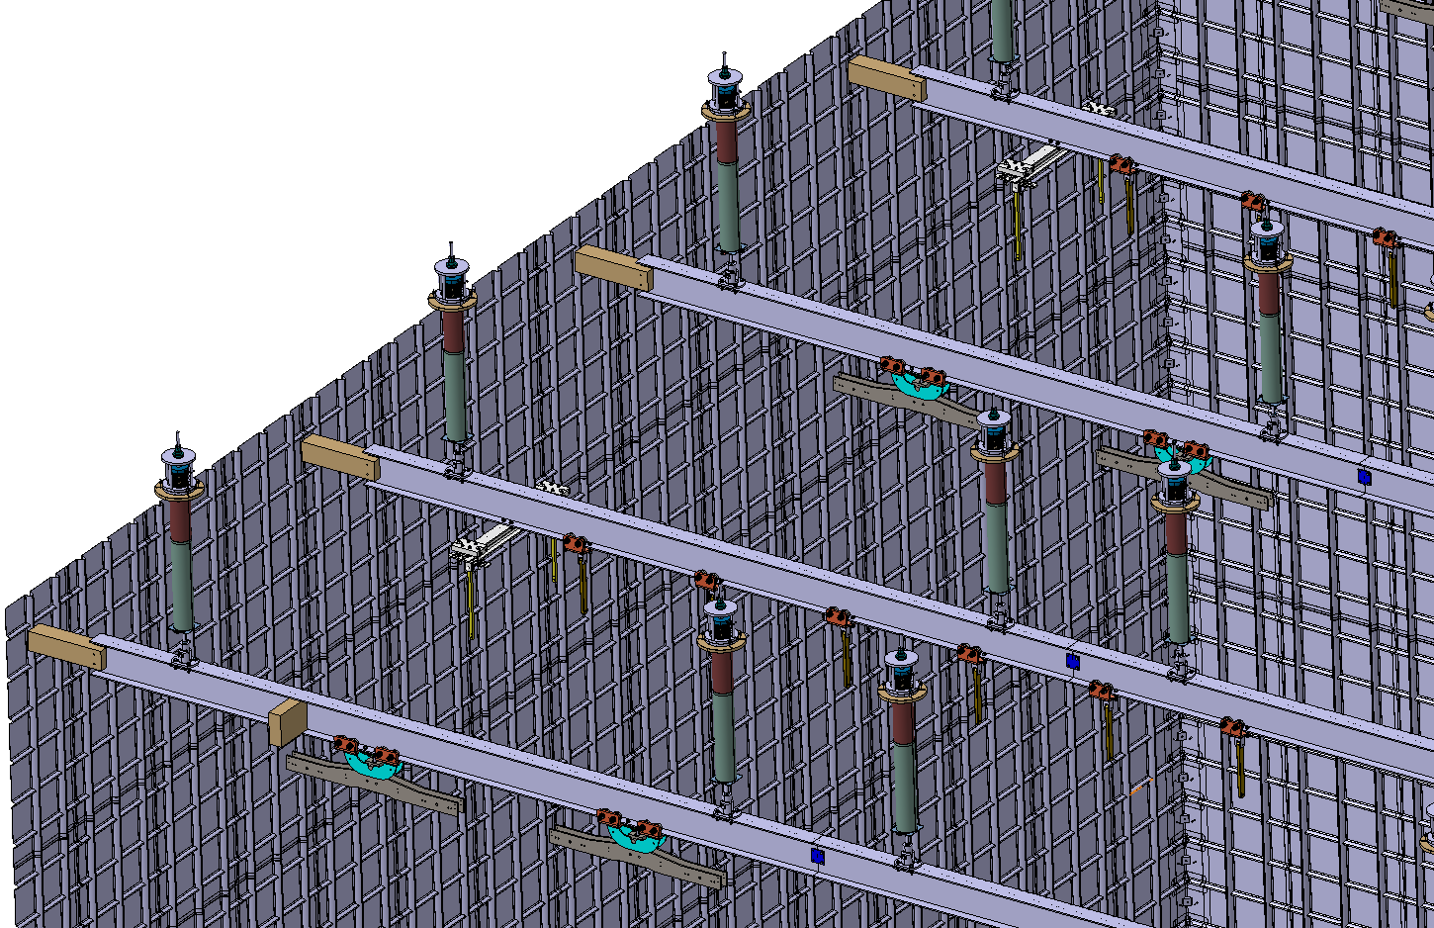
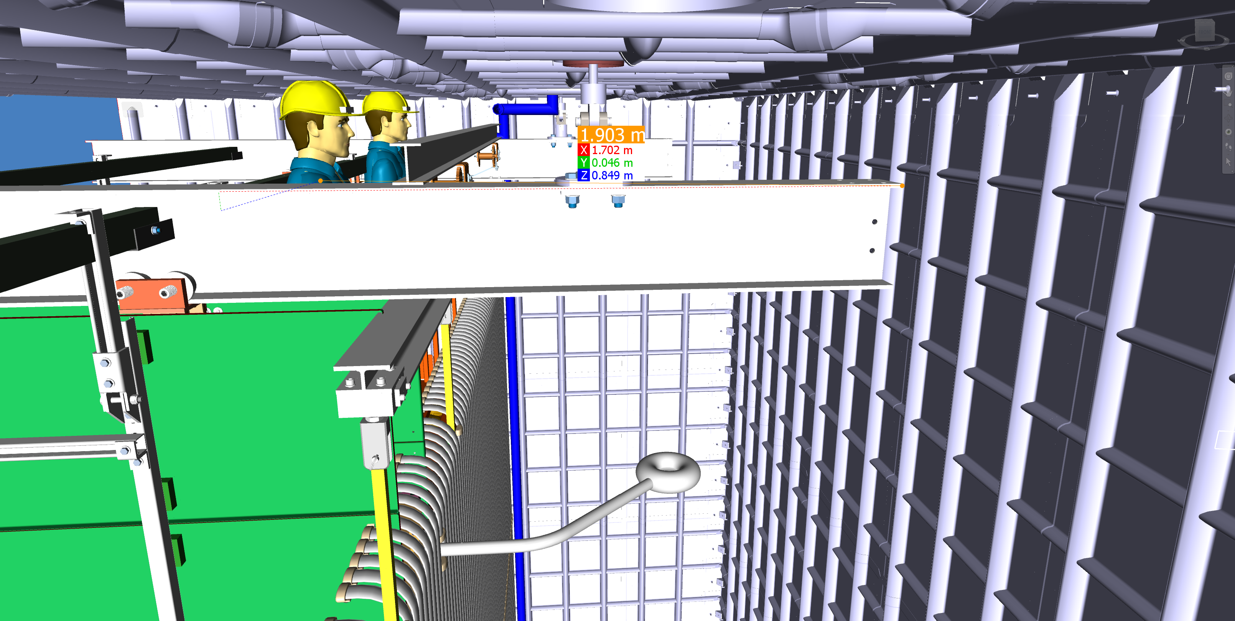
DSS stabilization support during installation
This was shown during DSS PDR and how we remove this needs to be understood. The current installation sequence has us starting to deploy the ground planes and the first Field Cages when we have approximately 17 rows completed.

