Slide 1
Near-term R&D at BELLA towards a laser-plasma-based collider
A. J. Gonsalves, C. Benedetti, S. S. Bulanov,
C. G. R Geddes, E. Esarey, K. Nakamura, L. Obst-Huebl, C. B. Schroeder, S. Steinke, J. van Tilborg, M. Turner
Snowmass AF6 workshop
September 24th, 2020

Slide 2
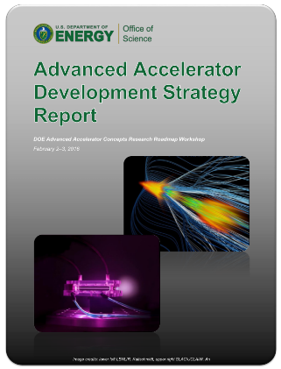
BELLA 2nd beamline under construction for staging experiments per strategic roadmap
Staged, channel-guided LPAs offer potential for high-gradient, efficient colliders
Staging mitigates dephasing and pump depletion. Plasma channel mitigates diffraction
R&D required
Stable, thin plasma mirrors with ~λ/10 flatness @ >Hz
Compact bunch transport with plasma lens
Multi-GeV 1st stage with stable ΔE <%1, and <mrad pointing error
C. B. Schroeder et al., PRSTAB 13, 101301 (2010);
S. Steinke et al., Nature 530, 190 (2016)
S. Barber et al., LOI Snowmass21
C. Benedetti et al., LOI Snowmass21
J. van Tilborg et al., LOI Snowmass21

Slide 3
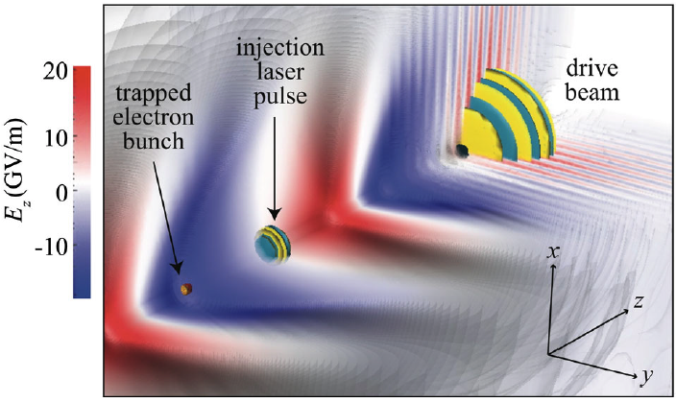
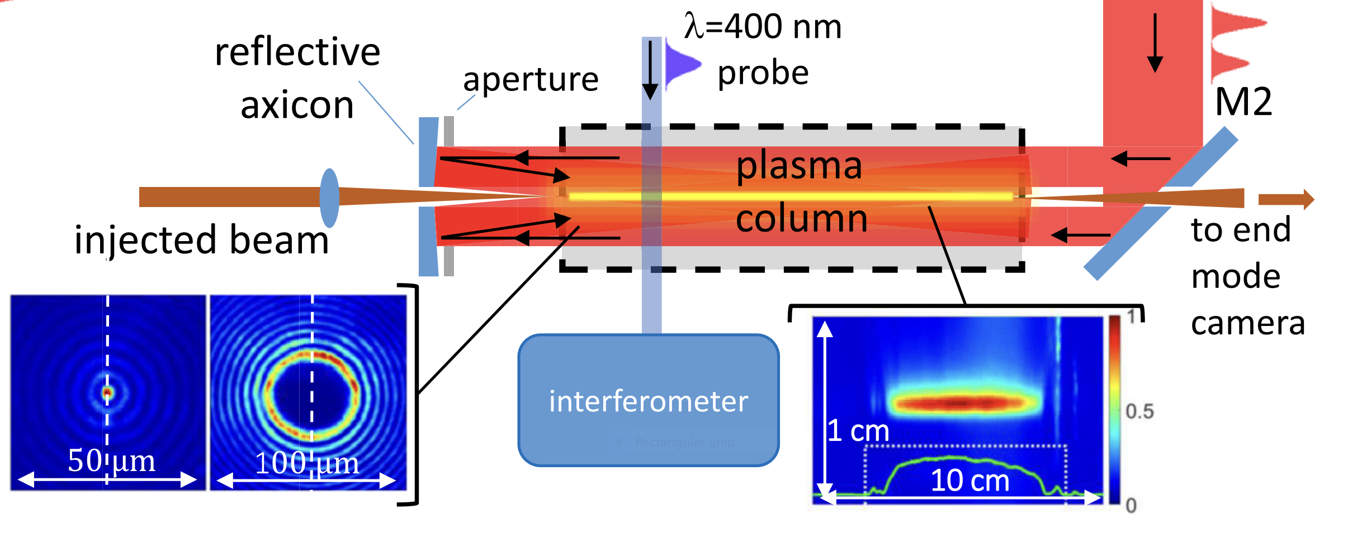
Single-stage optimization at BELLA follows strategic roadmap
Order of magnitude improvement in performance needed for HEP
Currently Developing .
E: Stable few % <1%
ΔE: Stable at 10% <1%
Diverg: ~ mrad < 0.1mrad
Point: ~ mrad < 0.1 mrad
Emittance: 0.1 µm 0.01 µm
Charge: ~10 pC ~100pC
Efficiency: few % ~30%
Rate: Hz ≥ kHz
e- only e-, e+
8GeV LPA demonstrated
A. J. Gonsalves et al., PRL 122, 084801 (2019)
nm ε injectors
Plasma channel development
Positron acceleration with 2nd Beamline
C. B. Schroeder et al., PRSTAB 17, 101301 (2014)
B. Miao et al., PRL 125, 074801 (2020);
C. Benedetti et al., LOI Snowmass21
Gonsalves et al., LOI Snowmass21
Injection & guiding demonstrations with BELLA PW 2nd beamline.
Future AIPs for additional beamlines could enable simultaneous injector, guiding, and staging beams for high-beam-quality staging
Laser spatio-temporal shaping & stabilization techniques needed. Expected with future kHz systems
L Kiani et al., LOI Snowmass21

