Slide 1
Plasma Sources for Laser Plasma Accelerators
A. J. Gonsalves¹, B. Cros², E. Esarey¹, H, M. Milchberg³,
C. G. R. Geddes¹, C. B. Schroeder¹, M. Turner¹, A. Zigler⁴
¹Lawrence Berkeley National Laboratory, Berkeley, California 94720 USA
²CNRS, LPGP, Universite Paris-Saclay, 91405 Orsay, France
³University of Maryland, College Park, MD 20742 USA
⁴Hebrew University of Jerusalem, Israel
Snowmass AF6 Workshop
September 24th, 2020

Slide 2
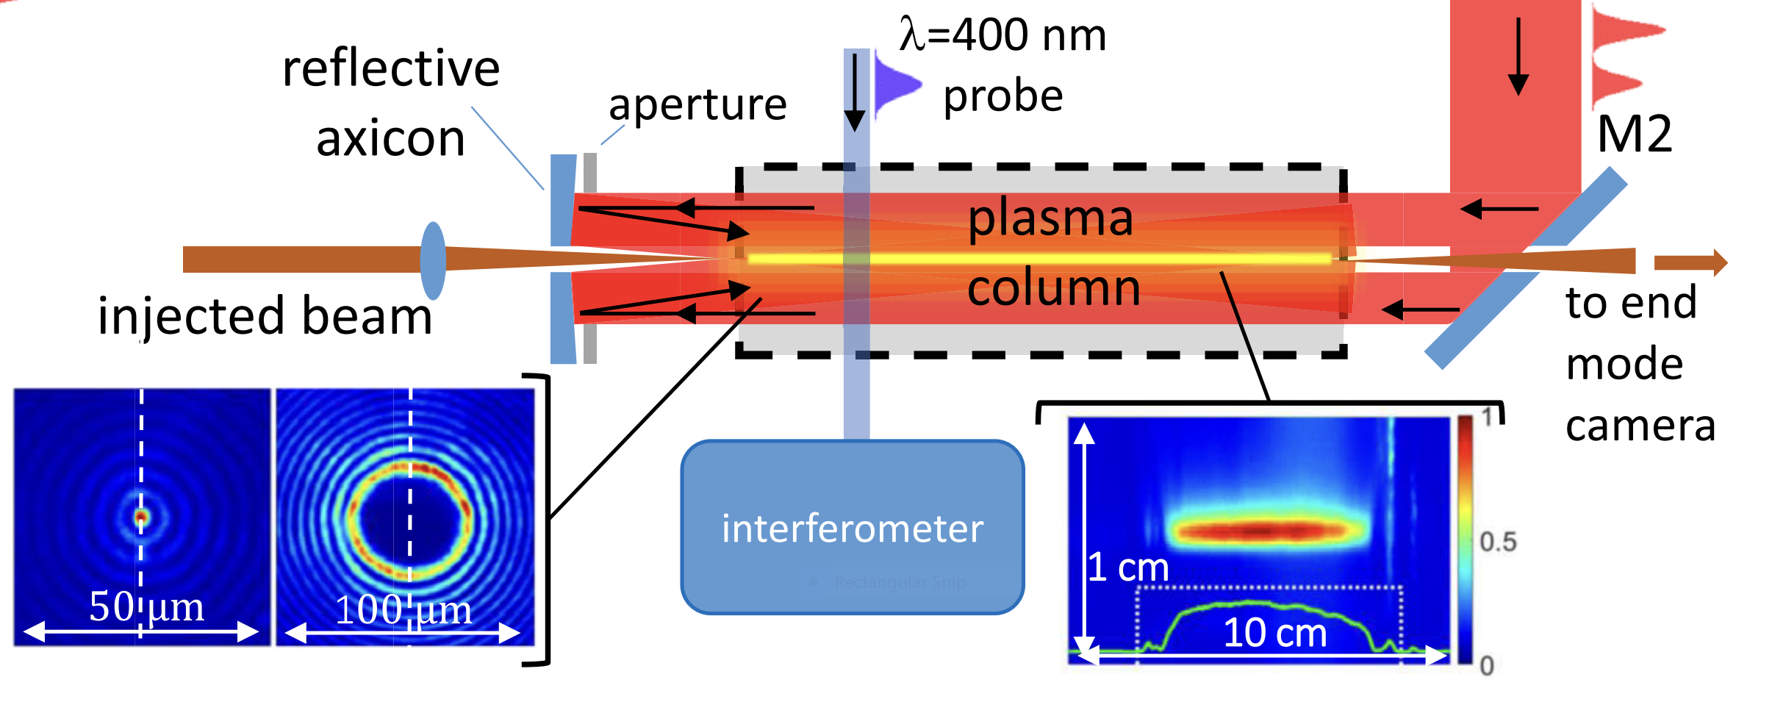
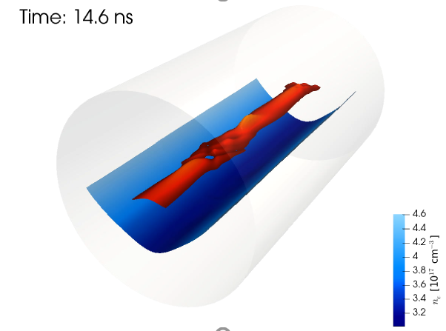
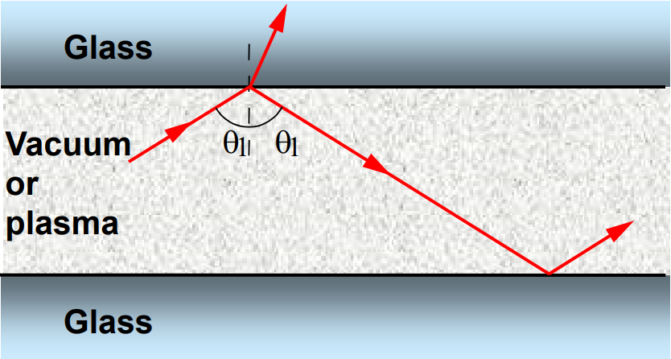
Plasma channels important for future collider designs. Several technologies demonstrated
Staged, channel-guided LPAs offer potential for high-gradient, efficient colliders
Staging mitigates dephasing and pump depletion
Plasma channel mitigates diffraction
C. B. Schroeder et al., PRSTAB 13, 101301 (2010)
Laser-heating
Plasma channels on DOE roadmap
B. Miao et al., PRL 125, 074801 (2020);
R. J. Shalloo et al., PRE 97, 053203 (2018)
Capillary discharges (& laser-heating)
Used to produce e beams up to 8GeV
Dielectric capillaries
A. J. Gonsalves et al., PRL 122, 084801 (2019)
Also can provide for:
Bunch transport (focusing) between stages
Laser pulse coupling between stages
Multi-GeV energy & emittance measurements
S. Steinke et al., Nature 530, 190 (2016)
A. Zigler et al., APL 113, 183505 (2018)
S. K. Barber et al., APL 116, 234108 (2020)
B. Cros et al., PRE 65, 026405 (2002)

Slide 3
Further plasma channel R&D required for HEP
Plasma channel requirements have not been demonstrated simultaneously:
density ~10¹⁷cm⁻³, matched spot size tens of μm, length tens of cm, kHz repetition rate, stable.
Example R&D
Can laser-heating in discharge capillaries operate at ~1x10¹⁷cm⁻³ lower density with laser heater while maintaining ~60μm matched spot size for ~10GeV stages? Needs optimization of heater laser. Operation at kHz repetition rates? Needs photon acceleration of a trailing beam.
Demonstrate low-leakage, high-power guiding in laser-based channels. Can they be made stable? Needs both neutral gas and laser stabilization and control. High rep rate feedback.
R&D on hollow channels for ideal E fields & Coulomb scattering mitigation needed
Requires orders of magnitude lower on-axis density than wall density of ~10¹⁷cm⁻³ & transition over ~micron length
How to generate?
In a dielectric capillary? How to lower wall density and maintain sharp transition? How to operate at high repetition rate (mitigate laser damage)?
Using cluster jets and flow around obstacles? Can high enough cluster fraction be produced?

