Slide 1
SWFA demonstrators with integrated technologies for future large-scale machines
Goal: Demonstrate technology integrations needed for large-scale SWFA-based machines (steppingstone facilities and ultimately linear colliders)
3-TeV Argonne Flexible Linear Collider (AFLC)
Key performance of one module (20 total)
Accelerator concept | Two Beam Acceleration
RF power from decelerator | 26 GHz, 1 GW
Accelerating gradient | 270 MV/m
Main beam energy gain | 150 GeV
Staging acceleration | 50 stages, 38 ACCs/stage
AC-to-RF efficiency | >30%
500 MeV demonstrator
2 stage, 2 structures/stage
3 GeV demonstrator
4 stage, 6 structures/stage
13 GHz main beam, 20% η
SWFA roadmap
3 GeV demonstrator
30% η with advanced klystron
5-GeV Multi-beam XFEL
Key performance of one beamline (10 total)
Accelerator concept | Collinear Wakefield
Transformer ratio | 5
Accelerating gradient | 100 MV/m
CWA energy doubler
180 GHz, 2 structures

Slide 2
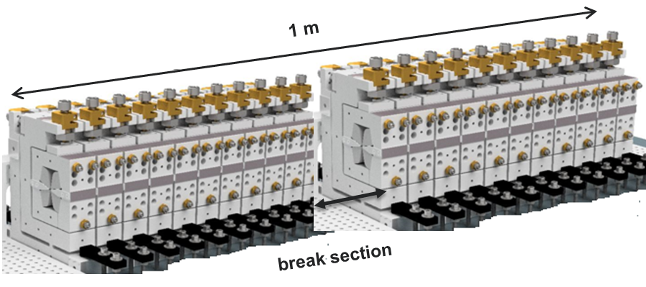
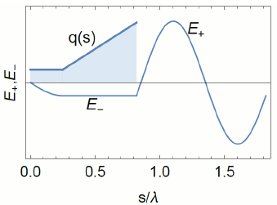
SWFA demonstrators with integrated technologies for future large-scale machines
500 MeV demonstrator fitting into AWA’s current bunker
Decelerated to 20 MeV by 2 PETS in each stage
70 MeV drive beam to two stages
2 x 8-bunch trains, 40 nC/bunch
14.5 m x 1.5 m testing area at AWA
J. Shao et al. NAPAC2019
15 MeV main beam
Single bunch
Accelerated to 500 MeV by 4 accelerators
Key technologies integration: 1) high charge drive beam generation and transportation; 2) advanced wakefield structure; 3) high fidelity staging acceleration
CWA energy doubler fitting into AWA’s current bunker
40 MeV drive beam
100 MeV main beam
Key technologies integration:
1) high charge drive beam shaping; 2) high frequency structure with BBU control; 3) staging acceleration
50 MeV shaped drive beam
50 MeV main beam
A. Zholents et al. IPAC2018

