Slide 1











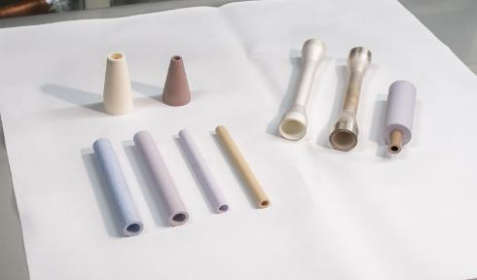
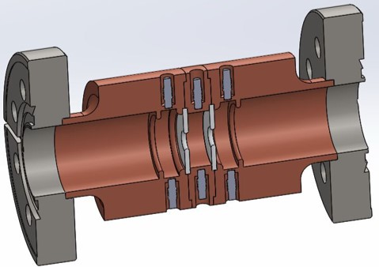
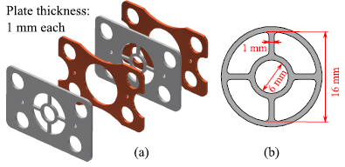
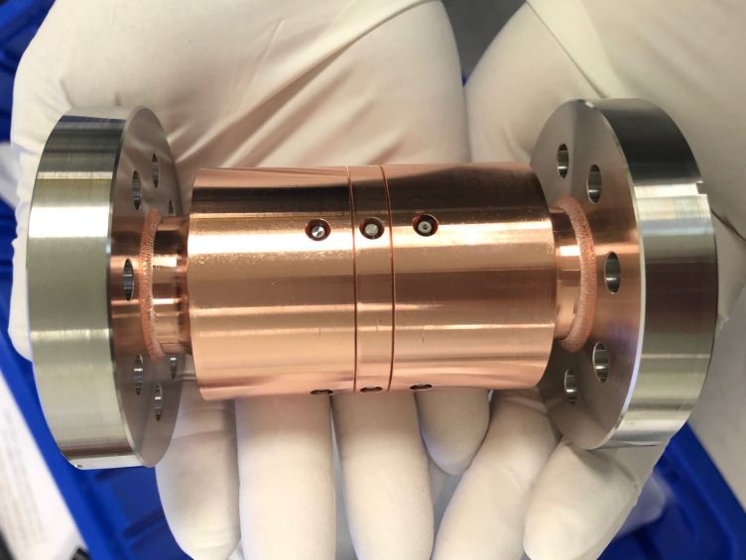
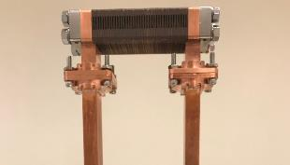




Short-pulse wakefield structure R&D for high gradient and high efficiency acceleration in future large-scale machines
Goal of LOI: Identify directions of structure R&D to increase gradient and efficiency in short-pulse wakefield acceleration
High efficiency
(AC-to-RF >30%)
Advanced structure R&D
$$BDR∝E^{30}τ^{5}$$
$$τ<20 ns$$
$$η∝t_{flat}/t_{pulse}$$
High gradient
(0.3-1 GeV/m)
$$E∝\sqrt{ωr/Q}$$
High shunt impedance
High group velocity
Dielectric loaded
Dielectric disk
Metamaterial
Most developed, simple geometry, low cost
B. Freemire et al. To be published
X. Lu et al. PRL 122, 014801 (2019)
Target: Develop fully functional structure for TeV-scale linear collider

Slide 2
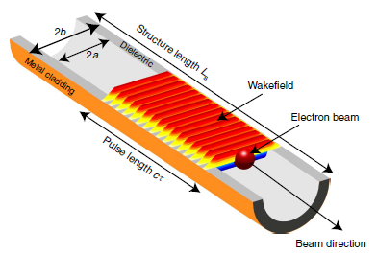

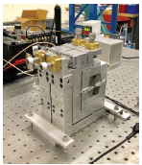
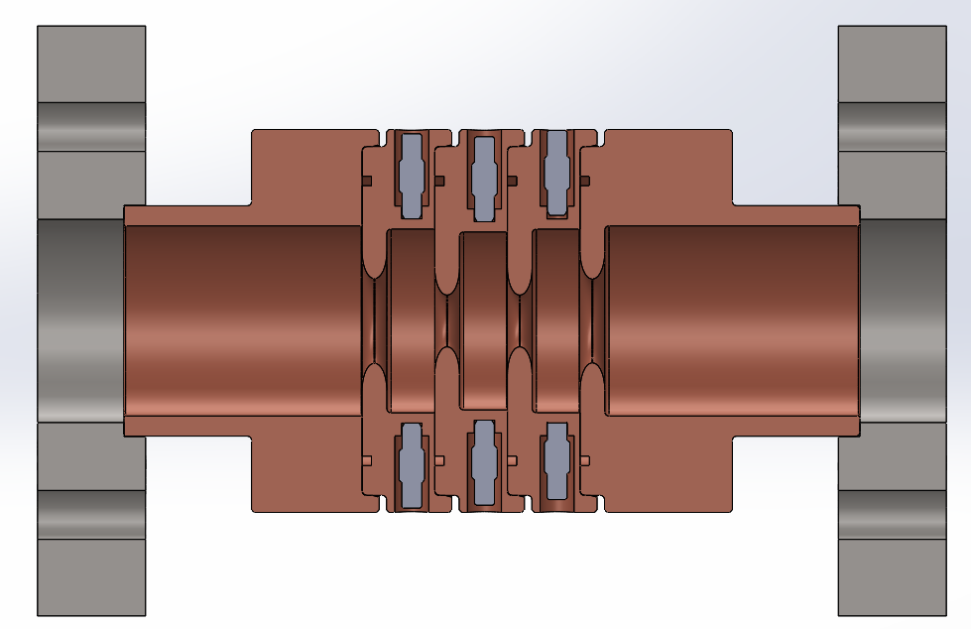

Short-pulse wakefield structure R&D for high gradient and high efficiency acceleration in future large-scale machines
mm-wave/THz structure R&D enabled by advanced fabrication
$$E∝\sqrt{ωr/Q}$$
GV/m capability
400 GHz dielectric-loaded structure
180 GHz metallic disk-loaded structure
B.D. O’Shea et al. Nat. Commun. 12763 (2016)
320 MeV/m
Under development
A. Zholents et al. IPAC2018
Target: Develop mm-wave/THz conceptual layouts and technology for linear colliders
Fundamental gradient limits study with short RF pulse
RF breakdown
Multipacting
Field emission
Others
* Preliminary result
X-band single-cell powered by 9 ns RF pulse, no breakdown at 250 MV/m acc gradient*
Target: Explore and understand fundamental limits in short-pulse regime

