Slide 1
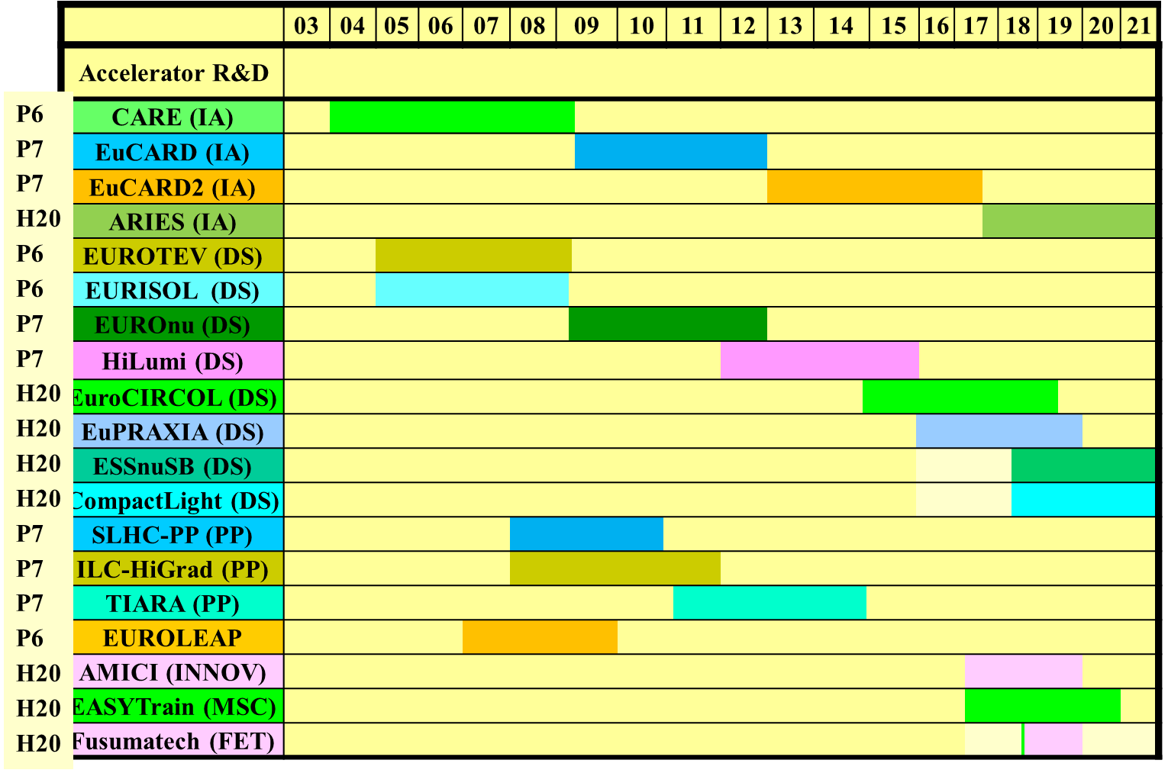
Exploiting Global Accelerator Network Synergies
R. Aleksan (CEA), A. Bogacz (JLab), S. Cousineau (ORNL), W. Fischer (BNL), G. Franchetti (GSI), J. Qiang (LBNL), D. Ratner (SLAC), V. Shiltsev (FNAL), M. Vretenar (CERN), F. Zimmermann (CERN)
Series of EU co-funded accelerator networks – including CARE (2004-2008), EuCARD (2009-2013), EuCARD-2 (2013-2017), and the ongoing ARIES (2017-2021) [1] – have developed the European accelerator R&D landscape into a “super-advanced community”, through a succession of topical workshops. So far 19 projects, with total cost >305 M€, and EC contribution ~105 M€, >100 partners (labs, universities, industry) in 21 countries.
EU co-funded European accelerator projects coordinated by the European
Steering Group for Accelerator R&D (ESGARD) [3] and Test Infrastructure and Accelerator Research Area (TIARA) [4] (from [2]) [IA: Integrating Activity; DS: Design Study; PP: Preparatory Project; INNOV: exploiting the Innovation potential of research infrastructures; MSC: Marie Sklodowska-Curie action; FET: Future and Emerging Technologies].

Slide 2
New EU instrument – Innovation Pilot – well adapted for super-advanced communities, next project “Innovation Fostering Accelerators Science and Technology” (I.FAST) [5]. If approved by the EC, I.FAST will be launched mid-2021, and extend over 4 years.
We propose to widen the I.FAST network activity beyond the borders of Europe, and strengthening links with the North-American accelerator community as a natural next step. Idea: leverage and extend the European network model to allow for a greater flexibility in catalysing new developments, not limited by any project scope, and to put to use the significant and complementary expertise available in the US. Widening I-FAST will also be of great benefit for the European accelerator science since it will receive new stimuli from the US community.
Jointly organized US/I.FAST workshops, held either in Europe or in the US or remotely as zoom meetings, could address some of the numerous intriguing opportunities at US facilities, such as IOTA, FRIB, CBETA, LCLS-II, PIP-II, EIC, SNS Proton Power Upgrade, and SNS Beam Test Facility. Other joint topical events could explore the grand challenges identified by the Snowmass process, and help develop longer-term strategies, e.g. for muon accelerators or micro/nanostructure-based highest-gradient accelerators.

Slide 3
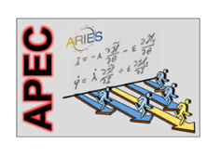
recent HORIZON 2020
ARIES WP6 workshops
APEC2018 workshop, Frankfurt am Main, Germany, 10-12 December 2018
DAFNE as Open Accelerator Test Facility, Frascati, 17 December 2018
Beam Tests and Commissioning of Low Emittance Rings, KIT, 18-20 February 2019
High Intensity RFQ meets Reality, Heidelberg, 15-16 April 2019
FCC Week 2019, Brussels, 24-28 June 2019
Mitigation of Coherent Beam Instabilities in particle accelerators (MCBI2019), Zermatt, 23-27 September 2019
Electrons for the LHC, Chavannes-de-Bogis, 24-25 October 2019
Space Charge mini-workshop, CERN, 4-6 November 2019
Accelerator Applications of Crystals and Nanotubes, EPFL Lausanne, 10-11 March 2020
Mitigation Approaches for Hadron Storage Rings and Synchrotrons (Mitigations2020), safe virtual space, 22 June – 1 July 2020

Slide 4
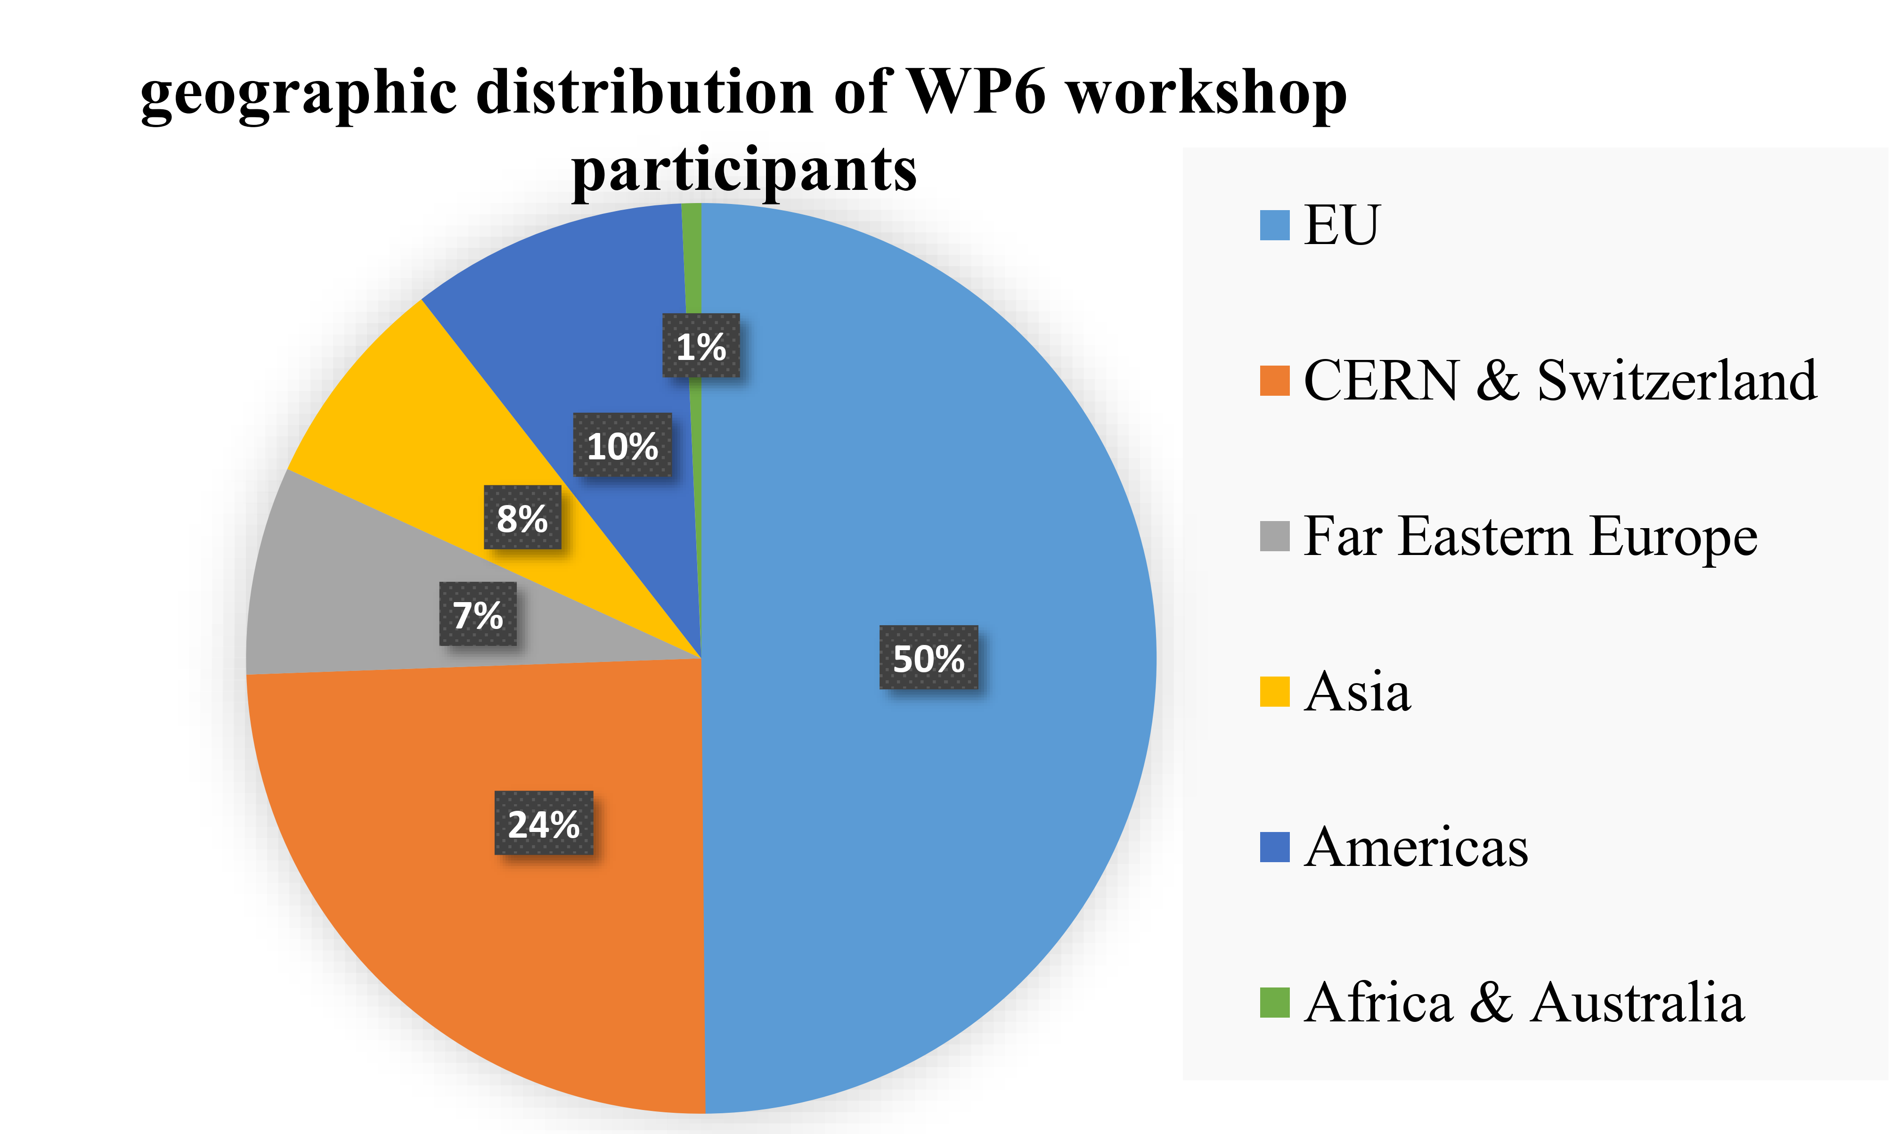
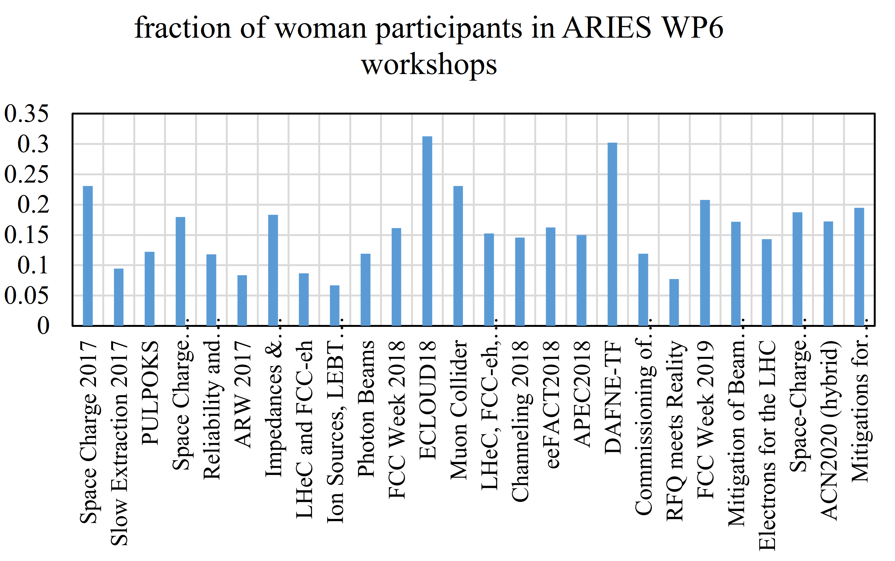
geographical distribution of ARIES WP6 workshop attendees
fraction of women participants in all WP6 workshops

Slide 5
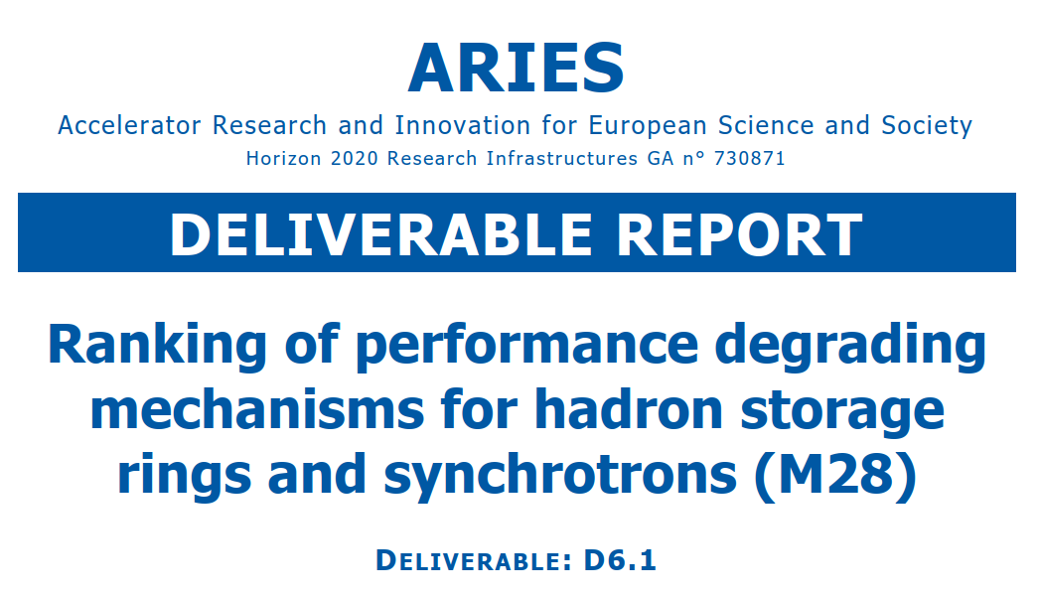
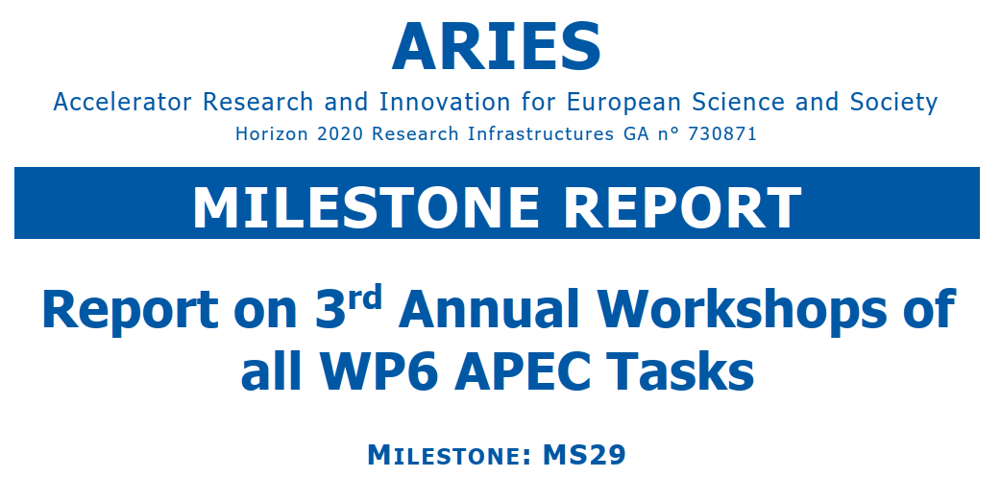
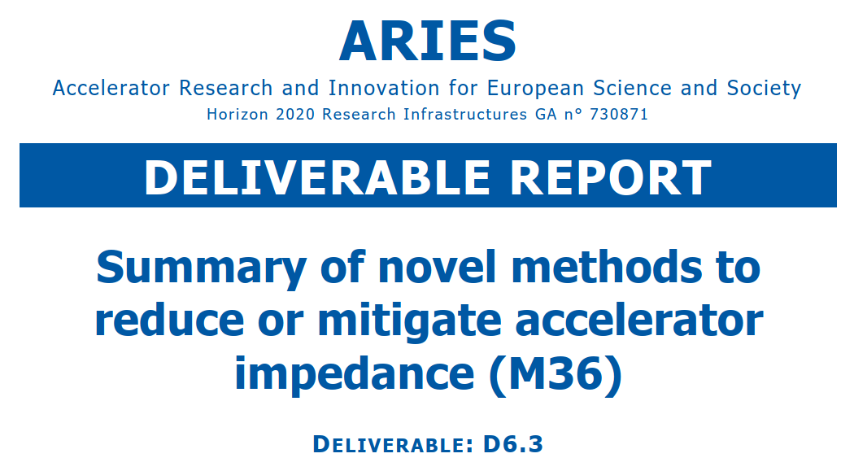
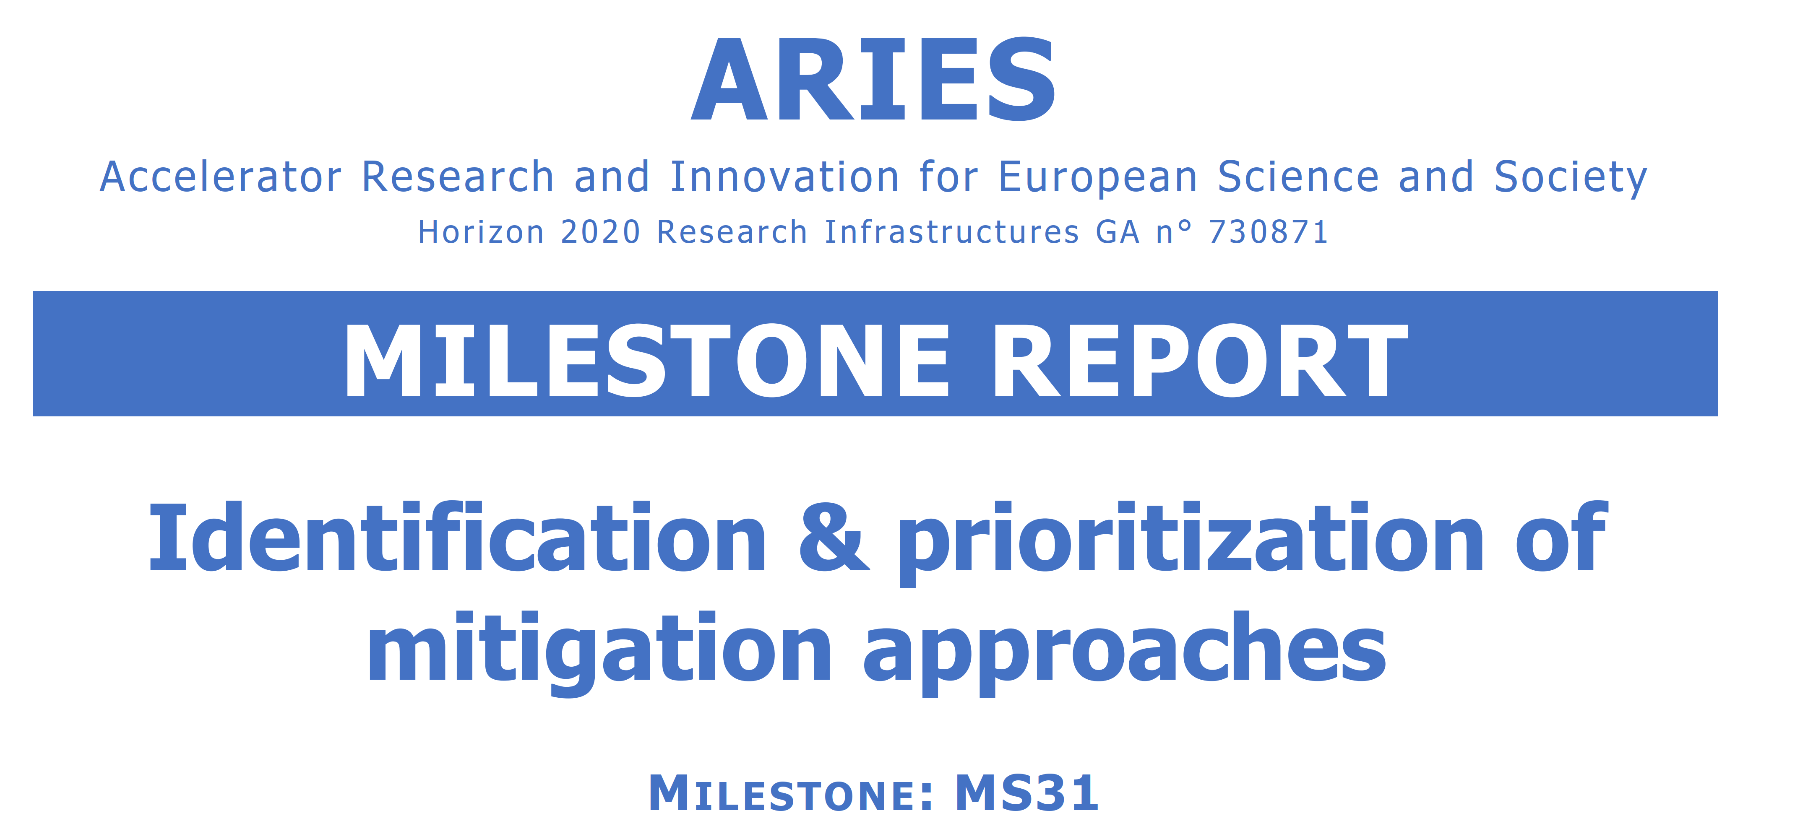
recent ARIES WP6 milestones and deliverables
approved
approved
approved
approved
approved
approved
submitted
approved

Slide 6
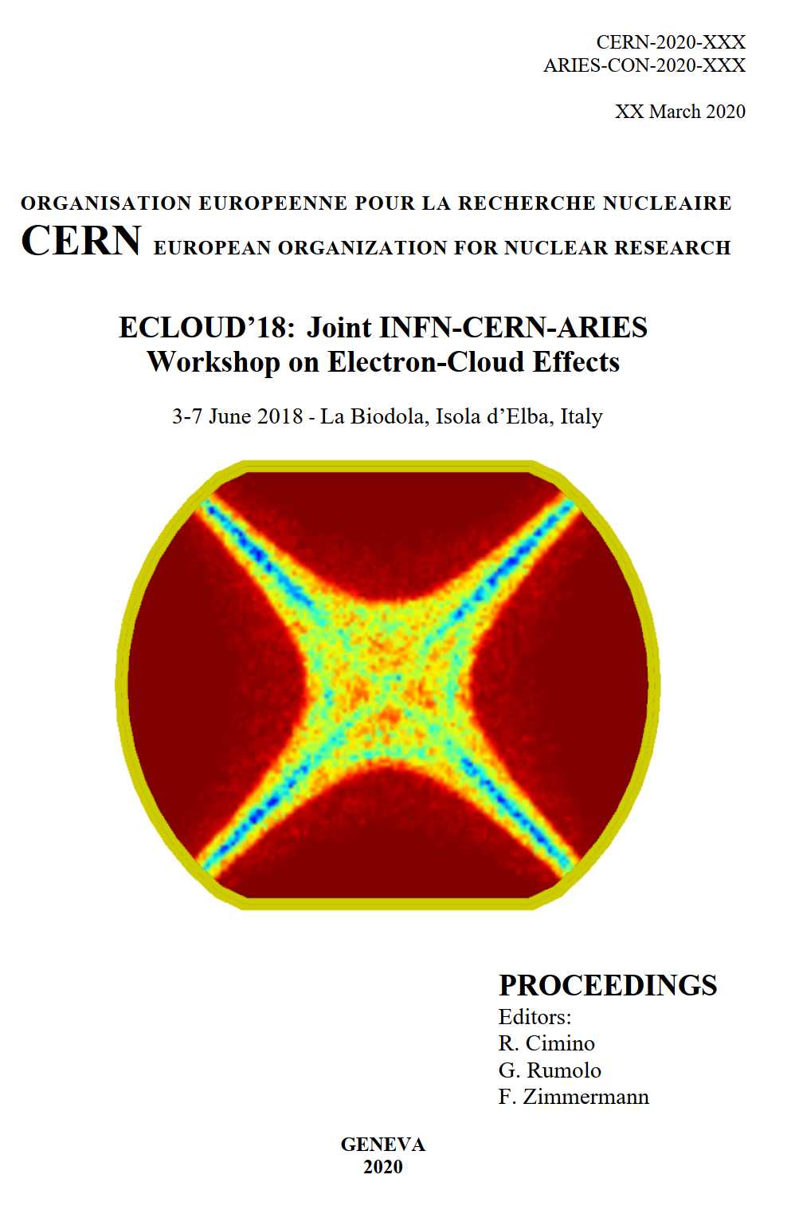
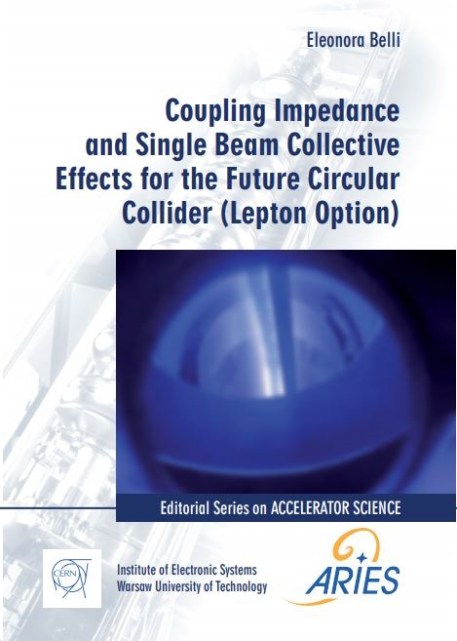
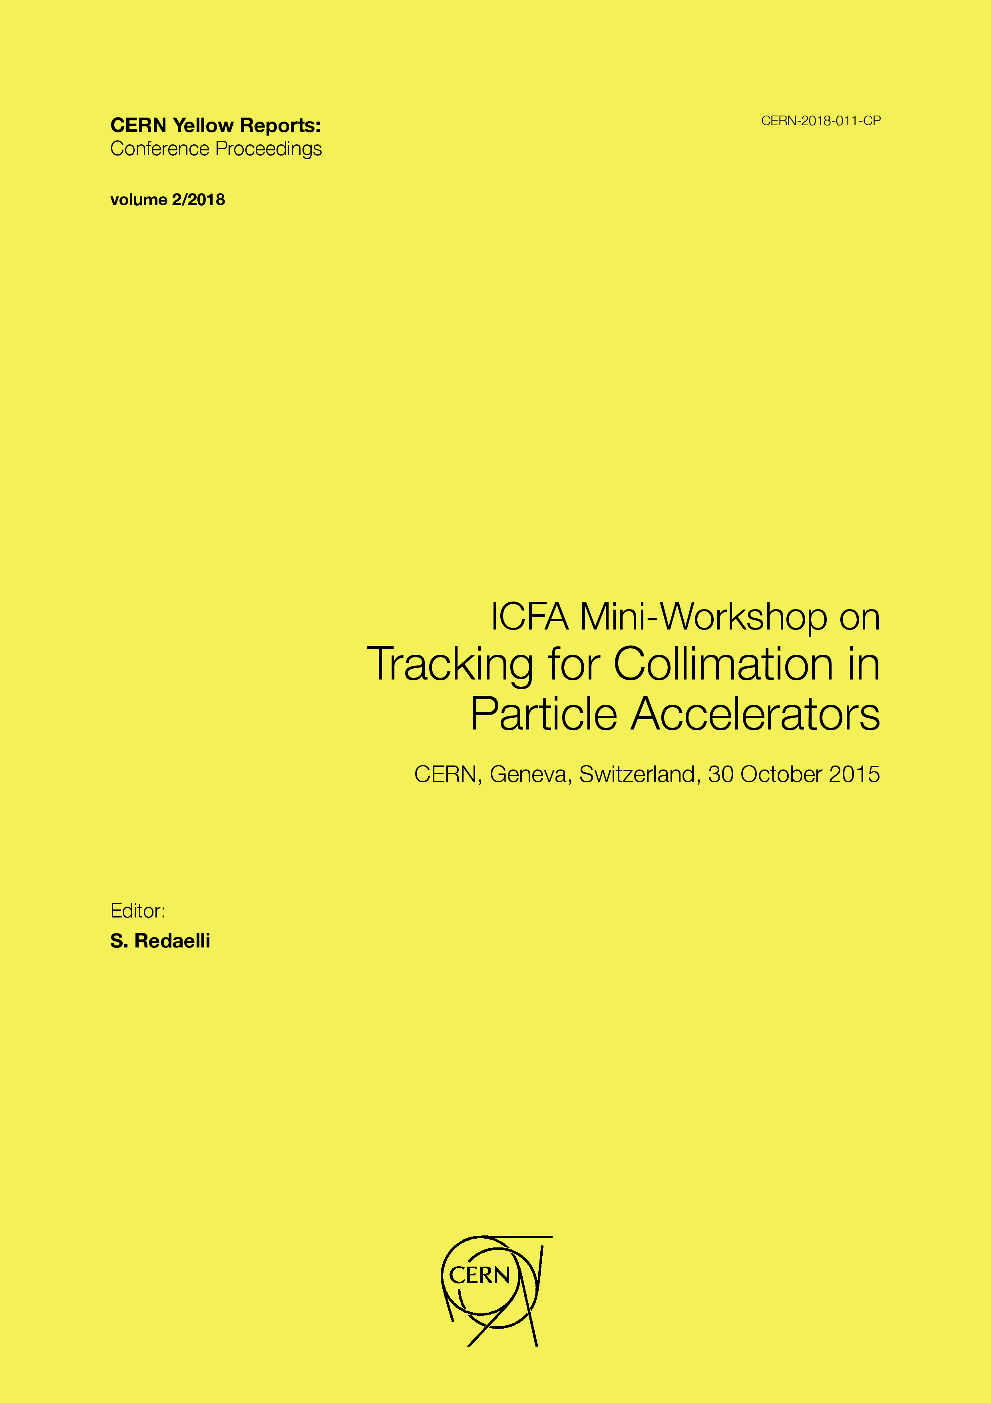
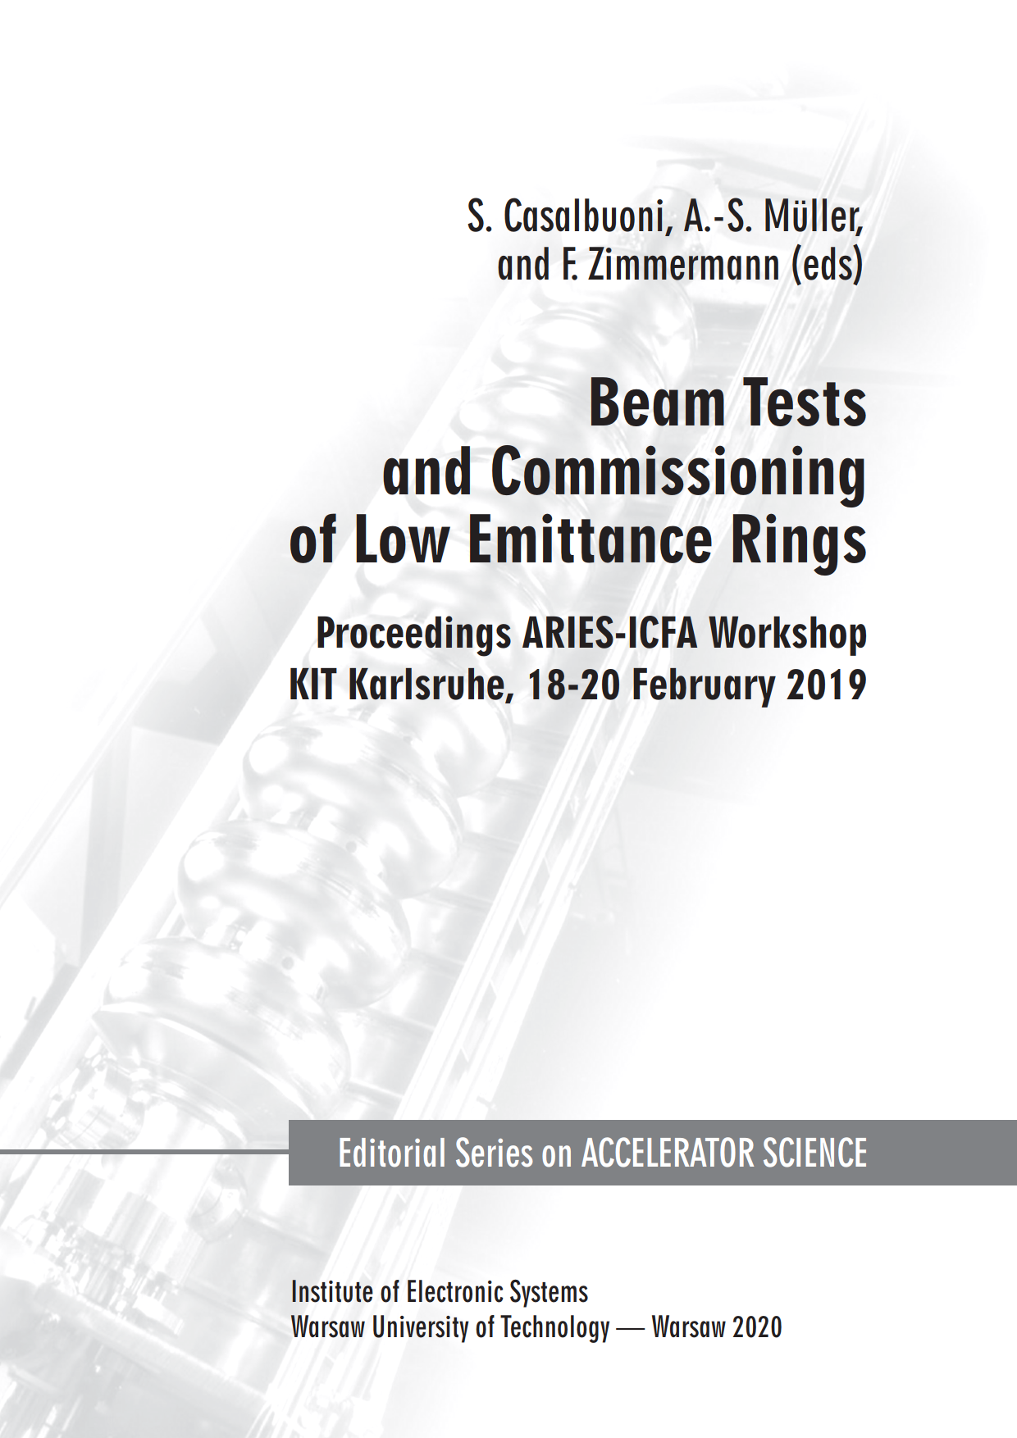
recent ARIES WP6 proceedings & monographs

Slide 7
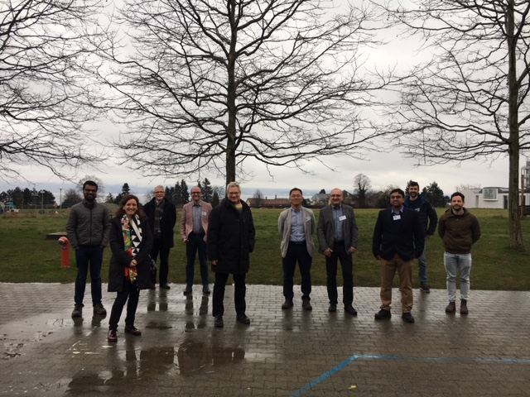
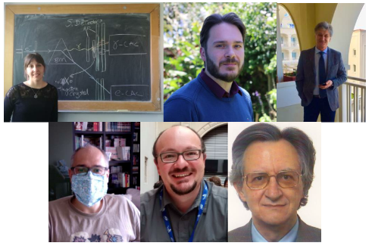
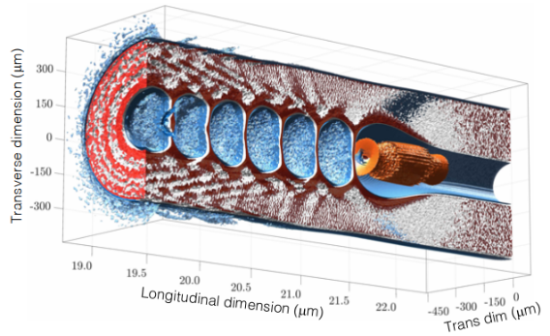
Applications of Crystals and Nanotubes for Acceleration and Manipulation, EPFL Lausanne, held during eruption of Covid-19 crisis
Organisers:
Tatiana Pieloni,
Marco Zanetti,
Frank Zimmermann
10 live participants
a few of the 19 remote participants
3D PIC simulation of near solid electron beam-driven crunch-in wakefield in a nanostructured tube of 200nm core diameter [Aakash Sahai]
workshop summary available

Slide 8
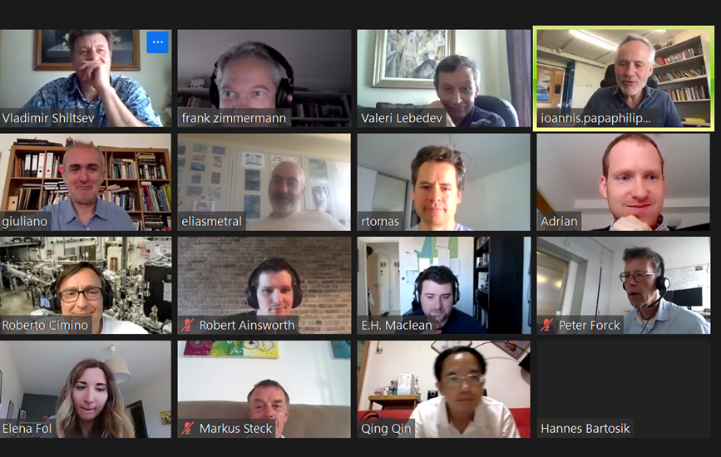
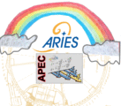
ARIES-APEC workshop on “Mitigation Approaches for Hadron Storage Rings and Synchrotrons” (Mitigations2020) was held, during the covid-19 pandemic, from 22 June to 1 July in a safe virtual space
118 participants

Slide 9
References
https://aries.web.cern.ch/home
R. Aleksan, TIARA Collaboration Council, June 2018.
http://www.esgard.org/
http://www.eu-tiara.eu/
M. Vretenar et al., “Innovation Fostering in Accelerator Science and Technology (I.FAST)”, proposal no. 101004730, submitted to the European Commission’s H2020 Call H2020-INFRAINNOV-2019-2020 (Demonstrating the role of Research Infrastructures in the translation of Open Science into Open Innovation) on 17 March 2020.

