Slide 1
Laser-Plasma Accelerator Facilities at the BELLA Center
n
Eric Esarey
Cameron Geddes and Carl Schroeder
BELLA Center
Snowmass AF6 September Workshop
Sep 24, 2020

Slide 2
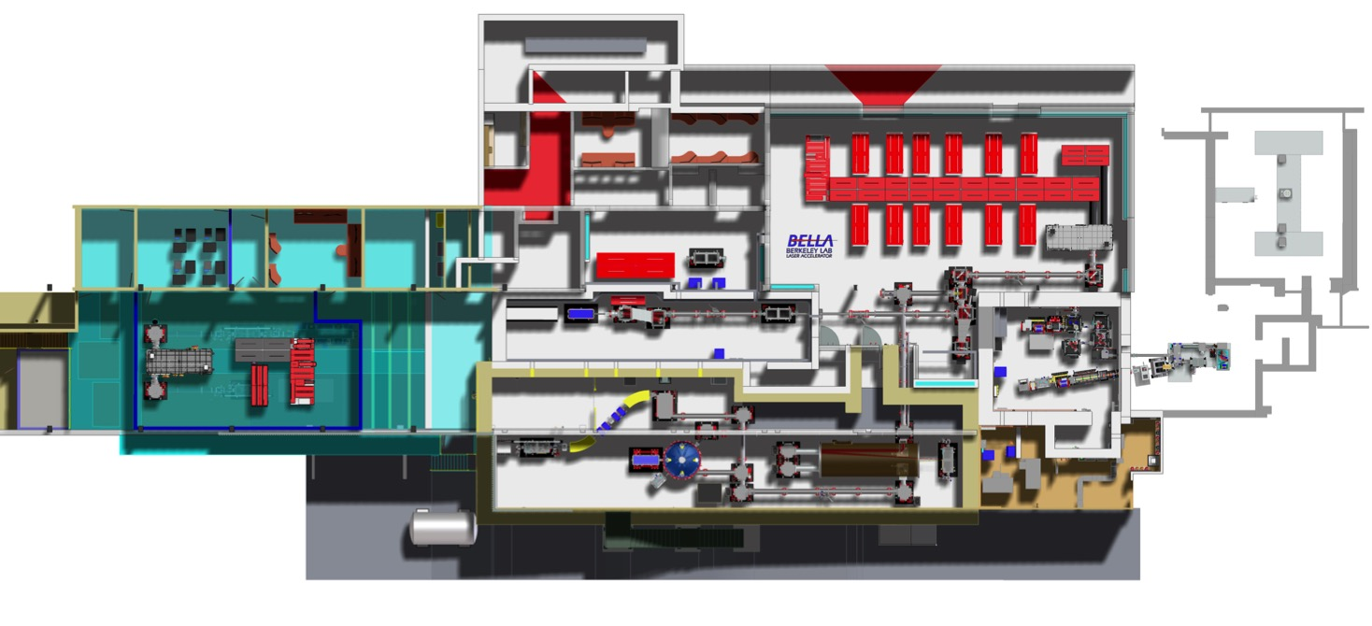
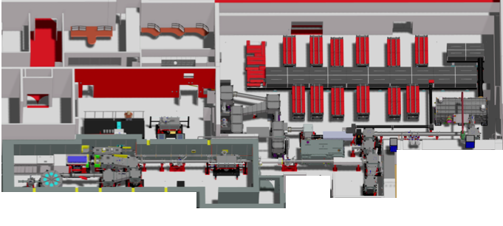
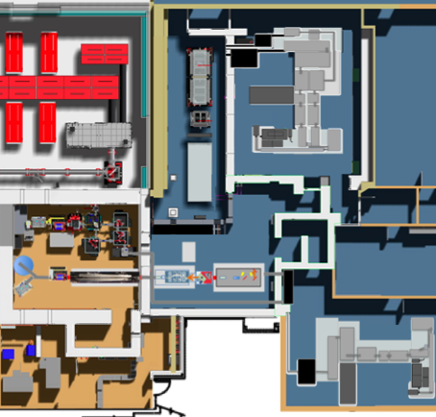
BELLA Experimental Facilities: World-Leading Capabilities Driving LPA Technology for High Energy Physics and Applications
Exisiting and planned laser facilities in Building 71 at LBNL
BELLA-2nd Beamline (Project)
5+5 GeV staging
Current BELLA PW: 10 GeV
100 TW
kBELLA
(Initiative)
kHz-kW LPA
Basic LPA Physics,
Radiation sources
BELLA-iP2 (Project)
Ion acceleration, HEDS
BELLA-i beamline
(Initiative)
100 TW
TW Medical
Unique resource of and for the DOE and beyond
2

Slide 3
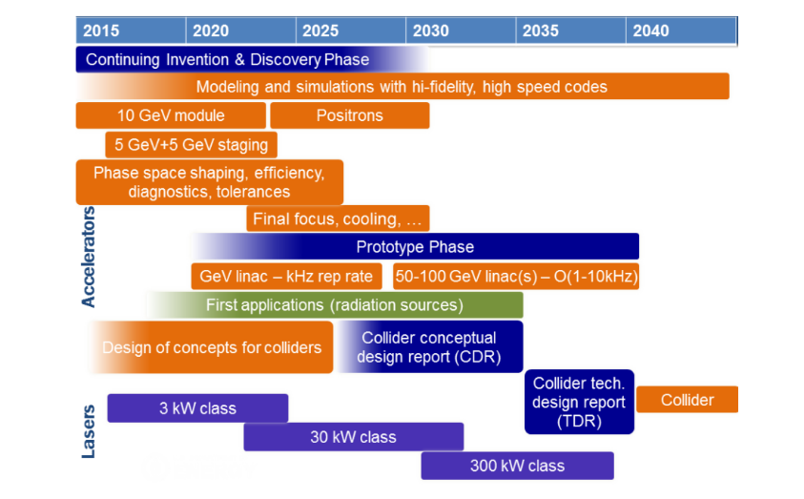
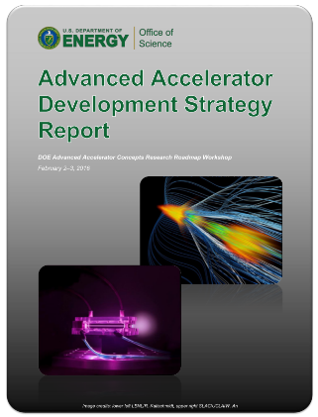
BELLA Center Activities Executing the 2016 U.S. National Advanced Accelerator Development Strategy
BELLA PW expts. underway
LDRD
2nd beamline underway
PW & 100 TW underway
kBELLA proposed
100 TW expts. underway
kBELLA proposed
Fiber lasers underway
3

Slide 4
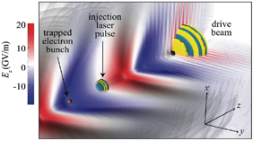
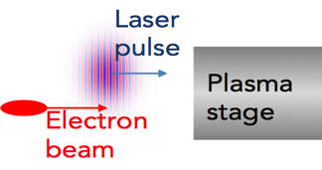
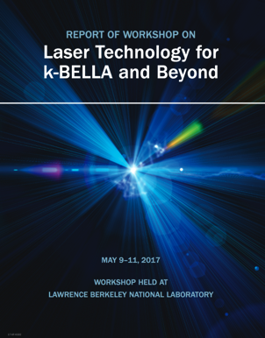
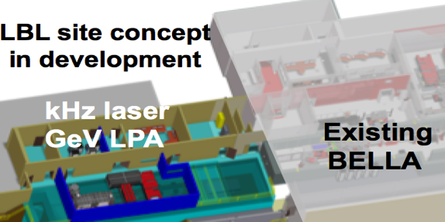
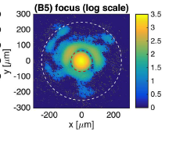
Future path beyond fluctuation limit & for applications: kBELLA kHz will enable step change in performance via active feedback & control
nm ε injectors:
≤ µm align
Important LPA firsts demonstrated
Order of magnitude in performance available, needed for HEP
kHz lasers enable precision for
increased LPA performance
Ground & air motion fall off at O[100Hz]
Correction demonstrated on kHz-mJ systems
Laser pointing: from µrad to < 0.1 µrad
Focal spot/wave front: now at fluct. limit
Pulse shape, near field, carrier envelope phase...
kBELLA: future khz, few-Joule 30 fs system: stabilized GeV
Enables light sources
Representative of stage physics
Develop LPA control and shaped laser pulse methods beyond limits of fluctuation
Currently Developing .
E: Stable few % <1%
ΔE: Stable at 10% <1%
Diverg: ~ mrad < 0.1mrad
Point: ~ mrad < 0.1 mrad
Emittance: 0.1 µm 0.01 µm
Charge: ~10 pC ~100pC
Efficiency: few % ~30%
Rate: Hz ≥ kHz
e- only e-, e+
Stage
Alignment
Stage efficiency
Shaped laser mode

Slide 5
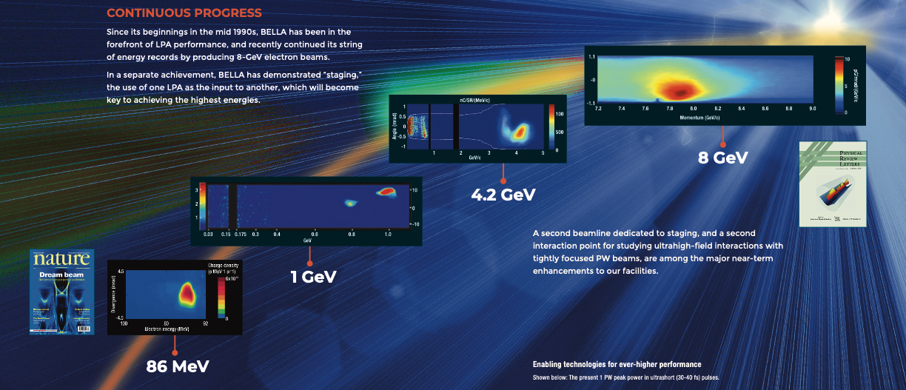
BELLA Center has driven sustained progress in Laser-Plasma Acceleration
Enabling a new generation of accelerators with orders of magnitude higher gradient
2019: 1000TW & laser heater
2014: 300TW
2014: 300TW
2006: 40TW
2006: 40TW
2004: 10TW
2004: 10TW
2016: 40TW staging demo

