Slide 1
Development of Long-Wave Infrared (LWIR)-based Advanced Acceleration Technology to Serve the Next Generation of Colliders
N. Vafaei-Najafabadi, V. Litvinenko, Y. Jing, I. Pogorelsky, M. Polyanskiy, M. Fedurin, M. Babzien, R. Kupfer, M. A. Palmer, A. Sahai, A. G. R. Thomas, C. Joshi, G. Andonian,Y. Sakai, J. Rosenzweig, R. Zgadzaj, M. C. Downer, S. Mirov, C. G. R. Geddes, C. Schroeder, E. Esarey

Slide 2
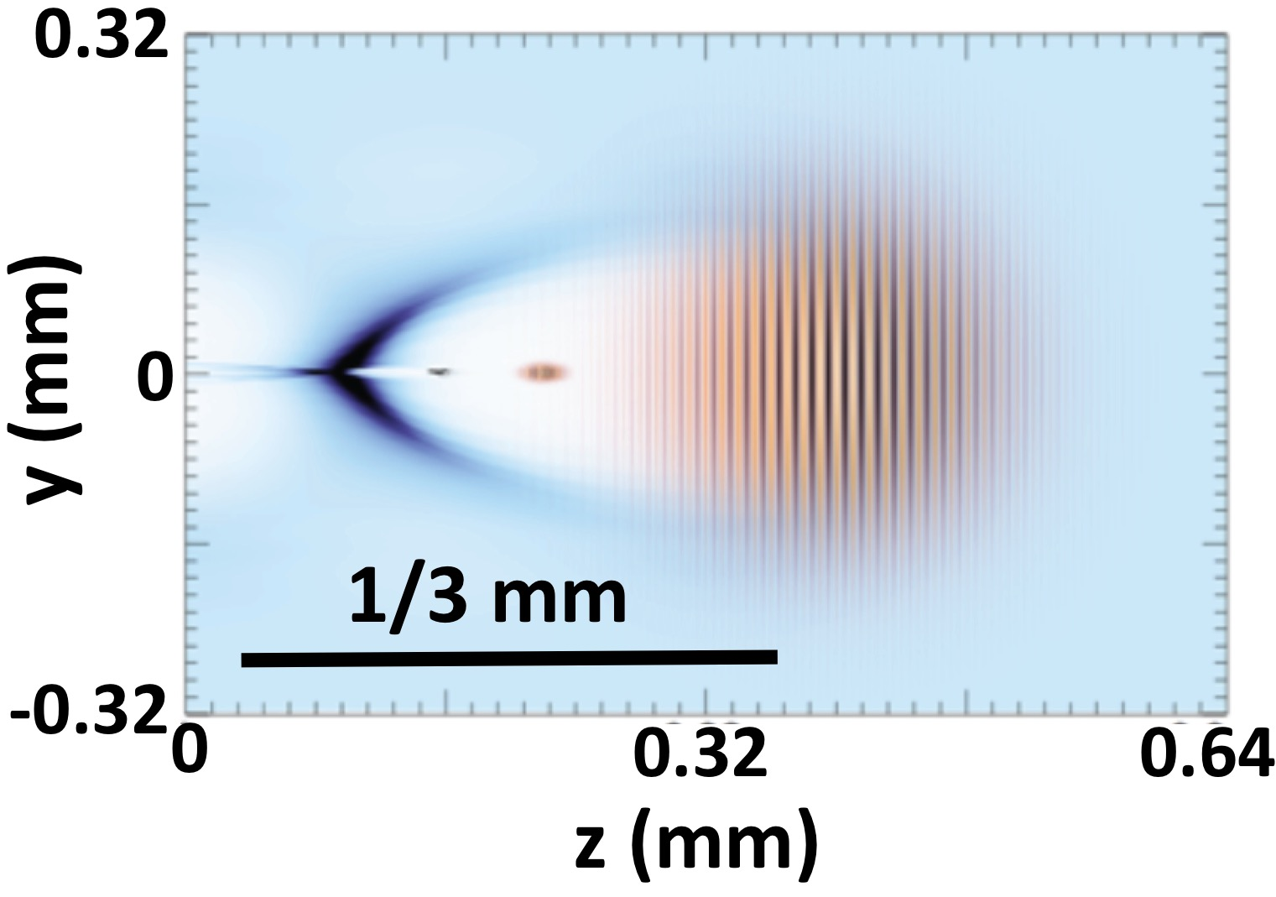
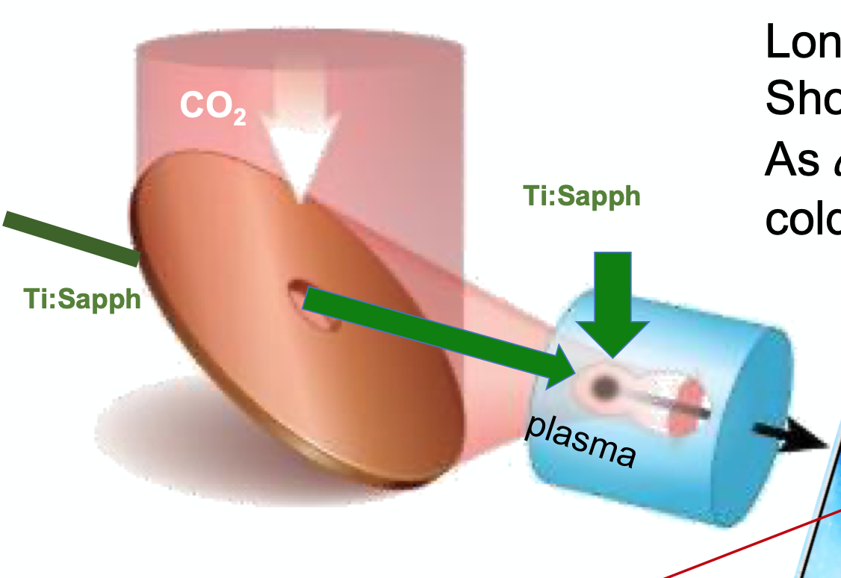
LWIR-Based High quality Particle and Photon Sources
Efficient driving of plasma wakefield at low densities allows LWIR to create plasma waves hundreds of μm in size
Acceleration of spin-polarized electron bunches with sub-% energy spread
Ultra low-emittance electron bunches via two-color ionization injection
e+ acceleration in quasi-nonlinear CO₂-driven LWFA
Efficient ICS conversion of e- to $γ$beams
Polarization control allows verification of Higgs circ. Pol.
LWIR allows suppression of pair production at TeV energies
Laser-driven ions: ultrashort beams at 100s of MeV with narrow energy spread
Increased population of hot electrons at LWIR compared with NIR
Feasibility of tailored critical density plasma using gas jets to optimize beam
Notes:
First picture:
n_{e} ≈ 2 × 10¹⁶ cm⁻³
Plasma electrons do not self-inject
inject ∆E_{e}/E_{e} = 10⁻³, spin-polarized, 1 nC e-bunches from 50 MeV linac (known technology).
∆E_{e}, Π_{s} preserved during acceleration *

Slide 3
Technology R&D at ATF is Bridging the Capability Gap
CO₂ Laser
λ =9.2 μm
Current: 5 TW, 2 ps
Goal: 20 TW, 0.5 ps
Linac e-beam
75 MeV, <2 nC at 1.5 Hz
$ε_{n} \sim 1 mm−mrad$
$σ_{z}>100$ fs
NIR (Ti:Sapphire)
< 100 fs compressed
10 mJ
Towards 20 TW, sub-ps, LWIR CO₂ laser pulses ($\sim$1-5 year time scale)
Solid-state mJ seed$→ \sim$1 ps (10 TW)
Nonlinear pulse compression $→ ≤$0.5 ps (20 TW)
Optical pumping for high repetition rate and increased reliability
e-beam ($\sim$1-5 year time scale)
Advanced Compression for $σ_{z}<$30 fs bunch to enable injection experiments
Diagnostics for phase space analysis (e.g T-CAV with femtoseconds resolution)
Experimental Diagnostics Capabilities
Tight synchronization and alignment enabled by high rep-rate
Advanced laser-plasma acceleration diagnostics (CTR, polarimetry , etc)
Notes:
Preliminary indications for NLPC is that TW power at sub-ps wavelength has been achieved

