Slide 1
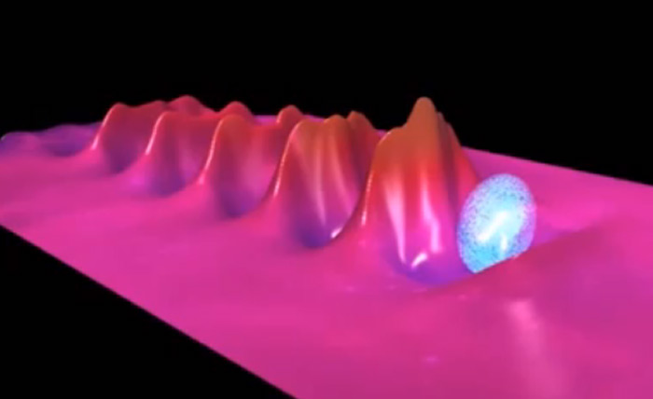
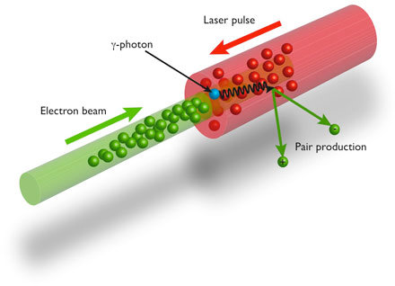
ZEUS is a combined wakefield accelerator / 3 PW laser system building on significant NSF investment at the University of Michigan
to operate as an international user facility operational in 2023
up to 500 TW (5 Hz) laser generating electron beams with energy > 5 GeV (for feedback control and machine learning)
Up to 100 J in pulse-shaped nanosecond beam for shock-driving
2.5 PW laser can be focused to 10²³ Wcm⁻², greatly exceeding the quantum electrodynamic critical field when colliding with a 5 GeV electron beam (in electron rest frame)

Slide 2
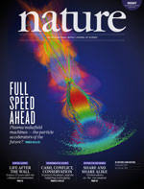
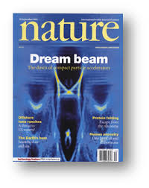
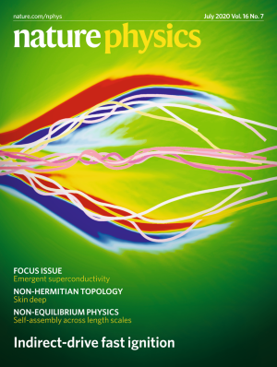
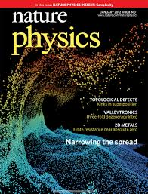
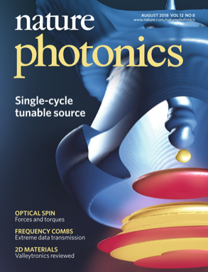
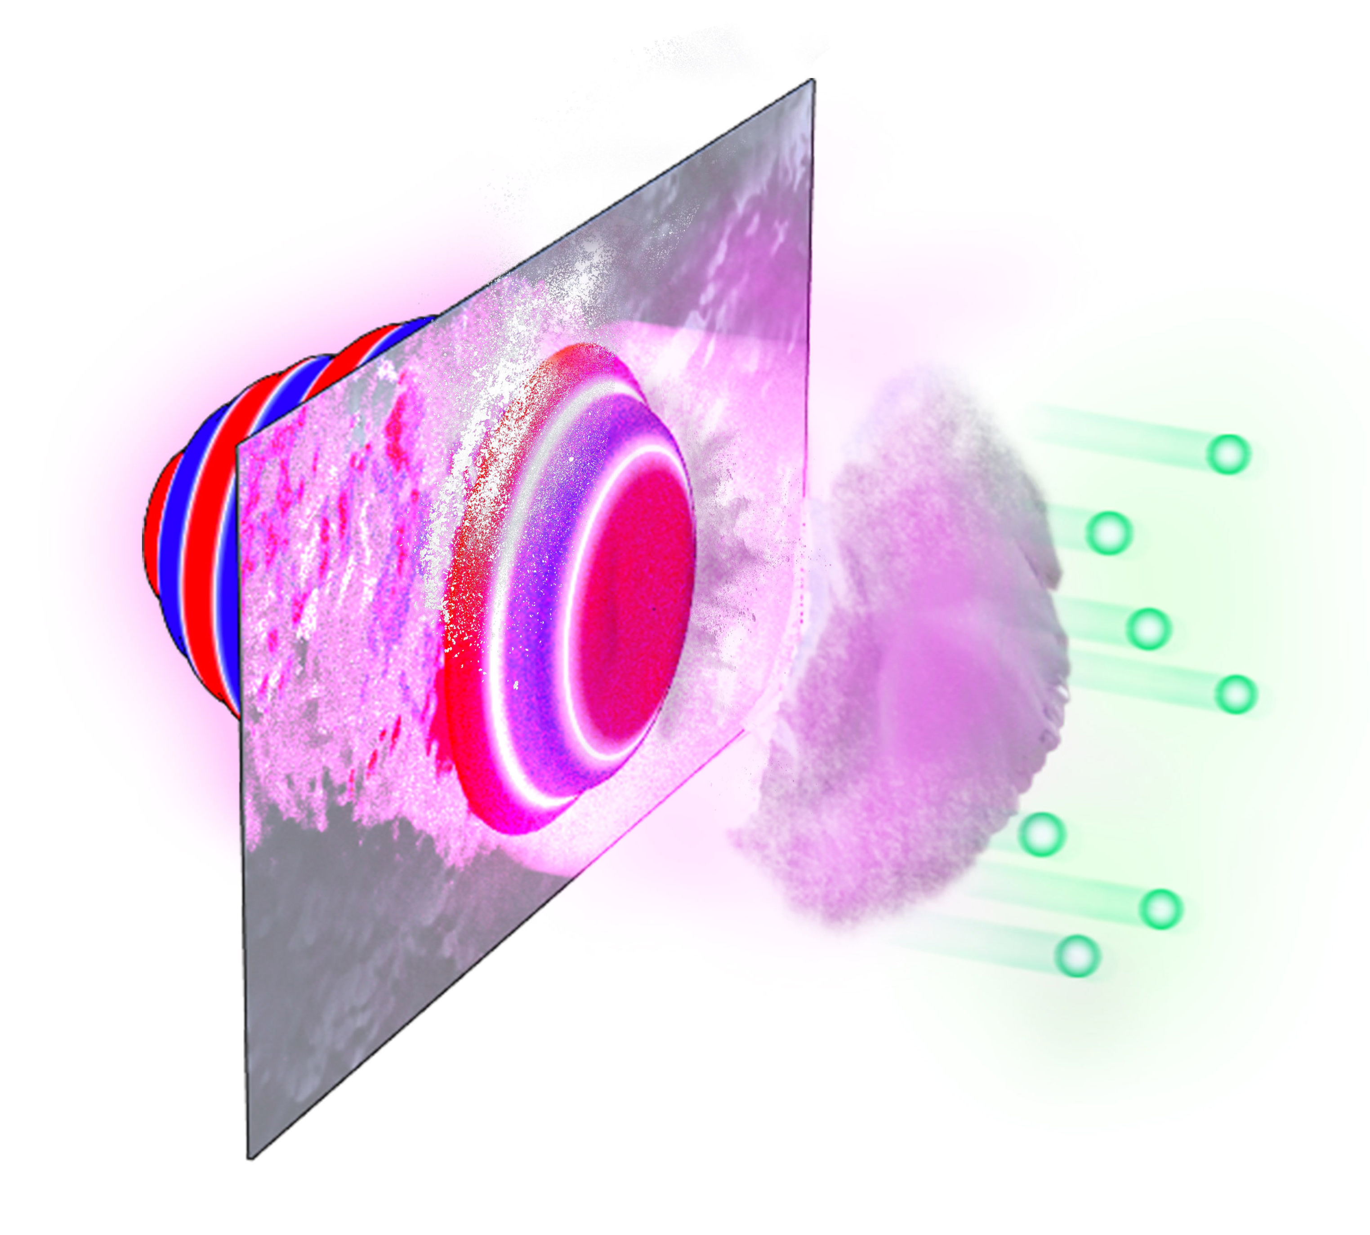
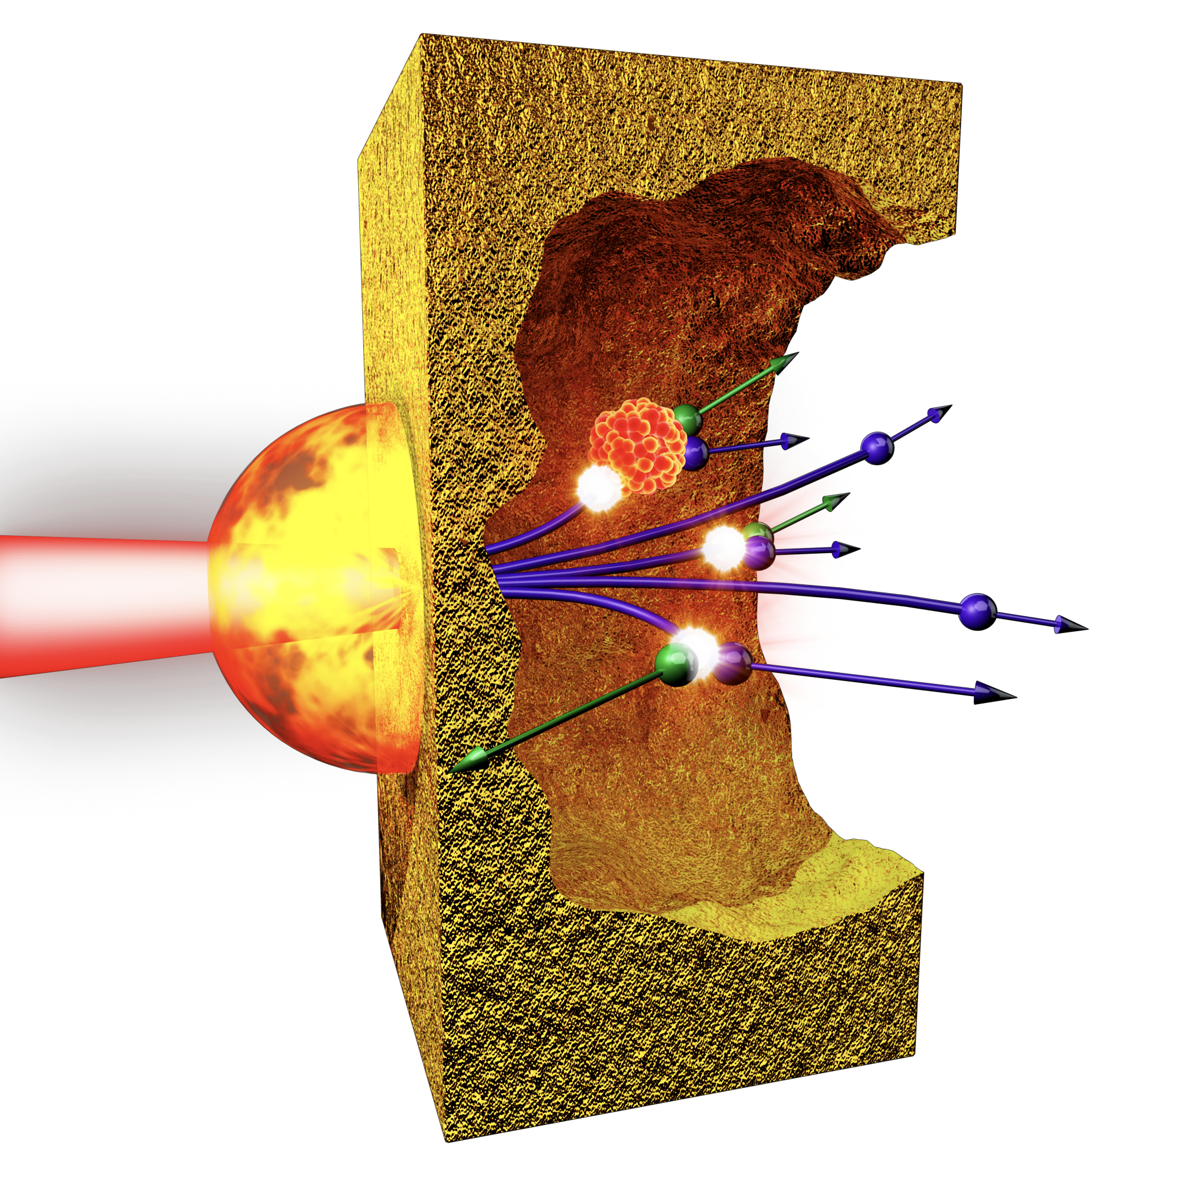
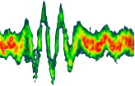
Can lasers and plasmas enable next generation X-ray and particle sources on a tabletop?
Intense laser interactions with plasma lead to strong electric fields that can accelerate charged particles to high energies
Ultrafast lasers lead to extremely short duration, high-brightness sources of radiation
Precision beams for scientific applications
Laser-plasma ion acceleration
Laser plasma-wakefield lepton acceleration
Coherent X-ray generation
Laser driven muon, positron, pion gamma ray, etc. sources

