Slide 1
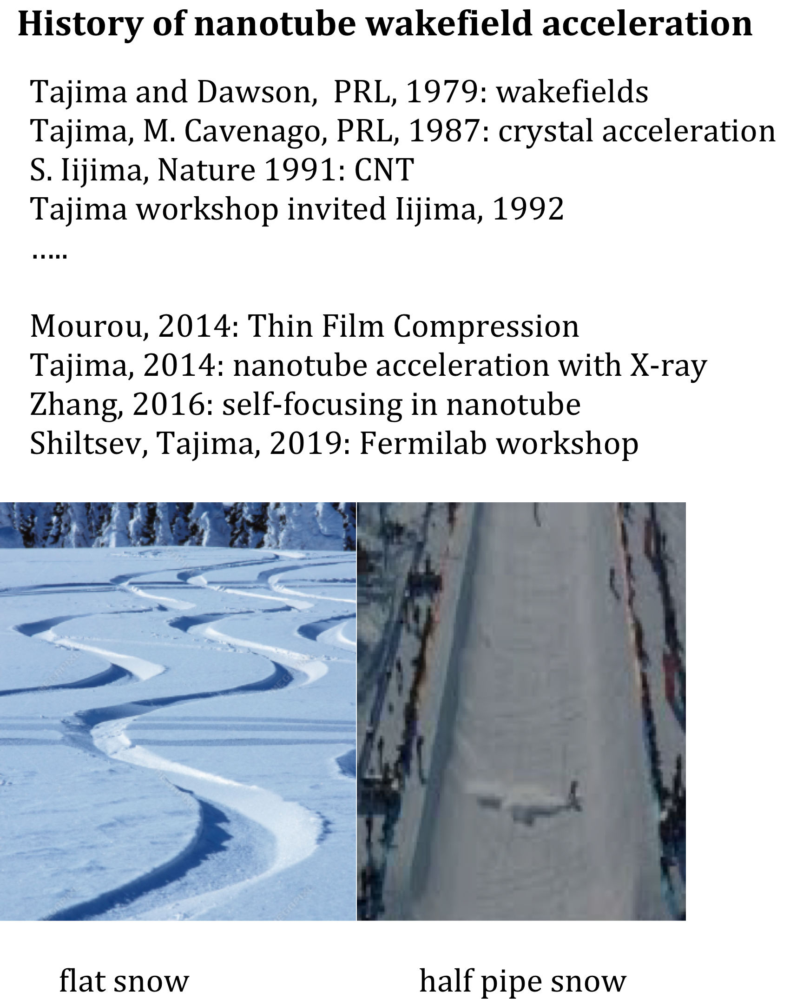
Many nanoholes
Single nanohole
Book published (2020)
Gathered for nanotube wakefield acceleration (Fermilab, 2019)

Slide 2
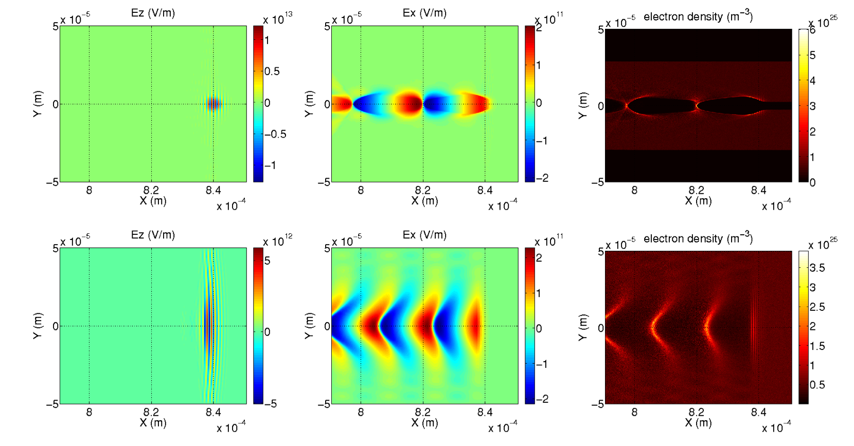
E.g., X-ray LWFA in nanotube vs. uniform
in nanotube
X. Zhang (PRAB 19, 101004 , 2016)
in uniform solid
A few-cycled 1keV X-ray pulse (a₀ ~ O(1)), causing 10TeV/m wakefield in the tube
more strongly confined in the tube cf: uniform solid
Project: proof-of-principle experiments, augmented with theory, modeling and diagnostics development
CNT diameter: 10s-100s nm, singular or bundle of nanotubes
drivers: lasers (higher harmonic, TFC X-ray) or ultra-dense e- bunch
Goals: studies, PoP demo, modeling confirmation → 1 GeV over < 1 cm in 4-6 years
Collaborators: Mourou, Geddes, Shiltsev, P. Chen, Corde, Taborek, Dollar, Hakimi, Sahai, Zhang, Bulanov, ELI-ALPS, Kawachi (QST), Sone (JST), Iijima, …. (open armed, see following speakers, too)

