Slide 1
Photonic Crystal (PhC)-based Dielectric Laser Accelerator (DLA)
G. Torrisi¹, L. Celona¹, S. Gammino¹, G. S. Mauro¹, D. Mascali¹, G. Sorbello^{1, 2},
A. Locatelli^{3,4}, C. De Angelis^{3,4},
A. Gallo⁵, M. Bellaveglia⁵, M. Diomede⁵, L. Piersanti⁵,
G. Della Valle⁶,
A. Bacci⁴
¹INFN-LNS, Catania, Italy
²University of Catania, Catania, Italy
³University of Brescia, Brescia
⁴ INFN-LASA, Milano, Italy
⁵ INFN-LNF, Frascati, Italy
⁶ Politecnico di Milano, Milano, Italy

Slide 2
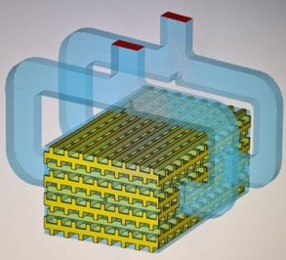
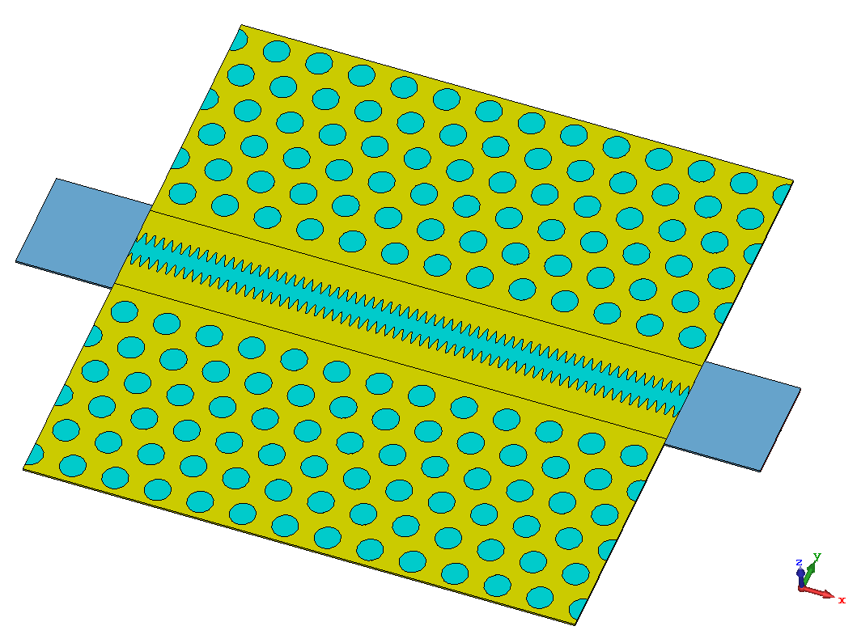
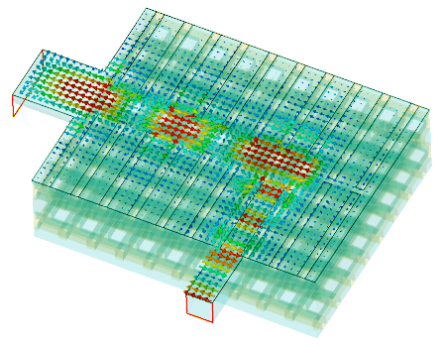
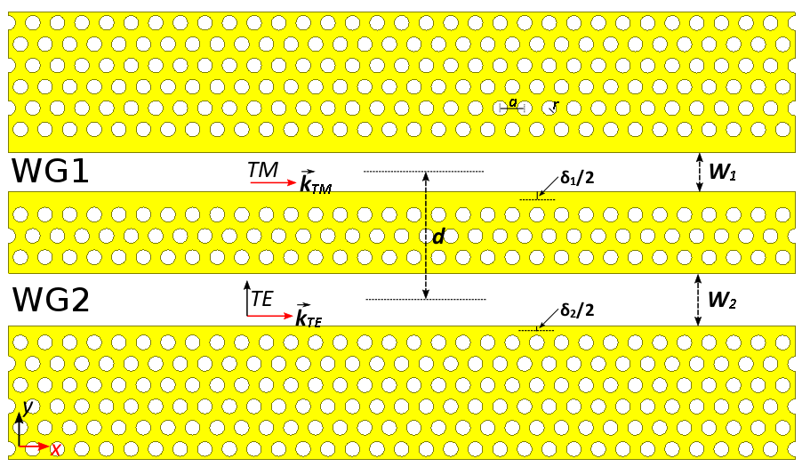
Photonic Crystal (PhC)-based Dielectric Laser Accelerator (DLA)
LoI Core Ideas:
Hollow-core waveguides for high power handling
High interaction impedance Z_{c} and accelerating gradient
Continuous wave (CW) laser operation (1-5 µm)
Collinear co-propagating laser and beam
Sub-wavelength features for sub-relativistic particles
Integrated nano-proton-source for proton-DLA
TE₁₀
TE₁₀
DLA high-Q photonic-crystal cavity
[courtesy of C2N]
TM₀₁
o
beam
3D Silicon Woodpile mode launcher
beam
TM₀₁
Laser
beam
o
Laser
beam
modulation of the
dielectric “electrode”
TE₁₀
RFQ-like 2D Longitudinal PBG
for tabletop proton-DLA
2D longitudinal Photonic Crystal
Directional Coupler
3D woodpile mode converter side-coupler

Slide 3
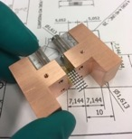
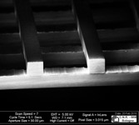
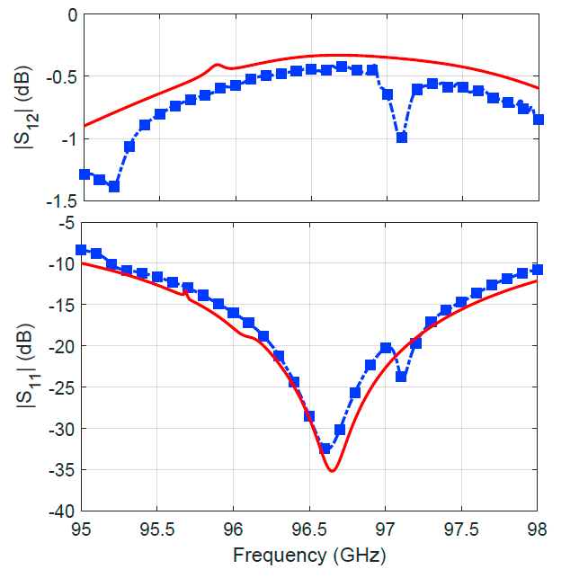
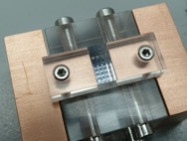
Silicon woodpile waveguide
Fabrication & cold test at scaled mm-wave frequencies
high speed and precision dicing saws
silicon wafers 850 µm thick with resistivity > 3 kΩcm
stacking together 9 silicon layers
geometrical tolerance of 10 µm
copper box
waveguide port
woodpile
Simulated vs Experimental
S-parameters
Manufactured dielectric PhC woodpile structure
TEAM
INFN-LNS, INFN-LNF, UniBs & UniCT: Accelerator design
PoliMi, Politecnico di Milano: Laser Source
INFN-LASA: beam dynamics
C2N, CNRS,Université Paris-Saclay design & manufacturing

