Slide 1
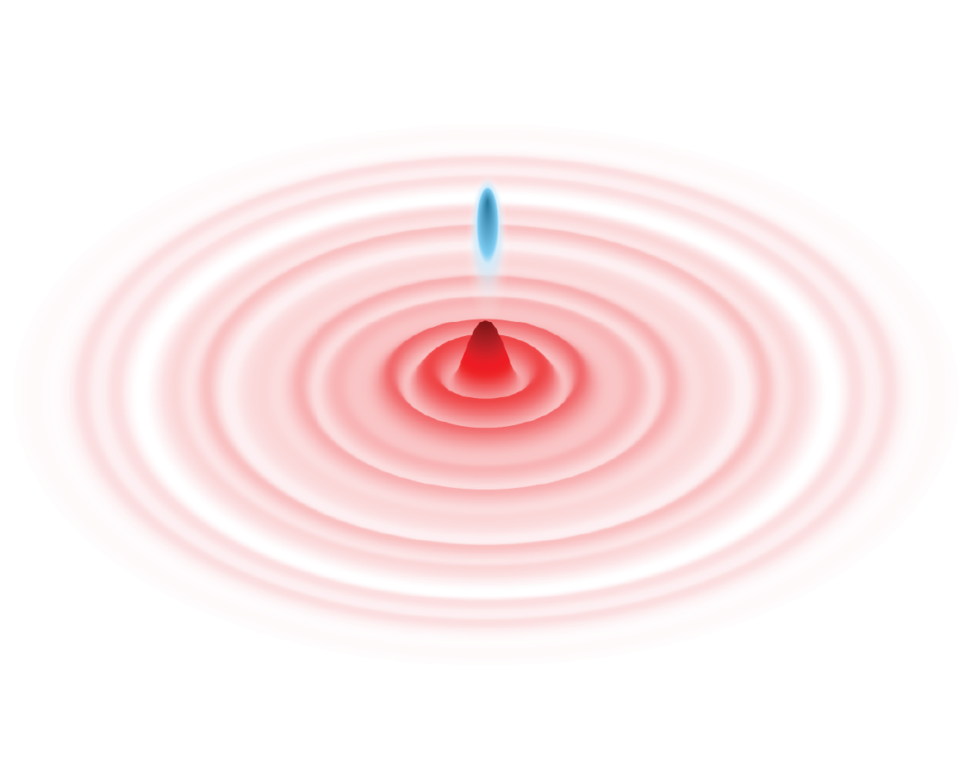

Slide 2
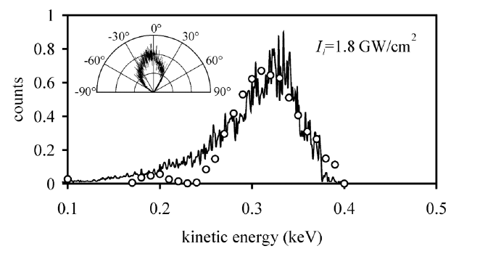
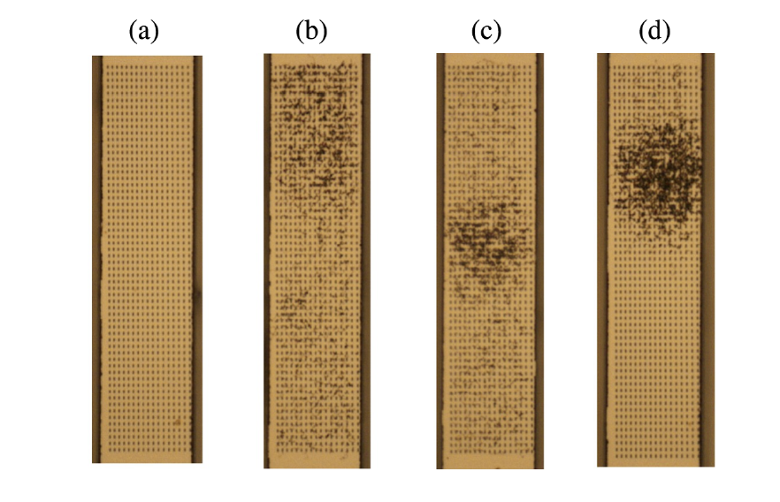
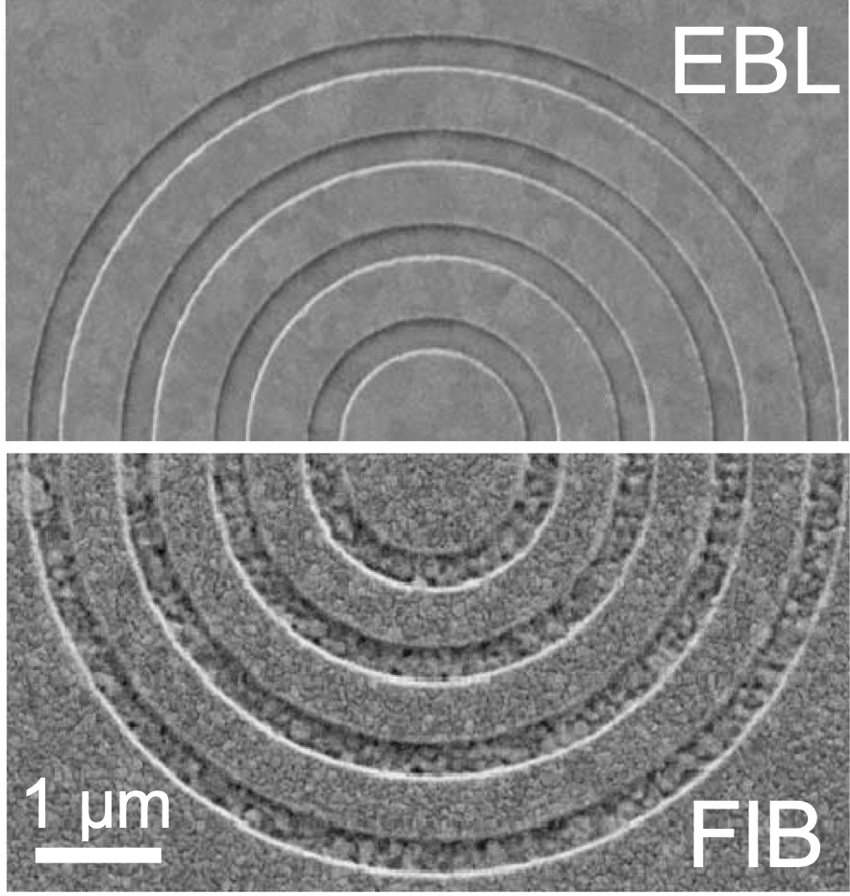
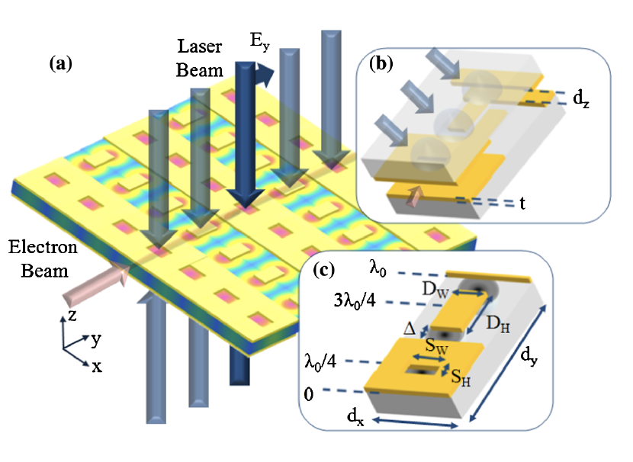
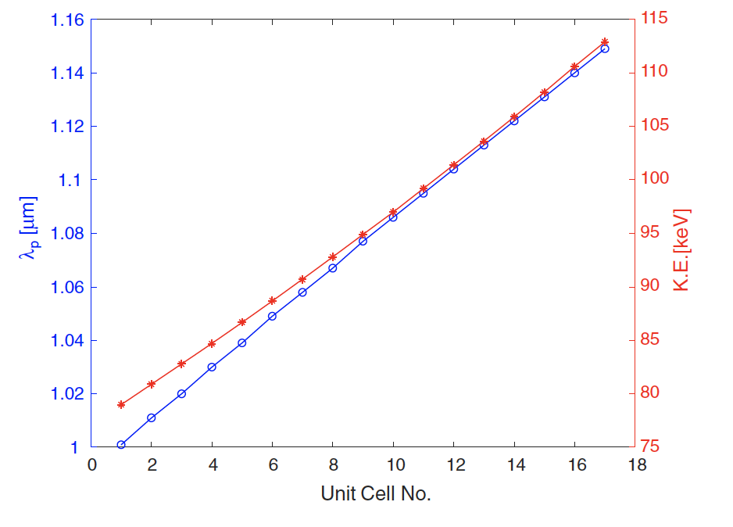
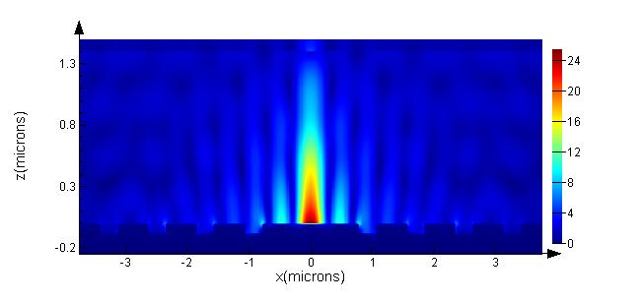
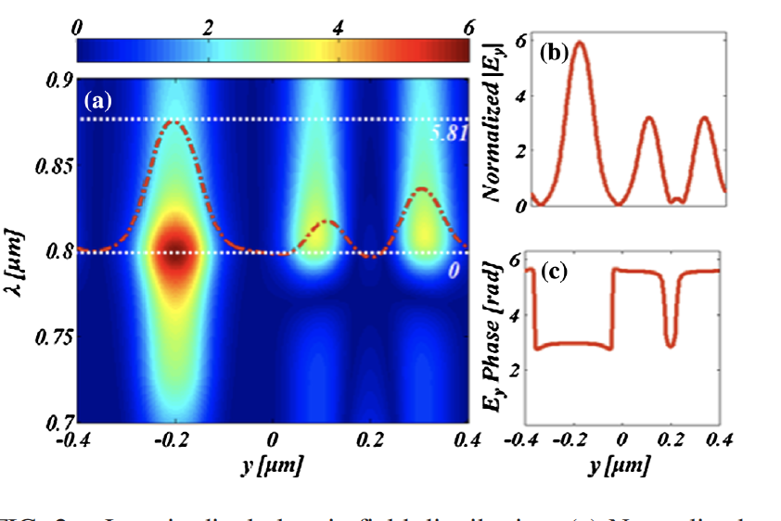
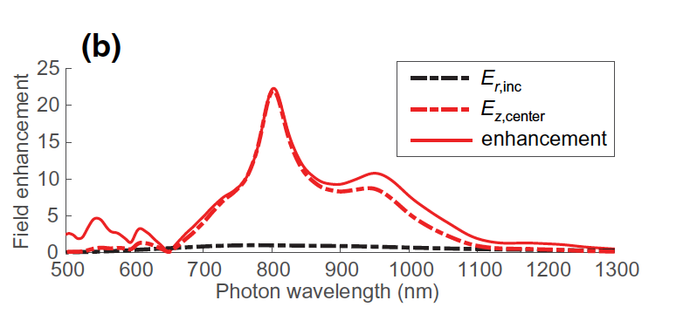
SPP-enhanced MLA : An emerging beam acceleration and manipulation technology for high energy accelerators
Relevance to HEP for Particle collider technology
SPP enhancement in metallic nanopatterned structures provides access to GV/m accelerating gradients from nJ-class laser pulses
Early experiments demonstrate field and e- acceleration
Initial tests on damage threshold confirm ability of GV/m fields
All the key parts of an MLA accelerator have been studied and/or characterized, and practical solutions are available (cathode, injector, accelerator)
The design of low-Q structures enables use of ultrashort pulses and minimization of local heating due to SPP trapping
Lasers and nanofabrication technologies ready.
System efficiency can be high, Use fiber lasers. SPP enhancement concentrates the field in the acceleration region.
Bunch format similar to DLA. Low charge/high repetition rate.
Plasmonic-based sensors for beam diagnostic can be included in the design
Au damage threshold
E_{i}~ 1 GV/m (250 fs, 100KHz)
E_{acc}=1.5 GV/m
Tapered acc. cells
D. B. Durham et al., Phys. Rev. App. 12, (2019).
E. Irvine, A. Dechant, and A. Y. Elezzabi, PRL 93, (2004).
D. Bar-Lev, et al., PRAB 22, (2019).
D. Bar-Lev and J. Scheuer, PRSTAB 17, (2014).

Slide 3
Overarching questions for AF: AF6
What is needed to advance the physics? Enable new capabilities
Laser-based acceleration mediated by nanostructured metallic surfaces, GV/m accelerating fields in a compact setup. Use of a static structures for acceleration. Nanotechnology allows to very precise control of the fabrication process. Very modest laser pulse requirements.
What is currently available in the world? progress in techniques, collider concepts and path
Design, realization and optical characterization of an SPP-based cathode. Design concepts and dimension optimization for injector and accelerator sections. Early tests and demonstration of e-beam acceleration.
New accelerator facilities available in the next decade?
Accelerating section modules can be tested in compact beamlines already used for DLA. Compact injectors. The power handling at high repetition rate operations could be tested at HiRES-LBNL, producing 1 MeV beam at MHz-rep rates.
Intermediate applications and how they contribute to collider path
UED, compact FELs, medical applications. Would increase technology readiness. Provide platforms for testing and optimization of tools for measuring, manipulating and controlling MLA beams towards LC.
What R&D would enable these future opportunities?
Testing of novel concepts at test facilities. Improved simulation tools merging FDTD EM simulations and particle tracking. Explore new concepts and structure design with ML and inverse design. Spatial beam combining from different MLA accelerators

