Slide 1
Modeling of structured plasmas for next generation accelerators Nathan Cook ncook@radiasoft.net LOI Link Co-authors: Carlo Benedetti², David Bruhwiler¹, Enrico Brunetti⁸, Stepan Bulanov², Stephen Coleman¹, Brigitte Cros⁷, Bernhard Ersfeld⁸, Spencer Gessner⁶, Ahmad Fahim Habib⁸, Thomas Heinemann⁸, Bernhard Hidding⁸, George Holt⁸, Dino Jaroszynski⁸, Remi Lehe², Jarrod Leddy⁵, Carl Schroeder², Paul Scherkl⁸, Peter Stoltz⁵, Maxence Thévenet³, Petros Tzeferacos⁴, Jean-Luc Vay², Samuel Yoffe⁸, Stephen Webb¹ ¹RadiaSoft LLC, Boulder, Colorado 80301 USA, ²Lawrence Berkeley National Laboratory, Berkeley, California 94720 USA, ³German Electron Synchrotron DESY, Hamburg, Hamburg 22607 Germany, ⁴Department of Physics & Astronomy, University of Rochester, Rochester, NY 14627 USA, ⁵Tech-X Corporation, Boulder, Colorado 80303 USA, ⁶SLAC National Accelerator Laboratory, Menlo Park, California 94025, USA, ⁷LPGP, CNRS, Univ. Paris-Sud, Université Paris-Saclay, Orsay 91405 France, ⁸Scottish Universities Physics Alliance, Department of Physics, University of Strathclyde, Glasgow G4 0NG, UK
September 23, 2020
SnowMass21 Accelerator Frontier LOI Workshop (Group 6: Advanced Accelerator Concepts)
Boulder, Colorado USA | radiasoft.net

Slide 2
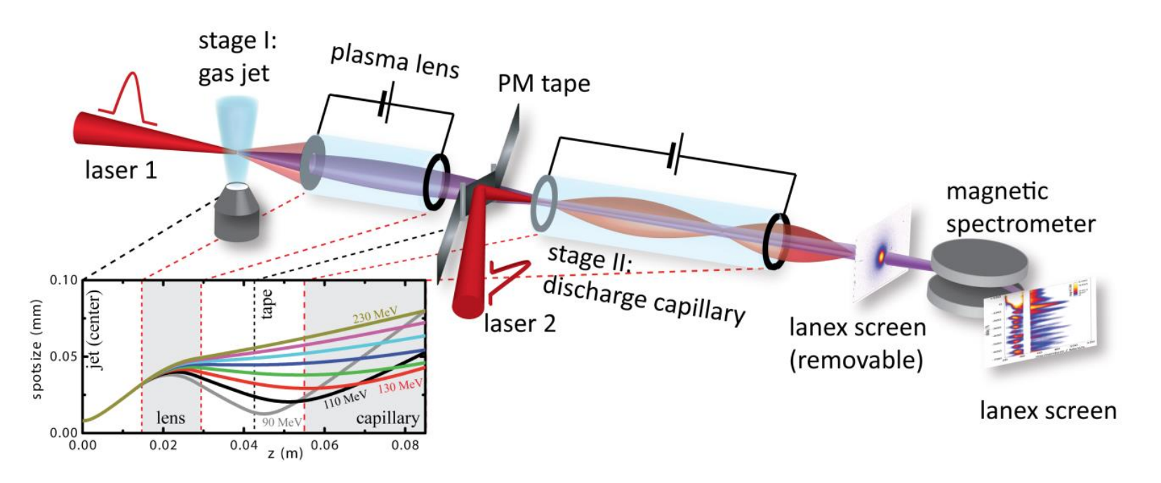
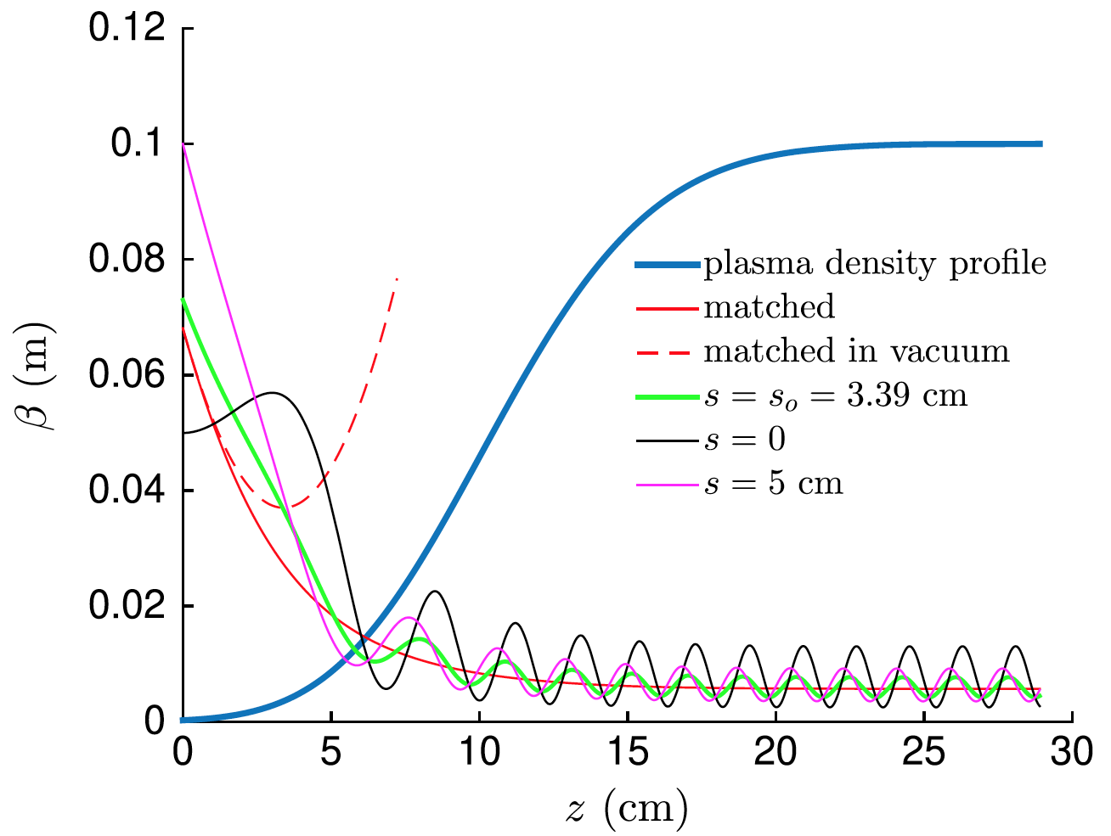
Structured plasmas enable advanced accelerator concepts technologies
Structured plasma devices will comprise a critical path technology for future high energy accelerators, enabling orders of magnitude improvements source design, transport, and control.
I. Compact, High Brightness Sources
II. Beam Transport and Staging
III. Beam Control and Diagnostics
Capillary discharge waveguides
Enabling technology for10 GeV LPA stage, central to linear collider design concept
Pre-ionized plasma channels
Enabling technology for meter-scale plasmas for highest energy PWFA gain
Hollow-channel plasmas
Enabling technology for positron acceleration schemes, with benefits for electrons as well
Active plasmas lenses
Orders of magnitude improved focusing
Tailored plasma ramps
Retain ultra-low emittance of witness beam between stages
Tunable energy decompensation
LPS manipulation for stable acceleration
Spatiotemporal diagnostics for fs beams
Non-destructive synchronization and reconstruction
These diverse systems present unique modeling challenges. Length- and time-scale disparities necessitate alternatives to existing modeling tools, while also capturing additional physics - energy deposition, ionization, and dissipation.

Slide 3
Integrated multi-physics simulation tools will improve accelerator designs
Our letter outlines three challenges which, if addressed, will advance the state-of-the-art in structured plasma modeling, and subsequently support advanced concept technologies
Develop and couple multi-physics capabilities for holistic plasma modeling
Understand plasma formation: energy deposition, laser propagation, ionization physics
Model dissipation mechanisms: heat exchange, conduction, radiative diffusion, recombination
Capture hybrid fluid-kinetic effects: discharge physics, wake dissipation, plasma-vacuum interface
Address computational complexity of structured plasmas
Scale-length disparities require meter-scale domains and 𝜇s duration with 𝜇m resolution
Complex boundaries require non-conformal implementation or mesh refinement
Multi-physics algorithms may prevent efficient scaling through implicit solvers
Support integration with community software infrastructure
Generate common, inherited description between fluid, PIC, and beam-physics codes
End-to-end virtual accelerator capabilities are synergistic to all collider concepts, and supported by the AAC Roadmap and recent HEP GARD Workshop
These challenges can be met in tandem with existing and planned experimental efforts at HEP facilities, laboratories, and universities, on a timescale commensurate with published roadmaps.

