Slide 1
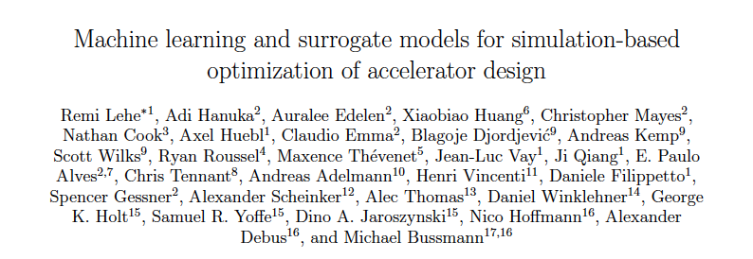

Slide 2
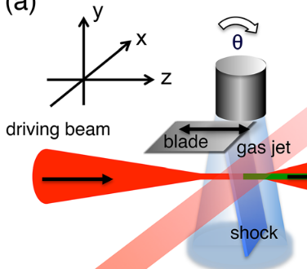
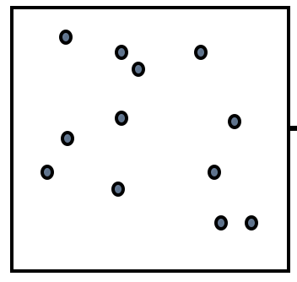
Machine learning and surrogate models for simulation-based optimization of accelerator design R. Lehe et al.,
Accelerator experiments involves many design parameters (e.g. laser intensity, gas density, …)
These parameters can be optimized through simulations, in order to maximize e.g. final energy, injected charge, etc.
Individual simulations
Workflow: iteratively:
Analyze simulation result
Pick most promising parameters to simulate next
Multi-dimensional parameter space (axes are e.g. laser intensity, gas density)
Approach:
Future developments:
Traditionally, the parameters to try next have been chosen by human intervention, or genetic algorithms
But recent papers show that using machine learning (ML) methods can be much more efficient.
The LOI calls for:
Exploring different ML algorithms and practices
Going towards a robust software framework for ML-based parameter optimization

Slide 3
High precision RF control for next generation accelerators G. Huang, L. Doolittle, C. Serrano, Q. Du, D. Li
High precision RF control for next generation accelerators
G. Huang, L. Doolittle, C. Serrano, Q. Du, D. Li
RF field and timing stability determine the machine performance.
Next generation accelerators (e.g. PIP-II, AWA etc.) need high precision controls.
Current FPGA based digital RF control system provide 10⁻⁴ RF stability or 10s of femtosecond synchronization among endstations.
Challenges and required R&D
Decoupled R&D and major projects to reduce project risk.
Modular system design enable flexible configuration.
Compact RF control module development enable deploy in place.
Low crosstalk (-100dB to -120dB) system architecture.
Follow ever changing technology from industries.
Goal: push the control limit toward the next order of magnitude

Slide 4
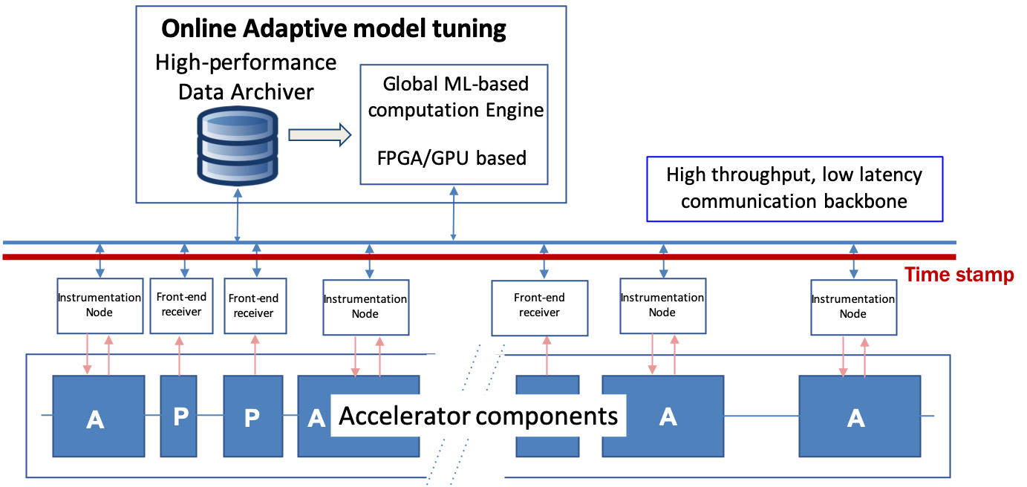
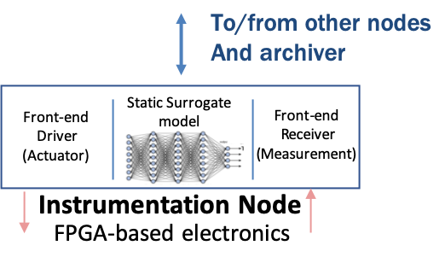
High bandwidth adaptive control systems for particle accelerators Daniele Filippetto, Carlos Serrano, Lawrence Doolittle, Qian Du, Alexander Scheinker
What are the advantages of a ML native CS?
From local to global real-time feedbacks
Performance improvement
Failure predictions
How do we effectively use ML for accelerator control?
Include surrogate models into the control electronics
Use supervised learning to continuously improve the model and catch time-varying effects.
How do we choose the hardware?
Optimize for noise reduction in specific frequency bands
Design of an Holistic control system
Fast local loops (ns)
ML-based global optimization
ML models changing with time
adaptive loop
ML based static loop
(Down-conversion tech)
High bandwidth static loops
(Direct-sampling tech)
Noise (dBc/Hz)

