Slide 1
Underdense Thin Plasma Lens as a Tool for Future Colliders
Snowmass AF6 Meeting - September 24, 2020
Christopher Doss - University of Colorado Boulder
Michael Litos - University of Colorado Boulder
Sebastien Corde - Ecole Polytechnique
Spencer Gessner - SLAC National Accelerator Laboratory
Bernhard Hidding - University of Strathclyde

Slide 2
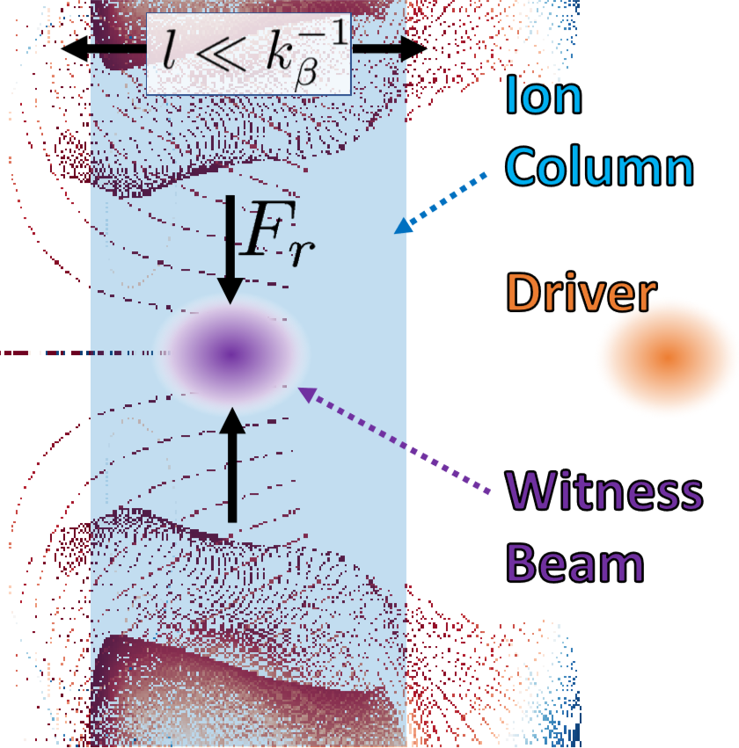
Underdense Passive Plasma Lens
Uses ion column in highly non-linear plasma blowout wake to focus ultra-relativistic electron beams
Axisymmetric and linear focusing response
Blowout driven by separate drive bunch or head of single bunch
Laser-ionized gas jet, e.g. He with density 10¹⁶⁻¹⁸ cm⁻³
Ultra-compact: 10 µm – 1 mm in length (<λ_{β})
Ultra-strong: 1000 x strength of electromagnet quadrupole; 100 x strength of permanent magnet quadrupole
Ionizing laser beam
fs pulse, 10’s mJ
focal length:
Optical lens
Gas jet
Plasma
lens
e⁻ path

Slide 3
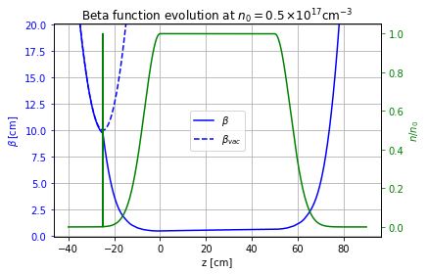
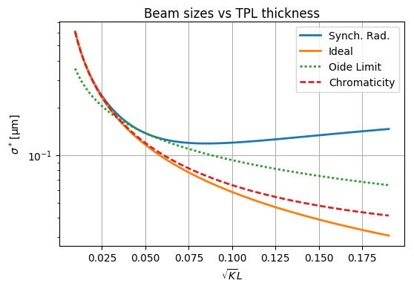
Applications
Collider-Related Applications
Final focus for lepton collider (speculative)
Final focus proxy for collider R&D, esp. for studying Oide effect (@ FACET-II)
Matching to plasma accelerator stages (@ FACET-II)
Other Applications
Plasma injectors (e.g. coupling into FEL)
High energy density physics
Oide Limit

