Slide 1
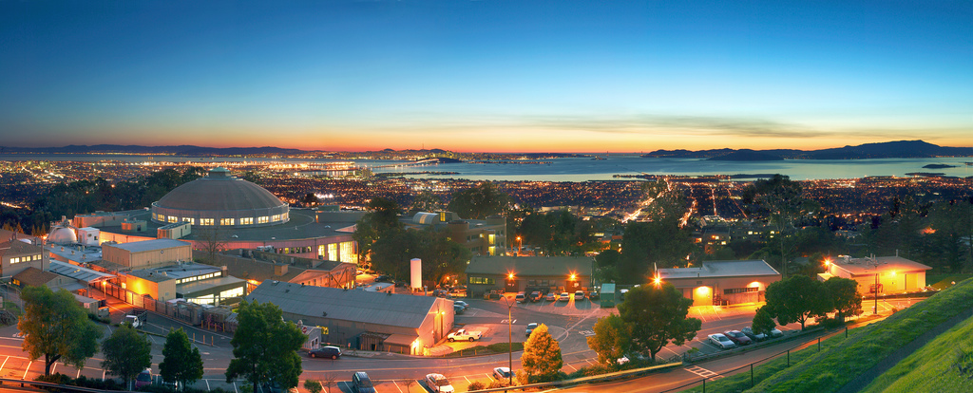


Active Plasma Lenses
S. K. Barber¹, J. van Tilborg¹, A. J. Gonsalves¹, S. Steinke¹, K. Nakamura¹, C. G. R. Geddes¹, C. B. Schroeder¹, E. Esarey¹, M. Ferrario², R. Pompili², C. A. Lindstrøm³, J. Osterhoff³, and H. Milchberg⁴
¹Lawrence Berkeley National Laboratory, Berkeley, California 94720, USA
²Laboratori Nazionali di Frascati, 00044 Frascati, Italy
³Deutsches Elektronen-Synchrotron DESY, Notkestraße 85, 22607 Hamburg, Germany44 ⁴University of Maryland, College Park, MD 20742, USA
Snowmass AF6 meeting
September 24th, 2020
Office of
Science
1
Notes:
12.54am
1.18am (24 minutes)

Slide 2
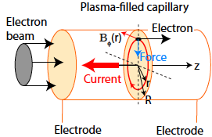
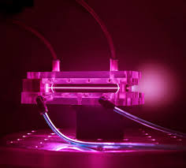
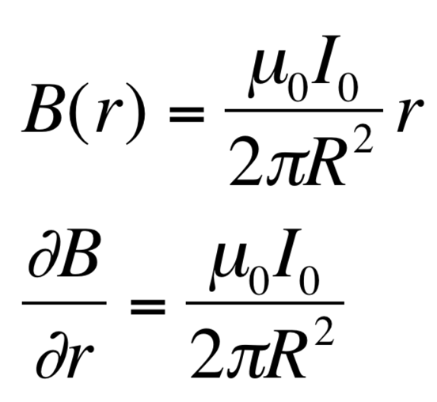
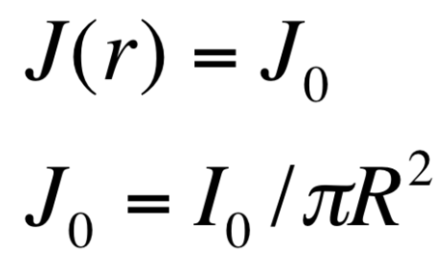
Active plasma lens an “old” concept for ion beams¹. Excellent complement for plasma accelerated beams
Discharged capillary
e-beam
Uniform current
Ampere’s law
Active Plasma Lens
Radially symmetric focusing
Tunable, up to ~1 kA (“active”)
Gradients >3000 T/m (!)
Compact
J
B
~ r
~ 1/r
r
r
Example: D=0.5mm, L=3cm, I=430 A
1400 T/m, F=4cm for 500 MeV electrons
R
R
¹Panofski et al. RSI 1950
van Tilborg et al. Phys. Rev. Lett. 115, 184802 (2015)
Office of
Science
2
Notes:
12.54am
1.18am (24 minutes)

Slide 3
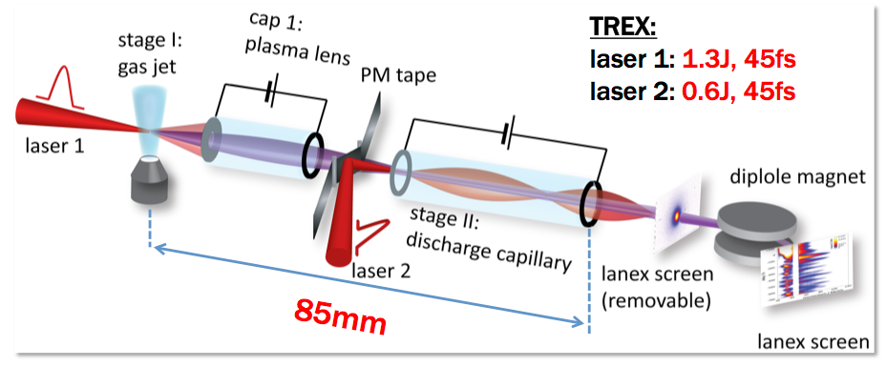
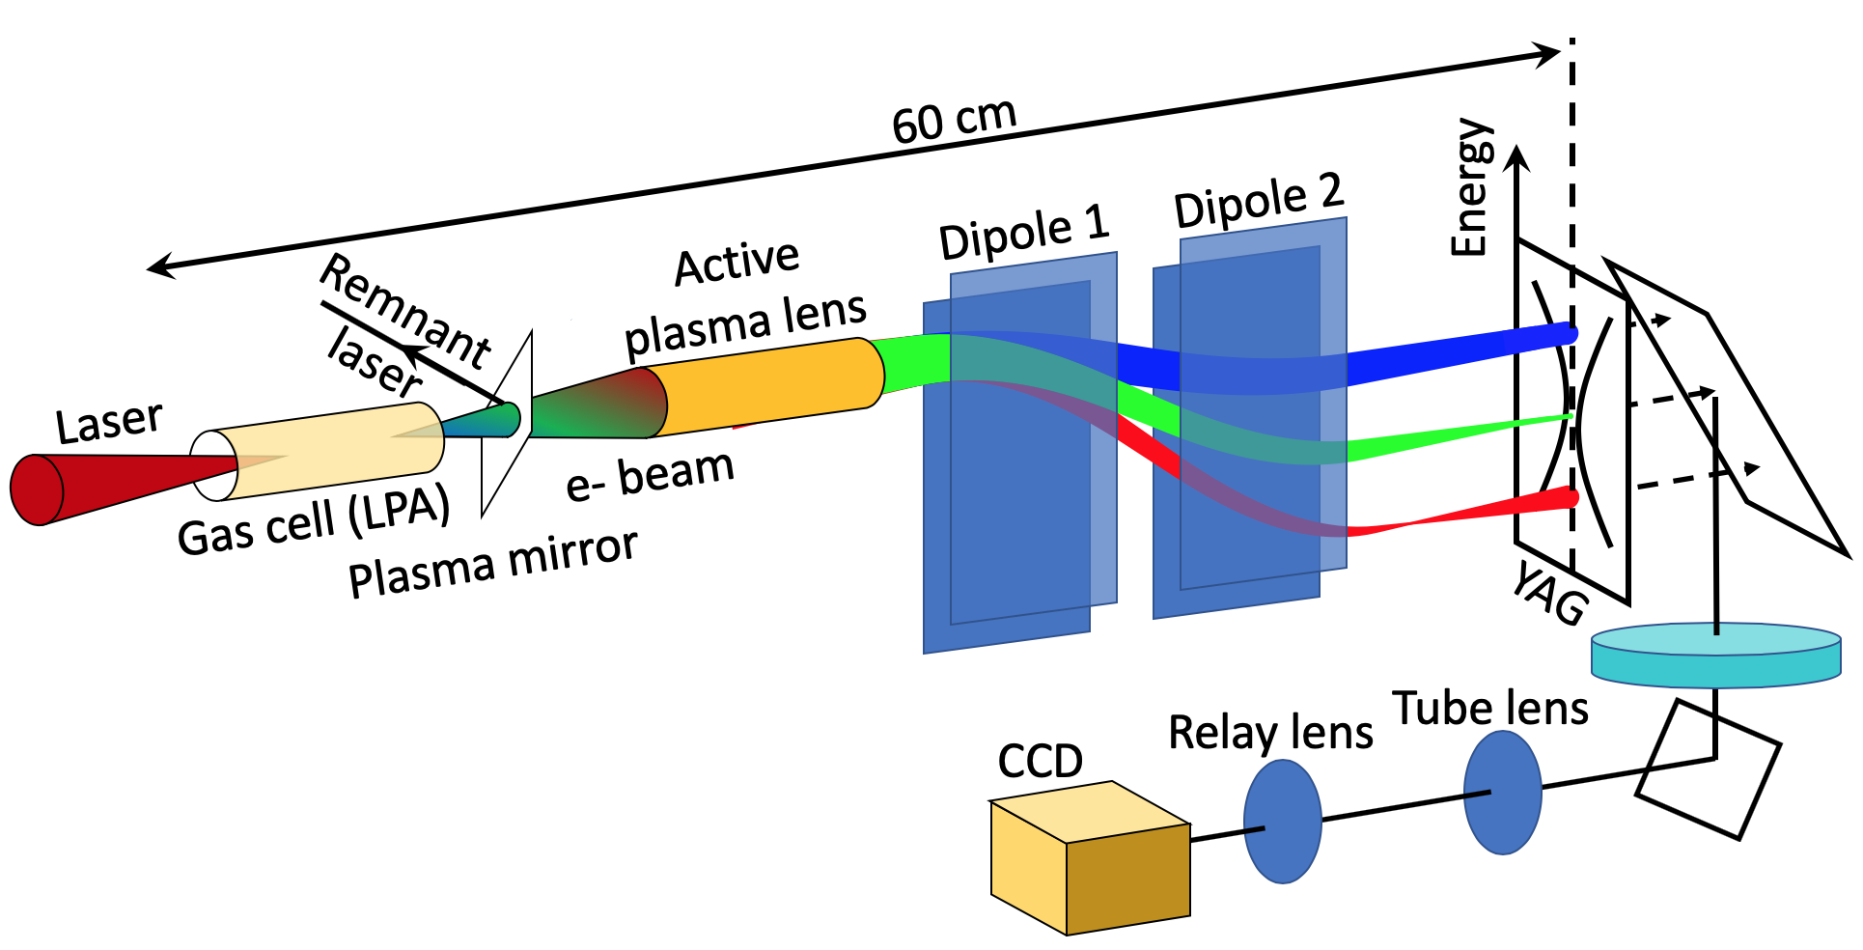
Many potential applications for APLs in HEP related areas
Areas of Impact
Inter-stage transport for multi-stage plasma accelerators¹
  5GeV+5GeV experiments planned at BELLA using APL, groundwork for collider
Final focus of collider
  symmetric focusing reduces chromatic effects, potentially more compact system
High gradient positron focusing
New diagnostics specifically tailored to LPA environments²
  specialized diagnostics improve beam characterization
Facilitates rapid research on complex topics
¹Steinke et al. Nature 2016
Future APL specific developments
Increased discharge repetition rates needed for collider (currently ~Hz need ~kHz)
High rep rate, ultra thin plasma mirror for laser/electron beam separation
Continued study of emittance growth from scattering, wakefields, current in-homogeneity, etc.
²S. K. Barber et al. Appl. Phys Lett. (2020)
Office of
Science
3
Notes:
12.54am
1.18am (24 minutes)

