Slide 1
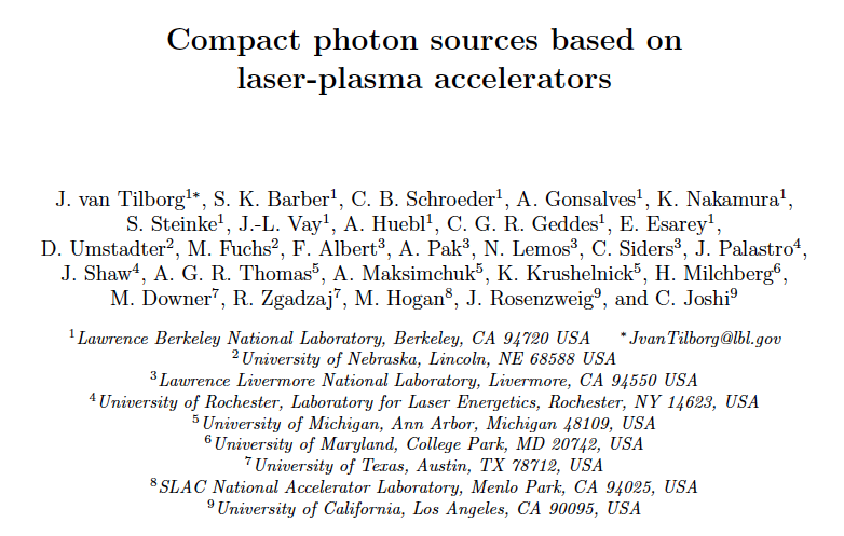
Letter of Interest
Snowmass 2021, Accelerator Frontier, Advanced Accelerator Concepts (AF6)

Slide 2
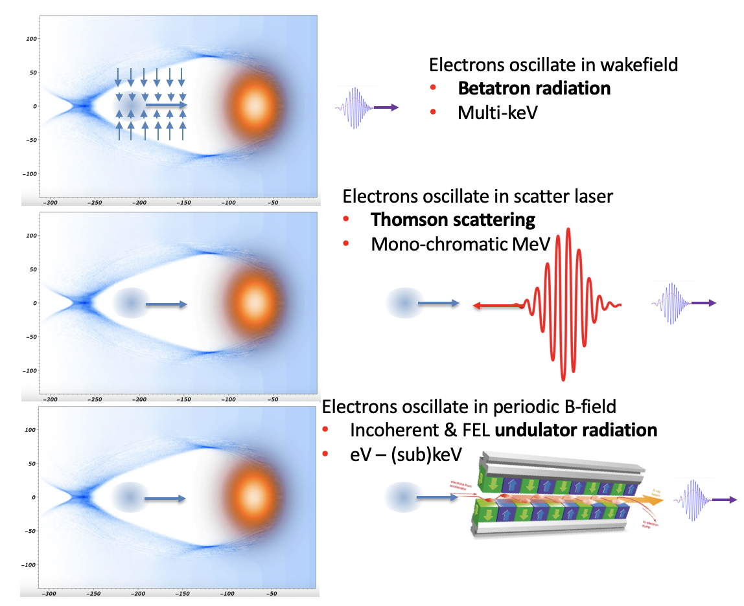
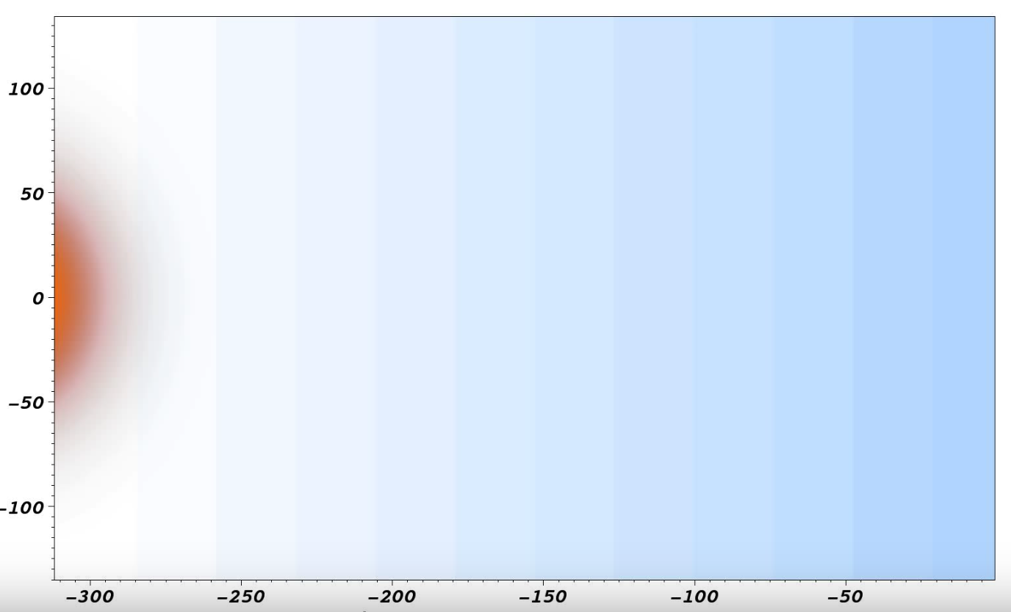
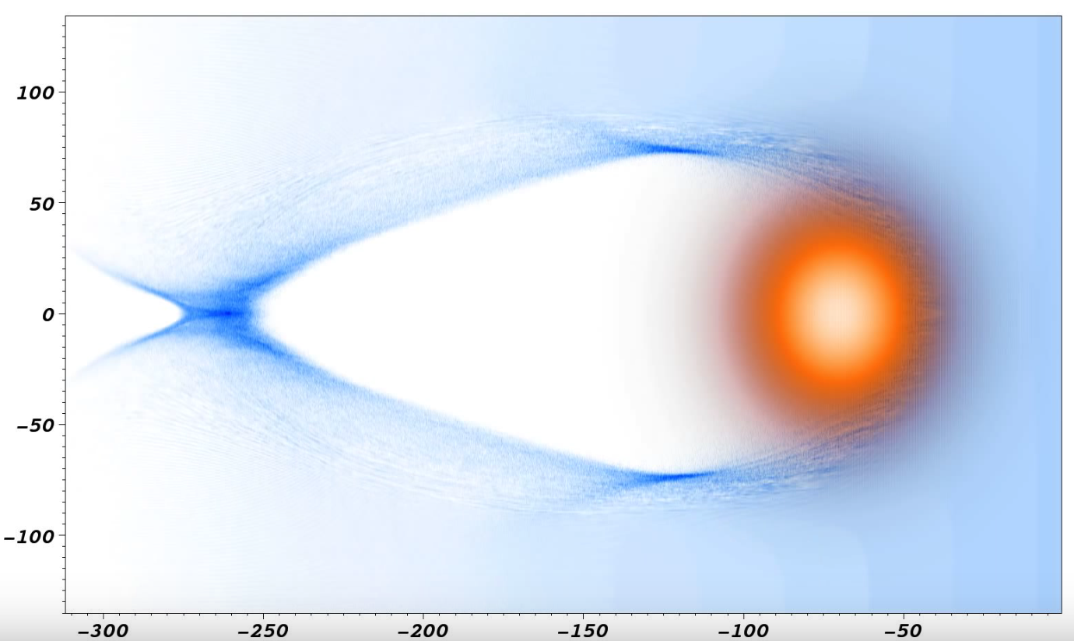
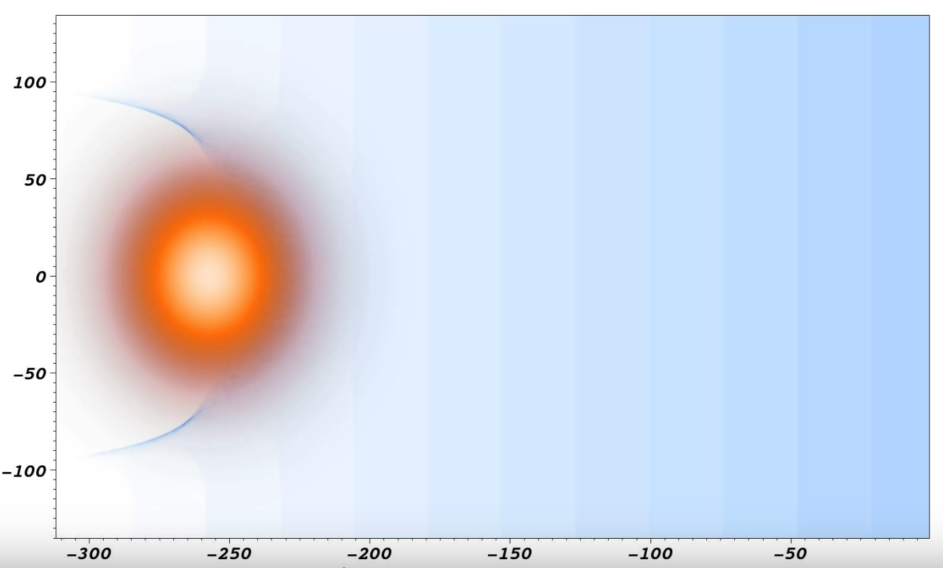
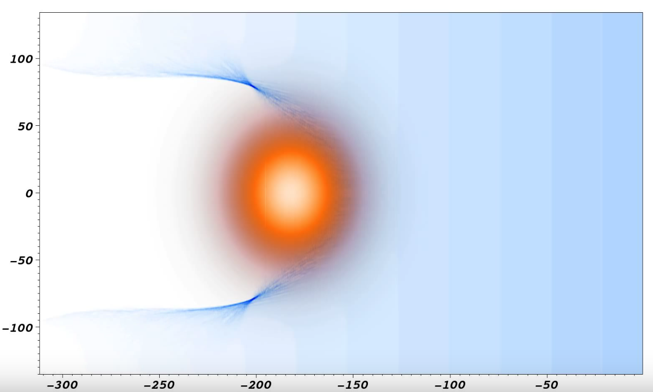
Plasma wakefields can sustain gradients of order 10-100 GV/m.
Strong potential for future collider technology and near-term high-impact photon sources.
μm
Plasma
Self-injection of background electrons
Laser
μm
150 μm
25 μm
15 μm (50 fs)
LPA:
~ 30,000 MV/m

Slide 3
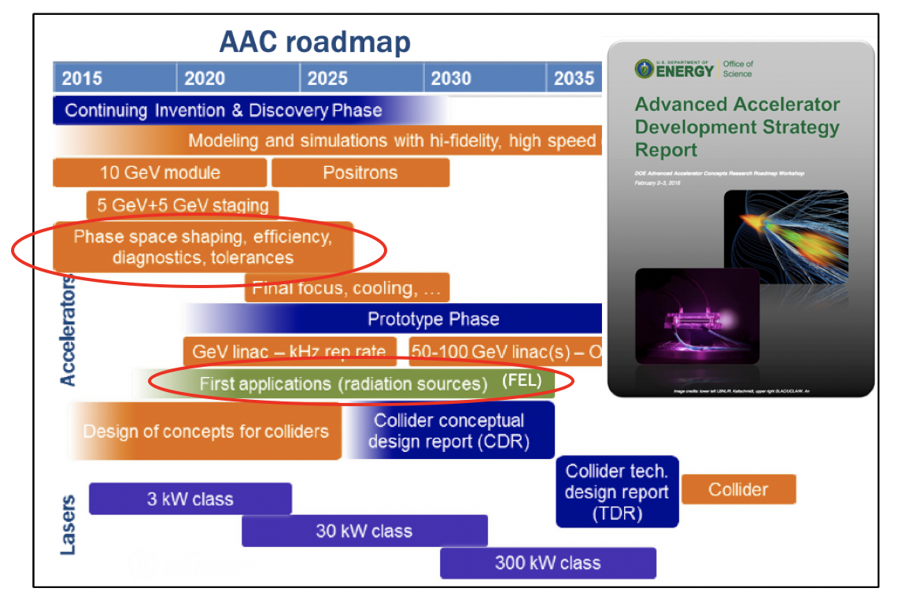
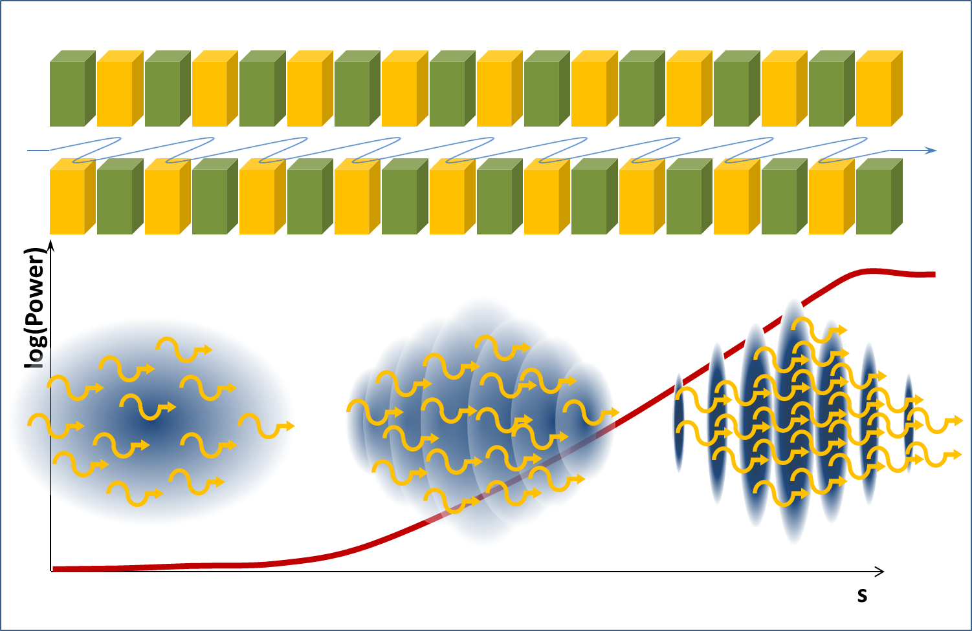
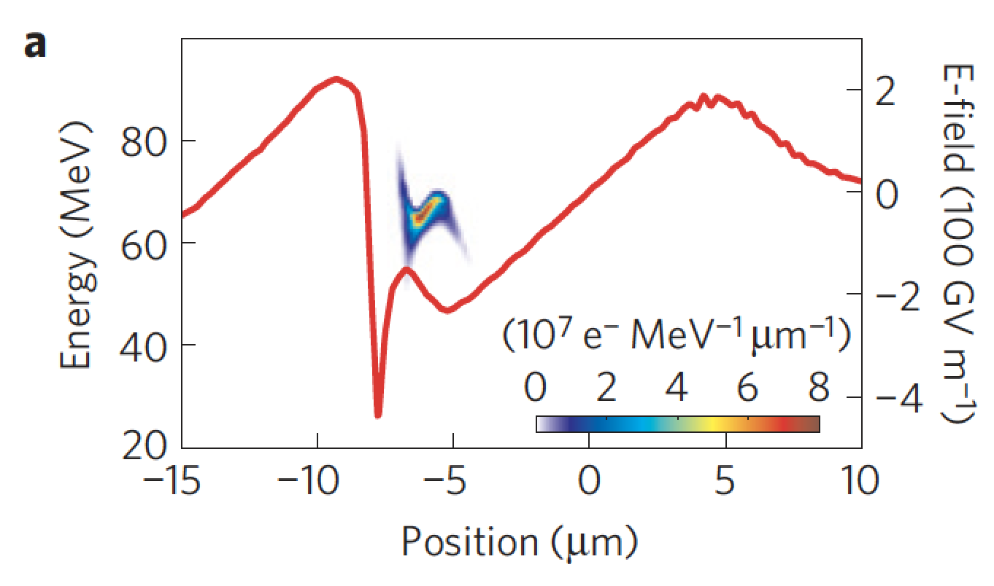
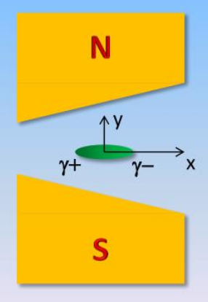
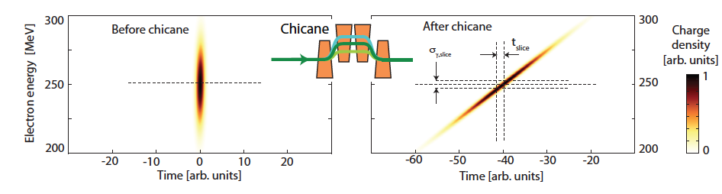
Plasma-based collider and LPA FEL both critically rely on the six-dimensional charge distribution, and its ability to be manipulated and controlled.
dE/E in a spatio-temporal bunch slice should be <ρ (~0.1%)
dE/E at few-%: disperse particles transversely or longitudinally
Charge density drops→ ρ decreases
Find optimum dispersion based on 6D charge distribution f(x,y,z,px,py,pz)
Quality & control of f(x,y,z,px,py,pz) is also critical in
applying plasma-based accelerators to future
collider concepts (charge density, current profile)
On AAC roadmap and in AAC strategy report
Smith et al. JAP 1979
Huang et al. PRL 2012
Maier et al. PRX 2012, Schroeder et al. FEL2013
Lundh et al. Nat. Phys. 2012

Slide 4
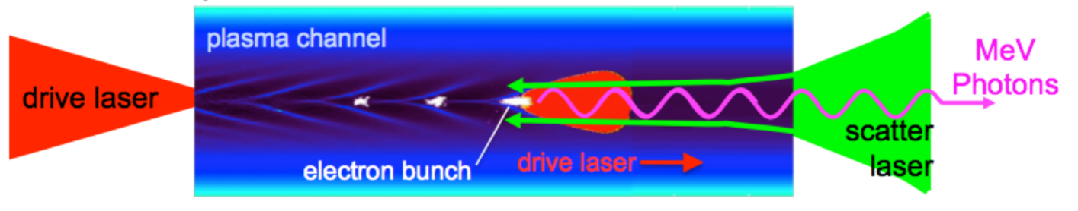

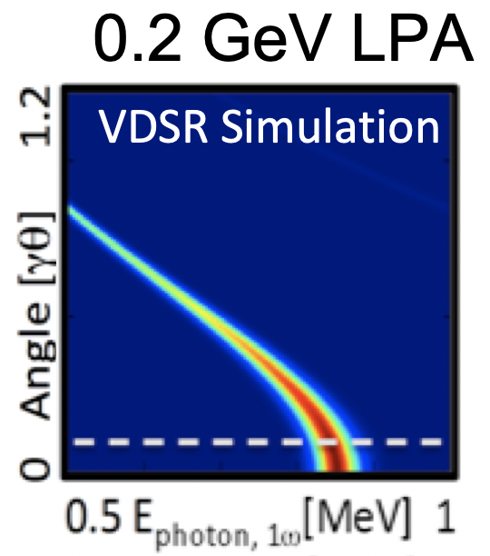

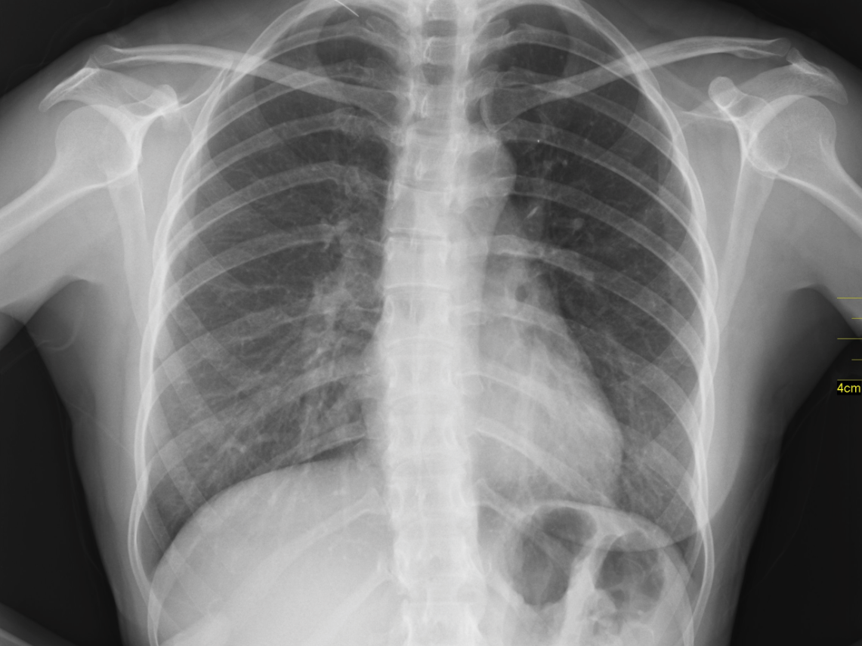
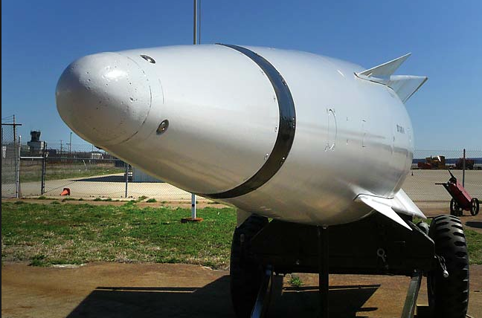
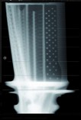
Mono-chromatic Thomson-scattered radiation: high-impact societal applications, and unique diagnostic into plasma-accelerator beam parameters
Thomson spectrum critically depends on electron beam parameters (emittance, energy spread)
Relies on ability to control spatio-temporal beam-beam overlap (→ collider staging, LPA stability, novel LPA injection schemes)
Gamma rays can be exploited for advanced methods of muon beam production
Application: Compact, quasi-monoenergetic, mrad photon sources at >MeV photon energies benefit nuclear signatures
Radiography, photo-fission & nuclear resonance fluorescence
Can be exploited for security, industrial, and medical applications, i.e. reduced-exposure & improved-specificity organ & tissue imaging.
Strong case for industrial partnership!
Schumaker et al. New. J. Phys. 2018
BW
laser amplitude
e- divergence
e- energy spread
Narrow ΔE_{γ} requires high quality e-beam

Slide 5
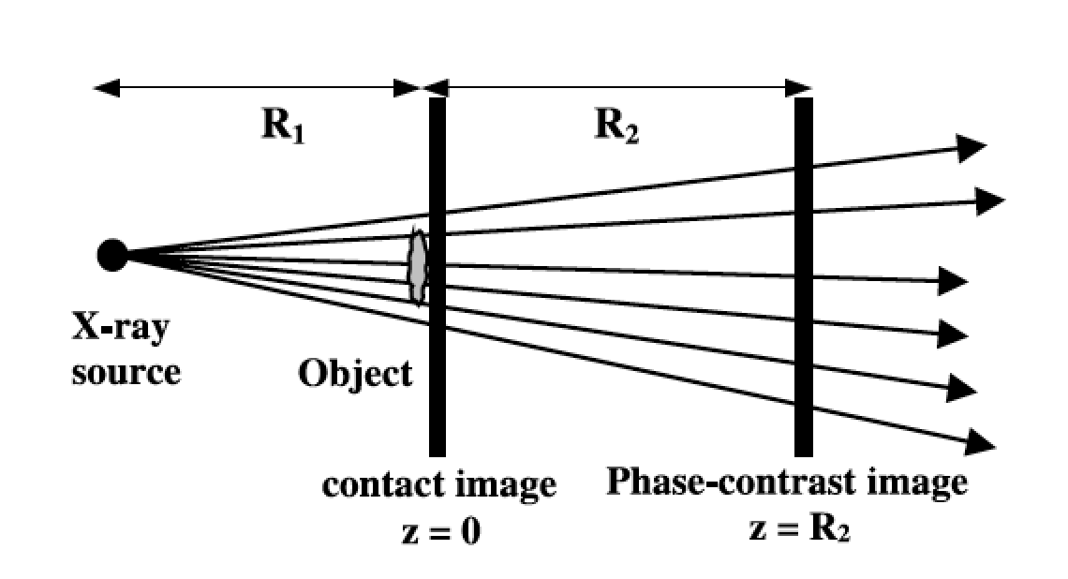
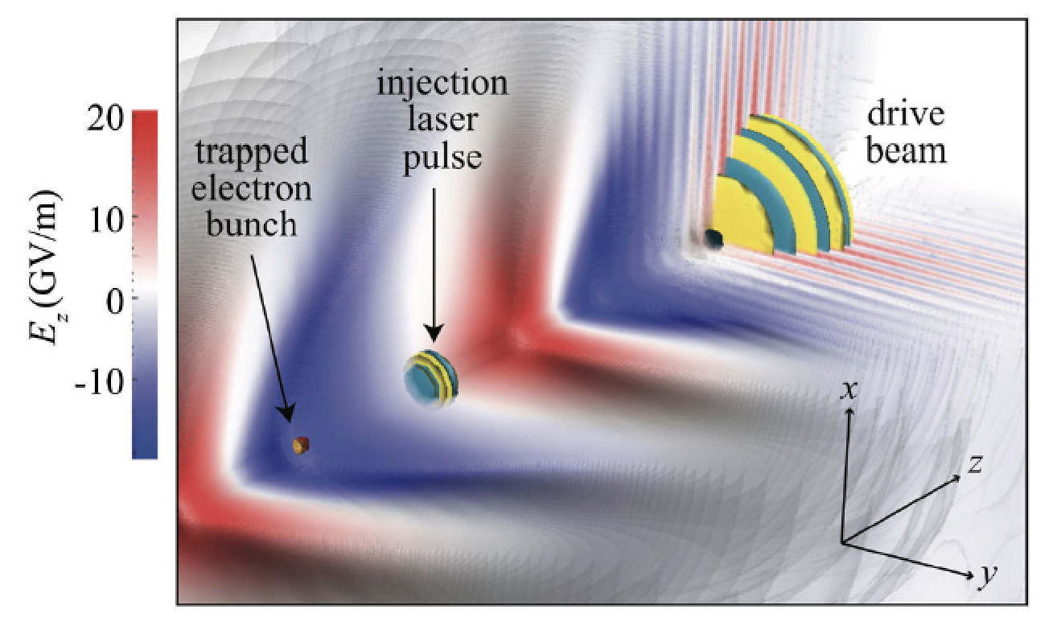
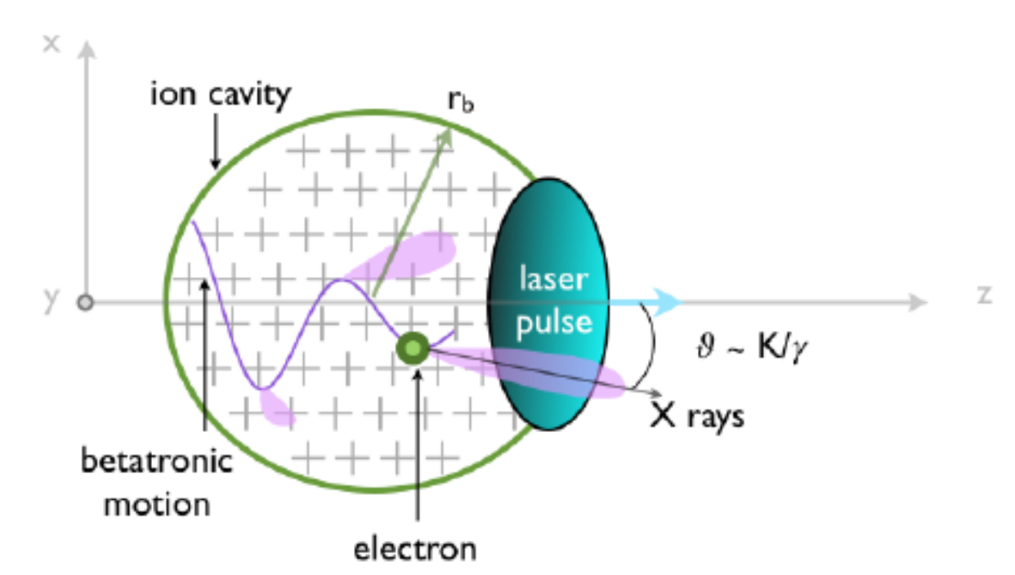


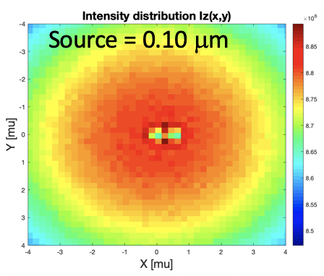
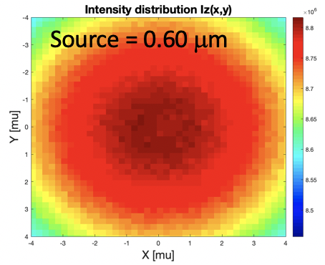
Betatron Radiation: intense (>1e9 φ/shot) & broad-bandwidth (10s keV) & hyper-spectral.
Industrial applications: medical and biological imaging, high-energy density science.
Schroeder, PRAB (2014)
Near-term efforts to be pursued by the LPA community
Explore new LPA injection regimes for improved quality (i.e. two-color ionization)
LPA 2.0: take advantage of stability & control with active feedback and machine learning
On the “pre-LPA” side: laser position/angle, wavefront, spatial mode, temporal/spectral phase, and plasma profile
On the “post-LPA” side: e-beam charge, pointing, size, profile, emittance, energy(spread), photon source parameters
Work with industry on light sources & their commercial applications (and make HEP accelerator science benefit from improvements in diagnostics, control, feedback, etc.)
Divide complex projects (multi-GeV LPA, collider, FEL, etc.) in small & exciting sub-projects, and work closer with pre-career high-school and college students for early-pipe-line engagement (targeting increased diversity)
Small source size ideal for lens- & optics-free phase-contrast imaging
Single-shot hyper-spectral imaging applications at <μm resolution
Collider relevance: direct probe of source size and electron dynamics inside the plasma accelerator
Like FEL & Thomson: a benchmark for LPA stability, control, novel injection concepts (two-color ionization), etc.
Develop collaboration with industry for high-impact capabilities

