Slide 1


Laser-Plasma Accelerator Linear Collider
C. B. Schroeder^{∗1}, F. Albert², C. Benedetti¹, J. Bromage³, D. Bruhwiler⁴, S. S. Bulanov¹, E. M. Campbell³,
N. M. Cook⁴, B. Cros⁵, M. C. Downer⁶, E. Esarey¹, D. H. Froula³, M. Fuchs⁷, C. G. R. Geddes¹, S. J. Gessner⁸,
A. J. Gonsalves¹, S. M. Hooker⁹, K. Krushelnick10, R. Lehe¹, W. B. Mori¹¹, K. Nakamura¹, J. Palastro³, M. Palmer¹², J. Power¹³, B. A. Shadwick⁸, M. Thevenet¹⁴, A. G. R. Thomas¹⁰, J. van Tilborg¹, N. Vafaei-Najafabadi¹⁵, J.-L. Vay¹, S. Webb⁴, T. Zhou¹, J. Zuegel³
¹Lawrence Berkeley National Laboratory, Berkeley, California 94720 USA
²Lawrence Livermore National Laboratory, Livermore, California 94550, USA
³University of Rochester, Laboratory for Laser Energetics, Rochester, New York 14623, USA
⁴RadiaSoft LLC, Boulder, Colorado 80304, USA
⁵CNRS, LPGP, Universit ́e Paris-Saclay, 91405 Orsay, France
⁶Department of Physics, University of Texas, Austin, Texas 78712, USA
⁷Department of Physics and Astronomy, University of Nebraska, Lincoln, Nebraska 68588, USA
⁸SLAC National Accelerator Laboratory, Menlo Park, California 94025, USA
⁹Department of Physics, Clarendon Laboratory, University of Oxford, Parks Road, Oxford OX1 3PU, UK
¹⁰Center for Ultrafast Optical Science, University of Michigan, Ann Arbor, Michigan 48109, USA
¹¹Department of Physics and Astronomy, University of California, Los Angeles, California 90095, USA
¹²Accelerator Test Facility, Brookhaven National Laboratory, Upton, New York 11973, USA
¹³Argonne National Laboratory, Lemont, Illinois 60439, USA
¹⁴Deutsches Elektronen Synchrotron, Notkestraße 85, 22607 Hamburg, Germany
¹⁵Stony Brook University, Department of Physics and Astronomy, Stony Brook, New York 11794, USA
September 23, 2020 - AF6 LOI Meeting – Collider Concepts Session

Slide 2
Basic configuration of a laser-plasma-based linear collider
Linac: staged laser plasma accelerators (LPAs):
Preliminary designs that yield required IP parameters have been produced to guide R&D
R&D focus has been on developing laser-plasma accelerator technology
Integrated design study needed
Main advantage of laser-plasma accelerator technology: compact linac footprint (high gradient and compact laser coupling of stages)
Key characteristics of a LPA-based collider:
Design (optimizing operational plasma density) yields 5 GeV/stage (100 stages/linac for 1 TeV):
    Compact laser coupling between stages yields geometric/average gradient = 2.3 GV/m
Time structure at IP:
    single bunches, separated by 20 μs
Short (~10 μm rms) beams:
    beamstrahlung reduction (reduces power):
    𝞂_{z}< β*
Flat or round beams may be accelerated
Laser energy recovery possible for high efficiency
Leemans & Esarey Phys. Today (2009)
2

Slide 3
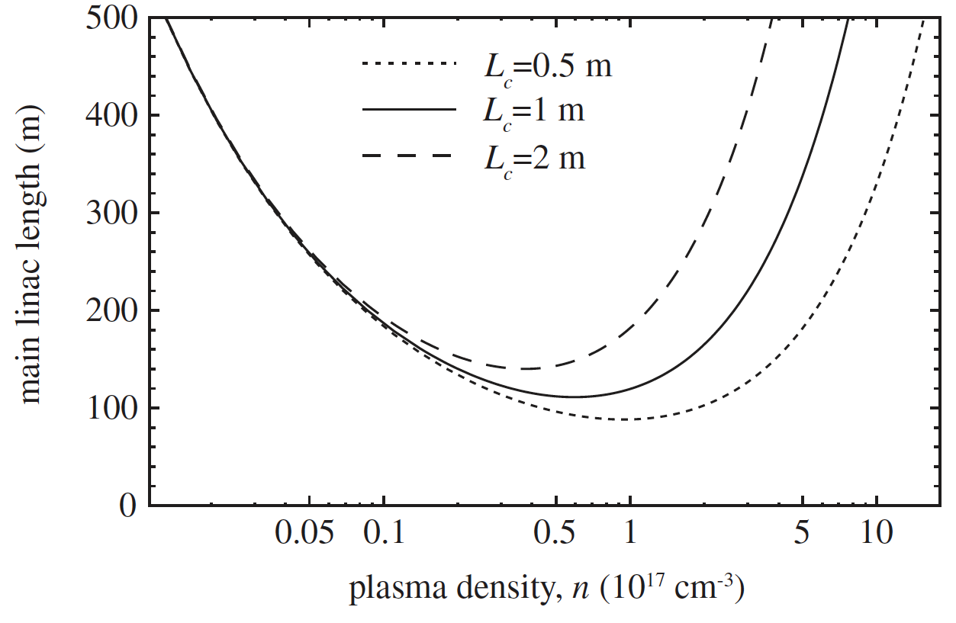

Requirements for efficient multi-TeV colliders:
guided laser-plasma accelerator and laser development
Luminosity at TeV scale requires development of 10 J, 100 fs class lasers at ~50 kHz rep. rate
Example: 0.5 TeV Linac Length
collider
requirement:
50 kHz
> 30% effic.
fiber
LPA 100 m
5 GeV/m
CLIC~14km
Tm:YLF
2µm – 4x stages
Key step
technically
feasible
today: kHz
average power [kW]
kBELLA (Ti:Sa)
Tradeoff: stage gradient vs. number of stages
  Minimum linac length sets density ~ 10¹⁷/cm³
  Consistent with optimal efficiency/charge
Hundreds of 10 GeV-class stages
  Each requires 10 Joule,10’s of kHz laser
  (for laser tech development, see K. Liani LOI])
fiber
HAPLS (ELI)
existing
laser
systems:
few Hz
CoReLS (Korea)
BELLA (LBNL)
C.B. Schroeder et al., PRST-AB (2010) and (2012); NIM-A (2016)
peak power [TW]
3

Slide 4
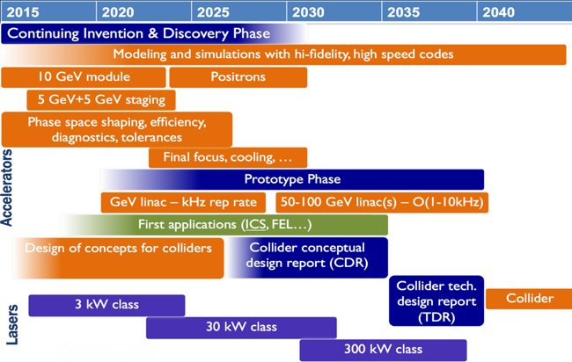
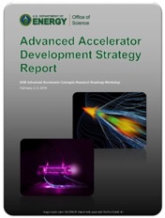
R&D timeline towards a collider
  US AAC community outlined R&D goals in 2016 roadmap
  Progress on all R&D goals
  Roadmap to be updated
DOE HEP AAC Roadmap (2016)
Critical technologies requiring R&D [see A. Gonsalves, LOI]:
  Plasma cell development: TRL3
  Multi-GeV/cell acceleration: TRL4
  Staging of LWFAs: TRL3
  Positron acceleration methods: TRL2
  Stability: TRL3
  Alignment: TRL2
Laser technology development required [see L. Kiani, LOI]
Promising technologies:
  Coherent combination of fiber lasers
  Tm:YLF
few kW average power feasible today
4

Slide 5
LOI Summary
Laser-driven plasma accelerators:
  Ultra-high gradient accelertor technology: ~10 GV/m
  Goal: e-/e+/gamma linear collider at TeV energy scale (and beyond), with much reduced footprint (and cost)
  Longer-term collider option
  Integrated collider design required (e.g., injector, cooling, focusing systems, etc.)
Experimental facilities required to advance R&D in next 5-10 years.
  Planned facilities: kBELLA (US), EuPRAXIA (Europe), etc.
  kHz rep rates will enable precision
Laser-plasma accelerators potential to play role in other collider systems:
  Rapid muon acceleration, high-brightness beam generation [see C. Benedetti, LOI], laser-plasma-based beam cooling [see S. Bulanov LOI], compact plasma-based focusing and beam delivery [see S. Barber, LOI], gamma collider
Near- and mid-term applications (LPA-driven X-FEL, compact gamma-ray source, ion acceleration for medical applications, etc.) are actively being pursued [see J. van Tilborg, LOI]
  Near-term applications are important demonstrations of technology that will advance collider R&D
Sustained R&D following Roadmap required to realize potential of laser-plasma accelerator technology
5

Slide 6
Thank you.
Work supported by the U.S. DOE, Office of Science, Office of High Energy Physics, under Contract No. DE-AC02-05CH11231
6

Slide 7
Back up
7

Slide 8
Laser technology requirements for collider applications
1 kW
10 kW
100 kW
existing laser system
CoReLS (Korea)
technically feasible today
BELLA (LBNL)
HAPLS (ELI)
collider requirement
Laser energy/pulse [J]
fiber
+
kBELLA
(Ti:Sa)
Tm:YLF
fiber
rep. rate [kHz]
Two promising laser architectures for collider applications:
  Coherent combination of fiber lasers (1 micron). R&D at Jena, Michigan, LBNL, LLNL, et al.
      ~40-60% wall-to-laser efficiency
  Tm:YLF (1.9 micron) – (4x as many LWFA stages). R&D at LLNL
8

Slide 9
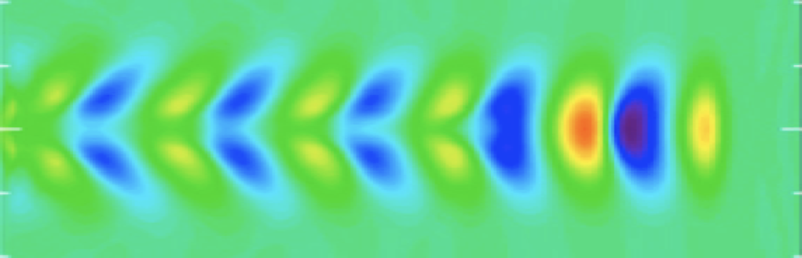
Laser-driven plasma wakefield accelerators
Esarey, Schroeder, Leemans, Rev. Mod. Phys. (2009)
Wakefield (plasma wave) driven by the ponderomotive force of a resonant laser pulse in plasma
Focusing and acceleration provided by plasma wave
Characteristic size of accelerating field:
    Plasma density n₀=10¹⁷ cm⁻³ yields E=30 GV/m
Uses short duration, high intensity drivers [laser drivers rely on Chirped Pulse Amplification (CPA) – Nobel prize 2018]
Compact coupling (< 1 m) of laser drivers using plasma mirrors
electron plasma density
laser driver
particle beam
plasma wavelength
Main advantage of laser-plasma accelerator technology: compact linac footprint (both accelerating plasma cell and drive laser beam)
9

Slide 10
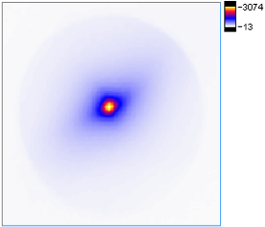
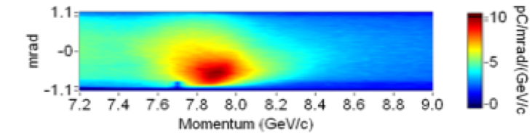
Status of experimental R&D
  Single stage achieved multi-GeV acceleration: 8 GeV in 20 cm (40 GV/m)
divergence:
150 mrad
discharge-capillary plasma waveguide
Gonsalves et al. PRL (2019)
2019 (LBNL)
Energy gain (GeV) in LWFA stage
2014 (LBNL)
  1 Hz rep. rate
  Reproducibility limited by laser fluctuations (at ~100 Hz)
2013 (GIST)
2013 (TPW)
2006 (LBNL)
  Proof-of-principle staging
Operational plasma density (x10¹⁸ cm⁻³)
Compact driver coupling using plasma mirrors
Steinke et al. Nature (2016)
Plasma lens focusing of beam
  Proof-of-principle experiment demonstrate 100 MeV energy gain
  Multi-GeV staging experiments are planned / being commissioned
10

Slide 11
Potential Facility Table
Laser-plasma collider - e-/e+ |  | 1 TeV cme | 3 TeV cme | 30 TeV cme
Beam Energy | TeV | 0.5 | 1.5 | 15
Luminosity (10^34) | cm-2 s-1 | 1 | 10 | 1000
Int. Luminosity | ab-1/yr | 0.18 (5000hrs) | 1.8 (5000hrs) | 18 (5000hrs)
Beam dE/E at IP |  |  |  | (Y>>1 regime)
Transv. Beam sizes at IP x/y | nm | 50 / 1 | 10 / 0.5 | 0.2 / 0.2
Rms bunch length / beta* | mm | 0.0085 / 0.1 | 0.0085 / 0.1 | 0.0085 / 0.2
Crossing angle | urad
Rep. frequency | kHz | 47 | 47 | 47
Bunch spacing | us | 21 | 21 | 21
# of IPs |  | 1 | 1 | 1
# of bunches |  | 1 | 1 | 1
Length (2x main linac tunnel) | km | 0.44 | 1.3 | 13
Facility site power (2 linacs) | MW | 105 | 315 | 3151
Cost range | $B US
Timescale till operations |  | >30 years | >30+ years | >30++ years
1 um laser wavelength
10¹⁷ cm⁻³ plasma density
Schroeder et al. NIMA (2016)
ALL PARAMETERS NEED SYSTEM-INTEGRATED DESIGN STUDY
TBD: similar to conventional collider designs
Laser rep. rate not available with present laser technology
Upgrade potential: Same laser system for 1, 3, 30 TeV
requires laser tech maturity before estimate
11

Slide 12
Key accelerator R&D challenges
Laser technology development
  Coherent combining of fiber lasers
  Development of Tm:YLF
  kW average power systems feasible today
Robust e+ acceleration configuration
  Proposed configurations (hollow plasma channels, plasma columns) require experimental demonstrations
Beam matching/coupling between stages
  Strong focusing forces in plasma: β~ 0.01 - 0.1 m
Alignment
  Small structures (~10-100 um) place severe (~nm) alignment tolerances
Stability in main linac
  Transverse stability (BBU) is issue in strong wakefield regime
  Proposed mitigation methods (ion motion, plasma focusing chirp) require R&D
common challenges for advanced accelerator concepts
12

