Slide 1
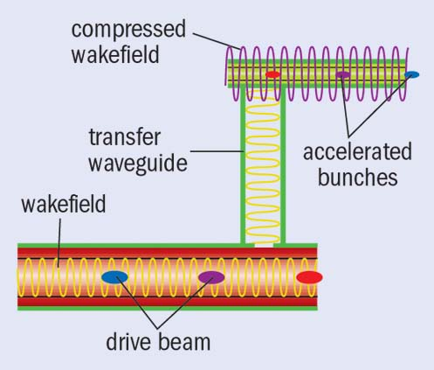
LOI-90: Argonne Flexible Linear Collider (AFLC) – Beyond Concept: A 3 TeV Linear Collider Using Short rf Pulse (~20 ns) Two- Beam Accelerator
Chunguang Jing, John Power, Jiahang Shao, Gwanghui Ha, Philippe Piot, Richard J Temkin, Spencer Gessner, and, Carl B. Schroeder
Core Message of LOI:
1) Conduct a full system-integrated design study Argonne Flexible Linear Collider as a viable option along with supporting LPA-based, PWFA-based and other AAC conceptual LC designs.
2) Attract more resources, and make technical advances aiming for the linear HEP machine.
A Path to a multi-TeV e+e– collider
Short Pulse TBA
3 TeV e+e– collider
Lower Construction Cost (high-gradient dielectric structures)
Lower Operating Cost/Improve Efficiency (Structures and Beam Shaping)
Beyond AFLC R&D
Improved AFLC
> 3 TeV

Slide 2
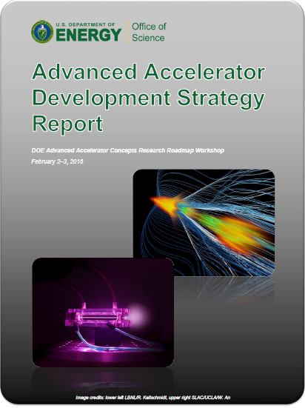
AFLC: Short-pulse SWFA 3 TeV collider concept
Based on dielectric TBA technology
LOW CONSTRUCTION COST: Dielectric structures
HIGH EFFECTIVE GRADIENT: Short RF pulses (20ns)
LOW OPERATING COST: Wall plug efficiency ~15%
details
Argonne Flexible linear collider
Modular design
(easily staged)
e⁺ e⁻ 267 MeV/m of loaded gradient
(200 MeV/m effective gradient)
Beam power=28MW

Slide 3
AFLC Tentative parameters
AFLC | units | Value
Beam Energy | GeV | 3000
Peak Luminosity (10^34) | cm-2 s-1 | 5.9**
Int. Luminosity | ab-1/yr | 708**
Beam dE/E at IP |  | 0.35%**
Transv. Beam sizes at IP x/y | nm | ~40/1**
Rms bunch length / beta* | μm | 44**
Crossing angle | mrad | 20**
Rep./Rev. frequency | Hz | 5
Bunch spacing | ns | 0.077
# of IPs |  | 1
# of bunches |  | 208 in macrobunch, 4160 in macrobunc
Length | km | 18
Facility site power | MW | 222
Cost range | $B US | ??? See CLIC but less ???
Timescale till operations |  | Resource dependent
**borrowed from CLIC parameters table (assumes damping ring)
**needs an Integrated Design Study!

Slide 4
Research and Development Plan (2021~2030):
CTE’s to be demonstrated at AWA
Main Beam Acceleration.
Drive Beam Power Source.
Staging of Multiple Acceleration Stages to High Energy.
Major experimental efforts at AWA
1. 500 MeV AFLC demonstrator inside the AWA existing bunker.
2. Efficiency improvement with a shaped bunch or modulated bunch train, which is also preparation for a 3 GeV stepping-stone facility.
Synergies from Research Community
1. Beam manipulation for high efficiency.
2. High shunt impedance, high gradient, low cost structure .

