Slide 1
Optical Energy Recovery for a High Duty Cycle Gamma Ray Source
Snowmass 2021 • AF6 September Workshop • Collider Concepts • 23 Sep 2020
A. Murokh* (RadiaBeam), P. Musumeci, J. B. Rosenzweig (UCLA), F. Zomer, K. Cassou, A. Martens, D. Nutarelli and K. Dupraz (LAL)
Challenge: Laser accelerators can achieve very high accelerating gradients, but as a rule require very high peak power. High peak power lasers are not easily scalable to high average power. Many HEP applications (i.e. ILC positron source, or $γγ$-collider) are not practical with solid state lasers.
High power
laser
Positron source
Proposed solution:
Inverse free electron laser (IFEL)
IFEL enables losses-free energy exchange between the laser and electron beams at ~ GV/m rate;
Efficient IFEL requires a strongly tapered undulator, and an intense laser seed (~ 10 TW);
IFEL can operate in reverse, so called TESSA (Tapering Enhanced Stimulated Superradiant Amplifier) configuration, where e-beam is decelerated while laser seed is amplified;
Combined with the CW (SCRF) e-beam source, TESSA can enable ~ MHz CW active optical cavity at > TW peak power
L.A. Gizzi et al., NIMA 909, 58-66 (2018).
*murokh@radiabeam.com

Slide 2
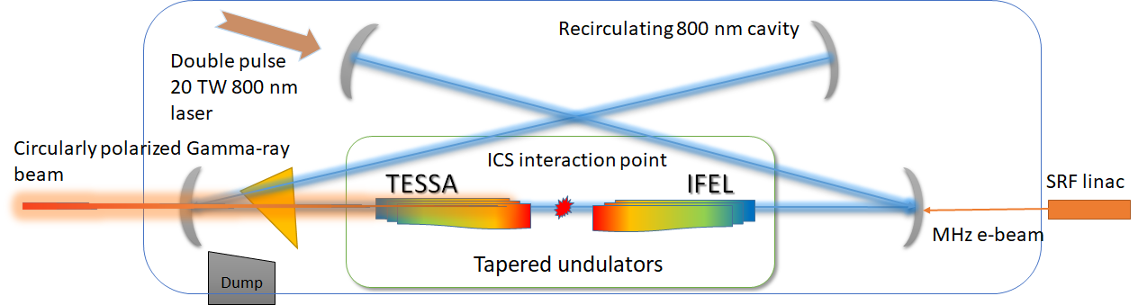
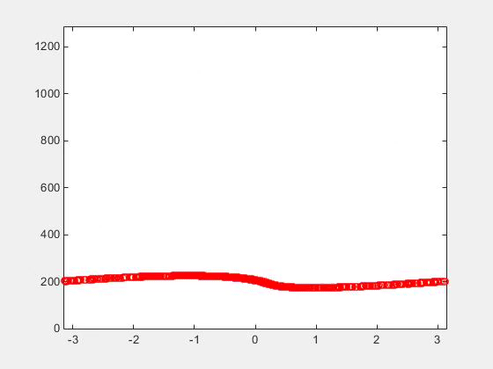
Intracavity IFEL-ICS-TESSA offers a promising path to very compact and high intensity gamma ray source (with TESSA replenishing the optical cavity losses:
Snowmass 2021 • AF6 September Workshop • Collider Concepts • 23 Sep 2020
IFEL stage is not strictly necessary, but makes the system more compact and reduces the beam dump requirements
~ 100 MeV
~ 600 MeV
~ 80 MeV
Near term R&D needs:
TESSA demonstration at the optical wavelength.
IFEL/TESSA pulse train dynamics.
Seed laser injection into the optical cavity.
MW-class CW optical cavity development.
Electron beam optimization (high peak current, low emittance, etc.)

