Slide 1
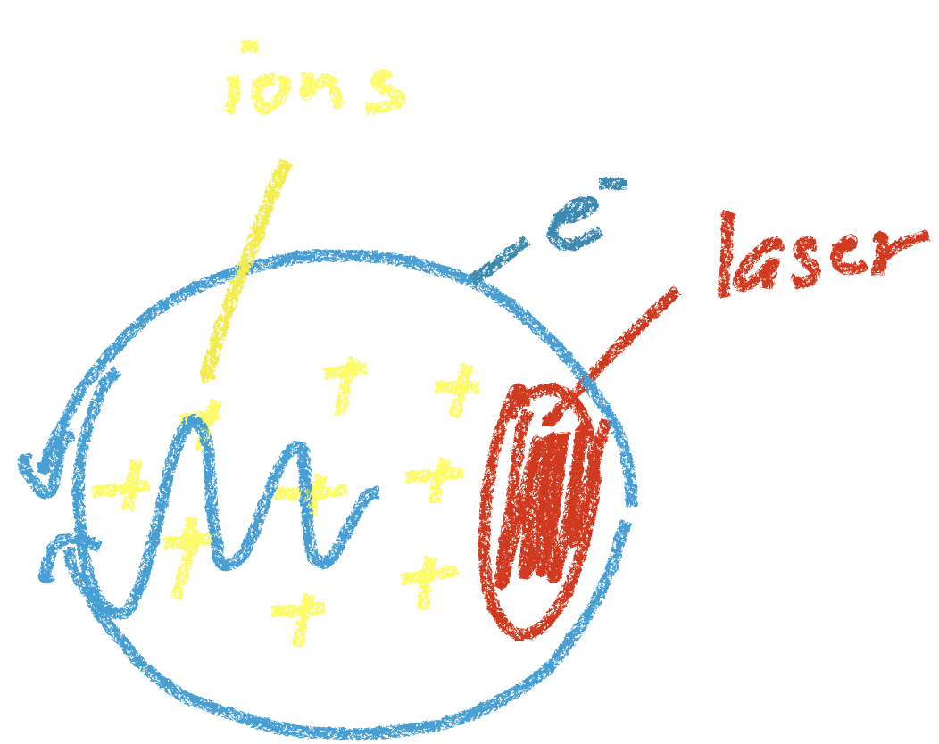
Laser-driven Injectors for Future Colliders (M. Fuchs^{UNL}, BA Shadwick^{UNL}, CB Schroeder^{LBNL})
Further improvements of LWFA beams are required (energy spread, efficiency, emittance, repetition rate, reproducibility, …)
Electron beam parameters mainly determined by injection and acceleration
Bubble-regime challenging: - control of self-injection - control of acceleration
Required driver laser challenging: - laser evolution has big impact on electron properties - rapid, highly nonlinear evolution of relativistic laser pulses - high peak power (> few 100 TW) difficult to scale to high repetition rates
Novel approaches required - improve electron beam properties - control over 6D phase-space with high accuracy
Novel diagnostics required to fully characterize 6D phase space

Slide 2
Laser-driven Injectors for Future Colliders (M. Fuchs^{UNL}, BA Shadwick^{UNL}, CB Schroeder^{LBNL})
Phase-space Shaping - control over electron beam phase space with high temporal and spatial precision - separate control over injection and acceleration processes - advanced target design - control over laser evolution - methods to improve efficiency - determination of properties for best-suited driver laser (higher-order spatial & temporal modes, multiple laser pulses, multi-colors, incoherent addition, … )
Novel diagnostics - information on 6D electron bunch phase-space (temporal and spatial) with sub-pulse resolution - high-resolution diagnostics of plasma and accelerating structure - ideally single-shot
Combined experimental & theoretical/simulation efforts - experiments guided by simulations - high-accuracy experimental measurements enable refinement of theoretical models and simulations - improve ability of predictions - also requires development of high-accuracy/low-noise simulation methods

