Slide 1
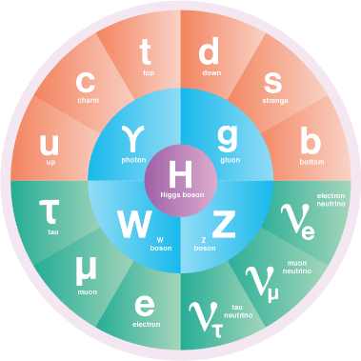
There are many applications that require high intensity beams!
(Pulsed beams: Spallation Neutron Sources, Future Colliders, …)
CW Beams:
800 MeV: DAEδALUS
CP-violation in neutrino sector
60 MeV: IsoDAR
Discovery level particle physics
https://arxiv.org/abs/1307.2949
Protons 10 mA cw
https://arxiv.org/abs/1205.4419
100 MeV
500 MeV
1.0 GeV
1.0 MW
5.0 MW
10.0 MW
Power
10-100 MeV: → Production of much needed medical isotopes
→Material research for Fusion
500 MeV to 1.0 GeV: Demonstrations for Accelerator Driven Systems and Accelerator Driven Subcritical Reactors
https://doi.org/10.1186/s41181-020-0090-3
https://doi.org/10.1016/j.scriptamat.2017.06.041

Slide 2
Needed Developments
Compactness:
Cost-effective, smaller footprint, potential for underground installation
Important to allow smaller labs and universities to participate → Teaching opportunity, broader impact, intellectual exchange
Hardware:
Developing WFA further and finding ways of chaining them together to achieve higher energies. Improve their duty cycle.
Continuing development of high gradient RF cavities for linear and circular machines.
Exploring how existing technology can be combined in new ways to overcome beam current limitations.
Developing high power cyclotrons.
Software:
Accurate treatment of physics
Inclusion into existing widely used simulation codes.
Unification of codes and interfaces
Application of Machine Learning in large scale accelerator simulations (e.g. to construct surrogate- and inverse models)
Research towards realistic multiobjective optimization with surrogate models.
Notes:
Space charge compensation.
Mirror charge effects.
Residual gas interaction.
Multipacting

Slide 3
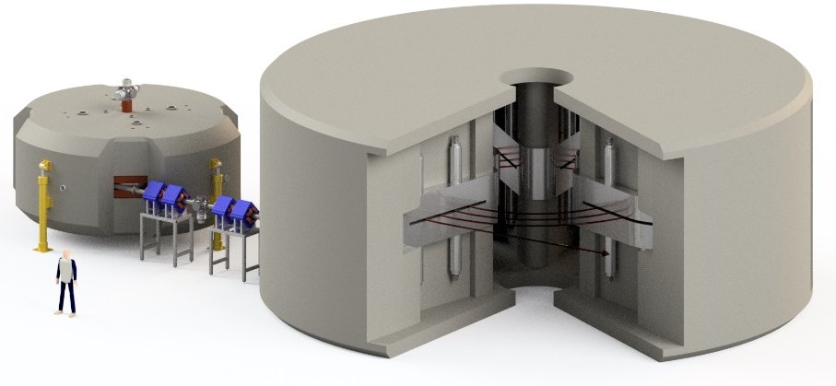
IsoDAR: Pushing the intensity frontier through cost-effective, compact accelerators, leading to MW beams
Computation
Understand High Intensity
Explore New Methods (AI/ML)
60 MeV
Impact on other fields
Medical Isotopes
Neutron Sources
800 MeV
Hardware Development
RFQ-DIP Prototype
Hands-On Teaching
ADS(R)
Particle Physics
https://arxiv.org/abs/2002.11264
https://arxiv.org/abs/1807.03759
https://arxiv.org/abs/1205.4419

