Slide 1
RunCo Report for IOTA/FAST Meeting 09/18
FAST Startup has started. (will run off-hours)
Tasks before beam: Laser ORC • HLRF • Cooldown • System check-outs • SRF conditioning
ES&H is (still) working on a way for electronic signatures
Cryo: Delays due to South Dry Engine (& other) issues
Cool-down continues • CM @5K (delayed several times)
CC1 & CC2 cooldown in progress
IOTA: B-R spool • E-Straight disintegration
FESS: Gas leak work outside NML next week • ESB A/C out (again) • 25t portable @ESB • ICW-AS fixed (again)
ACNET computer room outages: 9/19-20 & 9/23
Reminders:
Cave will remain Controlled Access (unless cleared with RunCo)
Document everything in the eLog!!!
Tomorrow is “Talk Like a Pirate Day”
Notes:
Why are you looking down here? Look back at the slide.

Slide 2
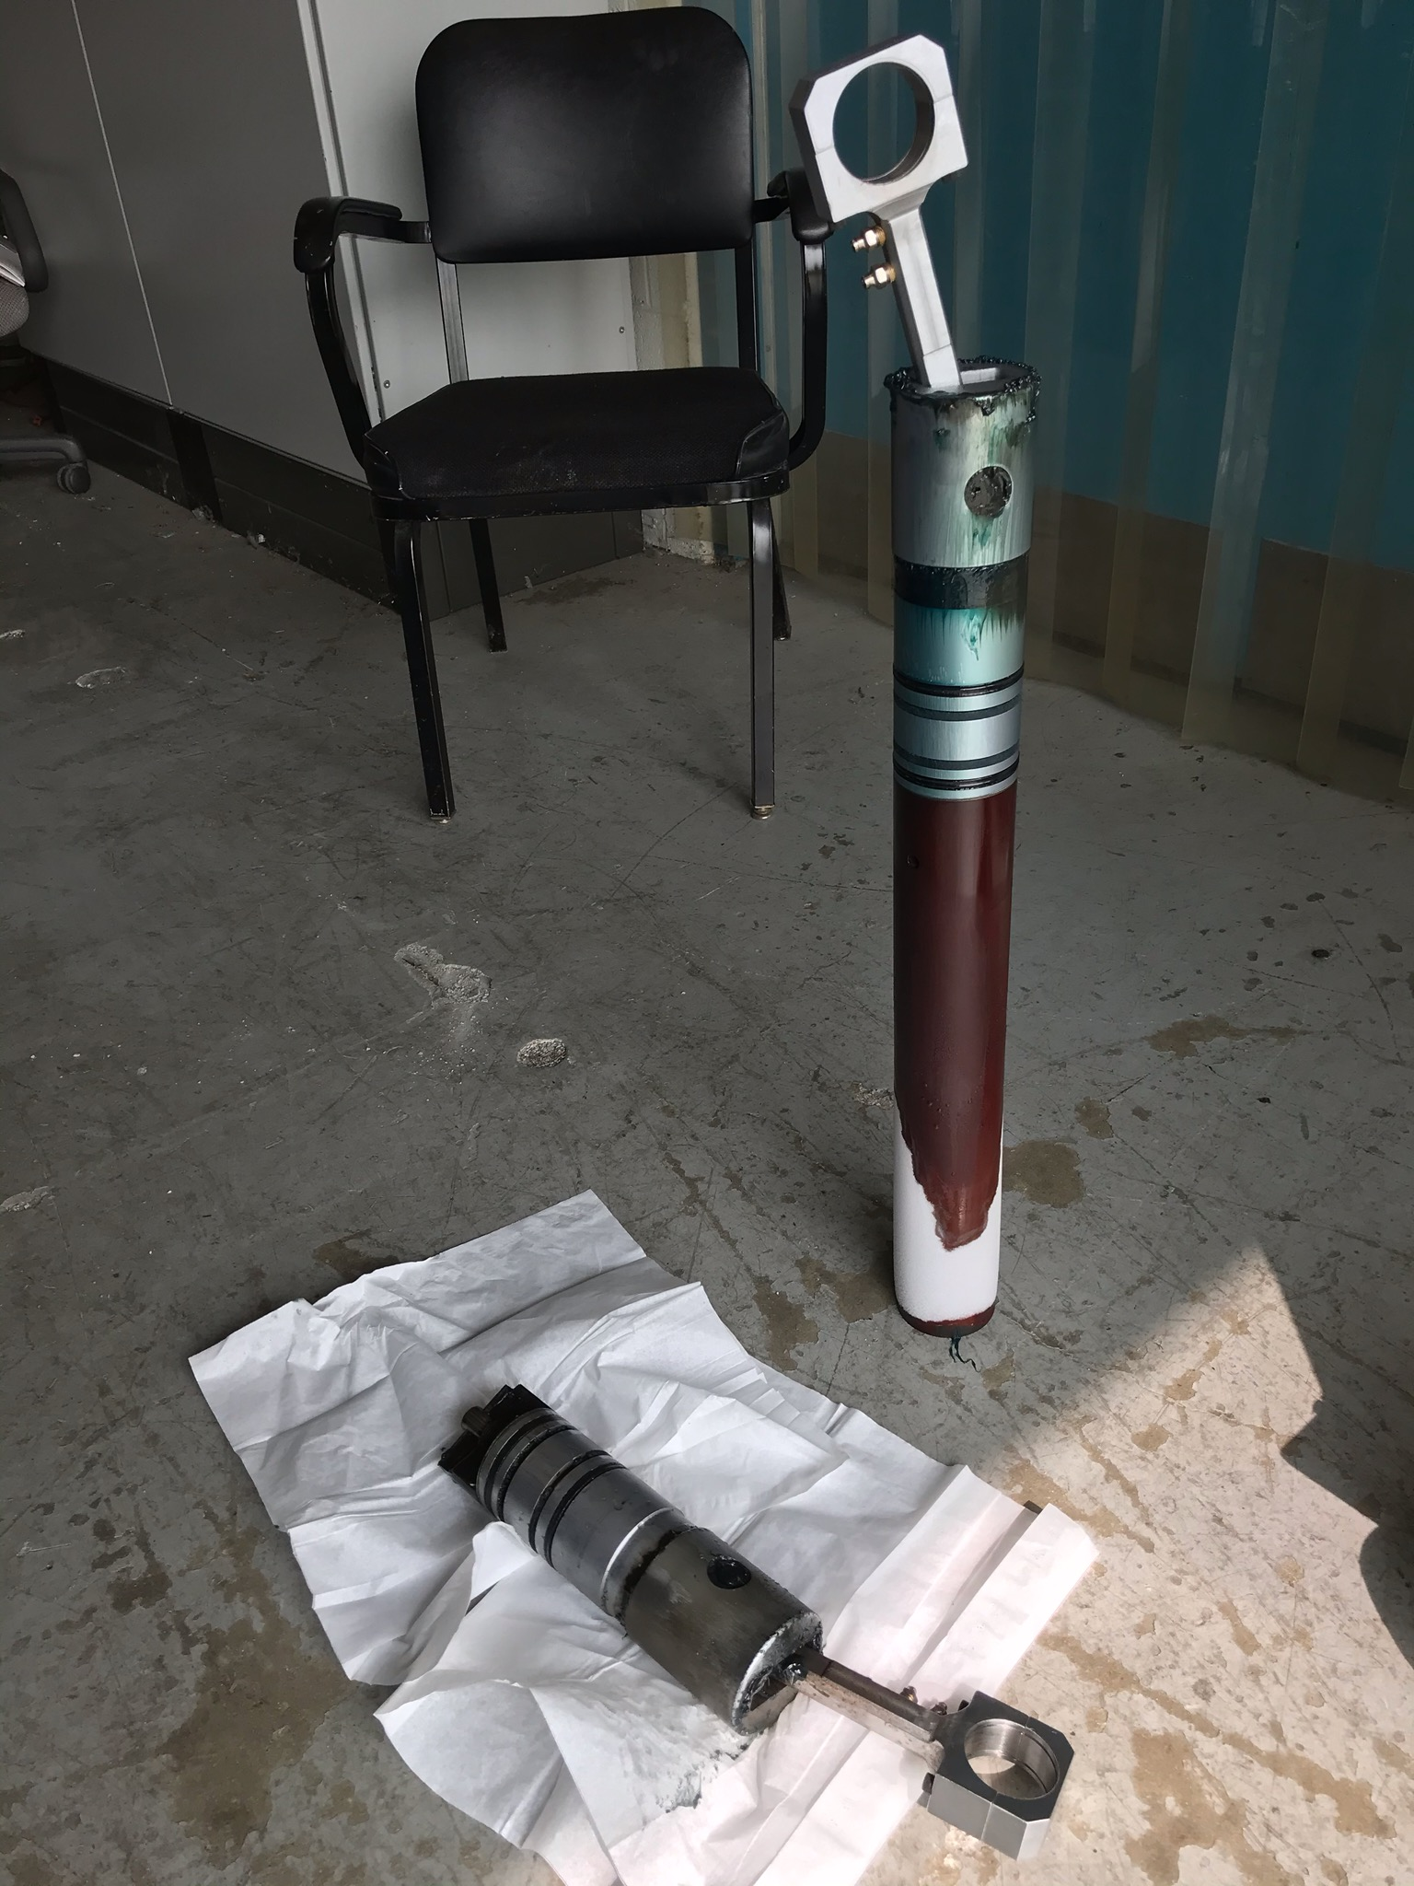
NML Cryo South Fridge Dry Engine piston failed
GOOD
BAD

