Slide 1
CDS Bayonet Deformation Analysis
Ram C. Dhuley / Fermilab
PIP-II Technical Workshop
Dec 1-4, 2020

Slide 2
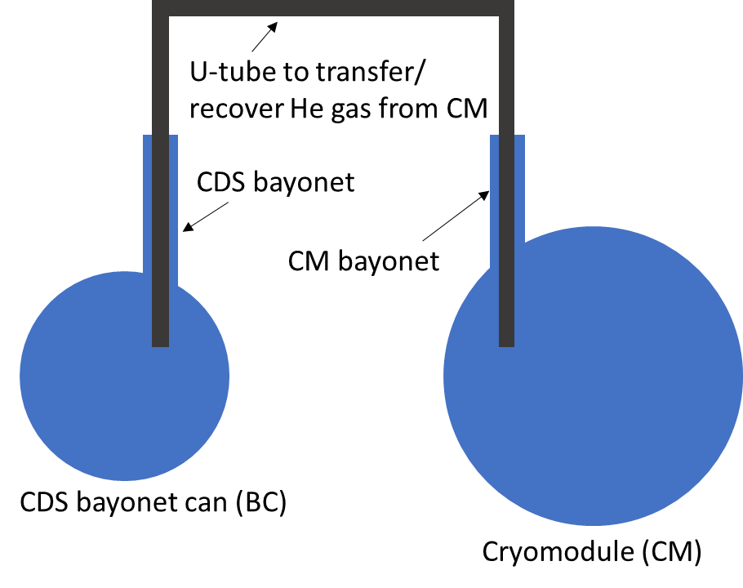
CDS bayonets overview
Looking down the PIP II Linac tunnel to
understand why bayonets are used
The CDS will use 5*25 = 125 bayonets!

Slide 3
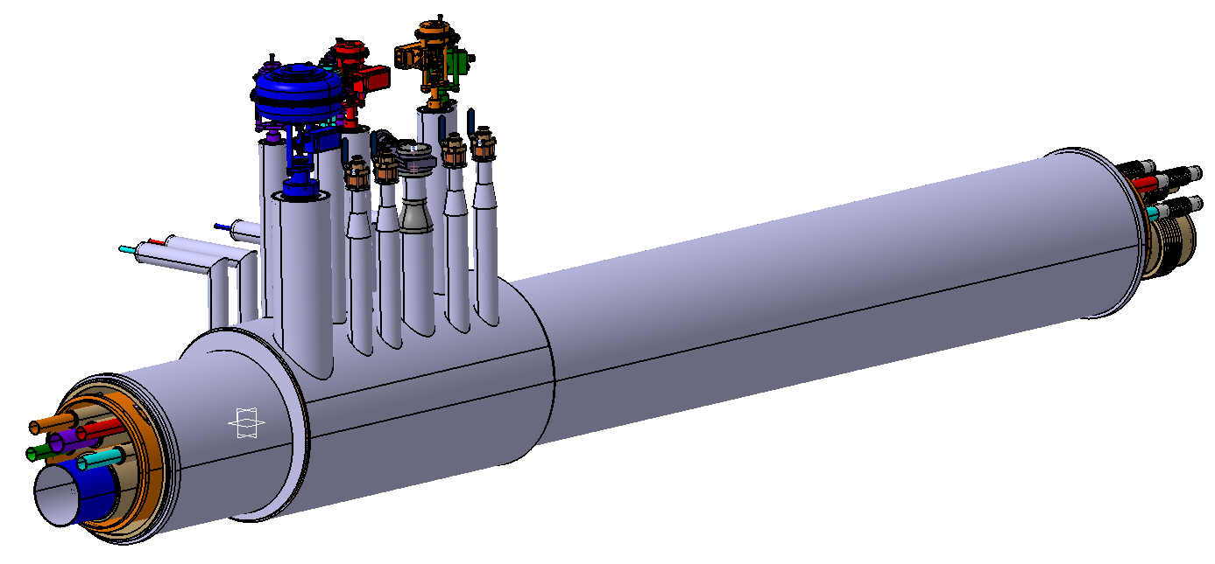
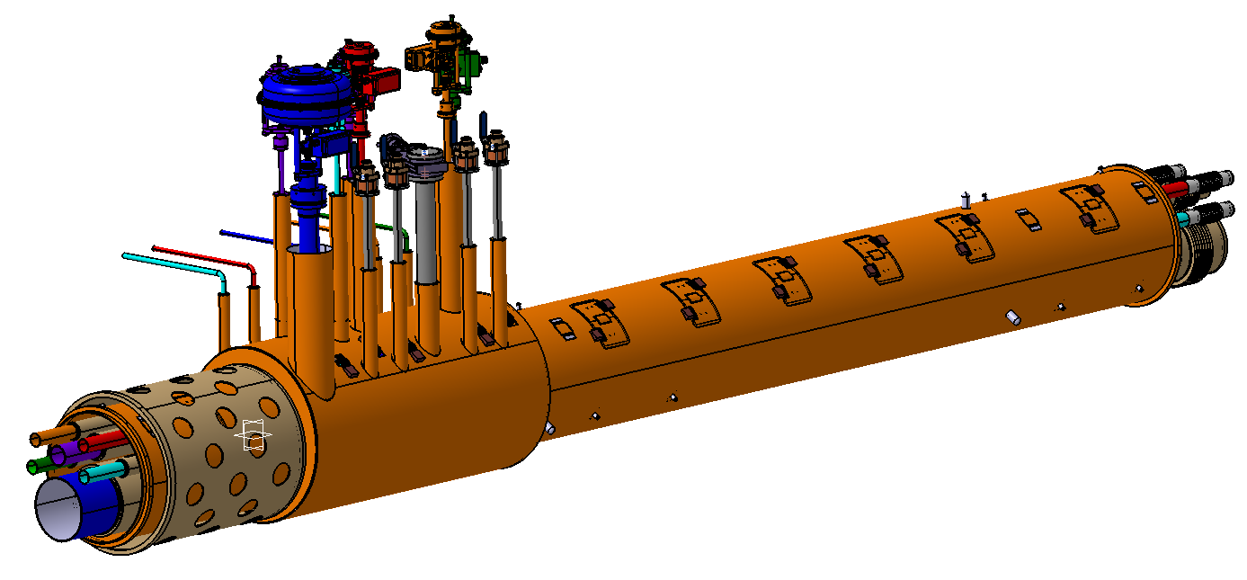
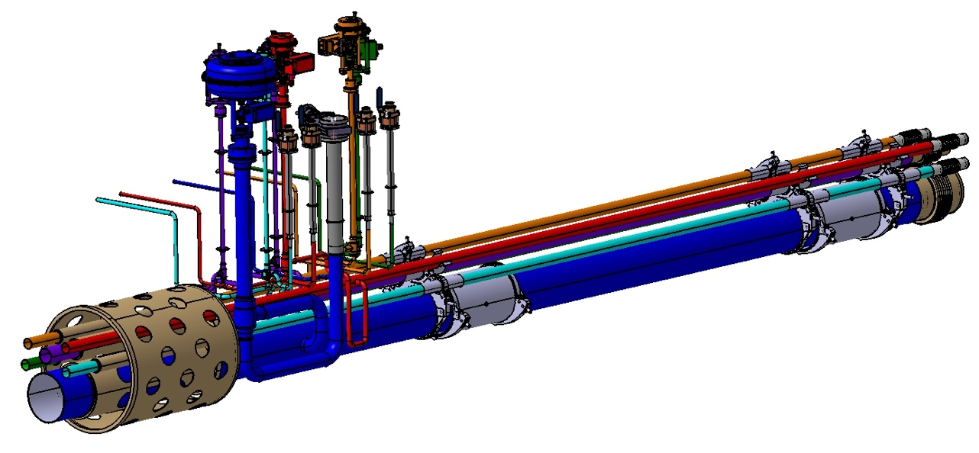
CDS bayonets overview
Each bayonet is designed to have
4 x DN20 bayonets (2 x HTTS + 2 x LTTS)
1 x DN65 bayonet (2 K return)

Slide 4
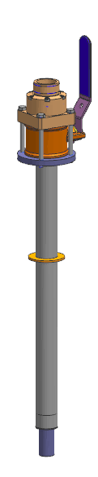
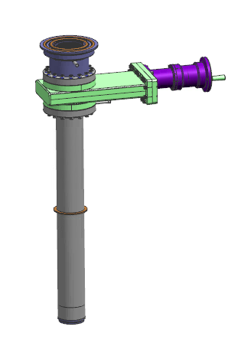
Why to do a deformation analysis for the CDS bayonets?
Both the bayonets are long, thin-walled pipes
DN20 -> 485 mm long, 0.889 mm wall
DN65 -> 630 mm long, 0.889 mm wall
The bayonet pipes may deform during
Construction and assembly with the process pipes
Cooldown and cryogenic process operation
How much deformation is acceptable before
CODE allowable stress is exceeded?
Fabrication vendor specification
Design input for process pipe flexibility
DN20
DN60

Slide 5
CODE allowable stresses
Material for bayonets
SS304L (1.4306) – minimum applicable temperature is -273 ⁰C
CODE | Pipe type | Allowable stress | Max. membrane stress | Max. membrane + bending stress
EN 13458-2 | ? | 215 MPa (=Rp1.0) | 172 MPa (=0.8*Rp1.0) | 286.6 MPa (=4/3*Rp1.0)
ASME Section VIII DIV II | Seamless | 115 MPa (=2/3*YS) | 115.1 MPa (=allowable) | 172.7 MPa (=1.5*allowable)
 | Welded | 97.9 MPa | 97.9 MPa (=allowable) | 146.9 MPa (=1.5*allowable)

Slide 6
Deformation analysis using FEM (courtesy: Ang Lee, Fermilab)
Boundary conditions
Cases considered
Bayonets at room temperature
Bayonets with temperature profile
during cryogenic process operation
DN20 – seamless pipe
DN65 – welded pipe
Fixed point
(connection to vacuum vessel)
Material properties sourced from
The CODEs – room temperature
structural properties
NIST - temperature dependent
linear expansion and thermal
conductivity.
Apply lateral deformation
1,2..5 mm
(comes from the movement of
process pipes; assumed “free” axially)

Slide 7
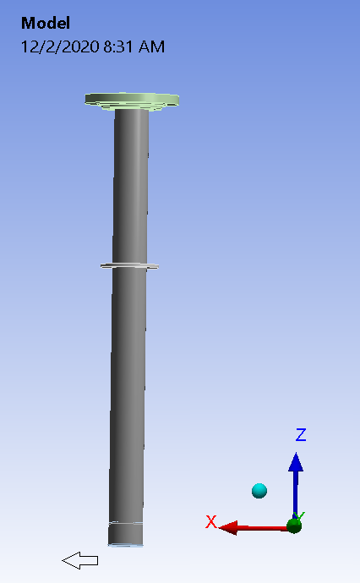
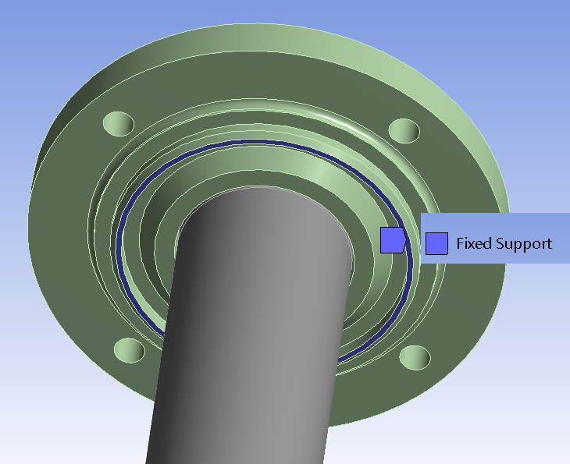
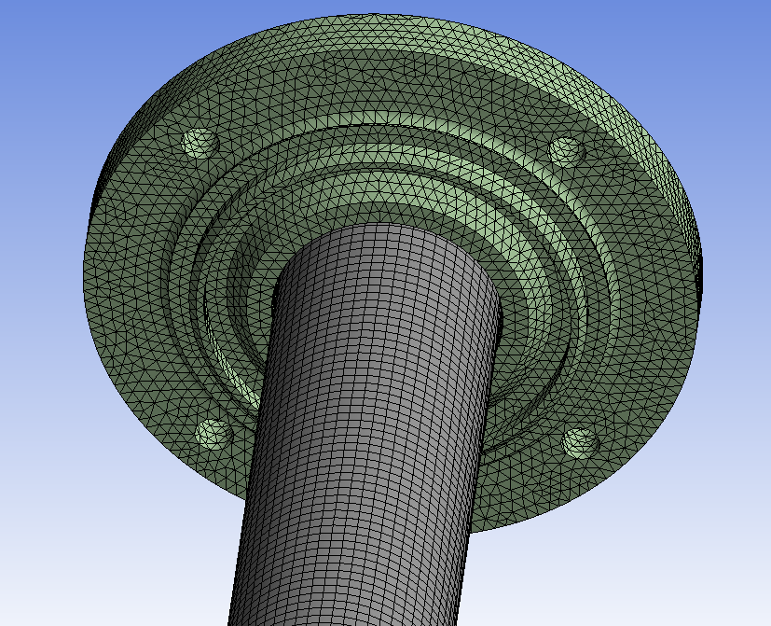
Deformation analysis using FEM
Meshing
Flange assembly – 20 node solid element with <2 mm mesh size
Thin wall pipe – 8 node shell element, 2 mm size (0.889 mm wall)
Apply lateral deformation

Slide 8
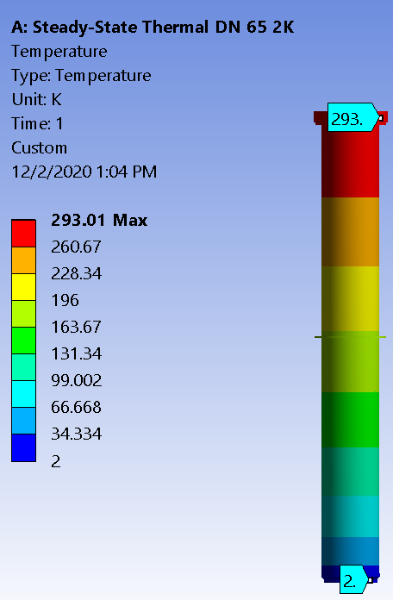
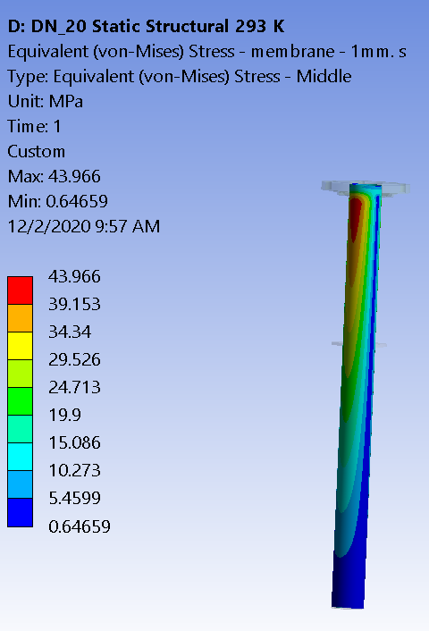
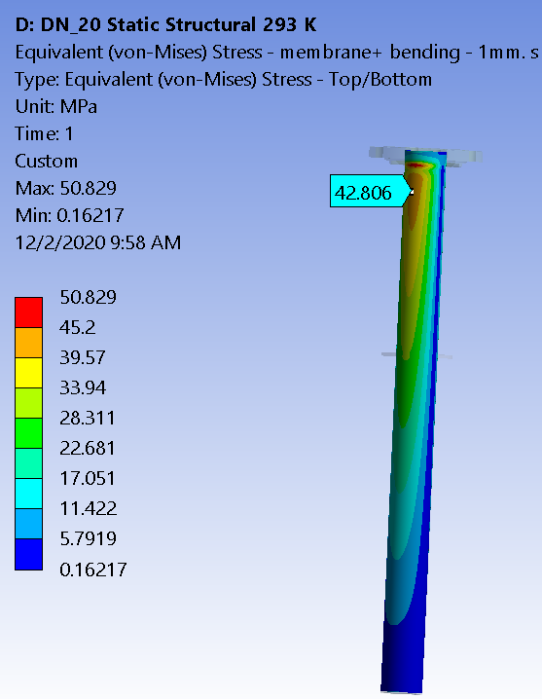
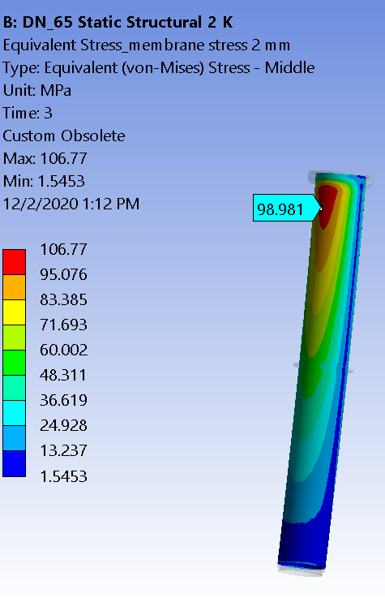
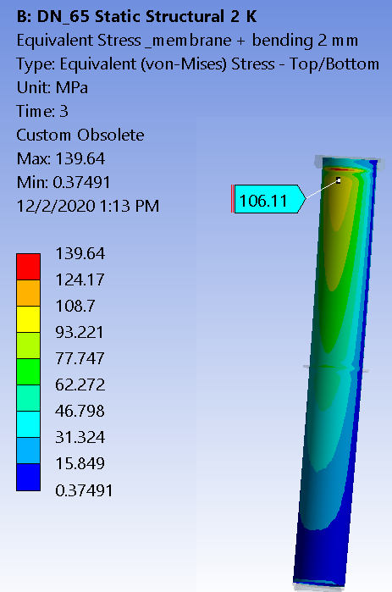
Sample FEA results
DN20, 1 mm deformation,
room temperature
DN65, 2 mm deformation,
cryogenic operation

Slide 9
DN20: Calculated stresses and allowable deformation
Horizontal displacement | 1 mm |  | 2 mm |  | 4 mm |  | 5 mm
Calculated max. stress (MPa) | membrane | membrane +bending | membrane | membrane +bending | membrane | membrane +bending | membrane | membrane +bending
293 K | 43.97 | 50.829 | 87.93 | 101.66 | 176.26 | 202.79 | 221.66 | 253.59
40K (process pipe T) | 44.9 | 53.95 | 89.69 | 105.77 | 179.76 | 208.8 | 226.09 | 260.68
80 K (process pipe T) | 44.79 | 53.67 | 89.53 | 105.39 | 179.44 | 208.26 | 225.69 | 259.95
5 K (process pipe T) | 44.9 | 54.1 | 89.74 | 105.89 | 179.86 | 208.98 | 226.22 | 260.79
9 K (process pipe T) | 44.9 | 54.04 | 89.74 | 105.89 | 179.85 | 208.87 | 226.21 | 260.78
Per EN 13458-2 code:
Membrane stress < 172 MPa
Membrane and bending stress < 286.6 MPa
Allowable displacement < 4 mm
Per ASME SECTION VIII,DIV II
Membrane stress < 115.1 MPa;
Membrane + Bending stress < 172.7 MPa.
Allowable displacement < 3 mm
(linear interpolation of the stresses from 2 mm and 4 mm displacement)

Slide 10
DN65: Calculated stresses and allowable deformation
Horizontal displacement | 1 mm |  | 2 mm |  | 4 mm |  | 5 mm
Calculated maximum stress (MPa) | membrane | membrane +bending | membrane | membrane +bending | membrane | membrane +bending | membrane | membrane +bending
293 K | 52.29 | 66.91 | 104.62 | 133.9 | 209.74 | 267.22 | 263.34 | 333.6
2 K (process pipe T) | 53.37 | 71.32 | 106.77 | 139.64 | 214.06 | 275.55 | 268.79 | 343.25
Per EN 13458-2 code:
Membrane stress < 172 MPa
Membrane and bending stress < 286.6 MPa
(not clear if the EN code distinguished welded vs. seamless)
Allowable displacement < 3 mm
Per ASME SECTION VIII,DIV II
Membrane stress < 97.9 MPa
Membrane + Bending stress < 146.9 MPa
Allowable displacement < 2 mm

Slide 11
Thanks and we welcome inputs/feedback

