Slide 1
Controls Working Group: Summary
Jim Patrick + Elvin Harms / Fermilab
PIP-II Technical Workshop
04 December 2020

Slide 2
Controls Working Group: Agenda Overview
Overview of the PIP-II control system
Common Hardware Platform discussion
Modern EPICS standards
Front-end/IOC standards
Controls hardware overview
RF interfaces to the control system
Instrumentation interfaces to the control system
PIP-II timing system
Software infrastructure and code management
Round table discussion with partners
Experiences and lessons learned with migration, collaboration
Many excellent presentations!

Slide 3
Control System Overview Summary
The PIP-II Control System will be based on EPICS
A parallel project, ACORN, will upgrade the existing complex to EPICS
Unified control system by the time of booster injection from PIP-II
We are in the early planning phases of the detailed implementation
And so do not currently have detailed standards for partners
We plan to leverage development and experience from recent accelerator projects
We plan to use modern features in EPICS – EPICS 7 and recent tools
We plan to contribute to future developments in EPICS to meet our requirements
The cryomodule test stand in 2022 will be the first full EPICS implementation
The system will be scaled up during beam commissioning

Slide 4
Common Platform + Instrumentation Interface (Drennan/Diamond) Front-end/IOC standards (Nicklaus)
Standard platforms provide engineered elements to reliable systems.
Initial cost savings
Commercially available hardware
Common Components
Reduced manpower both initially and into the life of the system.
Fermilab has been investigating microTCA
Still much to learn
Also has built network attached devices
No plans for future VME development

Slide 6
Fermilab Direction
Summary
Linux is replacing VxWorks as an embedded OS
Hard real-time requirements are being pushed into the FPGA
We’re converging on a common EPICS IOC platform
The path beyond VME is becoming more clear
Gigabit ethernet is replacing the VME bus for data acquisition
DDCP is a maturing, lightweight UDP protocol for communicating with ethernet-attached devices
Need to look at DPDK to eliminate the network-stack bottleneck
MicroTCA favored for high channel density systems
SoC FPGAs are affordable alternatives for low channel density
Replacing SBCs with commodity x86 server PCs and ARM SoCs is an affordable way to scale up CPU resources

Slide 7
Front-end IOC Standards - Minimum
Easily reconfigurable — e.g. we change your name prefix to match our standards and instances.
Locally rebuildable from source code
Adhere to our (TBD) standards (EPICS base version, ...) and protocols
Fit into our deployment plans
Test Suites So…
We need to publish our standards
Describe our database integration plans
Publish guidelines
PLCs — there are no plans to distribute a standard PLC hardware and software bundle. But there should be some thought/agreement here

Slide 8
Dalesio - Osprey

Slide 9
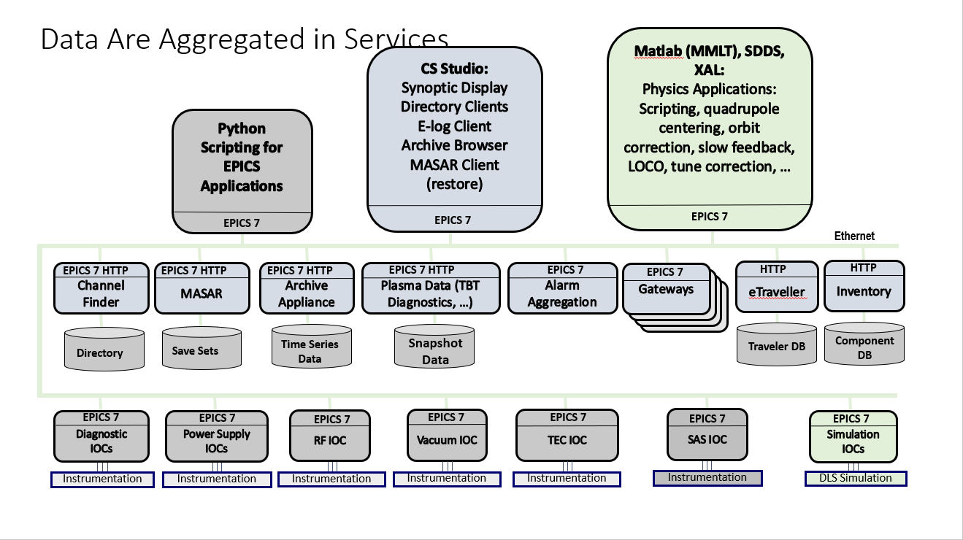

Slide 10
Hardware Overview (Kucera)
PLC based controls for
Vacuum gauges, pumps, valves, …
Beamline and cryo insulating vacuum
Cryo delivery system (PLCs responsibility of cryo)
Cooling water
General Data Acquisition
HRM-II – 64 10KHz ADCs, 8 16 bit DACs, 8 bytes digital I/O, 8 programmable triggers
Used for power supply control and monitoring at PIP2IT
Motion control
Cavity tuners, scrapers, instrumentation, collimators
Commercial hardware, currently VME based front-end

Slide 11
325 MHz SSA interface – Manjiri Pande

Slide 13
650 MHz SSA interface - Lad

Slide 14
PIP-II Timing System (Austin)
The PIP-II timing system is planned to be a two-part system
The first part is a global timing system (here called ACLK) that provides high level, event based timing for the whole Fermilab accelerator complex
The second part is a RF synchronized clock system unique to the PIP-II linac itself (here called LCLK-II)
The ACLK system will be clocked at 650 MHz. A frame consists of the following:
65 bits total frame |  | 0 | MSB |  | LSB | MSB |  | LSB | X | 111111111111111
 |  | start bit |  | 16-bit EVENT |  |  | 32-bit Data |  | Parity bit | Pad bits # 51-65
The LCLK-II system will be clocked at 650 MHz. A frame consists of the following:
52 bits total frame |  | 0 | MSB |  | LSB | MSB |  | LSB | X | 1 | 1
 |  | start bit |  | 16-bit EVENT |  |  | 32-bit Data |  | Parity bit | pad bit | pad bit
Data field may be time or cycle stamp to correlate data, or fast data needed by the front-end

Slide 15
PIP-II Timing System Block Diagram

Slide 16
PIP-II Software Organization (Levshina)
The development of the software for the PIP-II will take several years.
The maintenance of the PIP-II software will take many years.
There are multiple developers and multiple organizations with different approaches for software development and different organizational rules.
That is why it is crucial to figure out how we want to structure a project, so it is possible to
Understand the layout and dependencies
Understand the purpose of a particular subproject/module
Avoid duplication of development efforts and promote reuse
Decide on branching/tagging and release procedure

Slide 17
Fermilab Version Control Platform Roadmap
Recent code development has used a Fermilab git implementation - Redmine
Strong push to use GitHub for the future
Fermilab developers could contribute code to public GitHub Open-Source projects
Needs approval from Fermilab Intellectual Property Management team
The Core Computing Division supports GitHub Enterprise on-Prem. They are running PIP-II IT instance with 20 licenses
This allows private repositories
Some testing of Continuous Integration has been done
The Scientific Computing Division has some experience with GitLab on-site.

Slide 18
Invited Roundtable Panel Members
Gopal Joshi, Sandeep Bharade, Radhika Nasery - BARC
Julien Branlard – DESY/XFEL & FAST
Wojtek Cichalewski – Lodz University of Technology-DMCS/ESS
Graham Cox – STFC Daresbury Laboratory
Krzysztof Czuba – Warsaw University of Technology/ESS
Françoise Gougnaud & Paul Lotrus – CEA Irfu
Many excellent presentations on short notice – Thanks!

Slide 19
Opening Questions for Panel
To conclude this week's PIP-II Technical Workshop/Controls working group we intend to have a round table discussion on international experience with Controls. To start the conversation our panel members are asked to consider the following:
Notable ‘Lessons Learned’ with respect to controls
Best practices in Controls design/implementation
Controls migration experience
What requirements did you get/not get (and should have) for previous controls projects?
What languages and frameworks have you used for writing user applications?
optional: - git repository structure: what products have you used; what are their differences?
- experience with uTCA

Slide 20
Lessons Learned
Naming convention is valuable, not just for controls variable names but extending that to engineering drawings etc.
This has been done for PIP-II!
As designs progress, anticipate that the naming convention may need to evolve
Tools for flagging invalid names can be useful. Straightforward for controls names
MicroTCA is broadly used
Implementations vary in detail
Fermilab instrumentation proposal is different than what is done elsewhere
Ethernet with custom protocols
Interfaces should be discussed and agreed upon early in the design process
There may be unexpected interfaces as design matures
And requirements and detailed specifications should be shared as soon as available

Slide 21
Open Issues
Detailed planning for the full PIP-II system is currently in the early phases
Supported hardware platforms
MTCA – details – data transfer method etc.
Common general purpose boards?
VME discouraged?
Timing system integration – receiver boards, FPGA logic
IOC/front-end standards for
Supported platforms, operating systems
EPICS version and code, database structure
Application languages and frameworks
Code management system and code structure

Slide 22
Controls Working Group: Conclusions
Very productive meeting and worth repeating in ~6 months
11+ talks + roundtable discussion w/presentations
Average attendance ~50 people/day. Peak > 60 – many more than expected!
Detailed planning of the EPICS control system for PIP-II is beginning
We plan to learn from other labs as we do this
The first full EPICS system will be the cryomodule test stand
The system will be scaled up during beam commissioning
We are working with microTCA and would like to develop common platforms
Good communication with our international partners is essential at an early stage

