Slide 1
Topic 3 - Cavity and subcomponents manufacturing diagnostics
Michael Foley
PIP-II Technical Workshop
1 - 4 December 2020

Slide 2
Cavity and subcomponents manufacturing diagnostics
Eddy current scanning
- Conservatively speaking, it is preferred.
- The recent rejection rate for niobium sheet is very low, so
visual inspection plus overnight water submersion may be
sufficient.

Slide 3
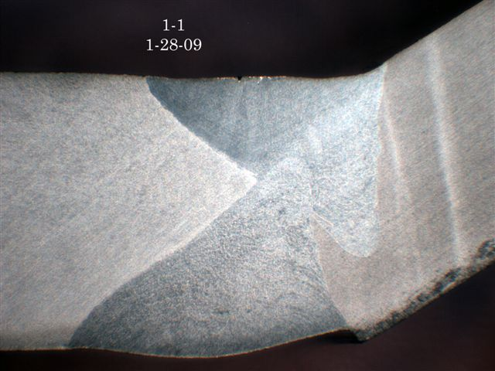
Cavity and subcomponents manufacturing diagnostics
EBW parameters development
- Parameters for non full penetration welds developed based
metallographic analysis of cut, etched and polished weld
weld samples

Slide 4
Cavity and subcomponents manufacturing diagnostics
EBW parameters development
- Parameters for full penetration welds (e.g., equator)
based on visual or optical inspection (e.g., borescope)
of weld samples.

