Slide 1
PIP2 Project Weld certification Robin Cubizolles

Slide 2
Code and standards
Directive used in CEA
PED : Pressure equipment directive 2014/68/EU
For pressure > 0.5 barg
Standards used in CEA for the conception of vessels
EN 13445 : Unfired pressure vessels
No distinction between the vacuum vessel and the inner vessel
/!\ do not take into account the insulation vacuum for the test pressure P_{T}=1,43xP_{S}
EN 13458 : Cryogenic vessels — Static vacuum insulated vessels
Specific to the cryogenic application (Transposition of the EN13445 to the cryogenic application).
Take into account the insulation vacuum for the test pressure.
EN 13458-2 can be used for the conception of the ‘’inner vessel’’ (helium diphasic tube) and ‘’outer jacket’’ (vacuum vessel).
| PAGE 2

Slide 3
Code and standards
Directive used in CEA
PED : Pressure equipment directive 2014/68/EU
For pressure > 0.5 barg
Standards used in CEA for the conception of vessels
EN 13445 : Unfired pressure vessels
No distinction between the vacuum vessel and the inner vessel
/!\ do not take into account the insulation vacuum for the test pressure P_{T}=1,43xP_{S}
EN 13458 : Cryogenic vessels — Static vacuum insulated vessels
Specific to the cryogenic application (Transposition of the EN13445 to the cryogenic application).
Take into account the insulation vacuum for the test pressure.
EN 13458-2 can be used for the conception of the ‘’inner vessel’’ (helium diphasic tube) and ‘’outer jacket’’ (vacuum vessel).
| PAGE 3

Slide 4
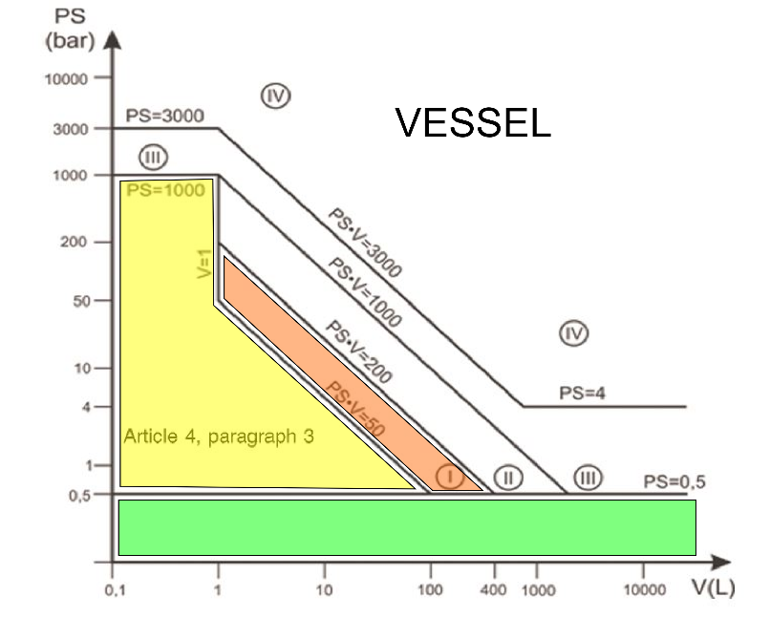
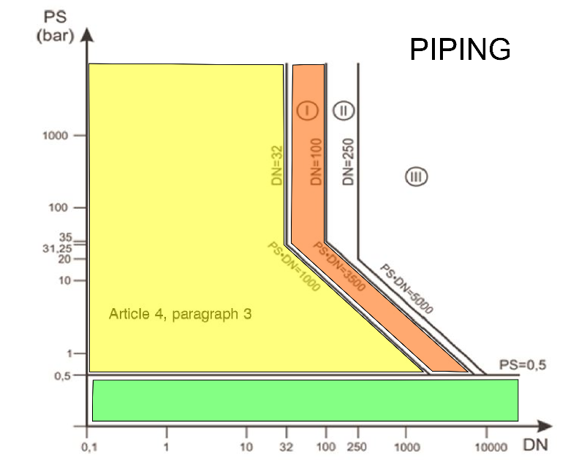
PED
PED - Pressure equipment directive 2014/68/EU
2 groups of gases : non-dangerous / dangerous
2 families : Vessel or Piping
5 risk category : with associated control procedures
| PAGE 4

Slide 5
PED
Article 4.3:
Designed and manufactured in accordance with the sound engineering practice of a Member State of the European Community
Category 1: Module A
Technical documentation.
Keep the documentation at the disposal of the relevant national authorities for inspection purposes for a period of ten years.
Affix the CE marking to each item of pressure equipment.
Declaration of conformity.
A general description of the pressure equipment.
Conceptual design and manufacturing drawings and diagrams of components, sub-assemblies, circuits…
Descriptions and explanations of the drawings, diagrams and the operation of the pressure equipment,
A list of the standards,
Results of design calculations made, examinations carried out…
Test reports.
| PAGE 5

Slide 6
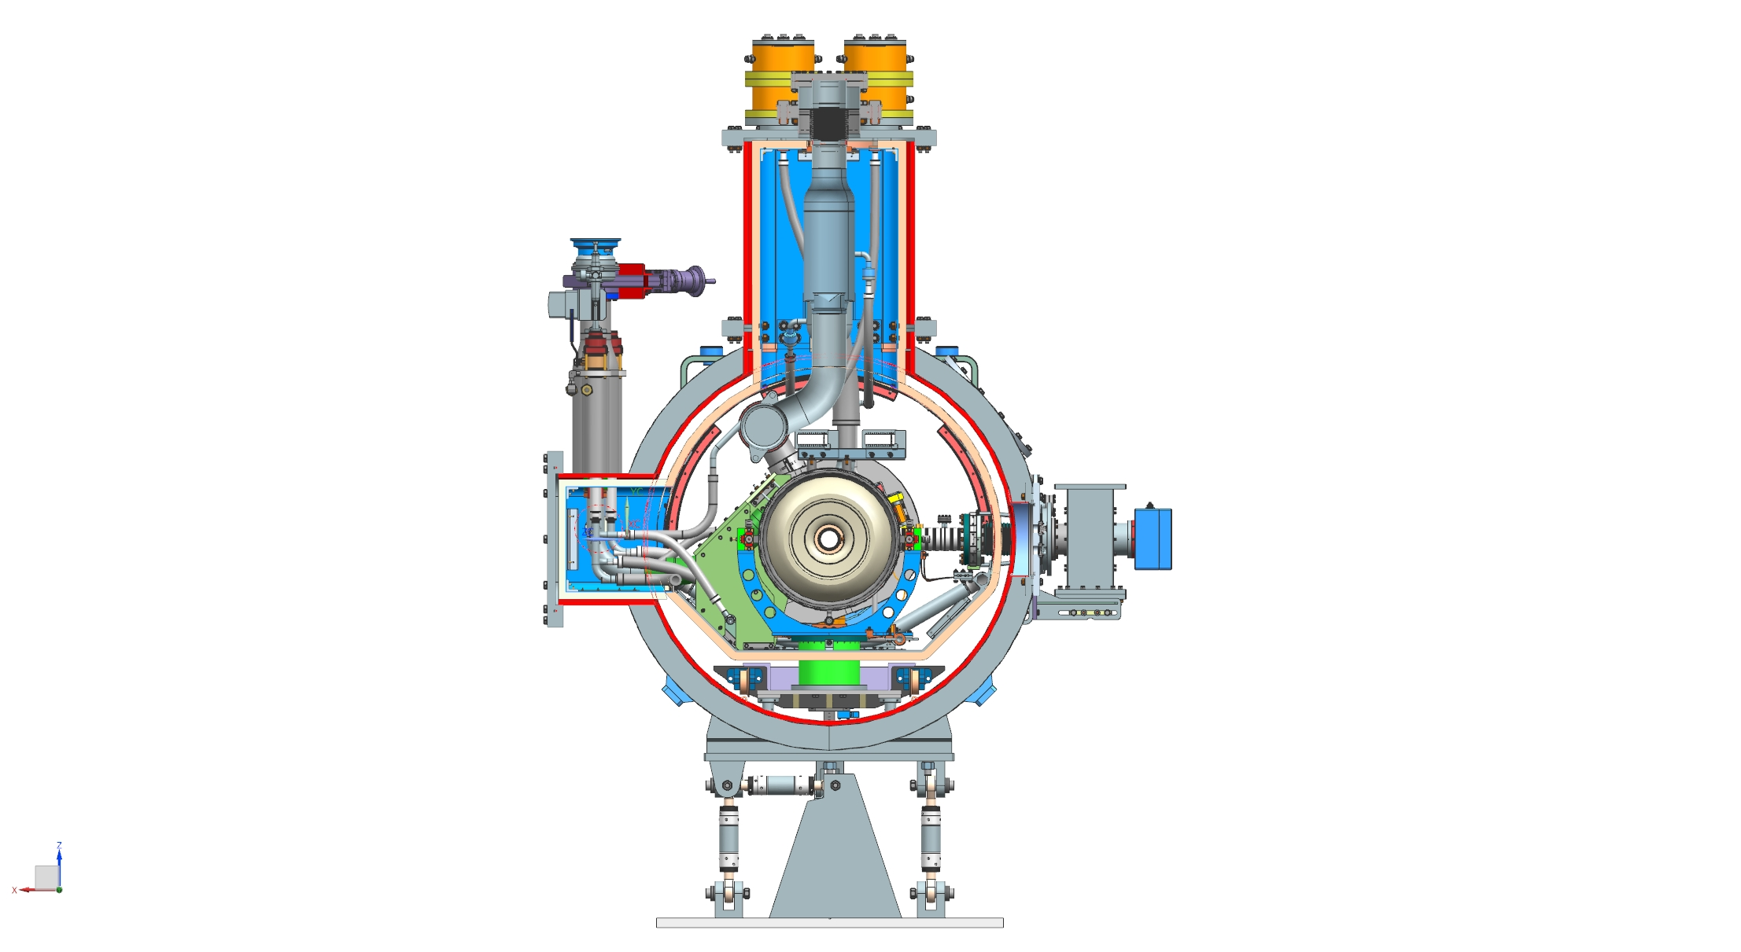
Cryomodule Components
Pipe B - Pumping line
MAWP: 2.05 bar
Pipe G - 2phase He pipe & Relief line
MAWP: 2.05 bar
Pipe E & F - 35-50 K line
MAWP: 20 bar
Pipe A - 2 K supply
MAWP: 20 bar
Pipe H - Cool down /
warm up line
MAWP: 20 bar
Pipe C & D - 5 K line
MAWP: 20 bar
From FDR Hβ650 Cryomodule design overview - part 1 | V. Roger
| PAGE 6

Slide 7
Cryomodule Components
For the Lβ650
Article 4.3
Pipe B - Pumping line
MAWP: 2.05 bar
Submitted to the Category 1
Pipe G - 2phase He pipe & Relief line
MAWP: 2.05 bar
Pipe E & F - 35-50 K line
MAWP: 20 bar
Pipe A - 2 K supply
MAWP: 20 bar
Pipe H - Cool down /
warm up line
MAWP: 20 bar
Pipe C & D - 5 K line
MAWP: 20 bar
Article 4.3
From FDR Hβ650 Cryomodule design overview - part 1 | V. Roger
Use of the EN 13445 or EN 13458 for the conception and fabrication of the 2phase pipe
| PAGE 7

Slide 8
Code and standards
Directive used in CEA
PED : Pressure equipment directive 2014/68/EU
For pressure > 0.5 barg
Standards used in CEA for the conception of vessels
EN 13445 : Unfired pressure vessels
No distinction between the vacuum vessel and the inner vessel
/!\ do not take into account the insulation vacuum for the test pressure P_{T}=1,43xP_{S}
EN 13458 : Cryogenic vessels — Static vacuum insulated vessels
Specific to the cryogenic application (Transposition of the EN13445 to the cryogenic application).
Take into account the insulation vacuum for the test pressure.
EN 13458-2 can be used for the conception of the ‘’inner vessel’’ (helium diphasic tube) and ‘’outer jacket’’ (vacuum vessel).
| PAGE 8

Slide 9
Code and standards
Directive used in CEA
PED : Pressure equipment directive 2014/68/EU
For pressure > 0.5 barg
Standards used in CEA for the conception of cryomodule
EN 13445 : Unfired pressure vessels
No distinction between the vacuum vessel and the inner vessel
/!\ do not take into account the insulation vacuum for the test pressure P_{T}=1,43xP_{S}
EN 13458 : Cryogenic vessels — Static vacuum insulated vessels
Specific to the cryogenic application (Transposition of the EN13445 to the cryogenic application).
Take into account the insulation vacuum for the test pressure.
EN 13458-2 can be used for the conception of the ‘’inner vessel’’ (helium diphasic tube) and ‘’outer jacket’’ (vacuum vessel).
Quite similar for the conception of vessel but have some differences for the weld inspection and thus, weld certifications
| PAGE 9

Slide 10
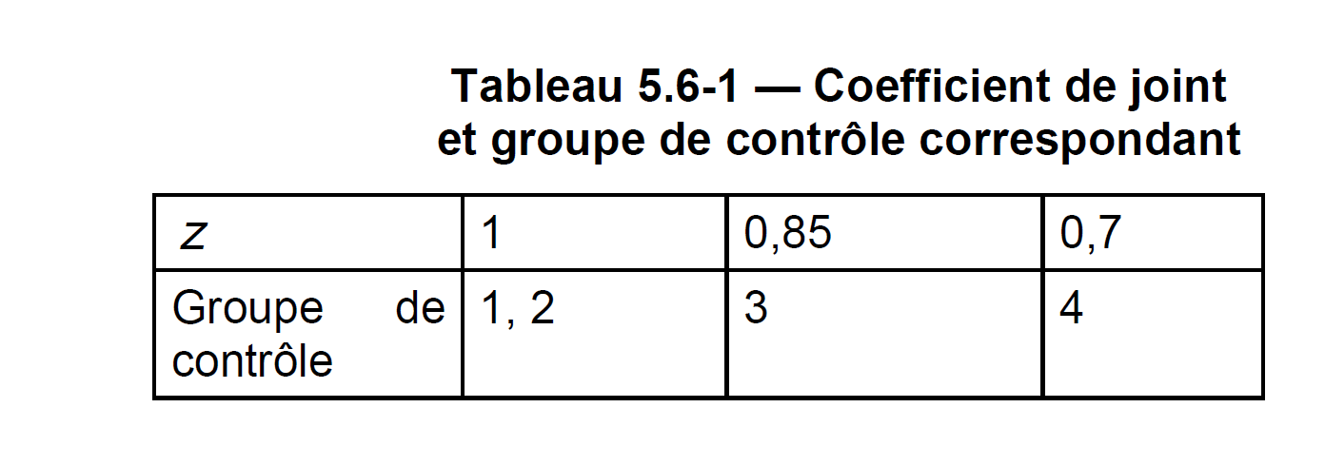
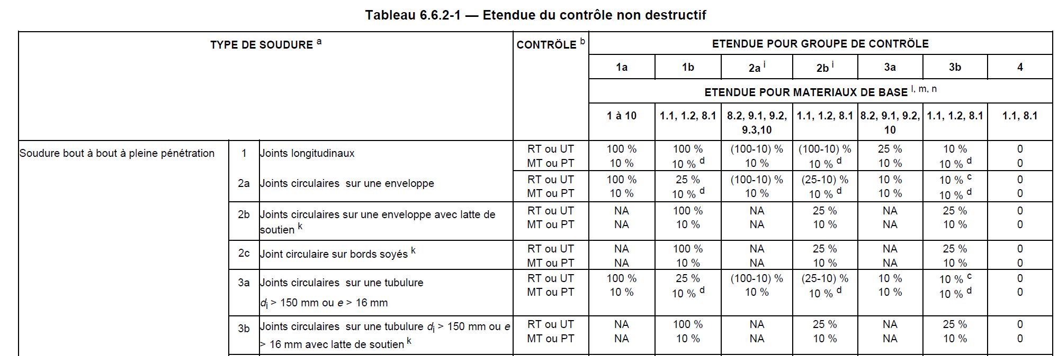
EN 13445-3 | EN 13445-5
Verification of the welds for pressure vessel depends of the group control.
Four groups control subdivided into 2 groups a) and b) for the group 1, 2 and 3.
Depend of the weld joint factor used during the conception of the components.
Form EN 13445-3
‘’Part Conception’’
The inspection of the welds.
Form EN 13445-5|‘’Part verification’’
| PAGE 10

Slide 11
EN 13445-3 | EN 13445-5
Verification of the welds for pressure vessel depends of the group control.
Four groups control subdivided into 2 groups a) and b) for the group 1, 2 and 3.
Depend of the weld joint factor used during the conception of the components.
Form EN 13445-3
‘’Part Conception’’
The inspection of the welds.
Depend of the type of control
RT : Radiographic inspection
UT : Ultrasonic inspection
MT : Magnetoscopy
PT : Dye penetrant testing
Form EN 13445-5|‘’Part verification’’
| PAGE 11

Slide 12
EN 13445-3 | EN 13445-5
Verification of the welds for pressure vessel depends of the group control.
Four groups control subdivided into 2 groups a) and b) for the group 1, 2 and 3.
Depend of the weld joint factor used during the conception of the components.
Form EN 13445-3
‘’Part Conception’’
The inspection of the welds.
Depends of the material
Example (see EN 13445-2):
P355GH : group 1.2 → b)
304L (1,4307) : group 8.1 → a) or b)
Form EN 13445-5|‘’Part inspection and controls’’
| PAGE 12

Slide 13
EN 13458-2
Inspection of the welds for the cryogenic inner vessel §6.3.3.
Depend of the weld joint factor used during the conception of the components.
Depend of the type of welds.
No verification of the vacuum vessel welds are required by the EN 13458
| PAGE 13

Slide 14
Summary
Conception depending of the standard
Choice of the weld joint factor
Choice of the material
Inspection of the welds
Control depends of :
Type of welds
Type of controls
Radiographic
Ultrasonic
…
| PAGE 14

Slide 15
Summary
Conception depending of the standard
Choice of the weld joint factor
Choice of the material
Technical documentations
Qualification testing of welders
Welding specifications
…
Inspection of the welds
Control depends of :
Type of welds
Type of controls
Radiographic
Ultrasonic
…
Testing
Helium leak check
Pressure test
Thermal shock with liquid nitrogen
…
CERTIFICATION
| PAGE 15

