Slide 1
SCRF Cavity Manufacturing WG Discussion Topics
Avinash Puntambekar, Laura Monaco / RRCAT, INFN
PIP-II Technical Workshop
2 December 2020

Slide 2
Outline
PIP-II Technical Workshop
  The PIP-II Technical Workshop will bring together members of the delivery teams from all partner organisations in an environment where success can be shared, and issues openly discussed, such that opportunities to learn from the experience of others are maximised.
SCRF cavity Manufacturing Workgroup
Based on the interactions and inputs from the workshop organizers and various subject experts five topics have been identified for this workgroup.
  1: Niobium material properties for high-Q0 cavities
  2: Cavity and sub-components Electron Beam Welding (EBW) and handling
  3: Cavity and subcomponents manufacturing diagnostics
  4: Cavity integration (tank, tuner, etc.) in helium tank (aka dressing or jacketing)
  5: Quality control of cavity production
Participant’s key contribution is meant to be their presence in the virtual room and their active participation with open discussion.
Day-2

Slide 3
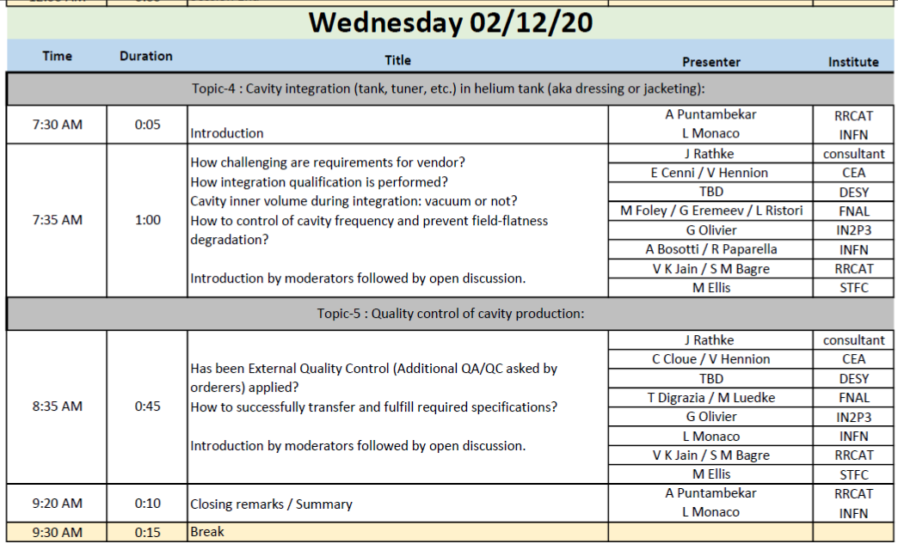

Slide 4
Topic-4: Cavity integration (tank, tuner, etc.) in helium tank (aka dressing or jacketing)
How challenging are requirements for vendor?
How integration qualification is performed?
Cavity during integration: open or closed?
How to control cavity frequency and prevent field-flatness degradation?
Time allotted : 60 Min
Presentation material ; Total 4 + 1 submissions
Allotted time 8~10 min each presenter: 50 min total
10 min for discussions and feedback

Slide 5
Topic-5: Quality control of cavity production
Has been External Quality Control (Additional QA/QC asked by orderers) applied?
How to successfully transfer and fulfill required specifications?
How to transfer cavity geometry reference frame from manufacturing to string assembly? (impact on production cycle, open vs close cavity, etc.)
Time allotted : 45 Min
Presentation material ; Total 5 submissions
Allotted time 10 min each presenter: 40 min total
5 min for discussions and feedback

