Slide 1


Development of key technologies for Power Coupler manufacturing
Denis Kostin / DESY
PIP-II Technical Workshop
December 3rd, 2020

Slide 2
Outline
Introduction
FPC @ Eu-XFEL: parts / materials / technologies
FPC materials
FPC technologies
Summary

Slide 3
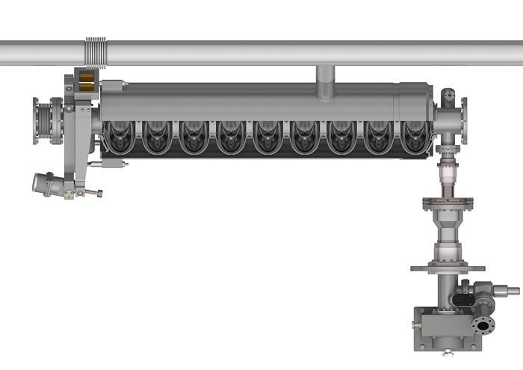
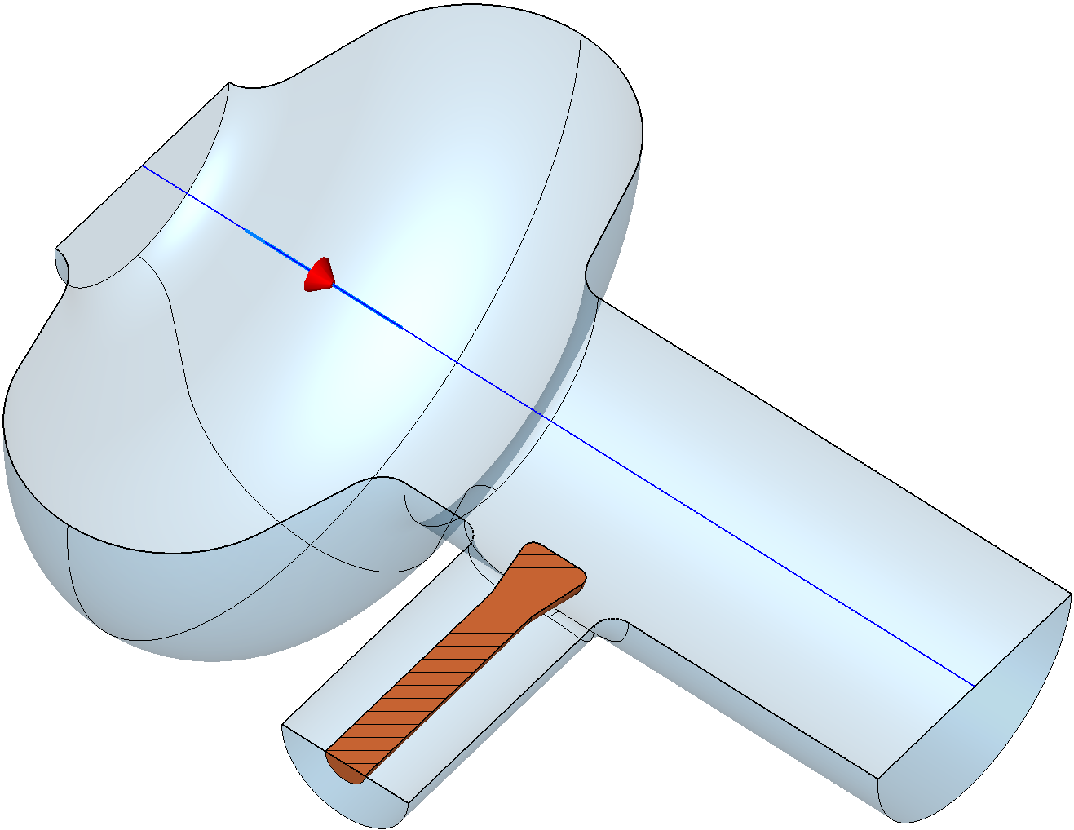
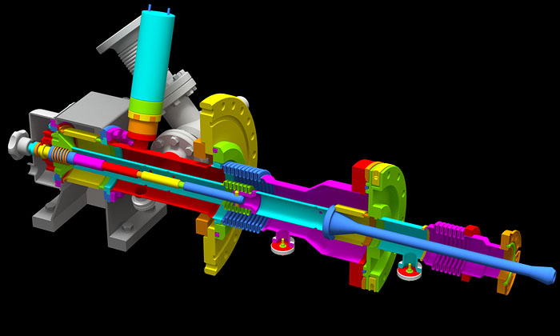
Introduction [1]
Fundamental Power Coupler (FPC) is an interface between High Power RF (HPRF) – an RF Power Source (Klystron, IOT, SSA etc.) with its power distribution system (waveguides) and Accelerating Cavity.
SRF cavities use mostly coaxial FPC type, in some cases (JLAB / CEBAF etc.) rectangular WG type.
coaxial FPC (ILC)
coaxial FPC
antenna

Slide 4
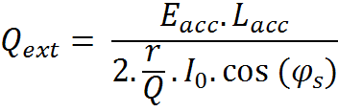
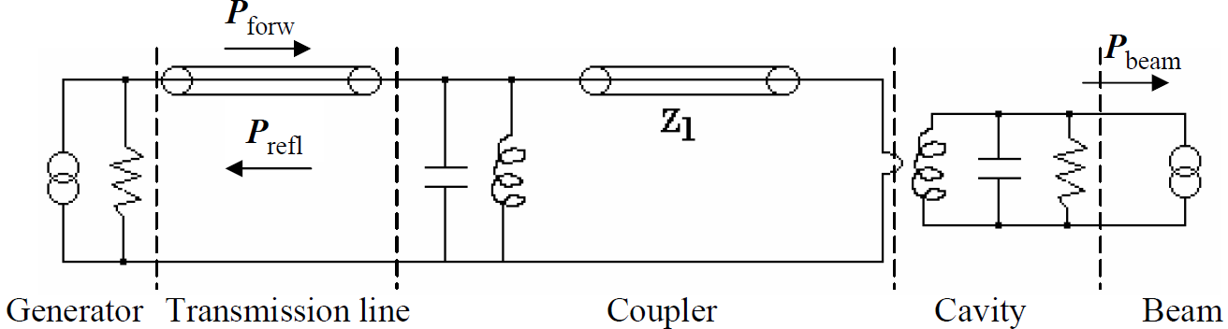
Introduction [2]
FPC design, materials and manufacturing technologies
follow the key specifications:
FPCs are passive impedance matching networks designed to efficiently transfer RF power from a source to a beam-loaded cavity operating under UHV conditions. UHV specs are important.
As transmission lines (coaxial or waveguide) are usually filled with gas, couplers have to have RF-transparent vacuum barriers (RF windows, planar or cylindrical).
Must be a low-heat-leak thermal transition between the room temperature environment outside and the cryogenic temperature (2 to 4.5 K) environment inside the cryomodule → extensive thermal simulations, carefully placed thermal intercepts and/or active cooling.
Should conform to clean cryomodule assembly procedures to minimize risk of contaminating the superconducting cavity → using cold window is advisable for high-field applications (2 windows design).
Should minimize cavity field perturbations that can affect beam or cavity performance → double couplers, compensating stubs, etc. Low magnetic fields.
Provide (in some cases, machine dependent) an adjustable coupling for different operating modes → can be supplemented by three-stub tuners in many cases.
Should be designed taking into consideration multipacting phenomenon: that is to be multipactor-free or provide cures such as bias voltage.
RF conditioning time may be too long for high-power couplers → need to improve/add new procedures and handling/preparation steps.

Slide 5
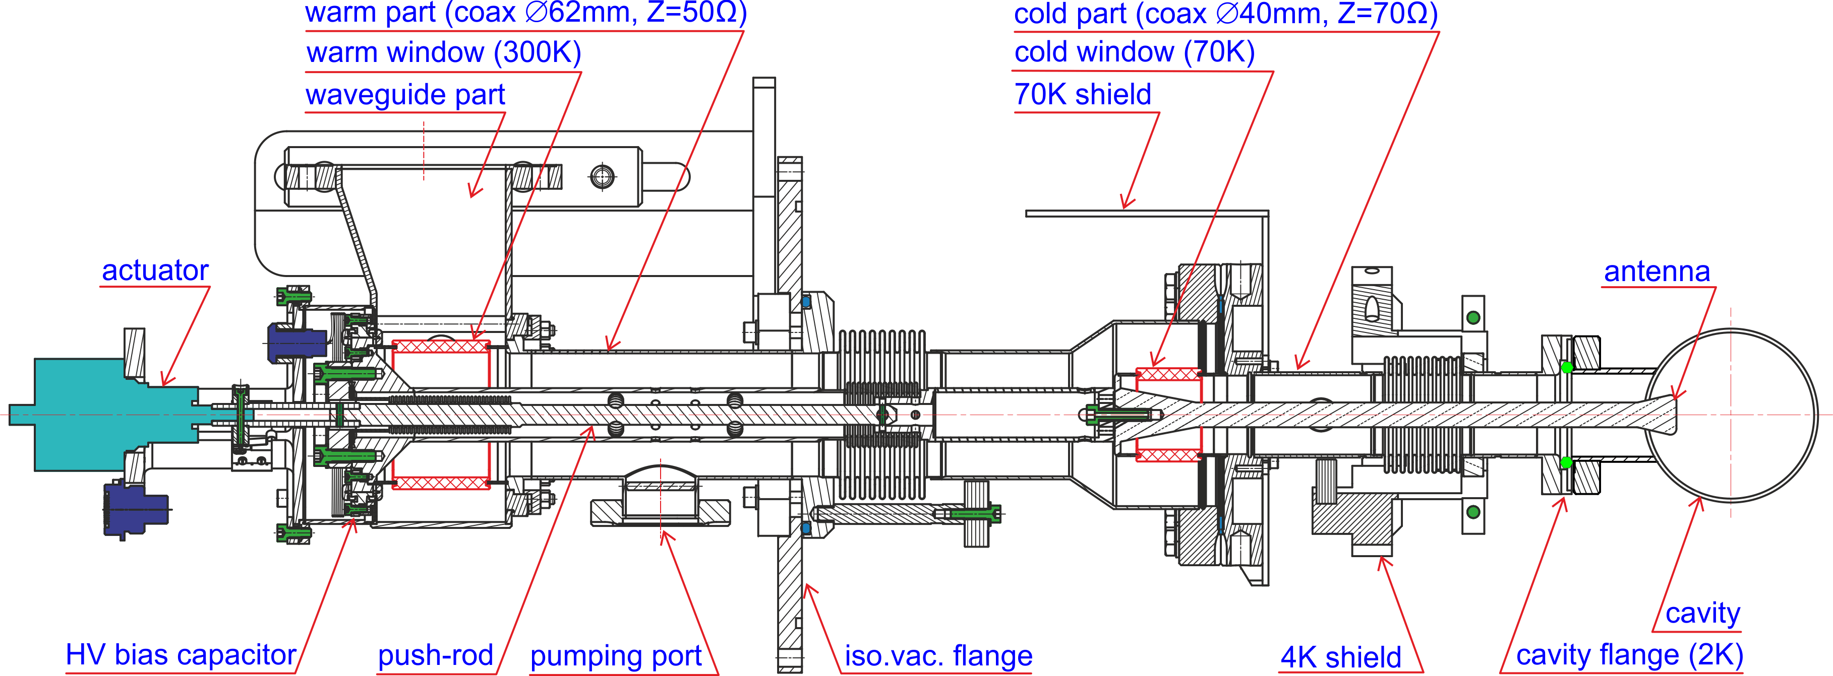
FPC @ Eu-XFEL: parts
Eu-XFEL FPC consists of warm, cold and waveguide main parts. Coaxial coupler is made of copper and copper plated (10/30µm)
stainless steel with alumina TiN coated ceramic windows. Motorized antenna tuning (±10mm) allows for Q_{ext} adjustment (10⁶..10⁷).

Slide 6
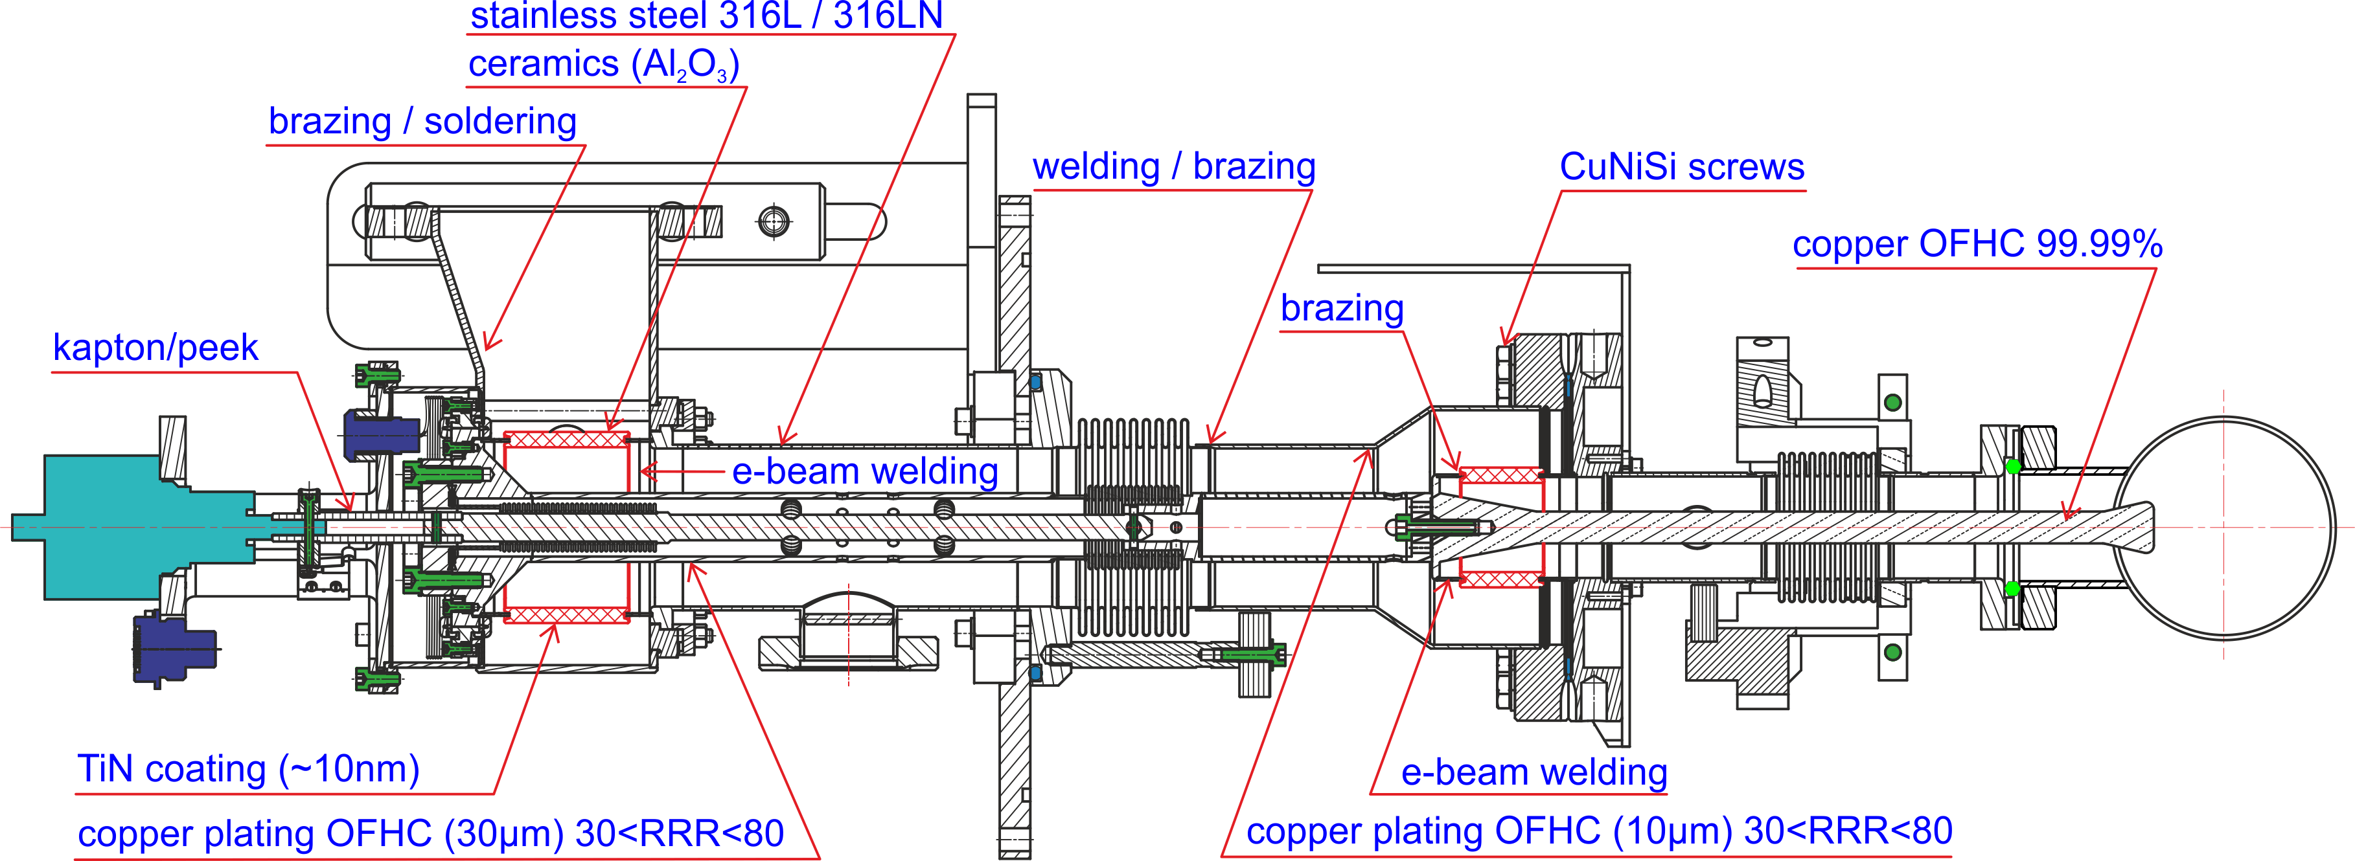
FPC @ Eu-XFEL: materials / technologies
FPC uses standard materials – SS 316LN, Cu-OFHC, Al₂O₃ ceramics, standard sizes – tubes, bellows, flanges
and standard fabrication techniques – brazing, welding, galvanic copper plating.

Slide 7
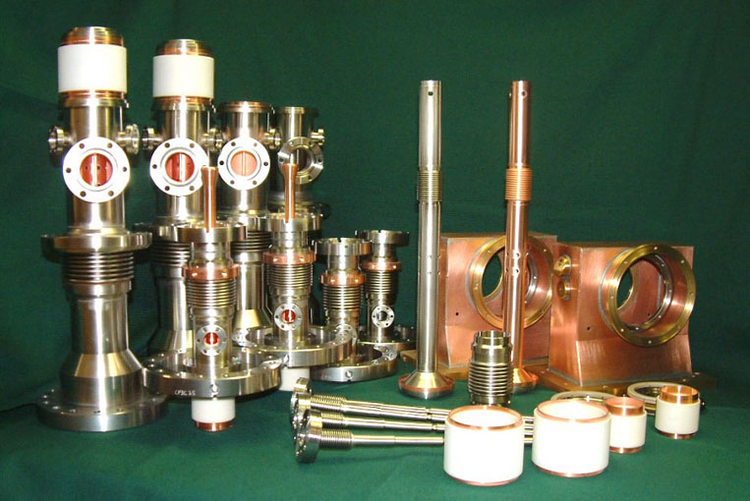
FPC @ Eu-XFEL: fabricated parts
Warm Part: 300K ceramic window with inner and outer coax. conductors
Cold Part: 70K ceramic window with inner and outer coax. conductors and antenna
Tuning rod
Warm inner coax. conductor
Waveguide Part
Ceramic window assembly

Slide 8
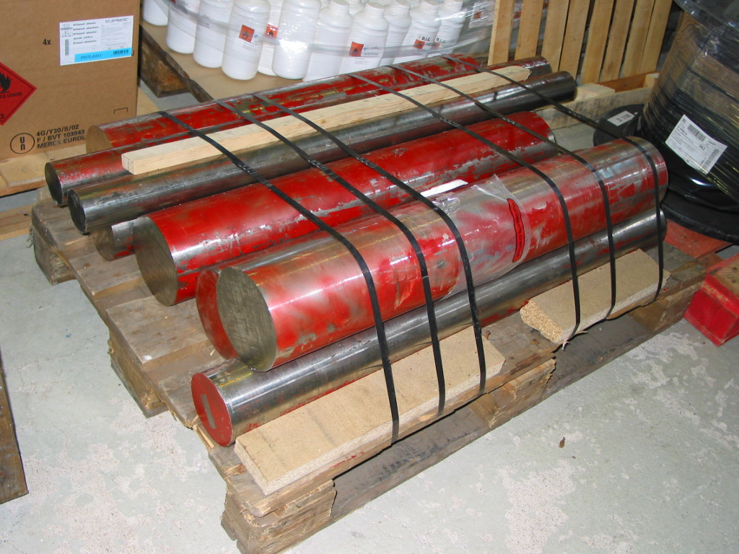
FPC materials: steel
decision for high austenitic steel (low magnetic field)
  316 LN (1.4429)
  316 L (1.4435)
316 LN steel: small quantities are often not available to buy
relative magnetic permeability: < 1.005 also after several thermal cycles (measurements in stock)
sometimes tolerances of standard composition have to be limited
flange material it has to be forged (to be cavity free) – after H₂ outgassing at 950 °C, sealing knifes is still hard, flanges should be standard, to be deliverable by vendors
seamless pipes available
H₂ degassing of steel is always advantageous in UHV systems, a common practice is hydrogen degassing at 1000°C

Slide 9
FPC materials: bulk copper
For high electric and thermal conductivity: OFHC copper
Content: 99.99%
Oxygen free
Strict limitation on contaminations
forged → no leaks after machining
electric conductivity close to 58 Sm/mm²
contaminant | ppm
Bi | 2
Cd | 1
H | 1
Hg | 1
O₂ | 10
P | 3
Pb | 10
S | 18
Se | 10
Te | 3
Zn | 1
As+Mn+Sb+Sn | 25
Hardness of solid copper coupler antenna:
as received 69HV5
after 150°/8h 62HV5
after 400°/2h 60HV5
after 400°/2h and 150°/8h 58HV5
Antenna screw: 316L with reference RDX A4-70

Slide 10
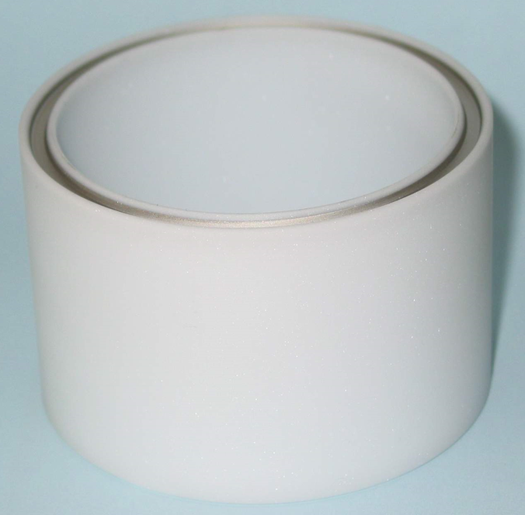
FPC materials: ceramics
ceramic with metallization
Low dissipation factor (tan(δ)≤10⁻⁴) = high purity
Stable dielectric constant over the temperature range (ε=9.0÷9.5)
no material imperfections:
  voids
  impurities
  surface imperfections
  micro cracks
easy to braze
  lower purity better to braze than high purity
quality control is necessary:
  measurement of ε and tan(δ) at RT and 70 K
  porosity
  outgassing
  mechanical dimensions
  dimensions on metallization
  micro cracks
TiN coating
Metallization (for brazing)

Slide 11
FPC technologies: copper plating [1]
Electrical conductance >99% IACS (International Annealed Copper Standard, 100%=58 Sm/mm² – which is a pure copper)
Low H₂ content
The copper plating specification:
  30 < RRR < 80
  Thickness: inner conductor 30 µm, outer conductor 10 µm, tolerances are ±20% with the exception for the bellows where it is ±30%
  Roughness < 1.6 µm
  Low hydrogen content
  Adherence has to be sufficient to withstand a 400°C (± 20°C) for 2h (± 0.1h) heat treatment. No blisters and peeling.
  Free from any defects
  Brushing is not allowed
The definition of defects is: any deviation from the specified values.
  The RRR, thickness, the roughness and hydrogen content has to be measured - samples
Additional defects found at the visual inspection can be defined also from the specified values:
  Scratches and particles on the surface which represent a Ra>1.6 µm are not acceptable
  Circular or otherwise shaped areas with copper thickness lower than specified are out of specification
  Discolorations and stains do not comply with the statement “defect free”
The size of defects is not defined in the specification.

Slide 12
FPC technologies: copper plating [2]
Different processes for thin layers:
  electroplating
  spattering
Both need special care
Electroplating on stainless steel:
  stable chromium oxides at austenitic nickel chromium steel has to be removed
  perhaps electropolishing is needed
  an adhesive nickel or gold strike (µm’s) as a basis
  bath: highly stable organic additive with only a low tendency of forming compounds
Plating only the RF surfaces
  exact jigs are needed to cover e.g. the sealing surface and threads
Plating company should have
  knowledge of vacuum technology
  knowledge of brazing technology
  analytical facilities
Aftertreatment: heat treatment in vacuum
  temperature depends from the layer thickness: 400 – 800°C
  improvement of electrical conductance (degassing and reduction of lattice defect density)
  test of adhesiveness
  improvement of adhesiveness by diffusion (but: pollution of the copper layer)
No high temperature brazing of copper plated parts – diffusion problem

Slide 13
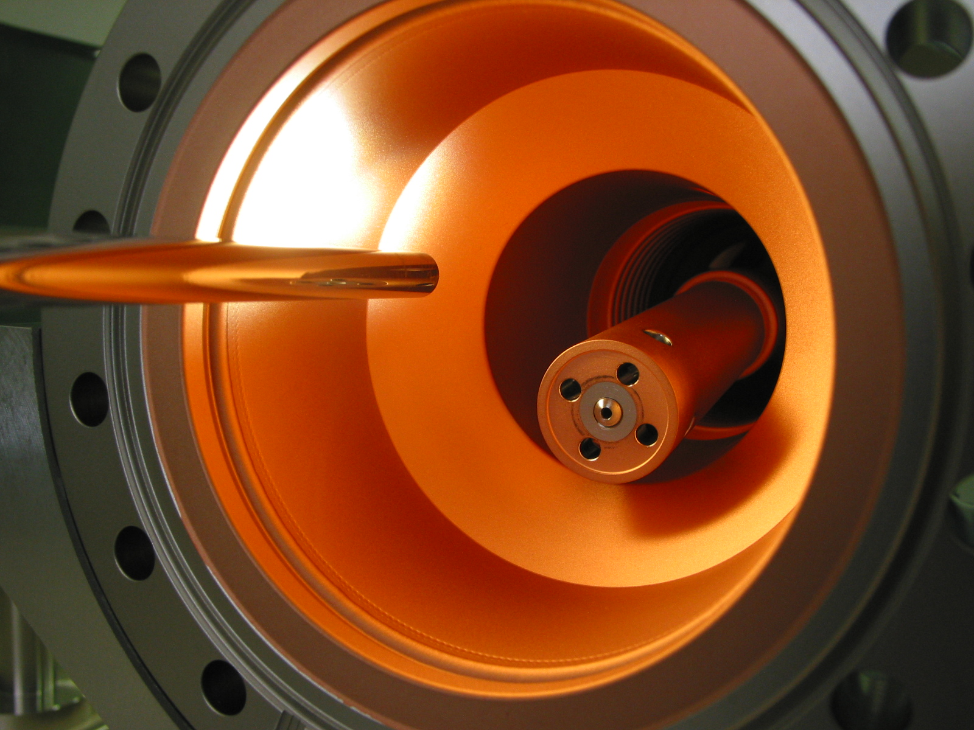
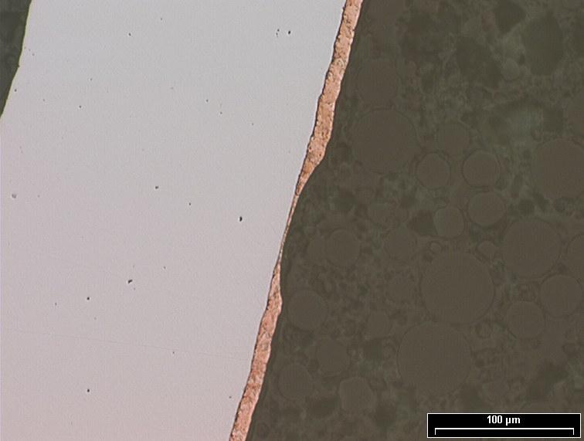
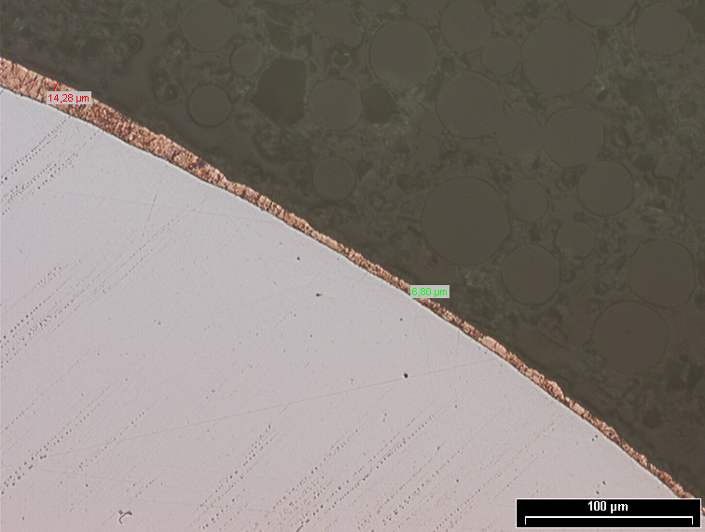
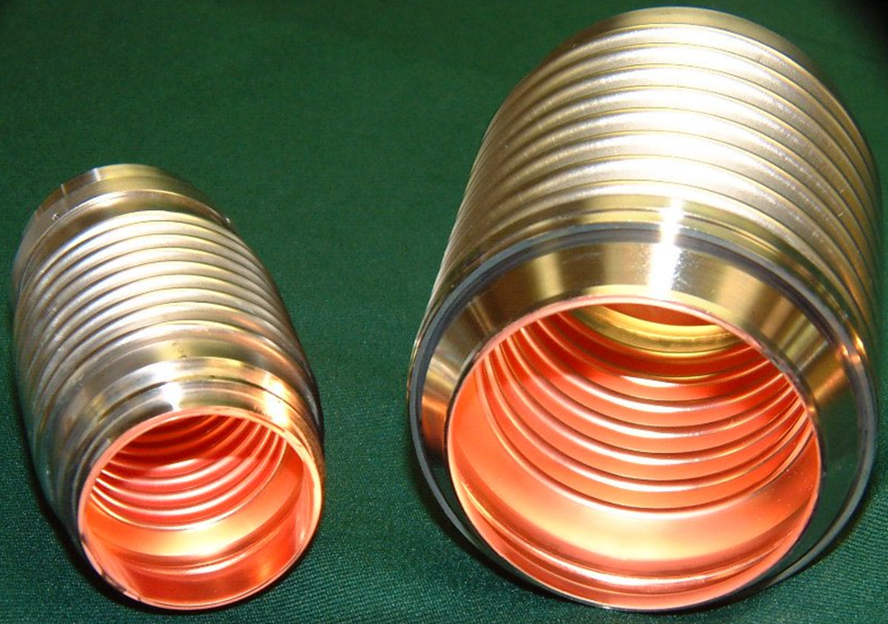
FPC technologies: copper plating [3]
A good plating has NOT a mirror like surface
Layer thickness variation must be investigated / addressed

Slide 14
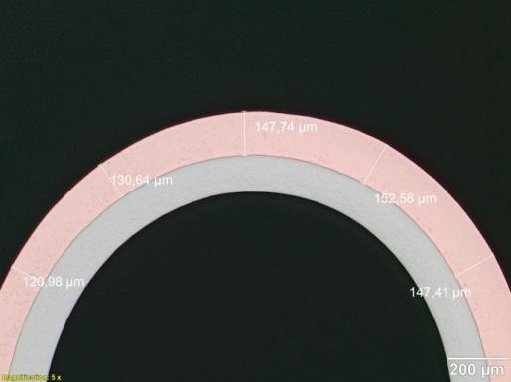
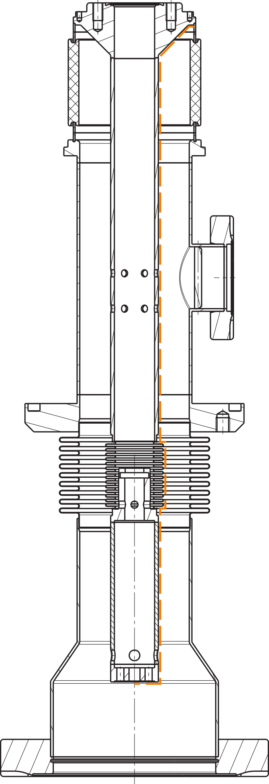
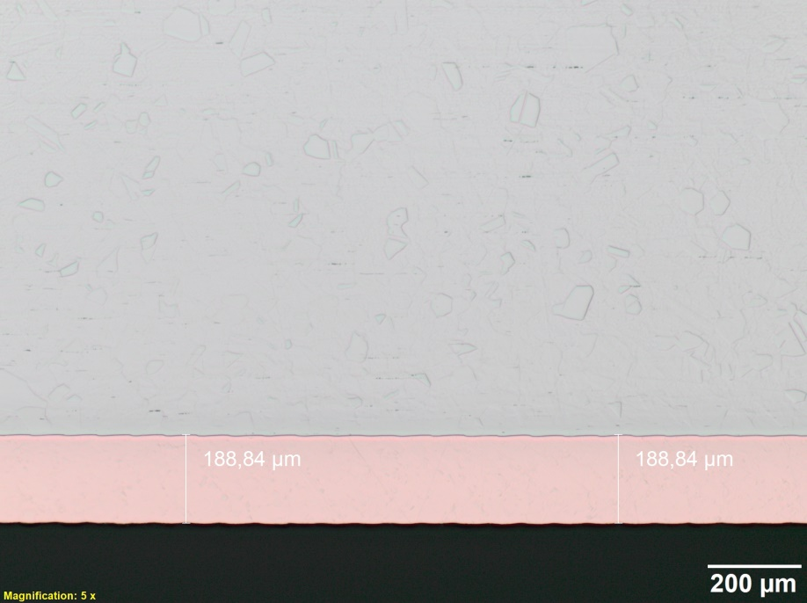
FPC technologies: copper plating [4]
plating samples
Copper plating with increased average RF power / CW operation
With inreased CW RF power inner conductor overheating will be an issue, with a maximum temperature on the warm inner conductor bellow (E-XFEL / TTF3 FPC example).
To decrease the inner conductor temperature it must be gas cooled from inside or copper-plated with increased layer thickness (≥150µm) and RRR (>50, 100..160 achieved on 150µm plating samples).
RRR 100..160
inner conductor temperature
copper plating with 150 µm layer

Slide 15
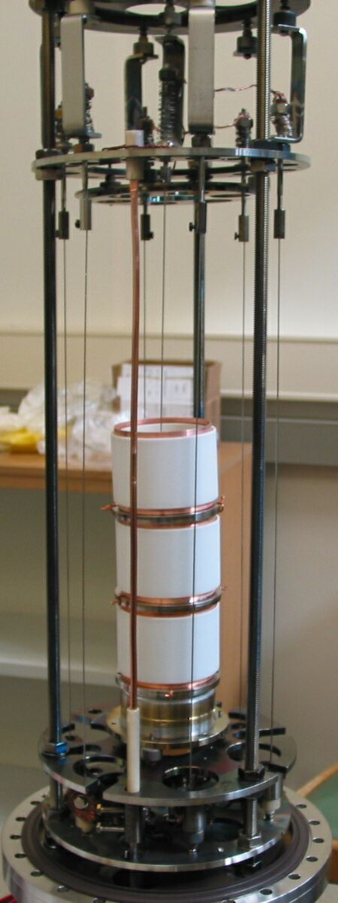
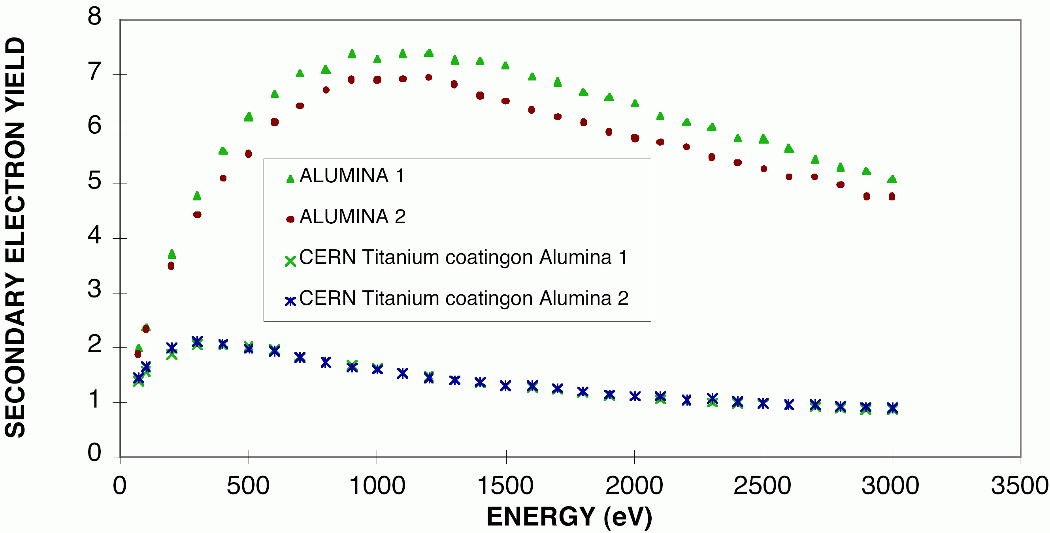
FPC technologies: TiN coating
Deposition by Ti evaporation from filaments heated by electrical current:
preheating of filaments @1000°C → cleaning
heat the substrate to 130 – 150°C
vacuum vessel filled with ammonia (10⁻¹mbar)
deposit the Ti at filament temperature
fill with ammonia 300 – 900 mbar for Ti conversion to TiN
copper collars are brazed to the ceramics prior to TiN deposition

Slide 16
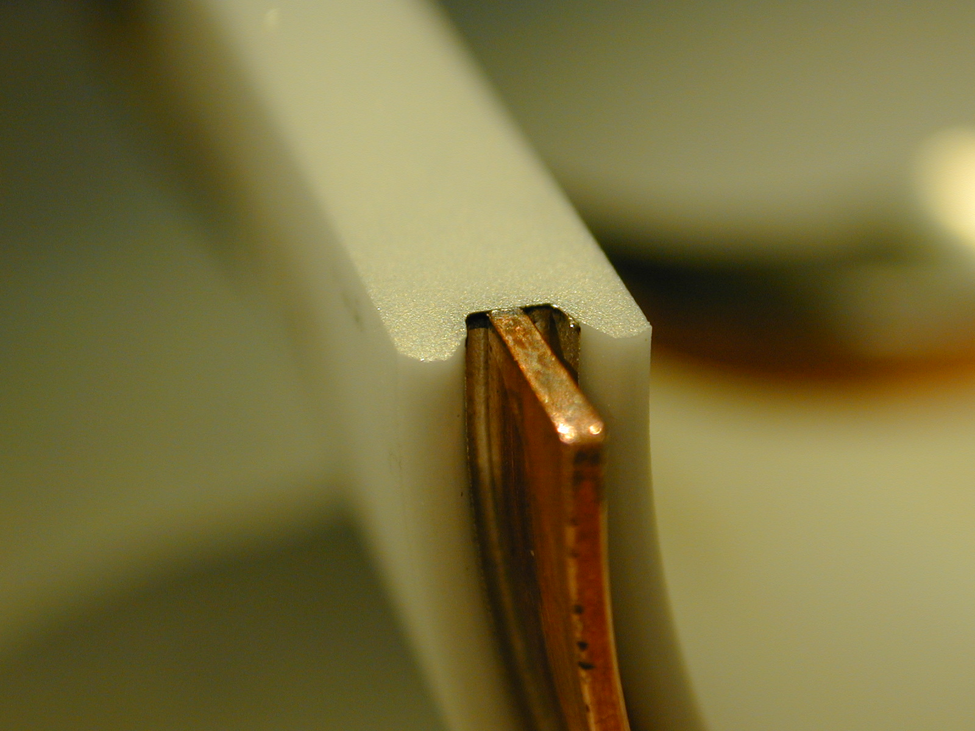
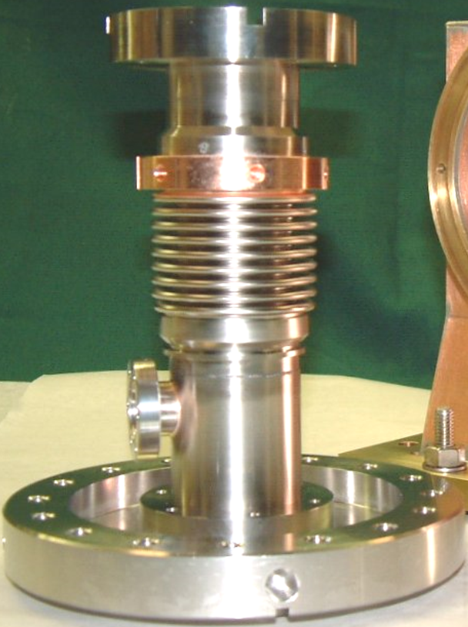
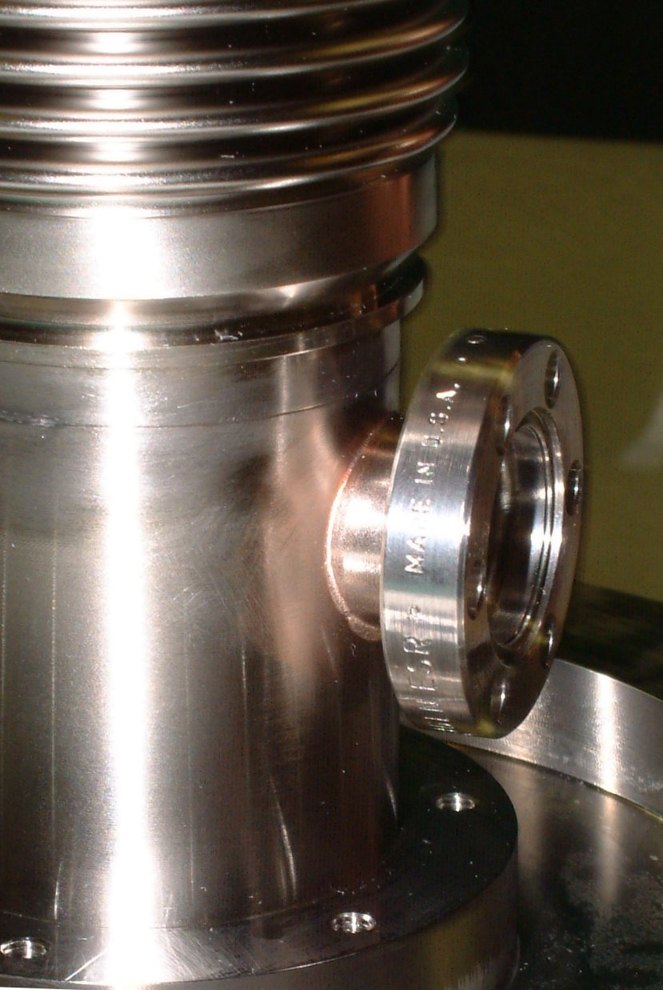
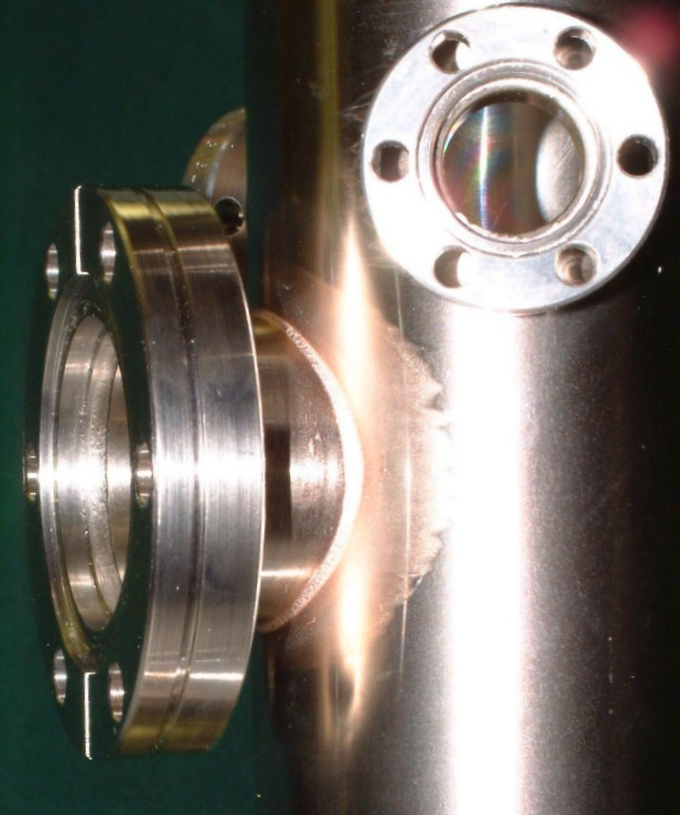
FPC technologies: brazing
ceramics brazing under vacuum:
Ceramics are received metallized by the vendor
Alkaline detergent cleaning (sandblast if necessary)
Eutectic Cu-Ag at 780°C
Shielding of ceramic against braze vapor
steel to copper brazing:
Prototypes: Cu-Sn at 1020°C
Alternative chosen by manufacturer: Cu-Au at 1040°C
conflat flanges brazing (alternative):
Cu-Au at 1040°C
cut-view of the ceramics to copper collar brazing: braze is very regular.
cold part outer conductor

Slide 17
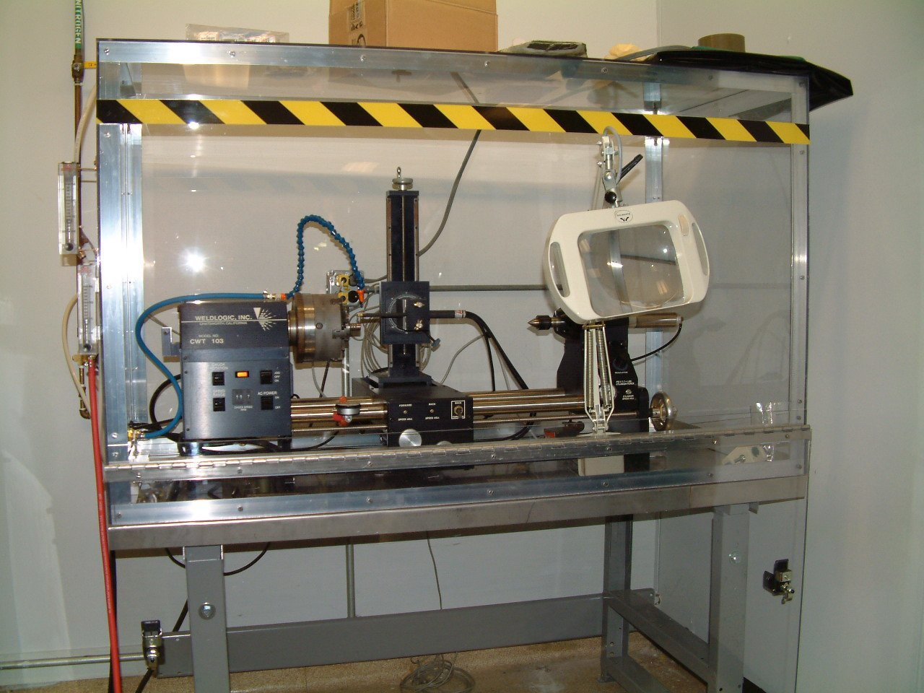
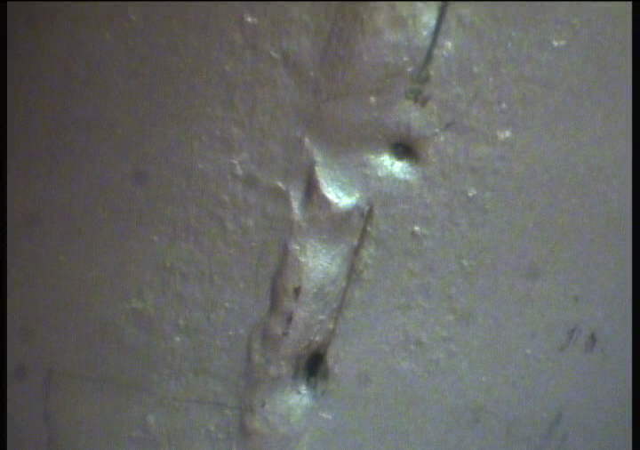
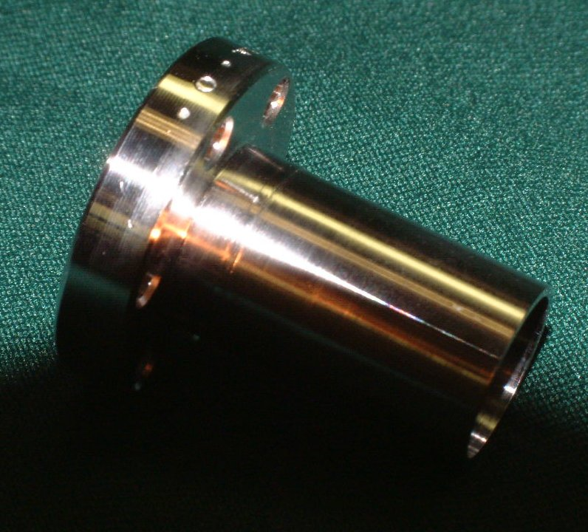
FPC technologies: TIG welding
Alternative FPC parts assembly method (to brazing, EBW)
Welding bench filled with N₂
  speed controlled lathe
  specific small electrode
Test and optimization of parameters:
  rotation speed
  current intensity
  argon flux
Validation prototypes needed
  weld quality control
TIG weld pits
TIG welding bench and validation prototype

Slide 18
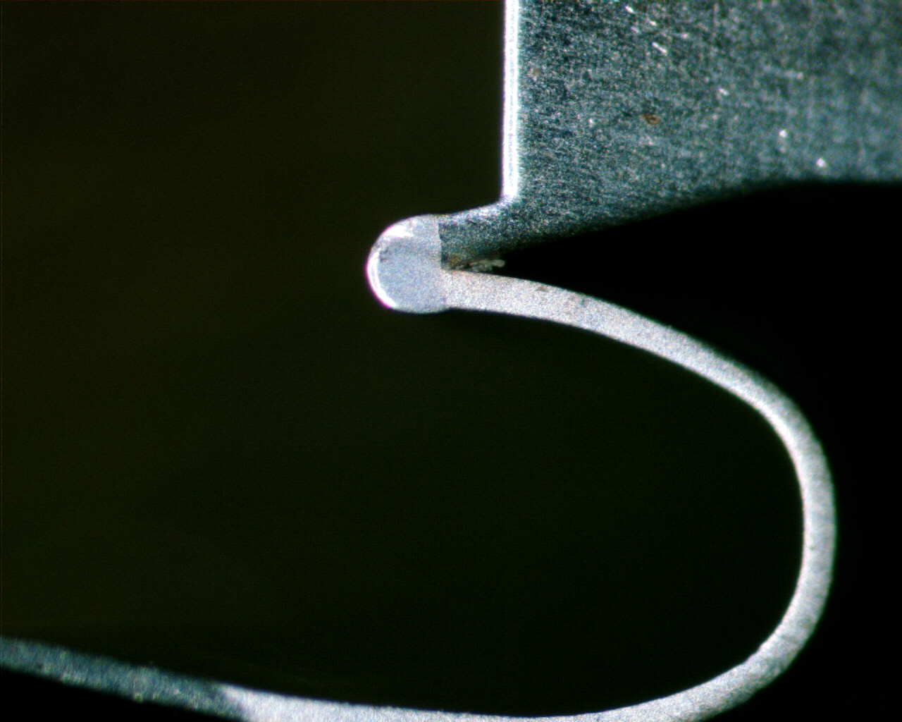
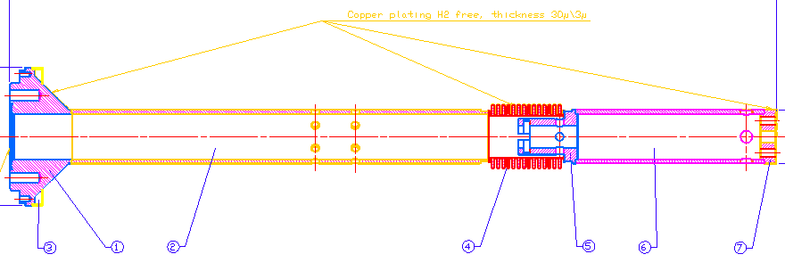
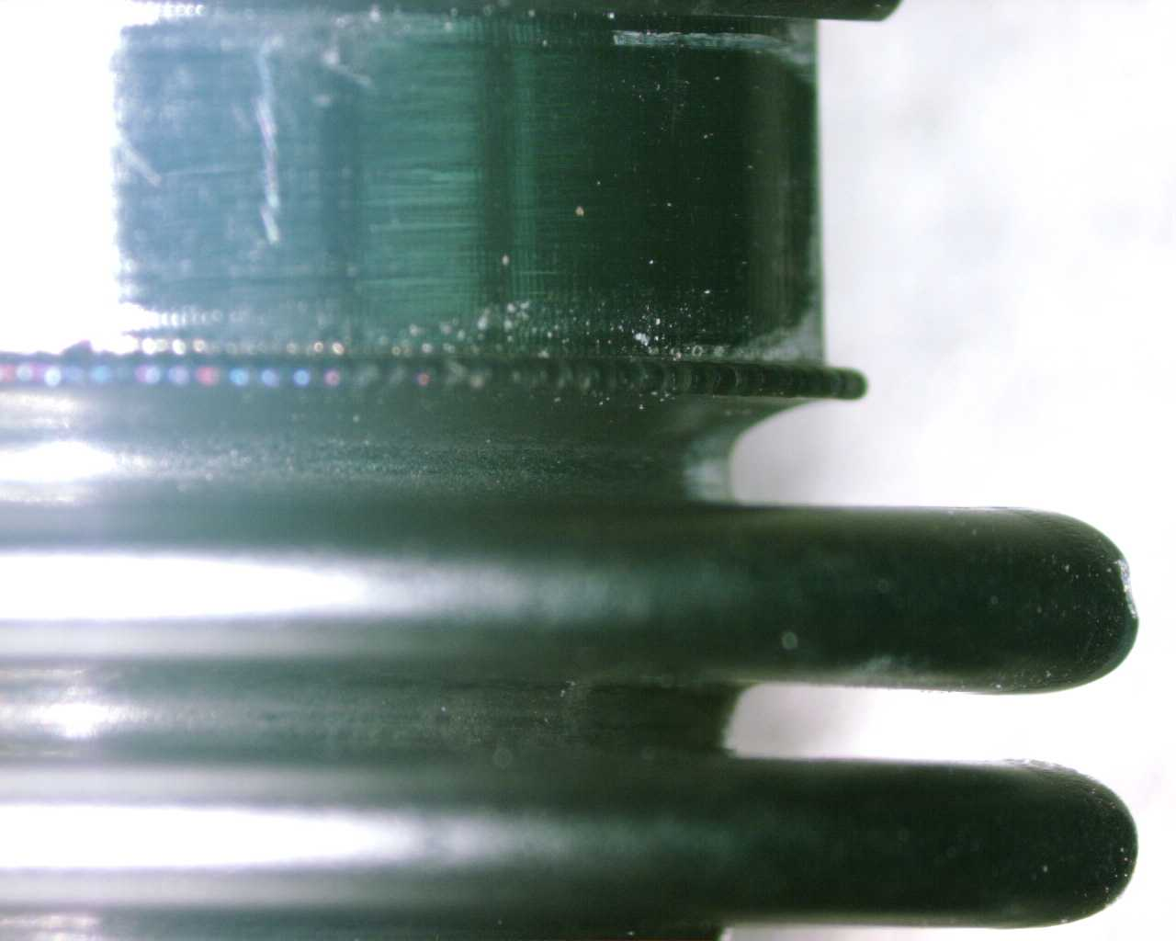
FPC technologies: laser welding
Alternative welding method:
small welds at the inner conductor bellows are done by laser
warm part inner conductor

Slide 19
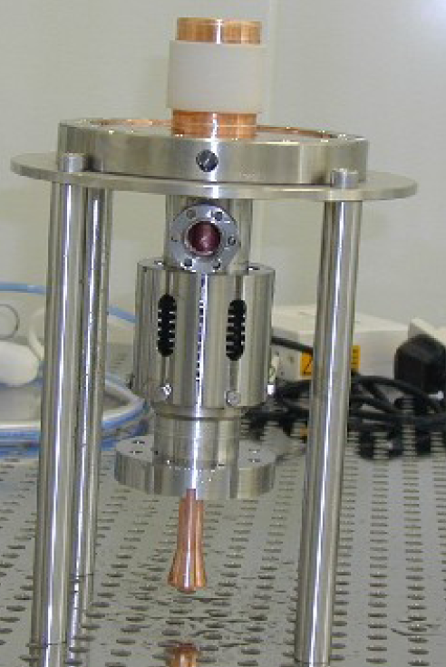
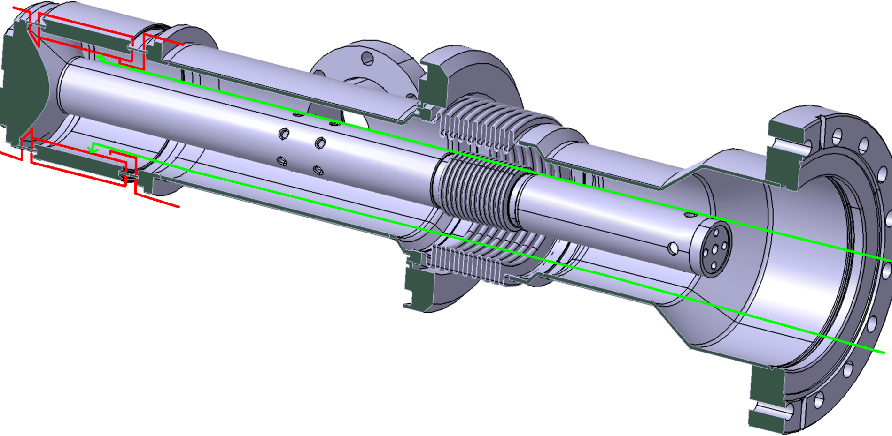
FPC technologies: e-beam welding [1]
e-beam weld
Last weld on the coupler:
ceramic window copper collar to copper collar of inner and outer conductors.
Specification:
100% penetration
no internal spatter
removable masks to protect the ceramic and RF surfaces from metal vapor, it has to be removed from the inside of the ceramic after welding – this is a major difficulty:
for mask support and removal
cold part
e-beam
shielding against metal vapor
warm part

Slide 20
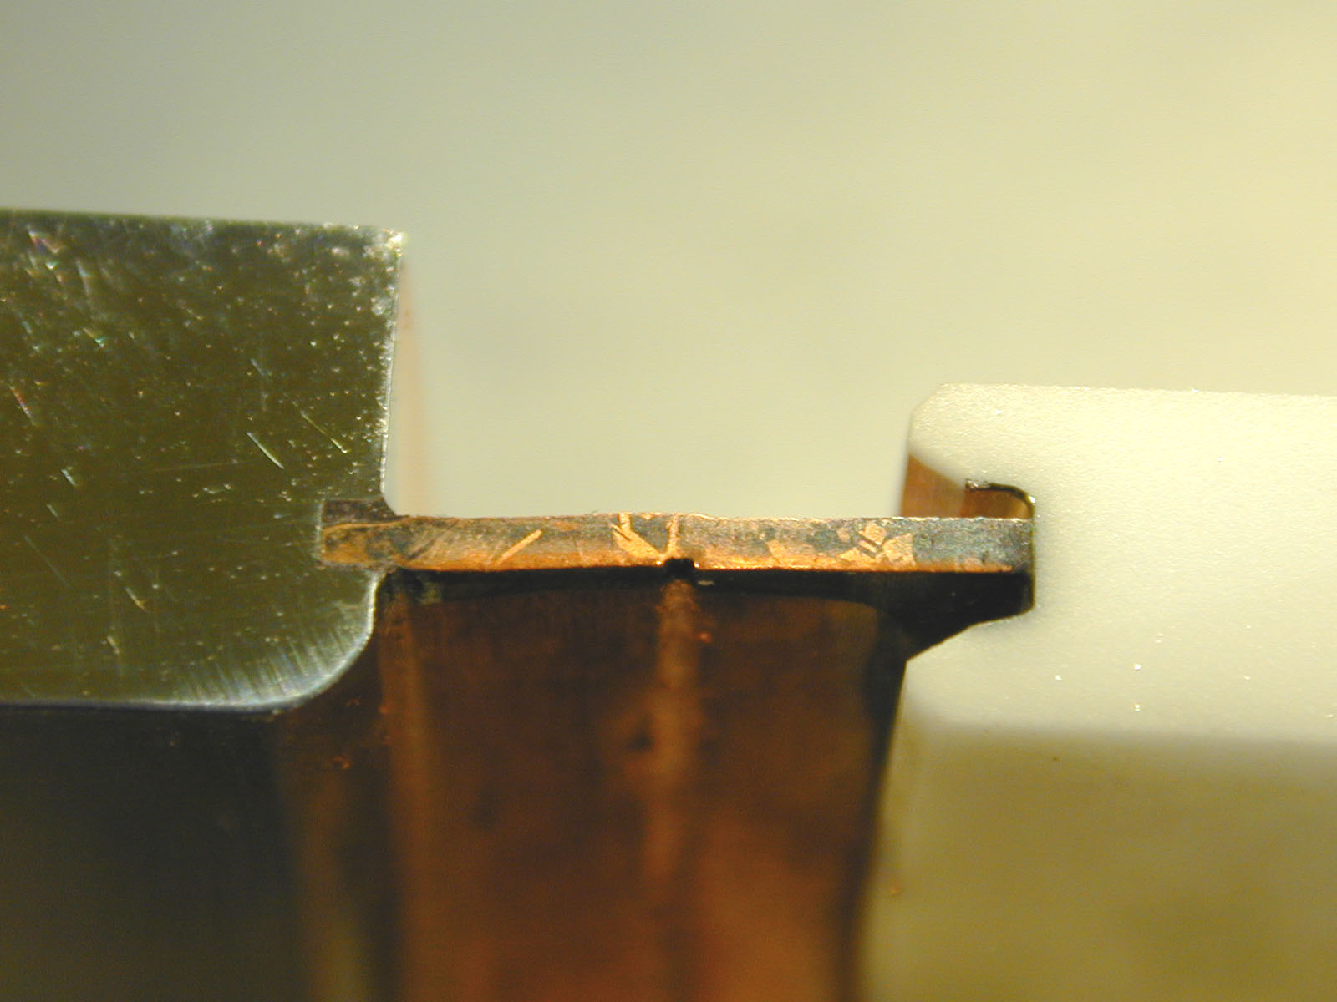
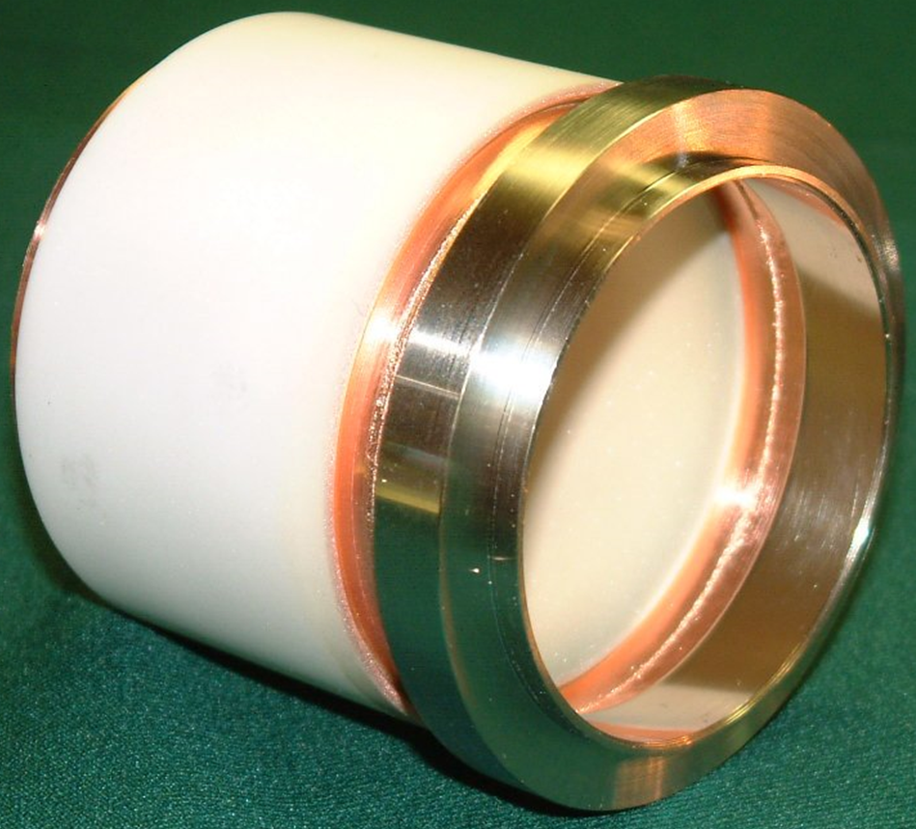
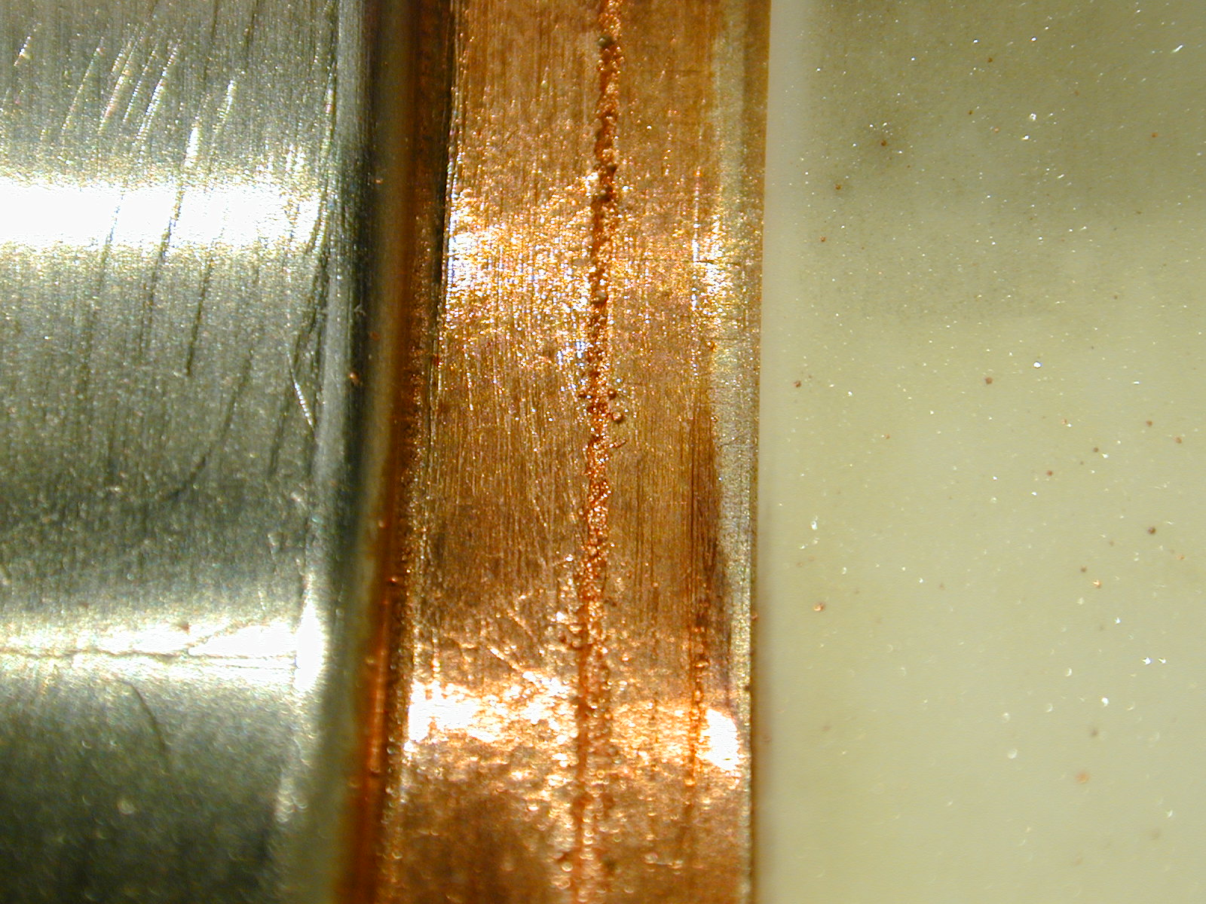
FPC technologies: e-beam welding [2]
full penetration
test samples to be welded and investigated:
free of spatter
e-beam weld

Slide 21
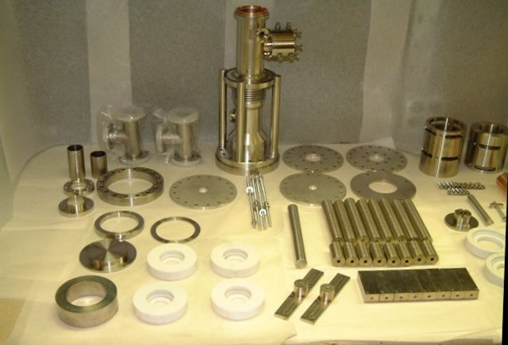
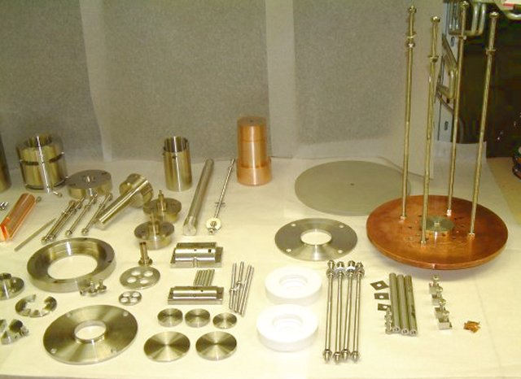
FPC technologies: fabrication tools
Last, but not least,
Some necessary tooling:
Fixtures for assembly of stainless steel parts
Ceramic braze fixtures
Fixture for laser welds
Fixtures for Cu plating
Tooling for length adjustments
Alignment fixtures for cold and warm assemblies
Fixtures for EB-welds
Mask tooling for EB-welds
Tooling for capacitor assembly
Fixtures for dimensional controls
Tooling for leak tests and desorption control
Fixtures for handling and storage, transport containers
FPC fabrication tools
tools are an important cost item and
have to be validated at the coupler production start

Slide 22
Summary
Fundamental Power Coupler (FPC) is an interface between High Power RF (HPRF) – an RF Power Source (Klystron, IOT, SSA etc.) with its power distribution system (waveguides) and Accelerating Cavity. FPCs for SRF cavities are among the most important and most complicated auxiliary systems in superconducting particle accelerators.
Successful FPC design uses modular approach, standard materials (steel, copper, ceramics etc.), standard sizes (tubes, bellows, flanges) and standard manufacturing techniques (welding, brazing, plating etc.).
Manufacturing problems can be solved in a prototype or pre series fabrication – close collaboration with the company is necessary with the investigation of problems on samples, also investigation tooling is needed to allow inspection of hidden surfaces and defects.
New fabrication methods emerge and may be effectively applied. Classic well known techniques are being developed as well – with some of them sometimes needing re-inventing – copper plating is an example.
Cleaning, handling and storage play important role in FPC manufacturing process.

Slide 23
Acknowledgement
I would like to thank all the colleagues from different labs and companies around the planet who took part in the research and development of the power coupler technologies.
I would like to specially thank Dr. Wolf-Dietrich Möller (DESY) for the help with the materials for this talk.

Slide 24
END
Thank You very much for Your attention !

