Slide 1
Data Transfer Mechanisms
Quality is the fitness for purpose or the degree of conformance of the outputs of a process or the process itself to requirements.
1253-qual-prs-0005
K J Cheetham
3 December 2020
BS ISO 8000-2:2020
Data quality
degree to which a set of inherent characteristics of data (3.2.2) fulfils requirements (3.1.2)
1

Slide 2
‘Requirements’ to ‘Validation’
Requirement - need or expectation that is stated, generally implied or obligatory (3.6.4)
Specification - document stating requirements, additionally stating results achieved by design and development (3.8.7)
Verification - confirmation, through objective evidence, that specifications have been fulfilled (3.8.12)
Validation - confirmation, through objective evidence, that the requirements for the specific intended use have been fulfilled (3.8.13)
Key performance parameters
Validation traceability
System Acceptance Reviews (SAR)
Physics requirements
Systems testing at STFC
Functional specifications
Verification traceability
Cryomodule assembly testing
Technical specifications
Sub-assembly testing, e.g. cavities
Detailed design
Component testing
Implementation
2
Numbers in brackets are ISO 9000:2015 clause references.

Slide 3
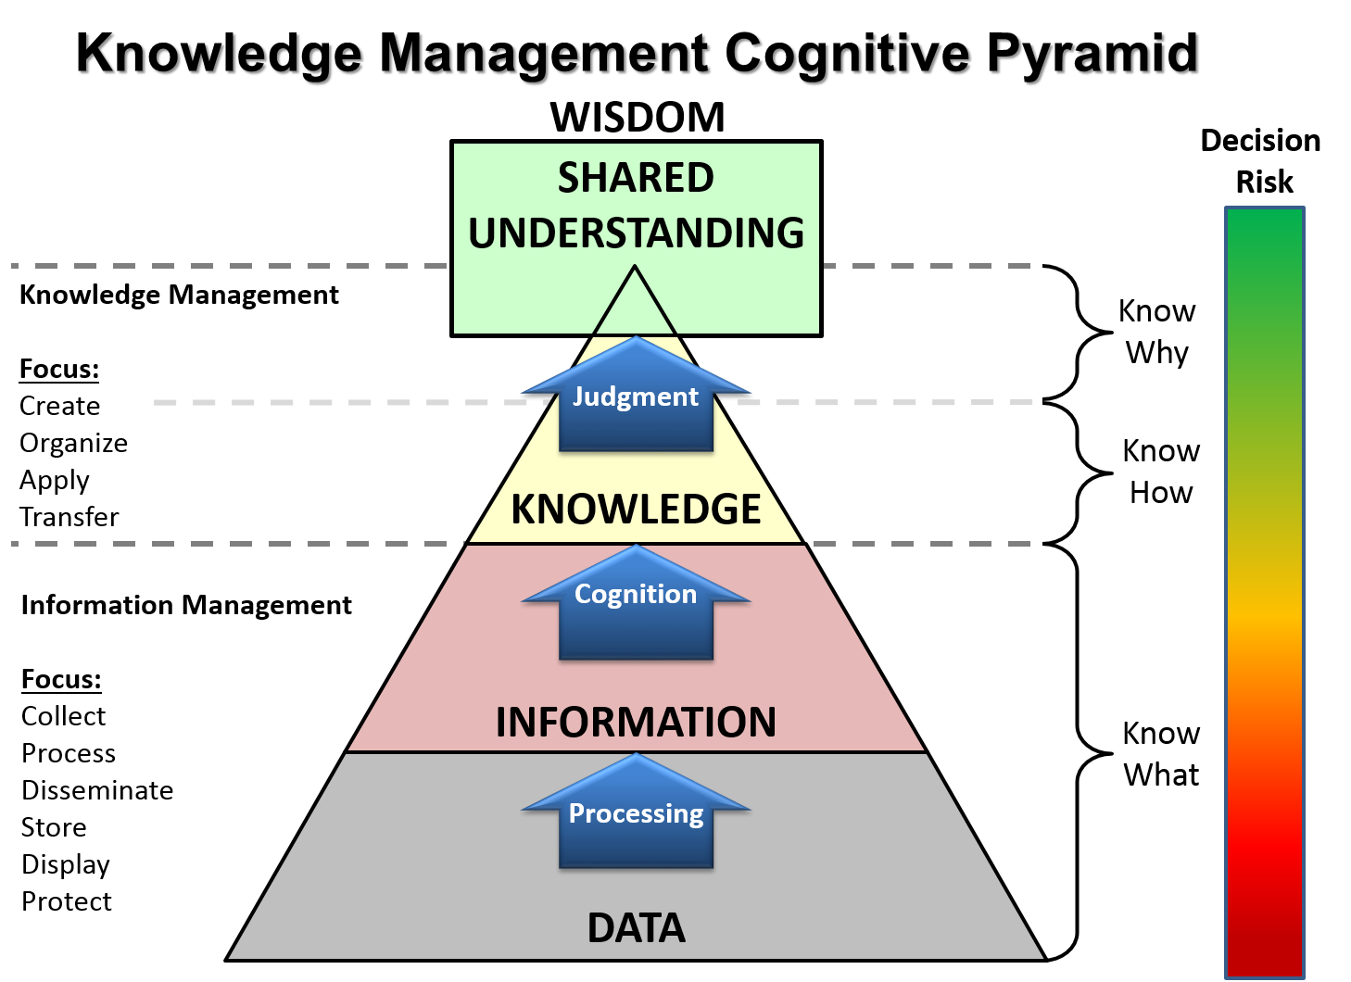
What is Data for??
Ref: File:KM Pyramid Adaptation.png - Wikimedia Commons
DIKW Adaptation in use within the US Army KM Community of Practice
3
Notes:
DIKW pyramid

Slide 4
Data Transfer Principle
A
B
4

Slide 5
SharePoint Interaction
Front-end
Back-end
5

Slide 6
ETL Process
Extract
Pulling data out of STFC systems, such as SuraBee
Data validation to confirm consistency
Transform
Converting raw data into data transfer format, such as exporting to Excel template files, or bundling Word documents
May include filtering and sorting processes
May include aggregating or splitting data
May include data cleansing, or translating coded values
Move to staging area
Load
Importing of files into destination system from staging area
Reporting of success/failure
6

Slide 7
Data Migration Process
Confirmation of receipt
7

Slide 8
Data Quality
GIGO – Garbage In, Garbage Out
Data needs to be fit for purpose
Input data validation
Restricts data entry – e.g. not allowing text in a number field
Individual data field requirements should be defined in IT system specifications
QA checks would include:
Consistency checks, to avoid for instance procurement register recording a component that doesn’t exist on the inventory register
Accessibility, comparability, latency
QC checks would include:
Validity, accuracy/precision, completeness, credibility, relevance
8
Notes:
Input data validation is against the IT system spec, not the project spec

Slide 9
Other more immediate data transfers
Change Requests
Non-Conformance Reporting
Documents for Review
Procurement document bundles
Including lists of drawings, QC plans, MIPs, etc.
Covered by FNAL Procurement Readiness Review process
Exchange of CAD models and drawings during development
Work on-going as part of Design Co-ordination Group
Email subject naming policy may be important to aid Outlook filtering.
e.g. Automated emails from STFC system may start with [PIP-II STFC].
9
Notes:
Keen to keep email file attachments to a minimum.

Slide 10
Related Documents
FNAL
PIP-II Approach to Quality Control, DocDB #4053
CAD exchange process?
STFC
Document Management Plan, 1253-qual-pln-0003
SharePoint Interactions Process, 1253-qual-procs-0008
Data Migration to FNAL Process, 1253-qual-procs-0009
Drafts
10
Notes:
Suppliers prefer to use their own reporting systems.

Slide 11
Out-standing issues
Proposed automated data traveller transfer process is untested
Initial tests will take place soon – high degree of confidence
Data storage systems still under development
Need to confirm specifications for data transfer bundles
E.g. Document structure and folder naming
Need to confirm which components count as “critical” for full import into Vector rather than just attachments to interface travellers
Need to confirm approval levels
Need to confirm final deliverable document lists which would form part of SAR
11
Notes:
Suppliers prefer to use their own reporting systems.

Slide 12
Thank you
Facebook: Science and Technology Facilities Council
Twitter:@STFC_matters
YouTube: Science and Technology Facilities Council
12

Slide 13
Data Science Glossary
dirty data - inaccurate/incomplete/inconsistent data
data cleansing - detecting and correcting dirty data
data validation - restrictions on data to ensure minimum data quality (part of data cleansing)
data quality - validity/accuracy/completeness/consistency/uniformity
data profiling - collecting statistics or informative summaries of existing data
data visualization - graphical presentation of data
data migration - selecting/preparing and then transferring to another system
data verification - checking after data migration
data corruption - errors introduced while writing/reading/transmitting/storing data
data scrubbing - low level automated error correction to reduce data corruption
data degradation - gradual corruption due to non-critical data storage failures
data preservation - conserving and maintaining both the safety and integrity of data
data dictionary - data type definitions and structure
metadata - data about data
database schema - formal description of the structure ("blueprint")
13

