Slide 1
Infrastructure for HB650 Assembly
Mitchell Kane
PIP-II Technical Workshop
2nd December

Slide 2
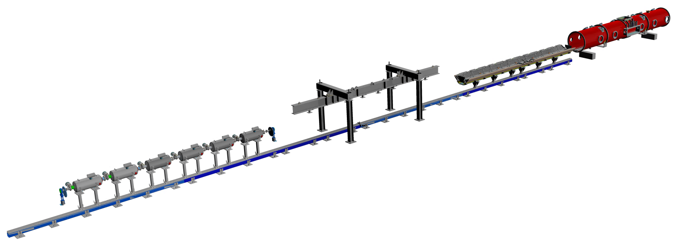
HB650 Assembly Overview
Vessel
Strongback
String Lifting
String Assembly
(Cleanroom)
Image © STFC John Dawson
Notes:
PLEASE DELETE/REPLACE PHOTO CREDIT IF CHANGING THE IMAGE.

Slide 3
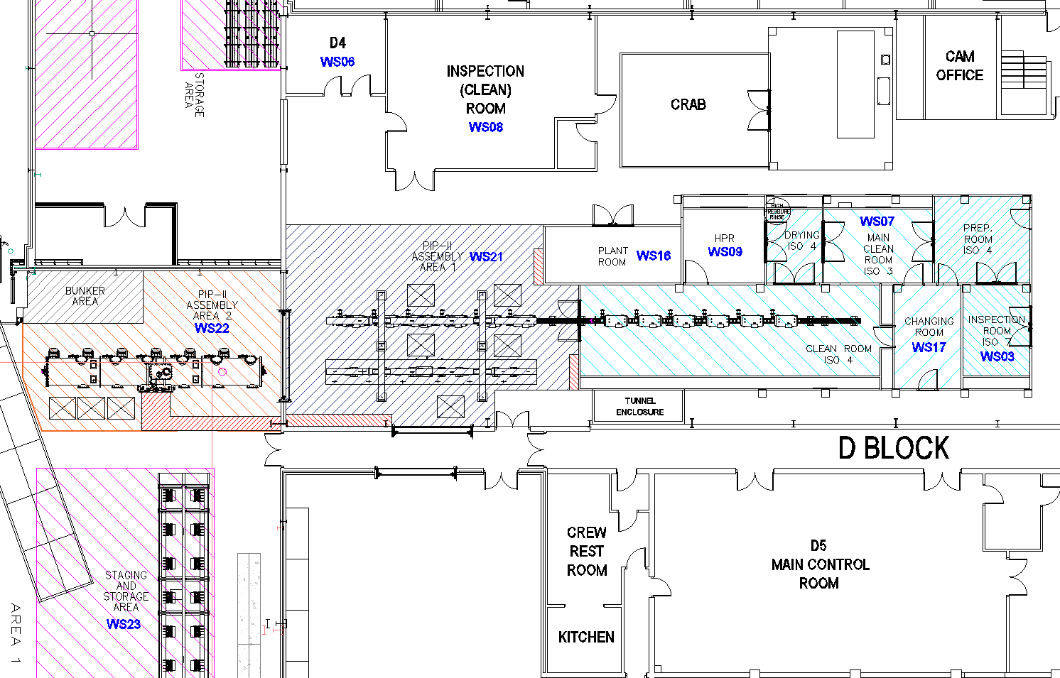
SuRF Lab HB650 Assembly Layout
Spans SuRF lab and Electron Hall
Room for 3 assembly stations in series
Existing cleanroom extended for PIP-II string assembly
More cleanroom detail tomorrow
SuRF Lab
Electron Hall
Image © STFC John Dawson
Notes:
PLEASE DELETE/REPLACE PHOTO CREDIT IF CHANGING THE IMAGE.

Slide 4
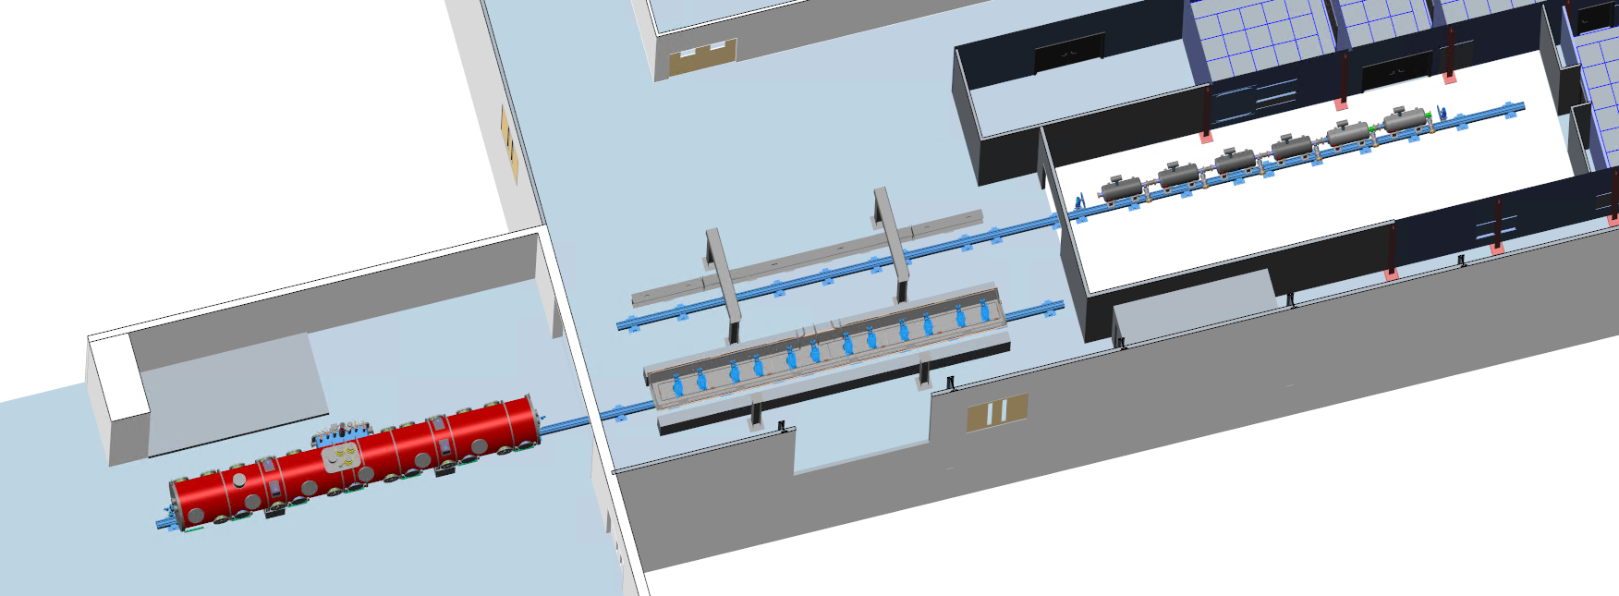
Assembly Stage 1
Assemble string
Prepare strongback
Prepare vessel
Pre-align strongback

Slide 5
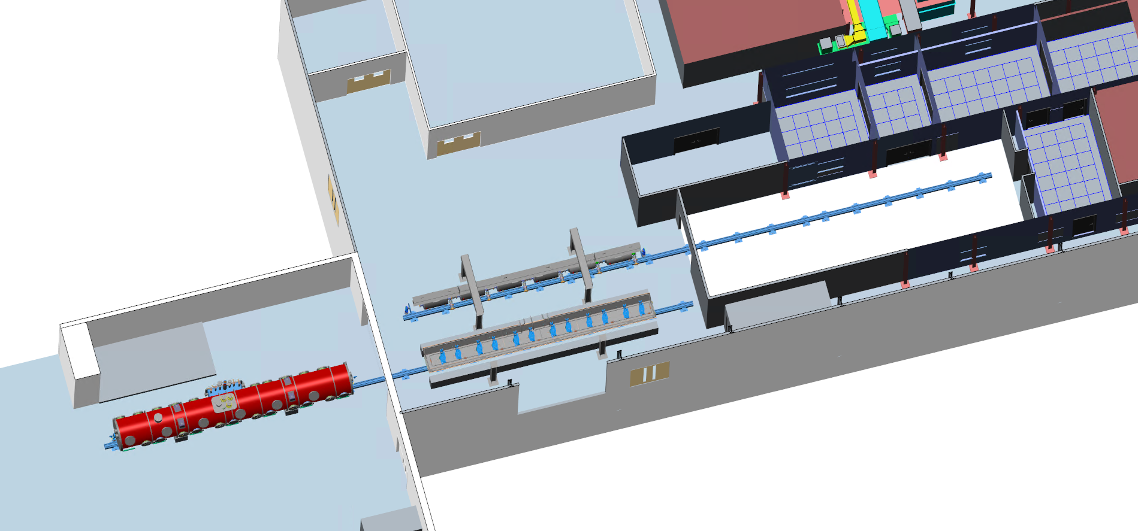
Assembly Stage 2
String leaves cleanroom
Install magnetic shield
Cavity cool down lines

Slide 6
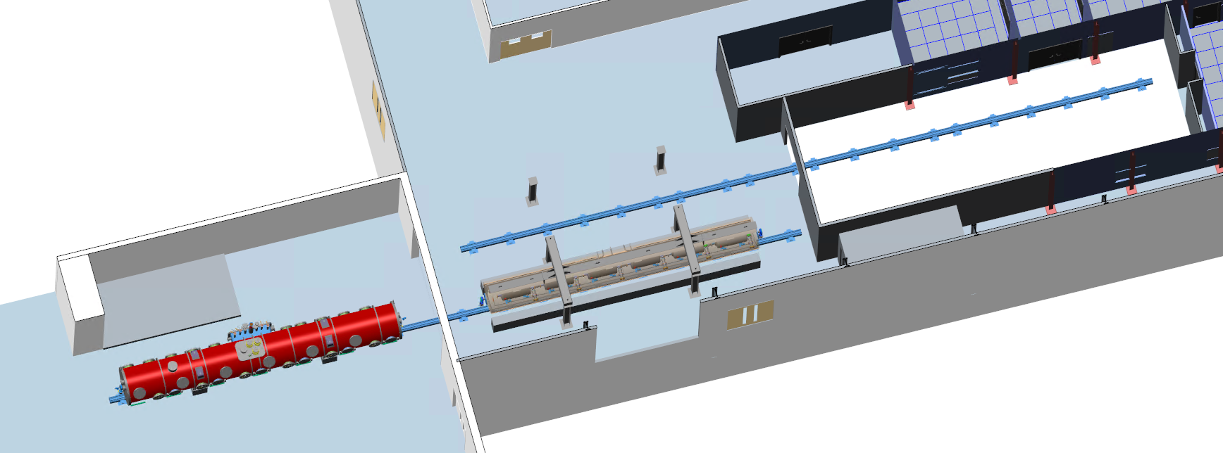
Assembly Stage 3
Lift string onto strongback
Weld two-phase pipe
Complete coldmass

Slide 7
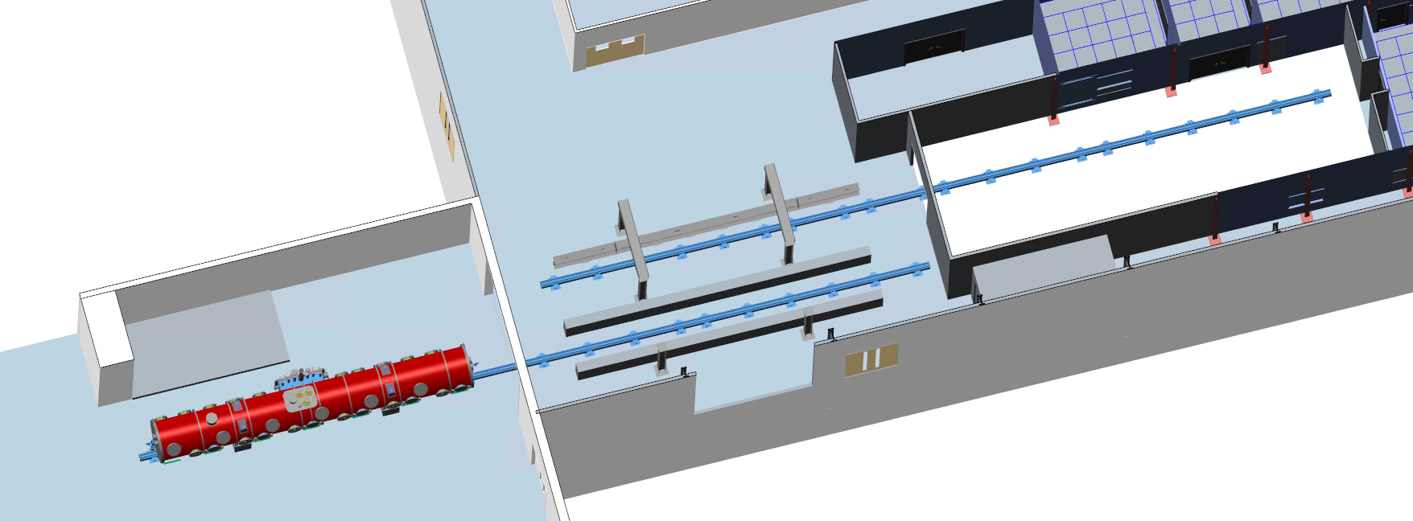
Assembly Stage 4
Insert coldmass into vessel
Complete cryomodule

Slide 8
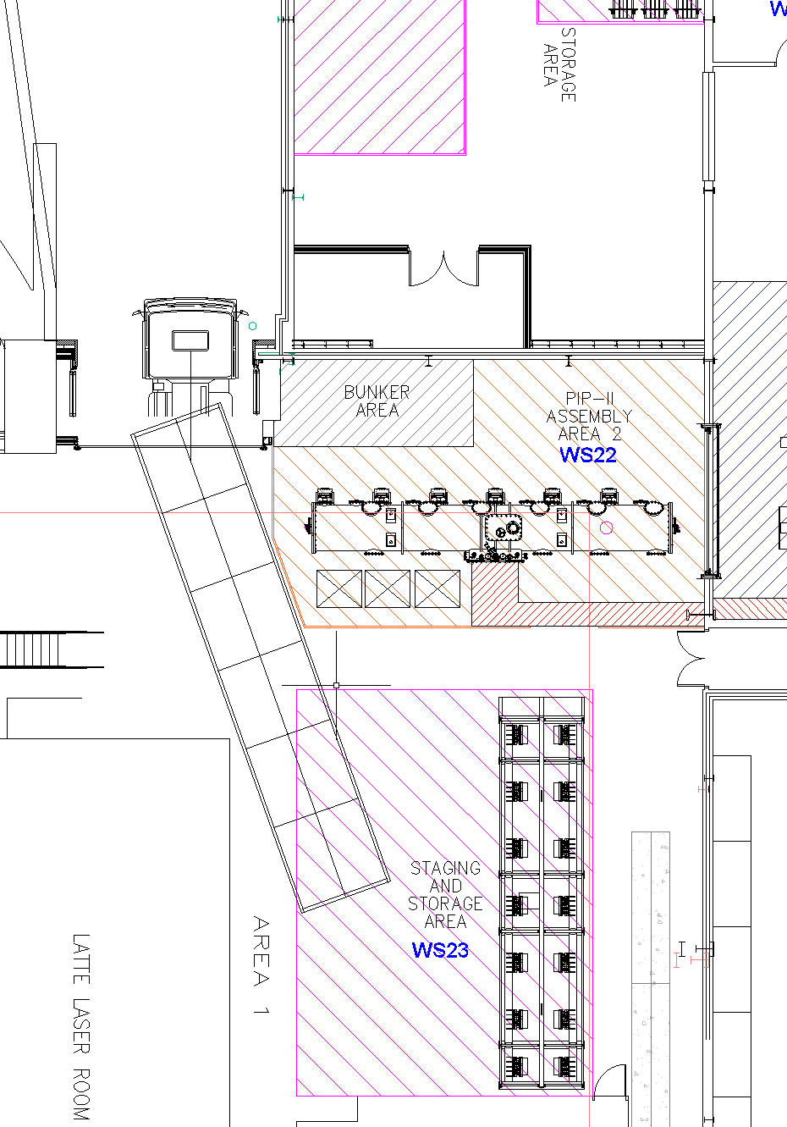
Transport
HB650 craned from assembly line onto transport frame
Secured and sealed
Truck reversed into Electron Hall
Loaded transport frame lifted onto truck
Transport Frame

Slide 9
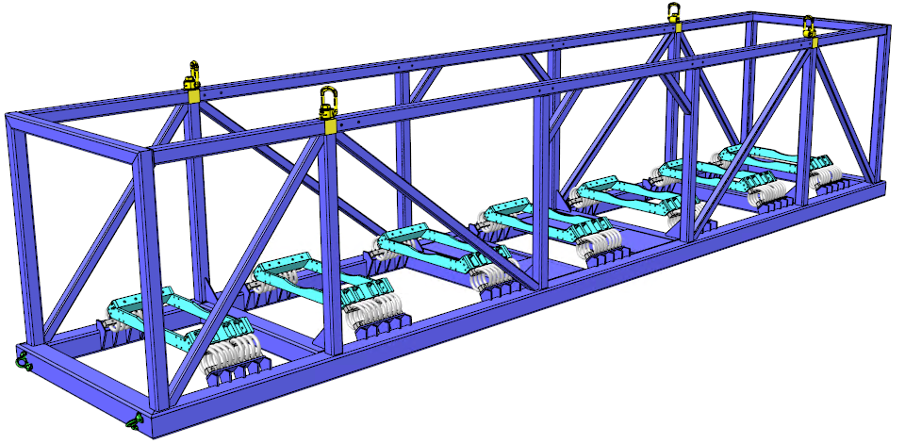
Transport Frame
4 lifting points
14 wire rope isolators
7 cradles

Slide 10
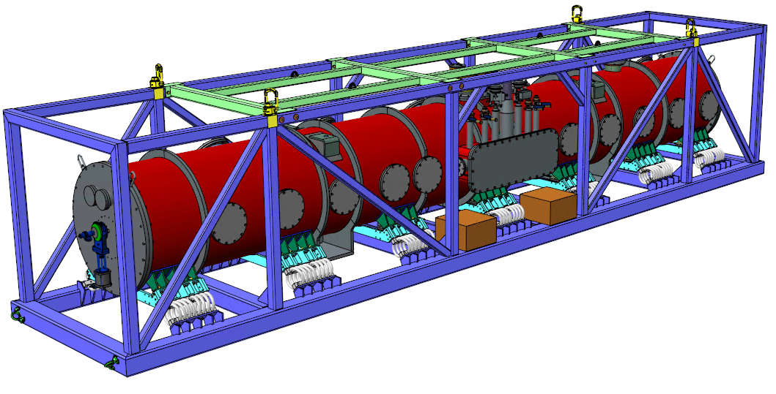
Loaded Transport Frame
Guard
Instrumentation

Slide 11
Questions

Slide 12
Questions 1
Given designs from FNAL for proposed rail solution
Constraints move centreline of string 1m from wall
Is 1m sufficient for the cavity lifter and coupler installation?
Approve roll-shutter design or double door solution

Slide 13
Questions 2
Constraints of working within zone allocated
What clearance is required to install the warm magnetic shield?
What clearance for the end cap installation?
Limited space around workstations – minimum for working?

Slide 14
Questions 3
Can the string be lifted to a parallel line?
Will alignment be an issue?
Is the string lifting tooling able to be used this way?

Slide 15
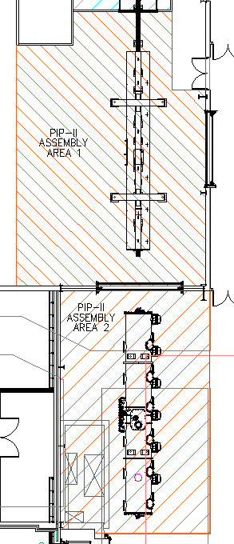
Questions 4
A single line approach is feasible but slower for multiple modules
Unable to pre-align next strongback or prepare next vessel until cryomodule shipped
Do we have updated estimates of the expected duration for each stage?
If string assembly >> than other stages then impact may be insignificant

Slide 16
Thank You

