Slide 1
PPD Department Heads Meeting
ESH/DSO Presentation
September 2020
Raymond Lewis, Katie Swanson & David Esterquest

Slide 2

Fire Prevention Week is October 4 – 10, 2020
Occupied buildings must do a table-top or functional drill (one for fire and one for severe weather) during the fiscal year.
There will be a mandatory evacuation fire drill for Wilson Hall on Tuesday, October 6th. Rain date: October 13th.
Emergency Wardens may not be onsite. Please choose an alternate to complete the drill critique. Emergency Warden training is online.
Table-tops can be done via zoom.
Critiques can be scanned and sent to your DSO.
This is a good time to review escape plans both
at work and at home.
Remember to grab your face mask if you are
sitting in your office.

Slide 3

COVID-19 or COVID-Like Symptoms?
COVID-19 is identified through an approved test, through nasal swab or sputum test.
COVID-Like Symptoms without a test, may include any of the following:
Cough
Sore Throat
Loss of taste or smell – even slightly
Chills, fever
Diarrhea or GI symptoms
Shortness of breath or difficulty breathing
Fatigue
Muscle or body aches
Headache
Congestion or runny nose
This Photo by Unknown Author is licensed under CC BY-NC

Slide 4
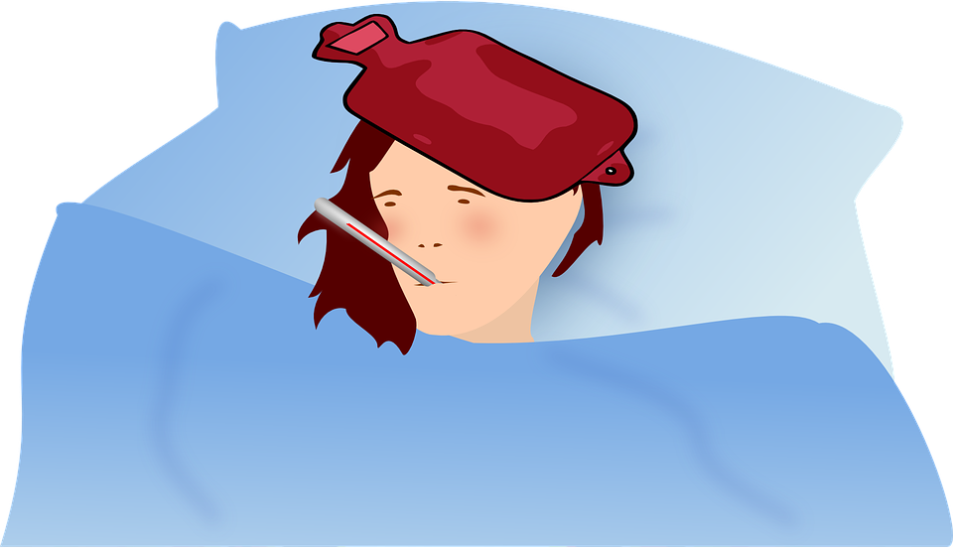
FAQs on COVID
What do I do if I’m not feeling well?
  Do not come to work! Contact your supervisor and DSO. Call Medical at 630-840-3232 or they will call you.
What do I do if a member of my household is not feeling well?
  Do not come to work! Contact your supervisor and DSO. Call Medical at 630-840-3232 or they will call you.
  “Not feeling well” can be defined as: cough, sore throat, chills, fever,
  shortness of breath, diarrhea, allergy symptoms that are not “typical or usual.”
This Photo by Unknown Author is licensed under CC BY-NC-ND

Slide 5
FAQs
Have you recently been made aware that you have been in close contact with someone with COVID-19 or COVID like symptoms?
Within the 48 hours before the person with COVID-19 developed symptoms or tested positive:
  Did you have direct physical contact with the infected person (hug, kiss, handshake)?
  Been within 6 feet of the infected person for more than 15 minutes inside or outside even if wearing a face covering?
  Been coughed/sneezed on by the infected person, contact with dirty tissue, sharing a drinking glass, food or towels or other personal items?
  Have an overnight stay in a household with the person?
  OR
  You will be identified through contact tracing and the Emergency Manager or Designee will be reaching out to you.

Slide 6

FAQs
What happens if I am a close contact?
  Contact your supervisor and DSO. Call Medical at 630-840-3232 or they will call you.
  If you are home, stay home. If you are onsite, leave your work area in a safe state.
  You must quarantine for at least 14 days from the last day you were with the person with COVID-19. Check back in with Medical when the 14 days is over, and they will determine if you can come back onsite. (Your quarantine may be longer if you are taking care of someone who is still sick.)
  If you are identified as a close contact through contact tracing, the Emergency Manager or designee will be calling you.
This Photo by Unknown Author is licensed under CC BY-ND

Slide 7
FAQs
What’s the difference between quarantine and isolation?
  Quarantine keeps someone who might have been exposed to the virus away from others; you may be in quarantine because you are waiting for your test result or you were a contact of someone who tested positive.
    14 days and begins one day after exposure to symptomatic, or COVID (+) person.
  A person in isolation has COVID like symptoms or has tested positive for COVID-19. Isolation keeps someone who is infected with the virus away from others, even in their home.
    10 days, and the person must be fever free for 3 days without fever reducing medications (Tylenol, acetaminophen, ibuprofen).

Slide 8

FAQs
What if I’m a close contact, but I test negative for COVID-19?
  If during your quarantine, you get tested for COVID-19 and the results are negative, you still need to complete the full 14 days of quarantine. There is no test that will get you out of quarantining. This is mandated by the IDPH and CDC.
What if I’m a close contact, and I test positive for COVID-19?
  If during your quarantine, you get tested for COVID-19 and the results are positive, you start isolation from the date of your test or when symptoms started for 10 days. Even if you get another test, regardless of its results, you still need to complete the 10 days of isolation.
This Photo by Unknown Author is licensed under CC BY-ND

Slide 9
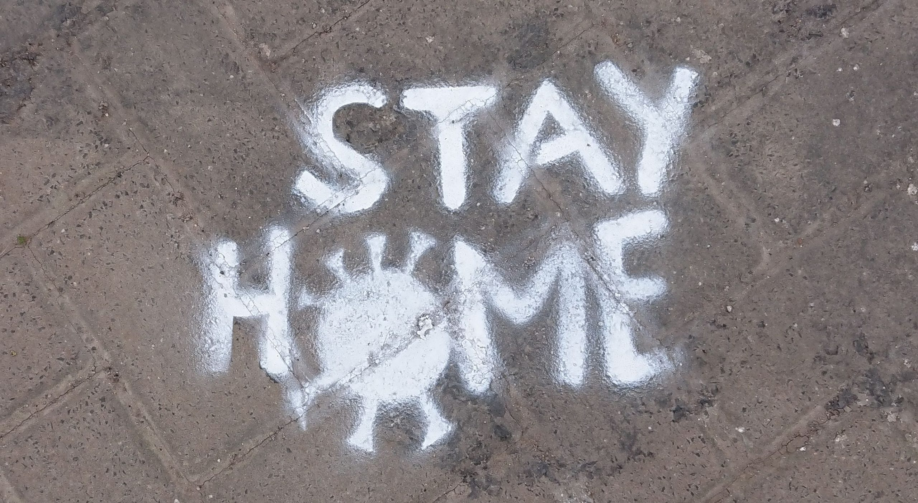
FAQs
What should I do if a member of my household is a close contact?
  That household member should quarantine for 14 days since the last date of exposure from the positive person or symptomatic person.
  You do not need to quarantine UNLESS the household member that is quarantined starts to develop symptoms or tests positive.
  What should I do if myself or a member of my household has or had symptoms, but tests negative for COVID-19?
  STAY HOME! Contact your supervisor and Medical. You will need to quarantine or be in isolation.
This Photo by Unknown Author is licensed under CC BY

Slide 10
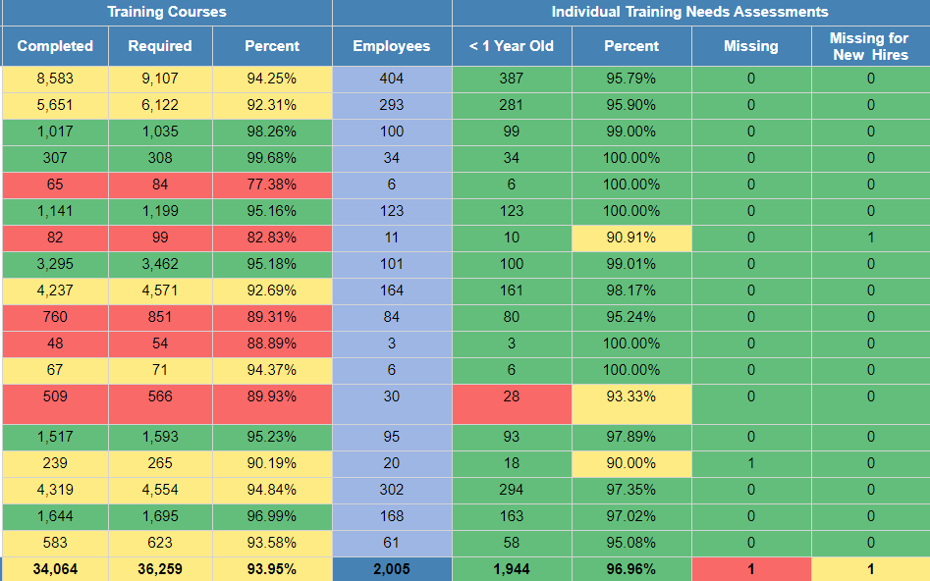
Training and ITNA Status for employees – as of 9/29/2020

Slide 11
FESHM Updates in August
FESHM Chapter 4270 – Static Magnetic Fields
  Magnetic Region Boundary terminology developed
  Low and High projectile boundaries defined and associated signage described
  MR Hazard Management controls defined
  MR Status Management requirements defined
FESHM Chapter 10140 – Mobile Cranes
  Added utility locate requirements
  Updated references
FESHM Chapter 10100 – Overhead Cranes and Hoists
  Removed “Special Lifts” and “Planned Engineered Lifts”, as they are now covered in new “Lift Plans” chapter
  Added references to “Lift Plans” chapter
  Added references to “Crane Personnel Lifting Platforms” chapter

Slide 12
FESHM out for comment until tomorrow
FESHM 7060, Fall Protection Program, is out for lab-wide comment until October 1, 2020.
  Updated to meet revised OSHA Walking Working Surfaces updates
  Added additional definitions
  Addition of requirements for openings, holes and dock boards
  Revised requirements for travel/fall restraint anchors and positioning systems
  Clarified harness/lanyard design standard requirements (ANSI Z359.1-2009 or later)
  Added reference to FESHM 7080 for non-fall protection concrete anchors
  Link to Draft Chapter: https://esh-docdb.fnal.gov/cgi-bin/sso/ShowDocument?docid=552
FESHM 10120, Powered Industrial Trucks (PIT’s), is out for lab-wide comment until October 1, 2020.
  Added reference to new Lift Plan FESHM chapter.
  Updated refresher training requirements (removed retraining every three years) and added back in the Lead Evaluator Program and requirements.
  Added technical appendix that addresses material lifts.
  Link to Draft Chapter: https://esh-docdb.fnal.gov/cgi-bin/sso/ShowDocument?docid=599

Slide 13
Security Updates: Wearing Badges and Keeping Buildings Locked
See Nigel's’ email of Friday, September 25th
As of October 1st, all personnel on site are required to wear their FNAL-issued ID badges
  Please start wearing/displaying your Fermi ID, either on a break-away lanyard or a clip.
  It should be displayed above your waist.
  Unbadged visitors must be escorted (escort training to be rolled out in the near term)
All building doors should be kept locked
  Currently, all building exterior doors should be locked at all times. This was a condition of the ‘covid safe state’ that was implemented in March.
  The memo from Nigel is stating that once we are back to “normal” the doors should remain locked (as they should be now).
  AD has locked the Footprint Area with AC4 cores as of yesterday.

Slide 14
Backup Slides

Slide 15
Fire Prevention Week Memo

Slide 16
WH Fire Drill Memo

Slide 17
Security Guidelines Email

