Slide 1
PPD Department Heads Meeting
Josh Frieman
Setp. 30, 2020

Slide 2
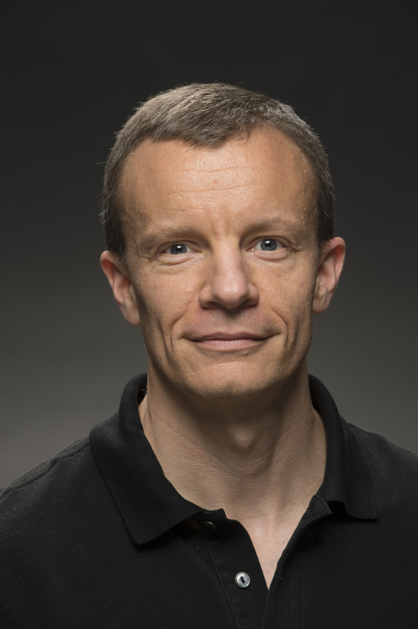
Congratulations to new APS Fellow Kevin Burkett!
Kevin Burkett is named an APS fellow by the Division of Particles and Fields for critical work on tracking devices and track reconstruction in hadron collider detectors and for major contributions in Higgs and beyond-the-Standard-Model physics at the CDF and CMS experiments.

Slide 3
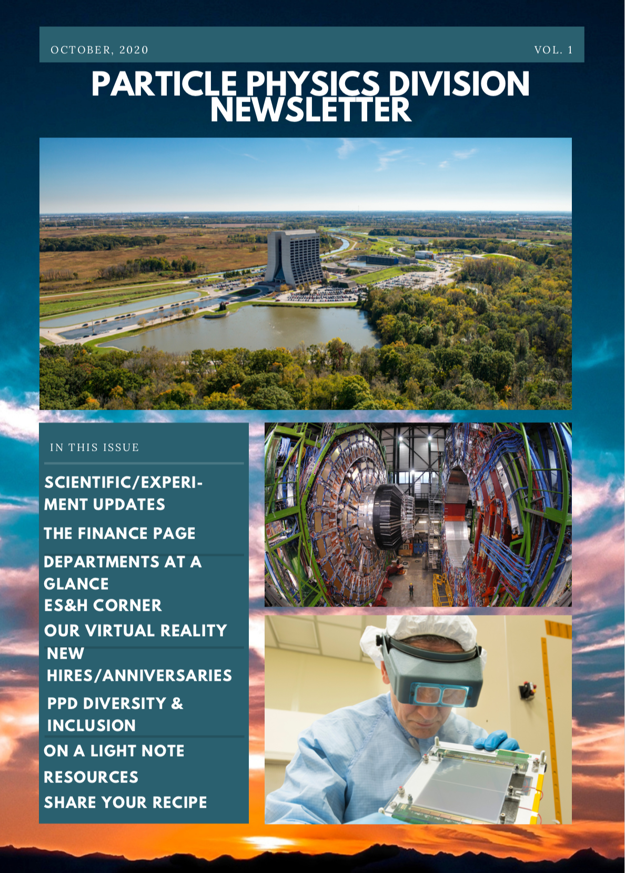
PPD Newsletter Re-boot
Coming soon to an email in-box near you!
Plan for these to be quarterly, starting early Oct.
Also putting finishing touches on new PPD website, rolling out soon!

Slide 4
Performance Reviews
See Ilene’s presentation
Please schedule evaluation meetings with your direct reports over the next week or so. Good opportunity to check in and get feedback even if no major issues.
Average raise was lower than previous year(s), but we were able to bring up ~40-50 employees above initial allocation: thank you for your help/input with that.

Slide 5
Recent Personnel changes
Terminations/Retired:
Jessica Turner, Theory RA
Remi Mommsen, CMS Computing Specialist
New Hires:
Jonathan Trebe, Technical Specialist (DDOD)
Christopher Madrid, CMS RA
Cristina Ana Mantilla Suarez, CMS RA
Next Jobs Committee meeting: Oct. 20
PPD invited to present 2 pending Job Reqs
Would like to use this opportunity to get others through the system: please submit planned reqs now

Slide 6
Diversity & Inclusion in PPD
D&I Committee Recommendations:
Draft & make public PPD Values Statement, aggregating input from the Departments (ground-up)

Slide 7
LDRD
13 Pre-proposals submitted from PPD (out of 51 total)
5 encouraged to submit full proposal (top tier)
1 in the 2nd tier
1 will be considered separately
Proposers will continue working with Lothar’s committee to submit full proposals.

Slide 8
New Safety, Security, and Travel Policies
See Kevin and Katie & Raymond’s presentations
If someone in your Department shows symptoms, please tell them not to come to work and notify Katie or Raymond, who will follow up with them and with Medical office.
Expect to pause RTOW in current phase for some time, with ~50% of Division and the lab on-site regularly.
Please reinforce COVID-safety (and general safety) messages with your groups: maintain vigilance
Please bring ITNAs up to date and exhort your groups to complete training

Slide 9
Next PPD Virtual All-Hands Meeting
Wed., Oct. 7, at 10 am Central Time, on zoom
Summarize Division updates, discuss status of Return to Work, D&I recommendations, Safety, etc.
Please send suggestions for any other topics, messages by COB Friday.

