Slide 1
Atomic/nuclear Clocks and Precision Spectroscopy Measurements for Dark Matter and Dark Sector Searches
Presenter: Marianna Safronova (U. Delaware, USA)
Co-authors: Julian C. Berengut (UNSW, Australia), Samuel Brewer (Colorado State U.), Dmitry Budker (Johannes Gutenberg U., Mainz, Germany, UC Berkeley), José R. Crespo López-Urrutia (MPIK, Heidelberg, Germany), Andrei Derevianko (U. Nevada, Reno), Victor V. Flambaum (UNSW, Australia), Elina Fuchs (Fermilab, U. Chicago), Roni Harnik (Fermilab), Eric R. Hudson (UCLA), Andrew M. Jayich (UC Santa Barbara), Shimon Kolkowitz (U. Wisconsin), Mikhail G. Kozlov (PNPI, ``LETI'', Russia), Gabriel Lee (Korea U., Republic of Korea, Cornell), David R. Leibrandt (NIST, Boulder), Roee Ozeri (Weizmann Institute of Science, Israel), Adriana Pálffy (MPIK, Heidelberg, Germany), Gil Paz (Wayne State U.), Ekkehard Peik (PTB, Germany), Gilad Perez (Weizmann Institute of Science, Israel), Piet O. Schmidt (PTB, Leibniz University, Hannover, Germany), Thorsten Schumm (TU Wien, Vienna, Austria), Vladimir M. Shabaev (St. Petersburg State University, Russia), Yotam Soreq (Technion - Israel Institute of Technology, Israel), Yevgeny Stadnik (Kavli IPMU, Japan), Andrey Surzhykov (PTB, Germany), Peter G. Thirolf (LMU Munich, Germany), Vladan Vuletić (MIT), Jun Ye (JILA, NIST, Boulder), Vladimir A. Yerokhin (St. Petersburg Polytechnic University), Jure Zupan (U. Cincinnati)
https://www.snowmass21.org/docs/files/summaries/RF/SNOWMASS21-RF3_RF0-CF1_CF2-TF9_TF10_Gil_Paz-091.pdf

Slide 2
The physics / basic idea of the LOI
A number of beyond the SM theories proposed to solve various problems of the SM, such as the gauge hierarchy, the strong CP problem or the flavor puzzle, feature light new particles with masses well below the GeV scale and small couplings to the matter fields.
This LoI presents a broad range of different experiments with atomic and nuclear clocks and other precision spectroscopy techniques to search for bosonic light dark matter and new force carriers.
Improvements of many orders of magnitude in sensitivity are expected in the next decade.
Goals:
The physics goal of this project is to find ultralight scalar particles and new force carriers or to reduce the parameter space for such particles by many orders of magnitude (~7 orders in coupling strength to SM).
Frontiers:
  Cosmic (CF2. Dark Matter: Wave-like)
  Rare Processes and Precision Measurements (RF3: Fundamental Physics in Small Experiments)
  Instrumentation (IF1: Quantum Sensors)
  Theory (TF06: Theory techniques for precision physics)

Slide 3
Extraordinary improvement of precision of optical atomic clocks
1 second loss per 30 billion years!
Rev. Mod. Phys. 90, 025008 (2018)
Notes:
Raise your hand if you used a GPS

Slide 4
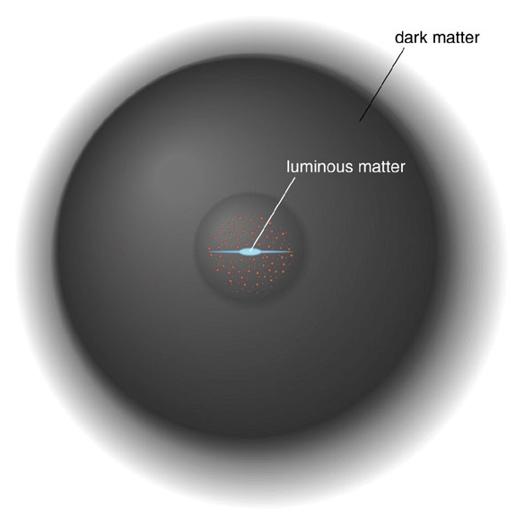
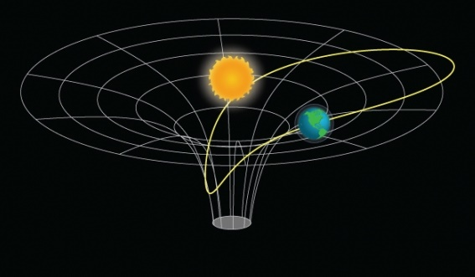
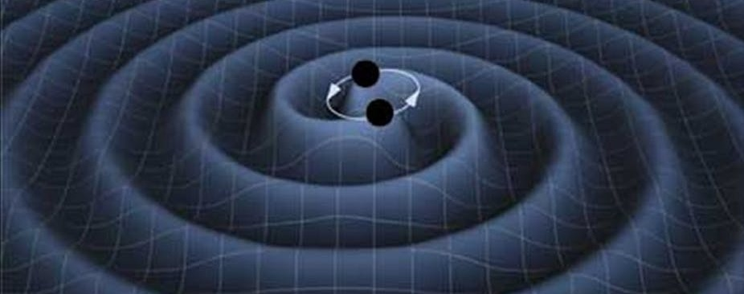
Search for physics beyond the Standard Model with atomic clocks
Dark matter
searches
Image credit: Jun Ye’s group
Nature 567, 204 (2019)
Search for the violation of Lorentz invariance
Tests of the equivalence principle
Are fundamental constants constant?
Image credit: NASA
α
Gravitational wave detection with
atomic clocks PRD 94, 124043 (2016)

Slide 5
Projects in this LOI
Several directions are being pursued to drastically improve the reach of the clock and other precision spectroscopy experiments for dark matter detection.
Significant improvement of the current clocks
Development of optical clock networks at the new level of precision
Development of new atomic clocks based on highly charged ions (HCI) that have much higher sensitivities to the variation of fundamental constants and dark matter searches
Development of a nuclear clock that is based on a nuclear rather than atomic transition
New experiments and theory to study isotope shifts to search for new force carriers
Dedicated precision spectroscopy experiments sensitive to higher DM masses than clocks (WReSL experiment)
Development and implementation of new clock-comparison schemes specifically designed to improve reach of oscillatory and transient dark matter searches
Development of molecular clocks
Network of quantum sensors as a part of multi-messenger astronomy
The experimental effort is strongly complimented by the development of high-precision atomic theory and particle physics model building.
Atomic clocks also provided the most stringent tests of Lorentz symmetry in the electron-photon sector. Several orders of magnitude improvements of these tests are expected with novel proposed schemes (see the LoI on CPT and Lorentz symmetry tests).

Slide 6
What is required for the LOI to succeed
Collaborations:
Strong collaboration of atomic, molecular, and optical (AMO) physics and particle physics communities is essential for full realization of new opportunities presented by these new quantum technologies.
Need coordinated efforts between established and emerging clock technologies with closely linked theoretical support. These will provide mutual benefit in identifying and reducing systematical errors and uncertainties by exploiting complementary technologies.
Continued international collaboration towards a world-wide optical clock network as a detector for BSM physics.
Strong collaboration of AMO theory and experiment with nuclear theory.
New detector technologies, instrumentation, facilities, computing, etc. to succeed:
Build nuclear clock(s) competitive to contribute to the light scalar DM searches (planned within 6 years).
Build and characterize new narrowband VUV laser systems (ideally CW) needed for optical control of nuclear clock transition.
Development of transportable (and ideally autonomously-functioning) clocks.
Continued development of optical clock network. Establishment of quantum fiber networks wherever we can.
Development of highly-charged ion clocks (prototype at the 10⁻¹⁵ level just demonstrated in Germany, 8 order of magnitude improvement in frequency precision in a single experiment). Need a US facility.
Need for a facility for developing frequency combs for extreme-ultraviolet and soft x-rays for precision studies and implementing re-trapping and cooling techniques for highly charged ions (HCI).
Continued development of optical clocks and lasers to next orders of magnitude accuracy. New Yb lattice clock.
Development of techniques for many orders of magnitude improvement of isotope shift (IS) measurements with entangled trapped ions (demonstrated for Sr⁺, need to extend to other ions, including HCIs).
Access to lab facilities with radioisotope beam lines (need 4 or more even isotopes in each system).
AMO theory: continued development of predictive abilities for systems of interest using high-performance computing facilities. Significantly improve theoretical prediction for the SM contribution to IS King plot non-linearities for best experimental candidates (also need nuclear theory collaboration).

Slide 7
What do you plan to do during Snowmass
Participate in all Snowmass events relevant to this LoI
Actively engage wider AMO and particle physics communites to increase collaborations needed for this LoI
Organize MIAPP program and a corresponding conference “Particle & AMO physicists discussing quantum sensors and new physics”, March 1-26, 2021
(4 out of 6 program organizer are co-authors of this LoI).
Link: https://www.munich-iapp.de/quantum-sensors
Contribute a paper to the Snowmass 2021 Proceedings. We are considering a 1-day online planning workshop for the community engagement. Timeline is being developed.
Actively pursue goals of this LOI. Several of the collaborations are already established via ERC Synergy grant (Thorium Nuclear Clock, Germany, Austria and US collaboration), part of the new NSF QLeap Q-SEnSE institute, NSF-BSF project, and others.

Slide 8
What do you hope to get out of Snowmass
We hope to stimulate in the community broad interest in new possibilities of precision AMO searches for physics beyond the standard model (BSM).
One need to create more theoretical involvement from the BSM community to improve our benchmarking as well as increase the understanding of what kind of new type of models can be probed by AMO table top experiments.
We need to improve the interactions between the atomic precision theoretical community and that of the particle physics as these are currently using different language and formalisms that makes it challenging to consider new ideas, identify the targets and interpret the experimental result.
We need to create further connections between theory and experimental table-top community to better connect the experiments to the main new 21st century themes that dominates the field of particle physics.
There is clearly enormous potential to search for new physics with precision quantum sensors, and we need strong collaborative engagement of particle and AMO communities to ensure its full realization in the next decade.
We expect many new ideas how to use precision AMO for new physics searches!

