Slide 1
Snowmass Community Planning Meeting Snowmass Timeline
Young-Kee Kim
University of Chicago
Chair, Division of Particles and Fields (DPF), American Physical Society
October 5, 2020
On behalf of the Snowmass Organization Team

Slide 2
U.S. Strategic Planning Process for Particle Physics
~year-long process
Community-Wide Science Study
(a.k.a. “Snowmass”)
Define the most important questions for the field Identify promising opportunities to address them
Organized by DPF w/ APS DAP, DGRAV, DNP, DPB
~year-long process
Particle Physics
Project Prioritization Panel (“P5”)
Formulate a 10-year execution plan
(20 year vision) within funding constraints Subpanel of High Energy Physics Advisory
Panel for DOE/NSF funding agencies
Input to P5
Snowmass 2013 P5 2014
Snowmass 2021 P5
Year
11 | 12 | 13 | 14 | 15 | 16 | 17 | 18 | 19 | 20 | 21 | 22 | 23 | 24 | 25 | 26 | 27
U.S.
2023 plan
2008 plan
2014 plan
Europe
2007 plan
2013 plan
2020 plan
Particle Physics is global:
Snowmass process involves the international community and strategies/plans from other regions
Particle Physics is not isolated:
Snowmass process involves communities and their strategies/plans from related fields
(Accelerator, Nuclear, Astro, Gravitational, AMO, …)

Slide 3
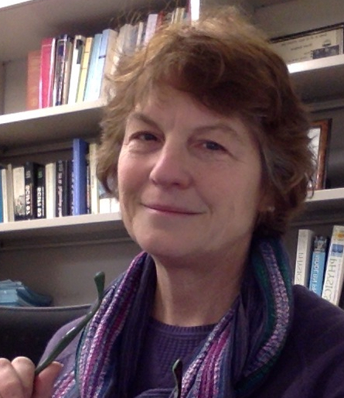
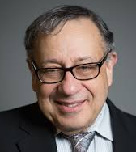
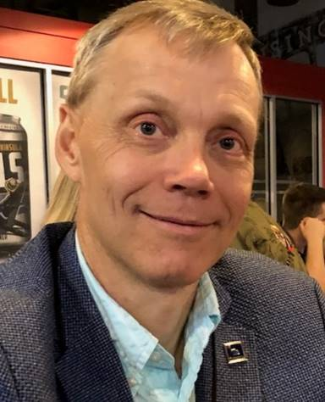
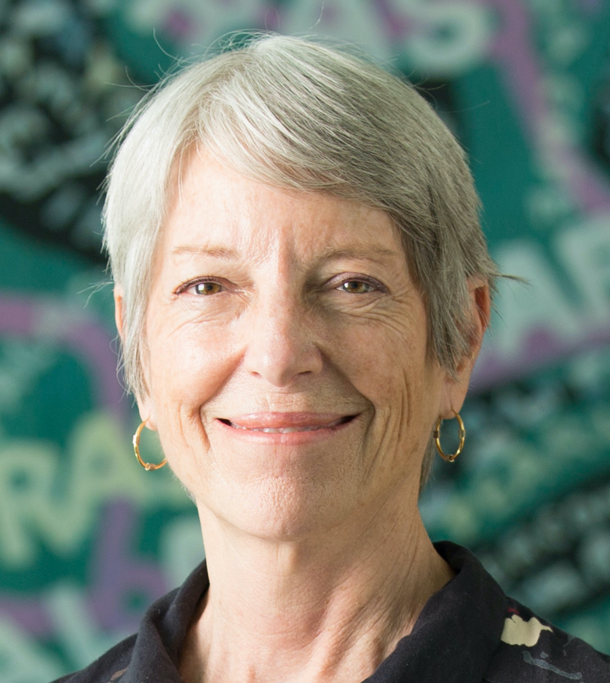
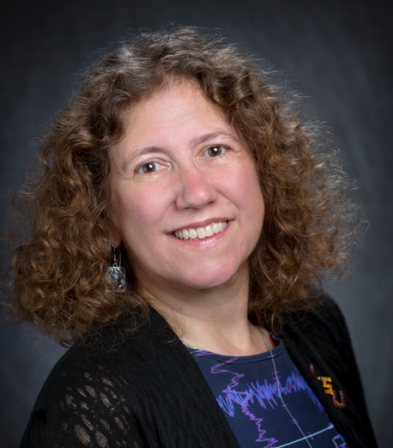
U.S. Strategic Planning Process for Particle Physics
Snowmass Preparation
Snowmass
NAS reviews Particle Physics
National Academy of Science (NAS) reviews each field every ~10 years
P5
DPF: Past Chair Chair Chair Elect Vice Chair
Prisca Cushman Young-Kee Kim Tao Han Joel Butler
DPB (Accelerator) DAP (Astro) DGRAV (Gravitational) DNP (Nuclear)
Sergei Nagaitsev Glennys Farrar Gabriela Gonzales Yury Kolomensky

Slide 4
Snowmass Advisory Group
DPF Executive Committee
Chair: Young-Kee Kim
Chair-Elect: Tao Han
Vice Chair: Joel Butler
Past Chair: Prisca Cushman
Secretary/Treasurer: Mirjam Cvetic
Councilor: Elizabeth Simmons
Member-at-Large: Rick Van Kooten
Member-at-Large: Elizabeth Worcester
Member-at-Large: Natalia Toro
Member-at-Large: Andre de Gouvea
Member-at-Large: Mary Bishai
Member-at-Large: Lauren Tompkins
Early Career Member-at-Large: Sara Simon
Editor and Communication
Editor – Michael Peskin
Communication – Bob Bernstein
Representatives from Related Divisions
DPB (accelerator): Sergei Nagaitsev
DNP (nuclear): Yury Kolomensky
DAP (astro): Glennys Farrar
DGRAV (gravitational): Gabriela Gonzales
Representatives from the Int. Community
Africa / Middle East
Azwinndini Muronga, Nelson Mandela Metropolitan Univ, South Africa
Asia / Pacific
Atsuko Ichikawa, Kyoto University, Japan
Xinchou Lou, IHEP, China
Canada
Heather Logan, Carleton University, Canada
Europe
Val Gibson, Cavendish Laboratory, UK
Berrie Giebels, CNRS, France
Latin America
Claudio Dib, Universidad Tecnica Federico Santa Maria, Chile
Steering Group
Special thanks to
Steering group meets weekly; Advisory group meets once every 4 weeks;
All Frontier conveners + Advisory group + CPM/CSS LOC co-chairs meet once every 4 weeks
Monitoring the progress to make sure that all is moving forward smoothly to achieve the goals of the planning exercise

Slide 5
Frontiers and Topical Groups
30 Frontier conveners + ~250 Topical Group conveners + >40 inter-frontier liaisons + ~25 early career liaisons
10 Frontiers | 80 Topical Groups
Energy Frontier | Higgs Boson properties and couplings, Higgs Boson as a portal to new physics, Heavy flavor and top quark physics, EW Precision Phys. & constraining new phys., Precision QCD, Hadronic structure and forward QCD, Heavy Ions, Model specific explorations, More general explorations, Dark Matter at colliders
Frontiers in Neutrino Physics | Neutrino Oscillations, Sterile Neutrinos, Beyond the SM, Neutrinos from Natural Sources, Neutrino Properties, Neutrino Cross Sections, Nuclear Safeguards and Other Applications, Theory of Neutrino Physics, Artificial Neutrino Sources, Neutrino Detectors
Frontiers in Rare Processes & Precision Measurements | Weak Decays of b and c, Strange and Light Quarks, Fundamental Physics and Small Experiments. Baryon and Lepton Number Violation, Charged Lepton Flavor Violation, Dark Sector at Low Energies, Hadron spectroscopy
Cosmic Frontier | Dark Matter: Particle-like, Dark Matter: Wave-like, Dark Matter: Cosmic Probes, Dark Energy & Cosmic Acceleration: The Modern Universe, Dark Energy & Cosmic Acceleration: Cosmic Dawn & Before, Dark Energy & Cosmic Acceleration: Complementarity of Probes and New Facilities
Theory Frontier | String theory, quantum gravity, black holes, Effective field theory techniques, CFT and formal QFT, Scattering amplitudes, Lattice gauge theory, Theory techniques for precision physics, Collider phenomenology, BSM model building, Astro-particle physics and cosmology, Quantum information science, Theory of Neutrino Physics
Accelerator Frontier | Beam Physics and Accelerator Education, Accelerators for Neutrinos, Accelerators for Electroweak and Higgs Physics, Multi-TeV Colliders, Accelerators for Physics Beyond Colliders & Rare Processes, Advanced Accelerator Concepts, Accelerator Technology R&D: RF, Magnets, Targets/Sources
Instrumentation Frontier | Quantum Sensors, Photon Detectors, Solid State Detectors & Tracking, Trigger and DAQ, Micro Pattern Gas Detectors, Calorimetry, Electronics/ASICS, Noble Elements, Cross Cutting and System Integration, Radio Detection
Computational Frontier | Experimental Algorithm Parallelization, Theoretical Calculations and Simulation, Machine Learning, Storage and processing resource access (Facility and Infrastructure R&D), End user analysis
Underground Facilities and Infrastructure Frontier | Underground Facilities for Neutrinos, Underground Facilities for Cosmic Frontier, Underground Detectors
Community Engagement Frontier | Applications & Industry, Career Pipeline & Development, Diversity & Inclusion, Physics Education, Public Education & Outreach, Public Policy & Government Engagement
30 Frontier conveners, ~250 Topical Group conveners,
>40 Inter-Frontier Liaisons, ~25 Early Career Liaisons:
Thank you, community, for your nominations!!
Significant efforts being made:
Frontier conveners (since January 2020)
TG conveners (since April 2020)
Early Careers (since June 2020)

Slide 6
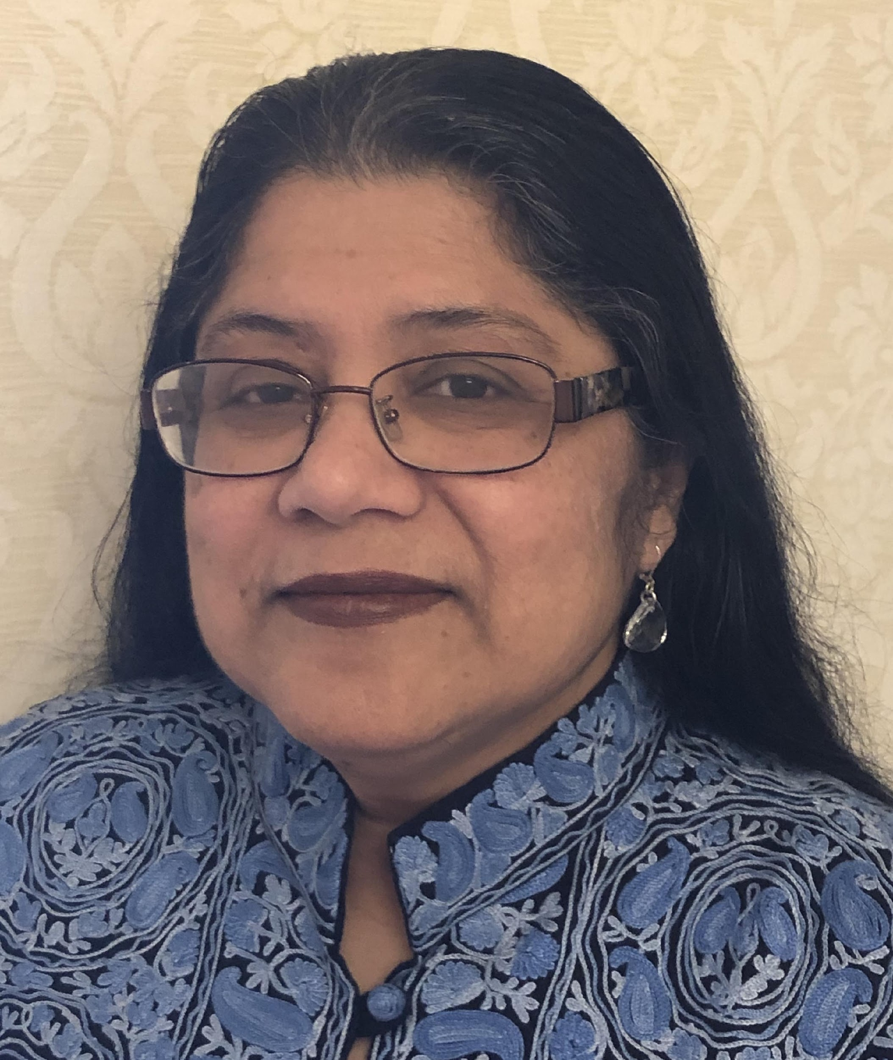
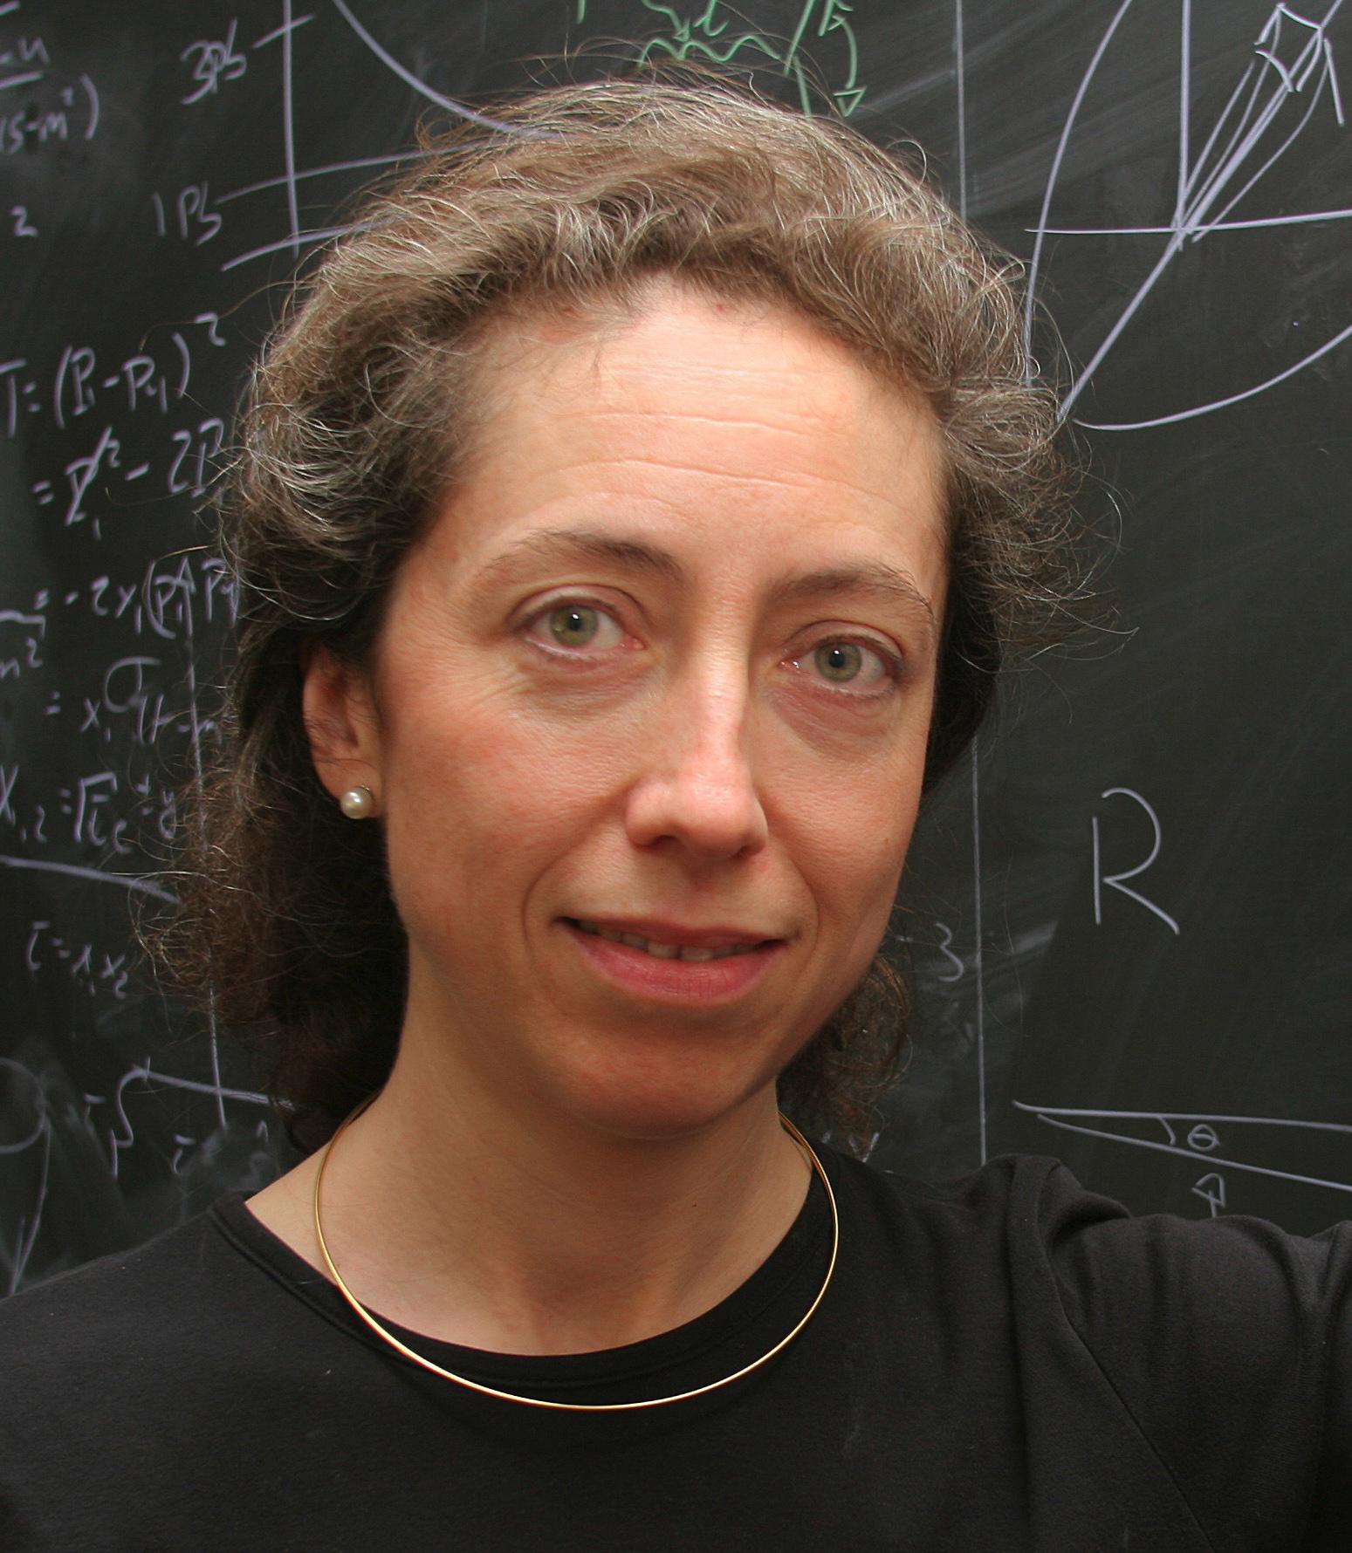
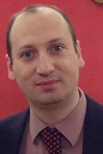
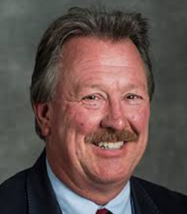
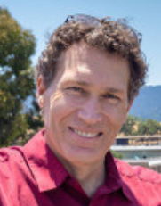
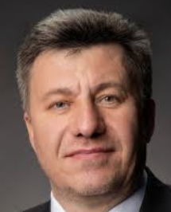
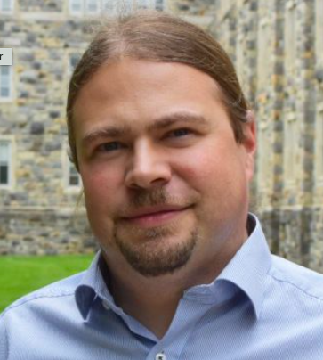
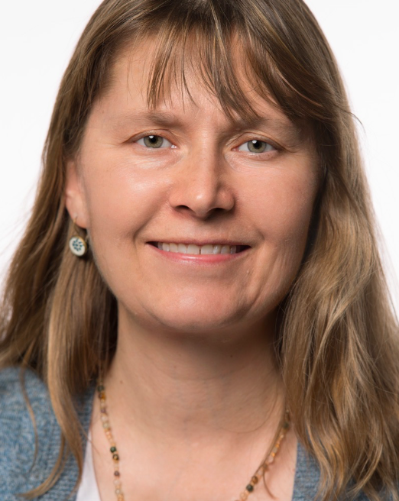
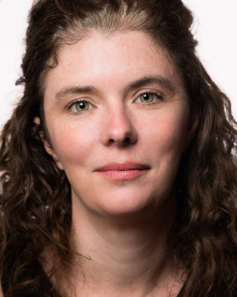
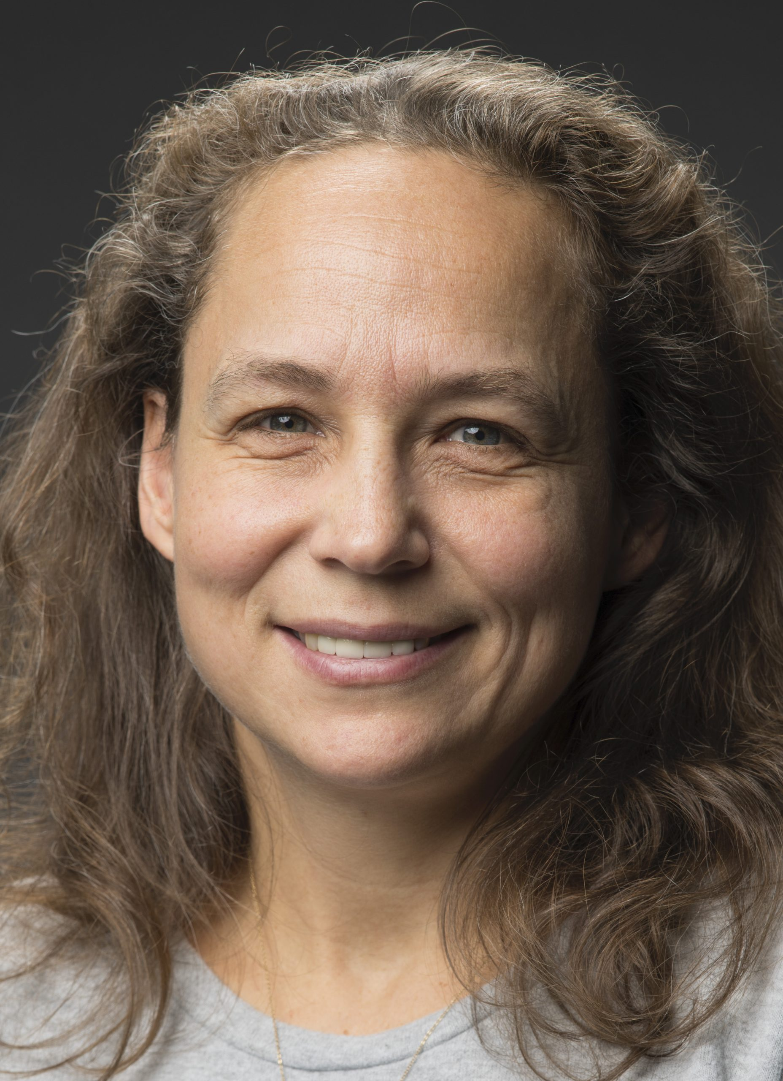
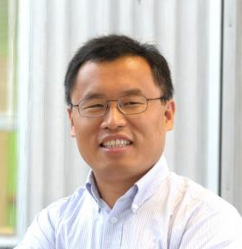
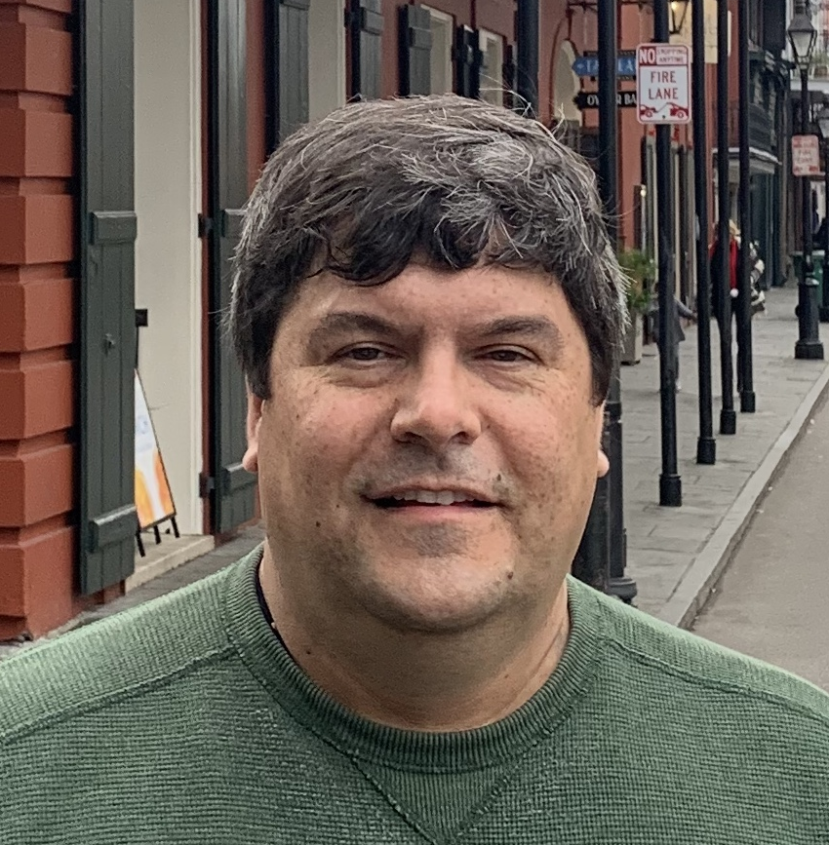
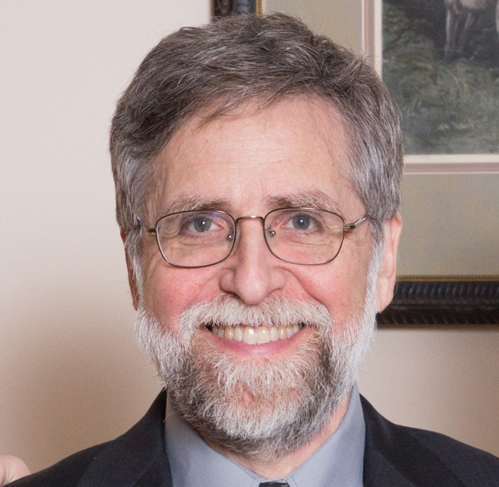
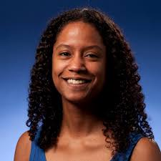
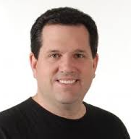
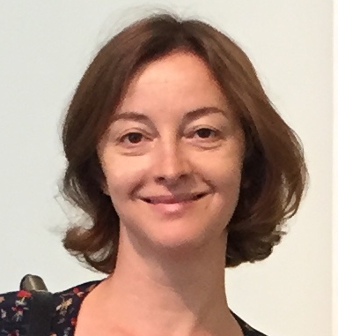
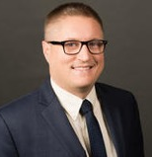
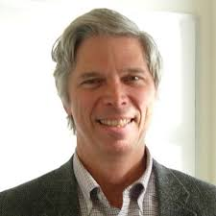
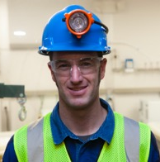
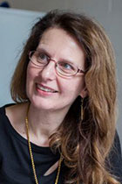
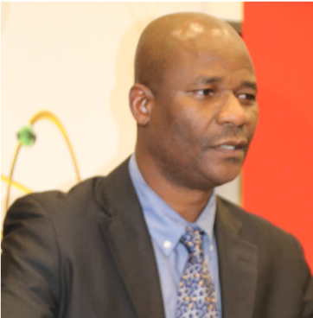
Energy
Frontier
Frontiers in
Neutrinos
Frontiers in Rare Processes & Precision Meas.s
Cosmic Frontier
Theory Frontier
Accelerator
Frontier
Instrumentation
Frontier
Computational Frontier
Underground Facilities and Infrastructure Frontier
Community Engagement Frontier
Meenakshi Narain
(Brown U)
Laura Reina
(FSU)
Alessandro Tricoli
(BNL)
Steve Gourlay
(LBNL)
Tor Raubenheimer
(SLAC)
Vladimir Shiltsev
(FNAL)
Patrick Huber
(Virginia Tech)
Kate Scholberg
(Duke U.)
Elizabeth Worcester
(BNL)
Phil Barbeau
(Duke)
Petra Merkel
(FNAL)
Jinlong Zhang
(ANL)
This Thursday’s CPM Plenary Sessions
Summary from Each Frontier
Key questions, outcomes of CPM breakout sessions, and future plans between now and CSS
Marina Artuso
(Syracuse U.)
Alexey Petrov
(Wayne State U.)
Bob Bernstein
(FNAL)
Steven Gottlieb
(Indiana U.)
Ben Nachman
(LBNL)
Oliver Gutsche
(FNAL)
Aaron Chou
(Fermilab)
Marcelle Soares-Santos
(U.Michigan)
Tim Tait
(UC Irvine)
Laura Baudis
(U. Zurich)
Jeter Hall
(SNOLAB)
Kevin Lesko
(LBNL)
John Orrell
(PNNL)
Nathaniel Craig
(UCSB)
Csaba Csaki
(Cornell)
Aida El-Khadra
(UIUC)
Kétévi Assamagan
(BNL)
Breese Quinn
(Mississippi)

Slide 7
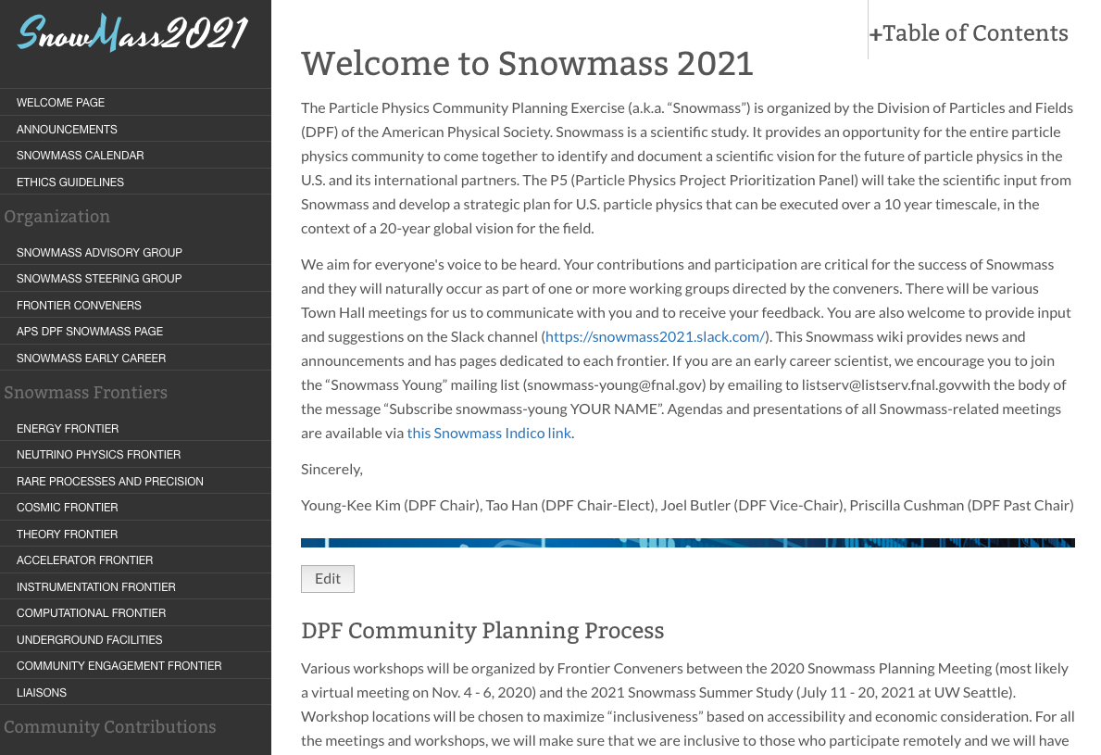
Snowmass Process
Wiki (https://snowmass21.org/) – one-stop shop
Structure, Frontier/TG activities, Calendars, News,
Community Input, Slack channels, …
Snowmass Early Career
Early career members actively engaging in the Snowmass 2021 process
This group will build a long-term particle-physics early career community that persists after the Snowmass process.
Ethics
Dynamic exchange of ideas across a large swath of the community in a variety of formats (slack channels, meetings, workshops). All community members should feel safe and supported in engaging in all exchanges.
DPF Ethics Task Force formed in April 2020 (DPF Core Principles and Community Guidelines), CP&CG Response Team for CPM formed
Establishment of DPF Ethics Committee (November 2020)

Slide 8
Snowmass Timeline
Community
Planning
Meeting
(CPM)
Oct. 5-8
Virtual Kick-off
Town Hall
APS April Meeting
European Strategy Update
11/19 | 12/19 | 1/20 | 2/20 | 3/20 | 4/20 | 5/20 | 6/20 | 7/20 | 8/20 | 9/20 | 10/20
Preparation
Letters of Interest
Contributed (“white”) Papers
10 Frontier & 80 Topical Groups: Meetings & Workshops
Community Summer Study (CSS)
July 11-20, 2021
+ DPF 2021
(UW Seattle)
2021
APS April
Meeting
Snowmass
Report
11/20 | 12/20 | 1/21 | 2/21 | 3/21 | 4/21 | 5/21 | 6/21 | 7/21 | 8/21 | 9/21 | 10/21
Contributed (“white”) Papers
10 Frontier & 80 Topical Groups: Meetings & Workshops

Slide 9
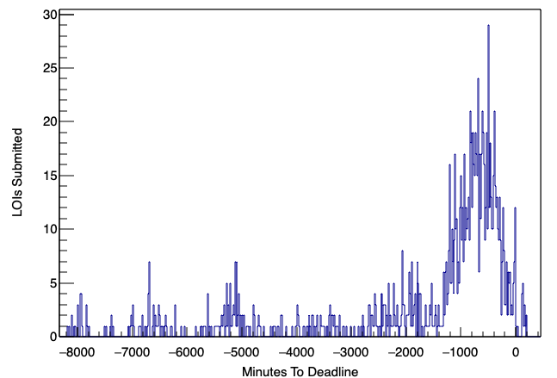
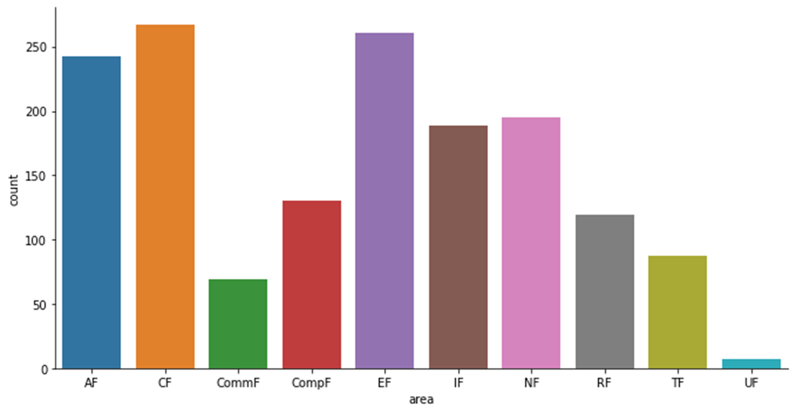
Letters of Interests
1,574 in total: submitted before August 31, 2020
Many LOIs – multiple frontiers
Frontier + TG conveners: tireless efforts to prepare the CPM using this information (Sept.)
# of LOIs vs time
Primary
Frontiers
Thank you, community, for your contributions!!
(Aug. 31
midnight in Hawaii)
(Credit: Sam Hedges)
(Credit: Gordon Watts)
20 hours

Slide 10
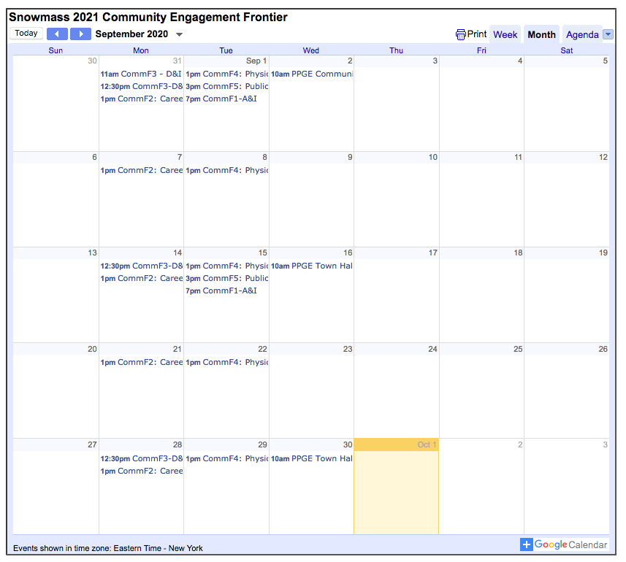
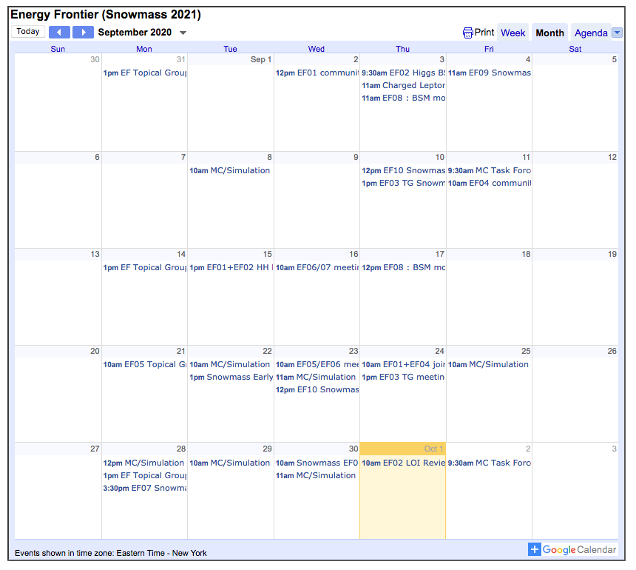
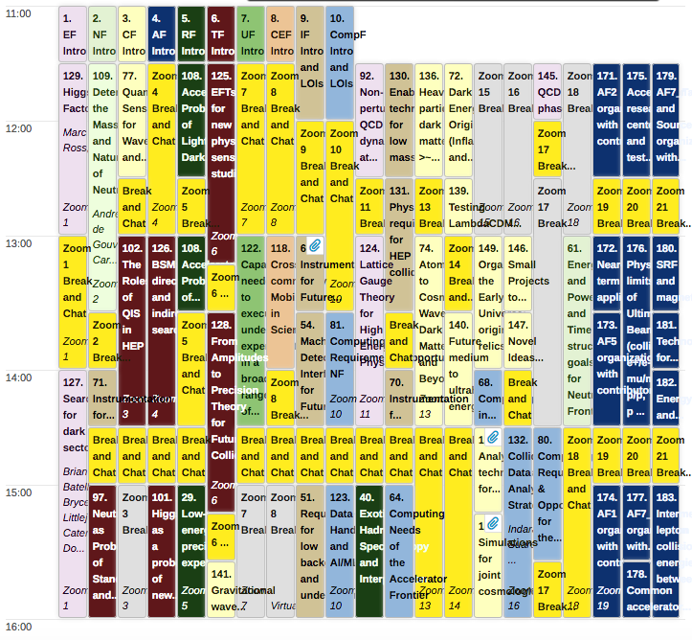
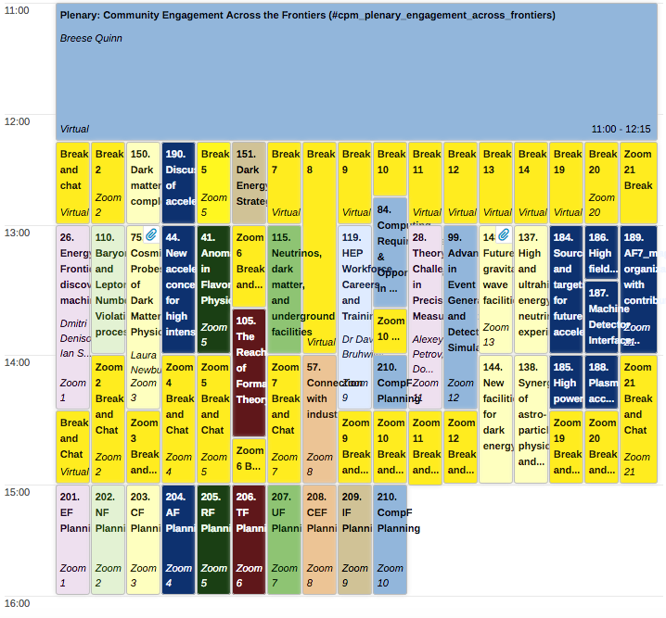
Community Planning Meeting (CPM): Goals
Community Engagement Frontier Calendar (Sept 2020)
April 2020 – Now (CPM)
Each Frontier and Topical Group: meetings and various workshops since Spring 2020
CPM’s goals
Develop plans and steps to take between October 2020 and the Snowmass Community Study in July 2021, leading to a final report in October 2021.
CPM Plenary Sessions
Exciting Physics
Plans from other regions and related fields
Messages from funding agencies
Voices of the community
CPM Parallel Sessions
First opportunity to bring together the community across the field
Focus on inter-frontier discussions
Establish cross working group connections.
Identify gaps and areas to focus / to study
Brainstorm new ideas
Energy Frontier Calendar (Sept 2020)
Yellow boxes: “virtual” hall-way chats
to brainstorm new ideas

Slide 11
Preliminary Snowmass Timeline / Process
Starting point for discussion with the community during CPM
Meetings & Workshops (10 Frontiers & 80 Topical Groups) + Contributed Papers
Nov.
2020
Dec.
2020
Jan.
2021
Feb.
2021
Mar.
2021
Apr.
2021
May
2021
Jun.
2021
Jul.
2021
Aug.
2021
Sep.
2021
Oct.
2021
Community Meeting
(APS April Meeting)
Community Summer Study (CSS)
July 11-20, 2021 + DPF 2021 (UW Seattle)
Snowmass
Report
TGs: effort on consolidation, coordination & solicitation, leading to studies & Contributed Papers
TGs develop their key questions and opportunities
TGs produce outlines of their reports
(TGs: communication with authors of Contributed Papers)
Frontiers/TGs produce Preliminary Frontier Reports
Community feedback on Preliminary Frontier Reports
CSS
Build consensus on key questions / opportunities of particle physics,
enabling technologies, and community engagement;
Formulate the content of the Snowmass Executive Summary
Frontiers/TGs produce Final Frontier Reports
Steering Group produces Preliminary Executive Summary
Community feedback on Prelim. Exec. Summary
Snowmass Draft Report and Review
Snowmass Final Report

Slide 12
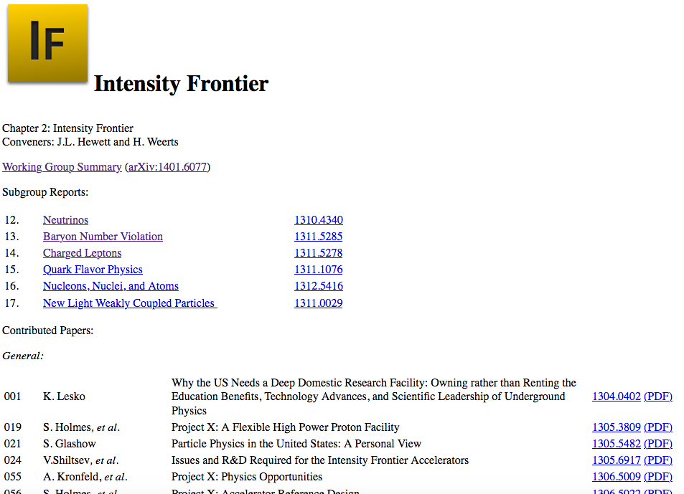
Preliminary Snowmass Report Structure
Starting point for discussion with the community during CPM
Preliminary
Report Structure:
Adopting Snowmass 2013
Executive Summary
(~50 pages)
Introduction
A few pages from each Frontier
Frontier Report
Frontier Summary
(20~50 pages)
Topical Group Reports
(20~50 pages per TG)
Contributed Papers as References
Snowmass 2013

Slide 13
Community Planning Meeting: Program Committee
Steering Group
DPF: Young-Kee Kim (Chair), Tao Han (Chair-Elect), Joel Butler (Vice-Chair), Priscilla Cushman (Past Chair)
Glennys Farrar (DAP), Gabriela Gonzales (DGRAV), Yury Kolomensky (DNP), Sergei Nagaitsev (DPB)
Frontier Representatives
Frontier Conveners
2 Early Careers
Vishvas Pandey (postdoc), Joshua Barrow (graduate student)
Co-chairs of CPM Local Organizing Committee
Bo Jayatilaka, Brendan Kiburg
Energy | Laura Reina | Florida State U.
Neutrinos | Patrick Huber | Virginia Tech.
Rare Processes and Precision Measurements | Marina Artuso | Syracuse U.
Cosmic | Aaron Chou | Fermilab
Theory | Aida El-Khadra | UIUC
Accelerator | Tor Raubenheimer | SLAC
Instumentation | Jinlong Zhang | Argonne
Computational | Oliver Gutsche | Fermilab
Underground Facilities and Infrastructure | John Orrell | PNNL
Community Engagement | Breese Quinn | U. Mississippi
All Frontier Conveners
All Topical Group Conveners
Special thanks to

Slide 14
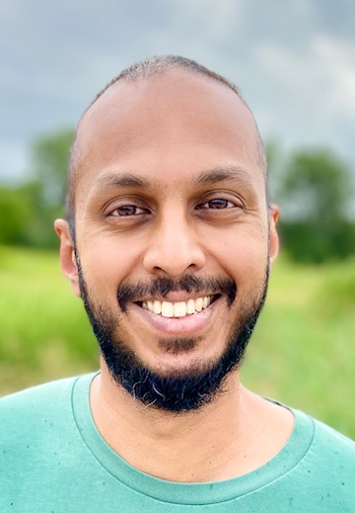
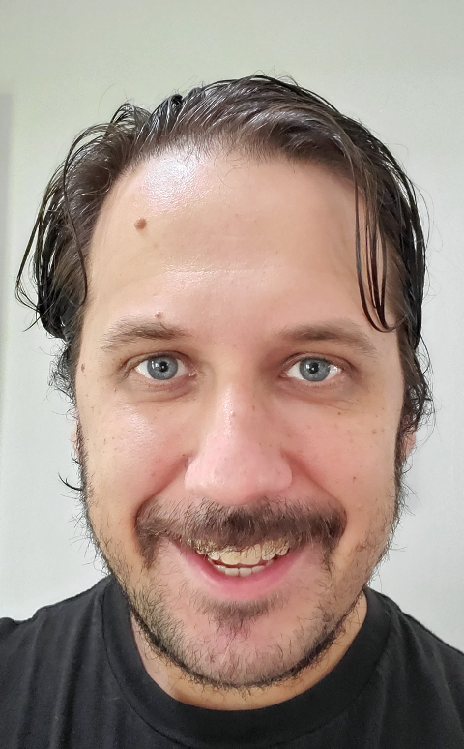
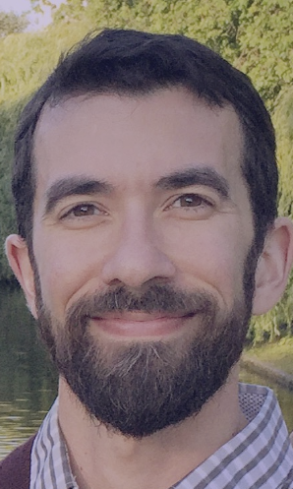
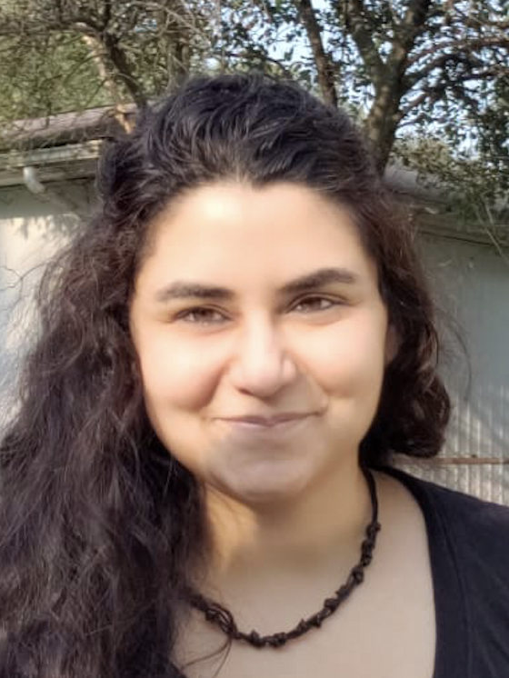
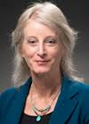
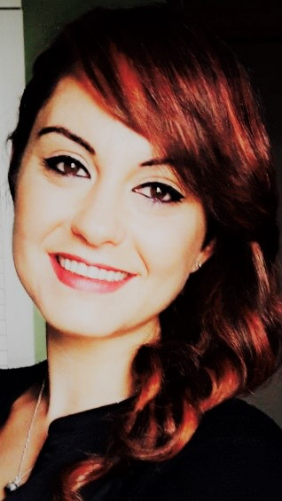
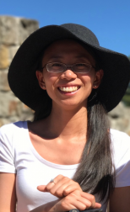
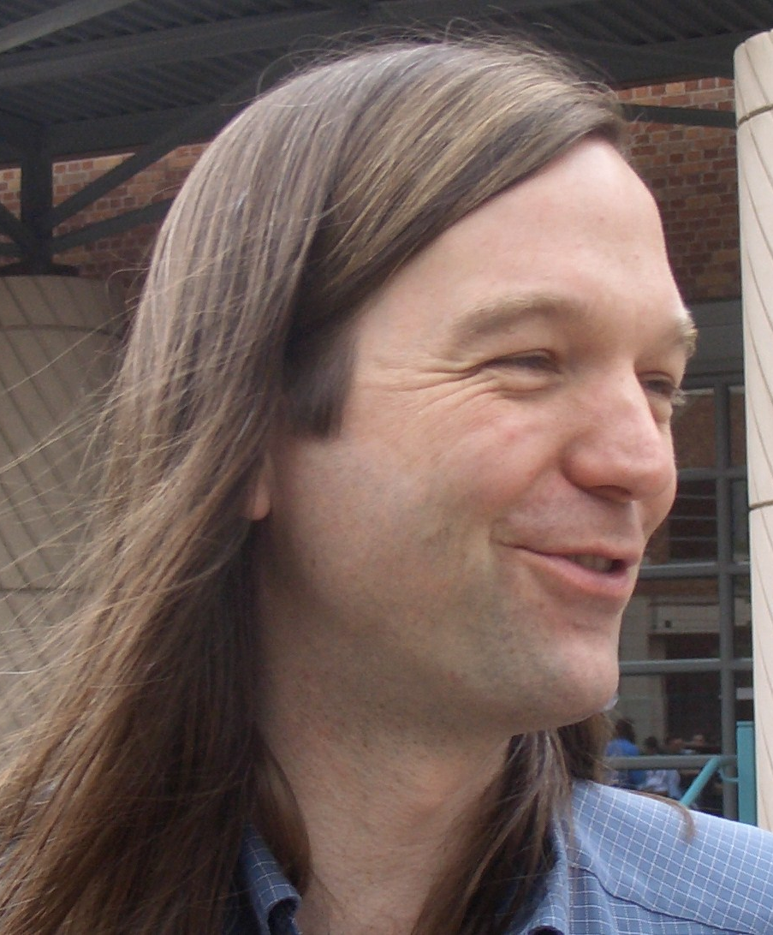
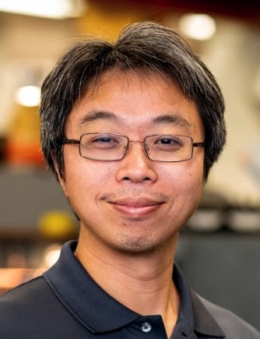
CPM Local Organizing Committee
Special special thanks go to
Bo Javatilaka Brendan Kiburg
Fermilab Fermilab
(Co-chairs of CPM Organizing Committee)
Jonathan Asaadi
UT, Arlington
Saptaparna
Bhattacharya,NW
Zoltan Gecse
Fermilab
Erica Snider
Fermilab
Tiziana Spina
Fermilab
Yuanyuan Zhang
Fermilab
Gordon Watts
UW Seattle
Shih-Chieh Hsu
UW Seattle
(Co-chairs of 2021 CSS)

