Slide 1
The First Report
You need to present
The place of your group’s work in a larger picture of Fermilab’s activities.
The audience is supposed to have a general knowledge about Fermilab
Briefly describe the physics of phenomena you deal with
The audience is supposed to have a general knowledge in physics
The goal of the project you participate in
Explain the importance of the project (if so)
The time frame of the project
What do you expect to accomplish
Try to be more specific about your personal goals

Slide 2
The First Report
The report should be prepared in Power Point and presented in English
The total number of slides is not more than 5
The length of the presentation is not more than 5 min
The presentation is expected to be uninterrupted
All questions follows the presentation
The report should be ready by 8 AM of the presentation day
This presentation can be included as the first part of your final report

Slide 3
Drag rate measurements in the Recycler electron cooler
Summer student meeting
July 13, 2011
Ivanov, Novosibirsk State University
Supervisor: John Smith, AD/Recycler department

Slide 4
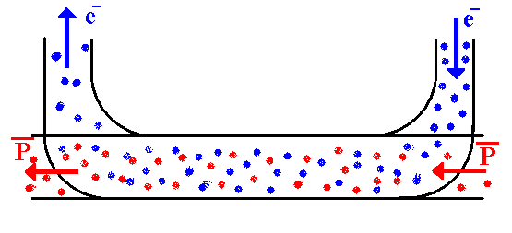
Electron cooling in the Recycler ring
The Recycler is a 8 GeV storage ring sharing the 3.3 km tunnel with the Main Injector
Presently the role of the Recycler is to accumulate antiprotons coming form the Antiproton source and to cool them for the shots to the Tevatron
Antiprotons are cooled by two methods, stochastic and electron cooling
Electron cooling is a process of a thermal exchange through Coulomb scattering between hot heavy particles (antiprotons) and cold electrons
For cooling to be effective,
the electron beam has to be cold
average velocities of both beams should be precisely matched

Slide 5
Drag rate measurements
Cooling properties of the electron beam can be characterized by drag rate measurements
A coasting antiproton beam is cooled down to an equilibrium
RF is turned off, so that the only longitudinal force comes from electron cooling
Electron energy is shifted
In the rest frame, electrons start moving with respect to antiprotons and accelerate (“drag”) them
The drag rate is recorded as a time derivative of the average antiproton momentum after the electron energy jump
Ve, Vp
Time
Ve and Vp are the average velocities of electrons and antiprotons, correspondingly, in the frame moving with the initial speed of beams.

Slide 6
Goal
We plan repeat the drag rate measurements using a recently improved procedure and measure
Dependence of the drag rate as a function of the voltage jump amplitude
Drag rate at various positions across the electron beam
My personal goals are
Participate in the measurements
Write a MathCad program fitting the results to a model
Estimate measurement errors
Present my results at the Recycler departmental meeting

